Slide 1
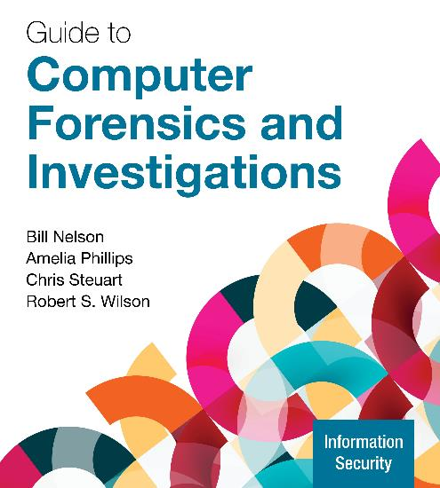
Guide to Computer Forensics and Investigations, 7e
Module 9: Virtual Machine Forensics and Live Acquisitions Forensics
Nelson/Phillips/Steuart/Wilson, Guide to Computer Forensics and Investigations, 7th Edition. ©2025 Cengage Learning, Inc. All Rights Reserved. May not be scanned, copied or duplicated, or posted to a publicly accessible website, in whole or in part.

Slide 2
Module Objectives
By the end of this module, you should be able to:
Describe virtual machines and virtual machine forensics
Explain how live acquisitions are performed
Describe tools used for remote acquisitions
Explain how to use Microsoft’s File System Utility Command

Slide 3
An Overview of Virtual Machine Forensics (1 of 2)
Digital forensic examiners need to know how to analyze virtual machines (VMs)
The software that runs VMs is called a hypervisor
The following are two types of hypervisors:
Type 1 hypervisor runs on “bare metal”, which means it loads on physical hardware and doesn’t require a separate OS
Type 2 hypervisor rests on top of an existing OS, such as Windows, Linux, or macOS
Type 2 are usually the ones you find loaded on a suspect device

Slide 4
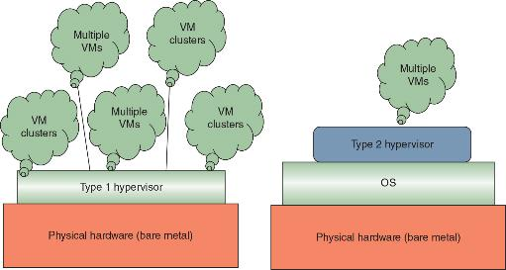
An Overview of Virtual Machine Forensics (2 of 2)
Figure 9-1 Type 1 and type 2 hypervisors

Slide 5
Investigating Hypervisor Systems (1 of 11)
Type 1 hypervisors are installed directly on hardware
Each type 1 hypervisor can host from a few to several hundred VMs per host
The following are some common type 1 hypervisors:
VMware vSphere
Microsoft Hyper-V Server 2019
Citrix Hypervisor
Red Hat Linux

Slide 6
Investigating Hypervisor Systems (2 of 11)
For an investigation involving a VM, begin by acquiring a forensic image of the host computer as well as network logs
Next, you should export associated VM files
A VM shares the host’s physical devices and can access files from peripheral devices and shared folders
From the VMware Workstation player window, you can create a VM, open an existing VM, or upgrade to VMware Workstation Pro

Slide 7
Investigating Hypervisor Systems (3 of 11)
Table 9-1 Files associated with VMware
File extension | Description
.ova or .ovf | A preconfigured file used to create a virtual machine; OVF stands for “Open Virtualization Format”
.vmx | Stores configuration files
.log | Contains logs of information such as when a VM was powered off, virtual appliances added, and so on
.nvram | Keeps track of the state of a VM’s Basic Input/Output System (BIOS)
.vmdk | Stores the virtual hard drive’s contents
.vmem | Stores VM paging files, which serve as RAM
.vmsd | Contains information about snapshots

Slide 8
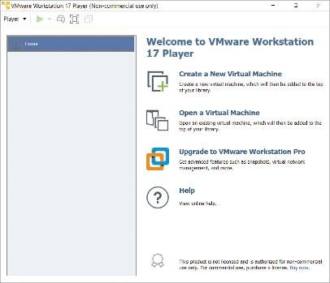
Investigating Hypervisor Systems (4 of 11)
Figure 9-2 The opening screen of VMware Workstation Player

Slide 9
Investigating Hypervisor Systems (5 of 11)
Oracle VirtualBox supports Windows, Linux, macOS, and Solaris
Keep in mind that VMs created with one type 2 hypervisor might not be able to be read by another
Example: VMware doesn’t read the Parallels format
Forensic tools such as Autopsy, FTK Imager, and OS Forensics can only read .vmdk and .vhd VM image files
If you encounter a .vdi (VirtualBox image) VirtualBox can convert it to a .vmdk, .vhd, or raw file

Slide 10
Investigating Hypervisor Systems (6 of 11)
The command to convert a VirtualBox image file is vboxmanage
For Linux VirtualBox VBoxManage is case sensitive
To detect whether a VM is on a host computer:
Look in the Users or Documents folder (in Windows) or user directories (in Linux)
Check the host’s Registry for clues that VMs have been installed or uninstalled
Check for existence of a virtual network adapter
Log files should be extracted and examined to determine the crime

Slide 11
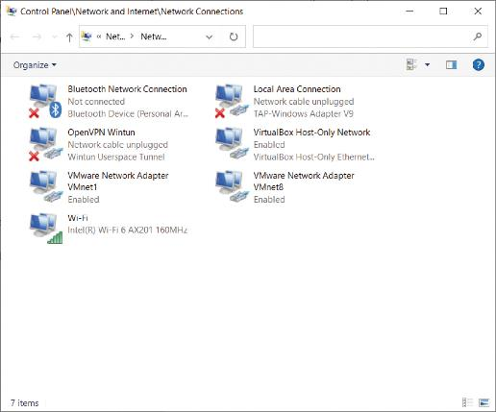
Investigating Hypervisor Systems (7 of 11)
Figure 9-7 Viewing network connections

Slide 12
Investigating Hypervisor Systems (8 of 11)
In addition to searching for network adapters, you need to determine whether USB drives have been attached to the host
They could have live VMs running on them
A VM can also be nested inside other VMs on the host machine or a USB drive
Some newer Windows systems log when USB drives are attached
Search the Windows Registry or the system log files

Slide 13
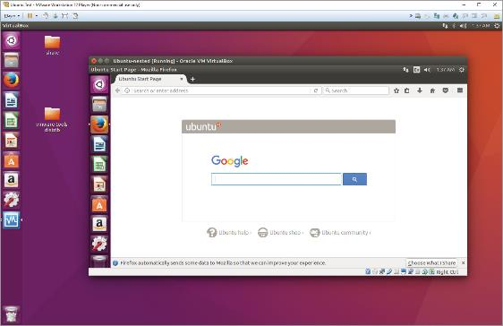
Investigating Hypervisor Systems (9 of 11)
Figure 9-8 A VM nested inside another VM

Slide 14
Investigating Hypervisor Systems (10 of 11)
Follow a consistent procedure when analyzing a VM:
1. Image the host machine
2. Locate the virtualization software and VMs using information learned about file extensions and network adapters
3. Export from the host machine all files associated with VMs
4. Record the hash values of associated files
5. Open the VM as an image file in forensics software and create a forensic image or mount the VM as a drive

Slide 15
Investigating Hypervisor Systems (11 of 11)
Live acquisitions of VMs are often necessary because they include all snapshots, which records the state of a VM at a particular moment (records only changes in state, not a complete backup)
When acquiring an image of a VM file, snapshots might not be included
In this case, you have only the original VM
Doing live acquisitions of VMs is important to make sure snapshots are incorporated

Slide 16
Other VM Examination Methods
FTK Imager, Magnet AXIOM and OSForensics can mount VMs as an external drive
By mounting a VM as a drive, you can make it behave more like a physical computer
This allows you to use the same standard examination procedures for a static hard drive
Make a copy of a VM’s forensic image and open the copy while it’s running
Start it as a live VM so that forensics software can search for clues

Slide 17
Knowledge Check Activity 9-1
Which of the following accurately describes .ova files?
They are only used on VirtualBox.
They are preconfiguration files.
They are stored configuration files.
They contain snapshot data.

Slide 18
Knowledge Check Activity 9-1: Answer
Which of the following accurately describes .ova files?
Answer: b. They are preconfiguration files.
The .ova files for VirtualBox contain the settings for the virtual image file. It is this file that predefines the virtual image file when loaded into VirtualBox.

Slide 19
Performing Live Acquisitions (1 of 3)
Live acquisitions are especially useful when you’re dealing with active network intrusions or attacks
Live acquisitions done before taking a system offline are also becoming a necessity
Attacks might leave footprints only in running processes or RAM
Live acquisitions don’t follow typical forensics procedures
Order of volatility (OOV) determines how long a piece of information lasts on a system

Slide 20
Performing Live Acquisitions (2 of 3)
The following steps for a live acquisition are as follows:
Create or download a bootable forensic CD or USB drive
Make sure you keep a log of all your actions
Send the information you collect to a network drive
Copy the physical memory (RAM)
The next step varies, depending on the incident you’re investigating
Be sure to get a forensically sound digital hash value of all files you recover during the live acquisition

Slide 21
Performing Live Acquisitions (3 of 3)
A remote acquisition is the process of monitoring, imaging, and remotely accessing/imaging a device over a network over many miles
Considerations when conducting a remote acquisition include:
In what country is the person being investigated located?
What are you looking for?
What type of device is on the network?
What is the OS of the remote computer?
Is the machine currently on?

Slide 22
Performing a Live RAM Acquisition in Windows
The following tools are available for capturing RAM:
FTK Imager and Mandiant Memoryze
Belkasoft RamCapturer
Kali Linux
GUI tools are easy to use but they often require a lot of system resources
They also might get false readings in Windows OSs
Command-line tools give you more control

Slide 23
Performing a Live Acquisition in Linux
Live acquisitions in Linux differ from live acquisitions in Windows
There are many different flavors and kernels in Linux
The two tools commonly used with Linux live acquisitions are LIME and Volatility
RAM is the priority, followed by logs, network traffic, and the actual drive

Slide 24
Selective File Live Acquisitions
Many investigations require the acquisition of only certain files rather than all the data on a disk
Live selective acquisitions may be done using one of two methods:
One is on a local computer
The other requires accessing the computer via a network connection and copying files of interest to remote storage media
Tools used for a selective live acquisition may include Windows DOS commands such as xcopy or robocopy

Slide 25
Remote Acquisition Tools
Most remote acquisition tools are expensive and have special requirements to operate
Such as administration privileges and knowledge of network configurations
This section provides an overview of some of the most popular digital forensics remote acquisition tools currently available
Not included in this list are network investigative tools designed to provide incident response and e-discovery data collection for large networks

Slide 26
Belkasoft Remote Acquisition
Belkasoft Remote Acquisition (Belkasoft R) can perform remote acquisitions on the following systems:
Computer’s internal and external connected drives
Memory acquisitions of remote computers
Mobile devices
Belkasoft R can deploy applications known as agents to the remote source computer, which is referred to as an endpoint
To deploy the agent, enter the IP address of the endpoint computer and its administrator password

Slide 27
F-Response Collect
F-Response provides a wide assortment of network management tools
It is designed to perform a wide range of remote data collection tasks including the following:
Conducting e-discovery
Creating raw and universally readable digital forensics images
Creating RAM imaging
Collecting custom files
It provides scripts that can acquire data from cloud servers

Slide 28
Magnet AXIOM Cyber – Remote Acquisition
The Magnet AXIOM Cyber – Remote Acquisition tool has a wide range of remote data collection capabilities
It can access various cloud services such as AWS S3 Buckets and EC2 Instances

Slide 29
Using Microsoft’s File System Utility Command (1 of 4)
To examine a victim’s computer for possible malware activity, examination of the $UsnJrnl file can be performed using the Windows DOS fsutil command
Running this command requires system administrator privileges
For a live system, type the following:
fsutil usn readjournal c:
To save the screen output to a text file, type the following:
fsutil usn readjournal c: > f:victim-usnjrnl –j –data.txt

Slide 30
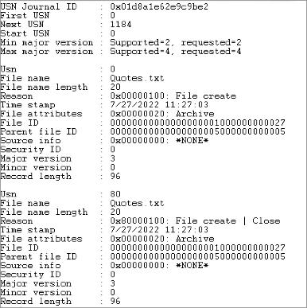
Using Microsoft’s File System Utility Command (2 of 4)
Figure 9-10 Output example from the fsutil command

Slide 31
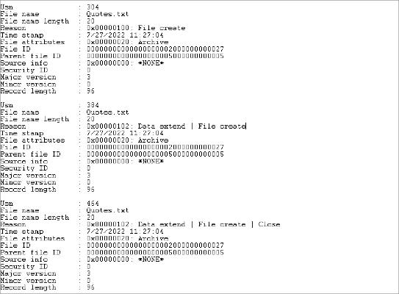
Using Microsoft’s File System Utility Command (3 of 4)
Figure 9-11 fsutil output showing a file’s create data and time

Slide 32
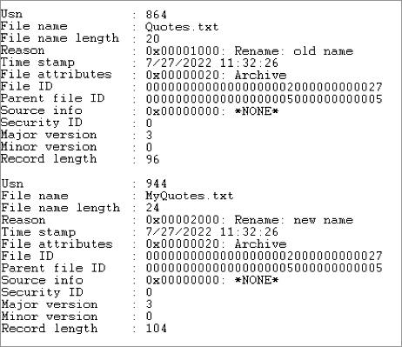
Using Microsoft’s File System Utility Command (4 of 4)
Figure 9-12 fsutil output showing a file’s name change

Slide 33
Knowledge Check Activity 9-2
When using a remote acquisition tool such as Belkasoft R, which of the following terms refers to the remote computer?
Endpoint
Server
Terminal
Host

Slide 34
Knowledge Check Activity 9-2: Answer
When using a remote acquisition tool such as Belkasoft R, which of the following terms refers to the remote computer?
Answer: a. Endpoint
Belkasoft R and some other remote acquisitions tools refer to the remote computer as the endpoint computer. The forensics workstation is typically referred to as the server computer.

Slide 35
Self Assessment
When performing a remote acquisition in another country, what is the first thing you should do?
What command can you use to determine if malware viruses may have changed their name in an effort to disguise their presence on a computer?

Slide 36
Summary
Now that the lesson has ended, you should be able to:
Describe virtual machines and virtual machine forensics
Explain how live acquisitions are performed
Describe tools used for remote acquisitions
Explain how to use Microsoft’s File System Utility Command

