Slide 1
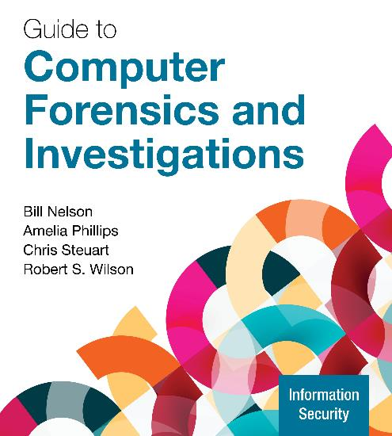
Guide to Computer Forensics and Investigations, 7e
Module 10: Network Forensics
Nelson/Phillips/Steuart/Wilson, Guide to Computer Forensics and Investigations, 7th Edition. ©2025 Cengage Learning, Inc. All Rights Reserved. May not be scanned, copied or duplicated, or posted to a publicly accessible website, in whole or in part.

Slide 2
Module Objectives
By the end of this module, you should be able to:
Describe network forensics
Explain the process of a network investigation
Use network forensics tools
Describe virtual network forensics
Describe how to research and investigate types of attacks

Slide 3
Network Forensics Overview (1 of 2)
Network forensics is the process of collecting and analyzing raw network data and tracking network traffic
The purpose is to ascertain how an attack was carried out or how an event occurred on a network
Intruders leave a trail behind
Knowing your network’s typical traffic patterns is important in spotting variations in network traffic
It can also help you determine whether a network is truly under attack

Slide 4
Network Forensics Overview (2 of 2)
Vulnerabilities can come from a variety of issues, including the following:
Misconfigured servers
Open ports – particularly port 23, the default port for Telnet
Settings and validation options used when installing additional servers, such as a database server
Auditing network logs is the key to network forensics
Tools that can digest large volumes of data is needed

Slide 5
Network Forensics Standard Procedures
Network forensics examiners must establish standard procedures for how to acquire data after an attack or intrusion
It is essential to ensure that all compromised systems have been found, brought offline, and restored as quickly as possible
Procedures must be based on an organization’s needs and complement the network infrastructure
NIST created the “Guide to Integrating Forensic Techniques into Incident Response” to address these needs

Slide 6
Securing a Network (1 of 2)
A layered network defense strategy sets up layers of protection to hide the most valuable data at the innermost part of the network
Defense in depth (DiD) is a similar approach developed by the NSA
DiD has three modes of protection:
People
Technology
Operations

Slide 7
Securing a Network (2 of 2)
Testing networks is as important as testing servers
Digital forensics investigators need to be up to date on the latest methods intruders use to infiltrate networks
As well as methods internal employees use to sabotage networks
Small companies of fewer than 10 employees often don’t consider security precautions against internal threats necessary
Can be more susceptible to problems caused by employees revealing proprietary information to competitors

Slide 8
Developing Procedures and Models for Network Forensics (1 of 2)
Network forensics can be a long, tedious process
A standard procedure often used in network forensics is as follows:
Always use a standard installation image for systems on a network
Fix any vulnerability as quickly as possible after an attack
Attempt to retrieve all volatile data
Acquire all compromised drives and make a forensic image of it
Compare files on the forensic image to the original installation image

Slide 9
Developing Procedures and Models for Network Forensics (2 of 2)
In digital forensics
You can work from the image to find most of the deleted or hidden files and partitions
In network forensics
You have to restore the drive to see how malware that attackers have installed on the system works

Slide 10
Effectively Reading Network Logs
Network logs record traffic in and out of a network
Network servers, routers, and firewalls record activity and events that move through them
The tcpdump command and Wireshark are good tools for examining network traffic
Wireshark can generate top 10 lists of websites visited as well as the top 10 internal users
Network logs can identify patterns, such as an employee transmitting data to or from a particular IP address frequently

Slide 11
Knowledge Check Activity 10-1
The defense in depth strategy uses all but which of the following as modes of protection?
People
Operations
Policies
Technology

Slide 12
Knowledge Check Activity 10-1: Answer
The defense in depth strategy uses all but which of the following as modes of protection?
Answer: c. Policies
The defense in depth strategy uses people, operations, and technology.

Slide 13
Exploring Common Network Forensics Tools
A variety of tools are available for network administrators to perform remote shutdown, monitor device use, and more
Examples of network forensics tools include the following:
Splunk
Spiceworks
Nagios
Cacti

Slide 14
Packet Analyzers (1 of 8)
A packet analyzer is a device or software that monitors network traffic
Most work at layer 2 or 3 of the OSI model
Most tools follow the pcap (packet capture) format
Some packets can be identified by examining the flags in their TCP headers
To take advantage of the strengths of different tools, many investigators do a capture with tcpdump and then analyze the capture in Wireshark

Slide 15
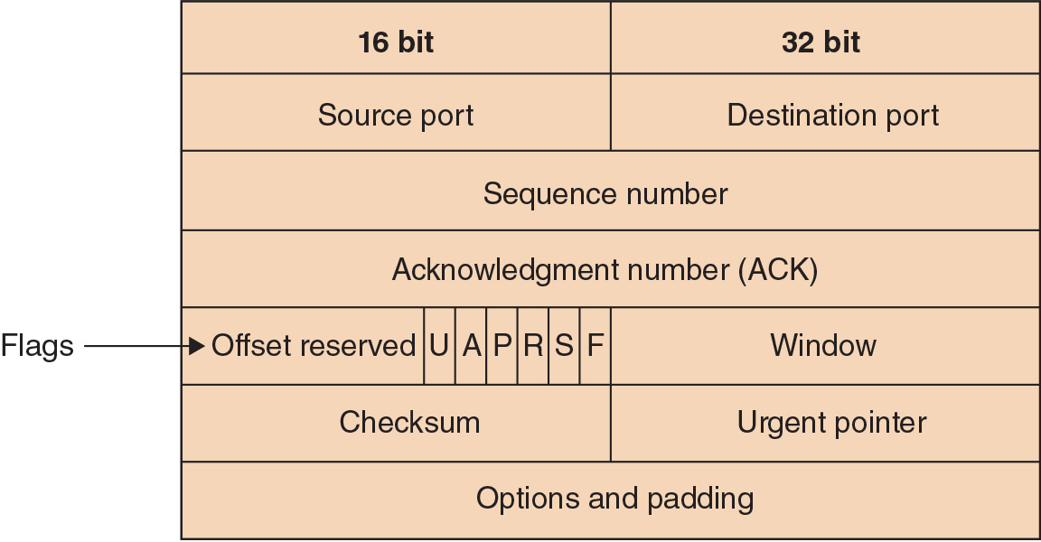
Packet Analyzers (2 of 8)
Figure 10-1 TCP header

Slide 16
Packet Analyzers (3 of 8)
Other network forensics tools include the following:
Tcpslice
Tcpreplay
Etherape
Netdude
Argus
Follow the steps starting on page 459 to see how the Wireshark tool works

Slide 17
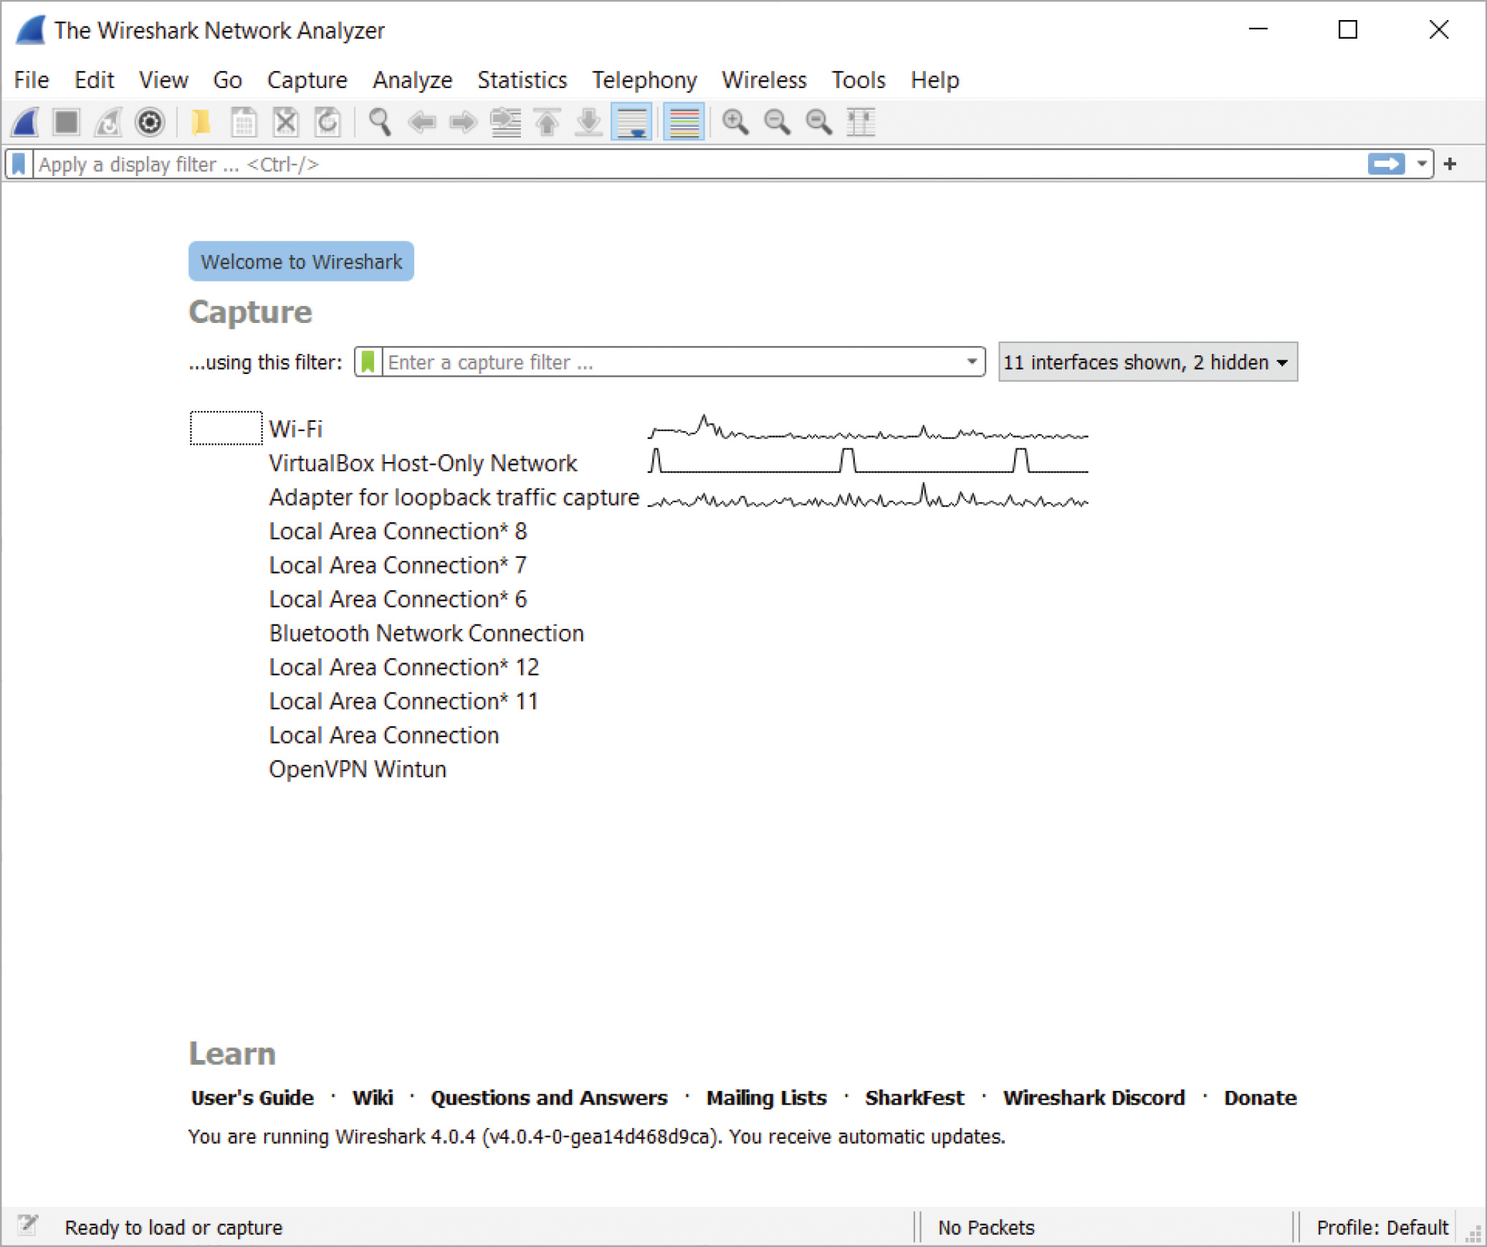
Packet Analyzers (4 of 8)
Figure 10-2 Wireshark opening screen

Slide 18
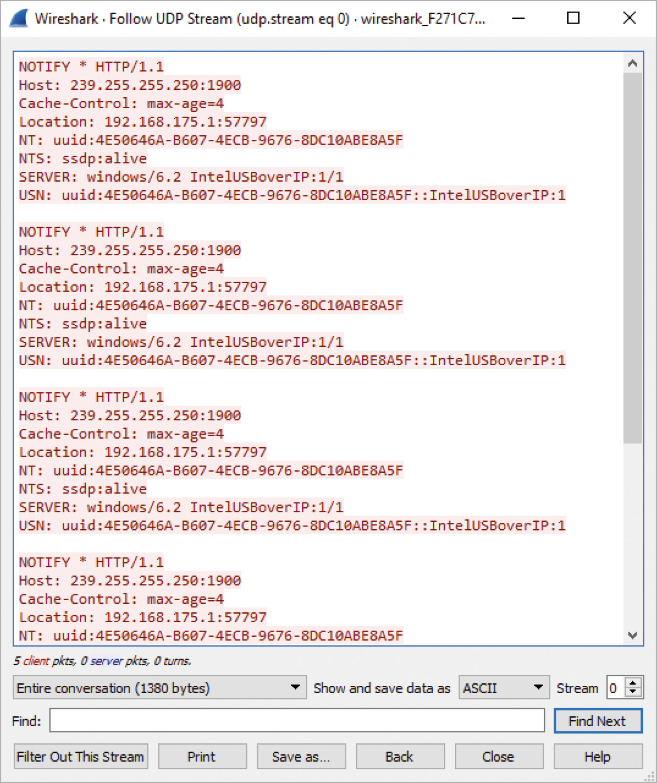
Packet Analyzers (5 of 8)
Figure 10-3 Following a UDP stream in Wireshark

Slide 19
Packet Analyzers (6 of 8)
Complete Activity 10-1 to explore Wireshark
Complete Activity 10-2 to analyze the file from Activity 10-1 using tcpdump

Slide 20
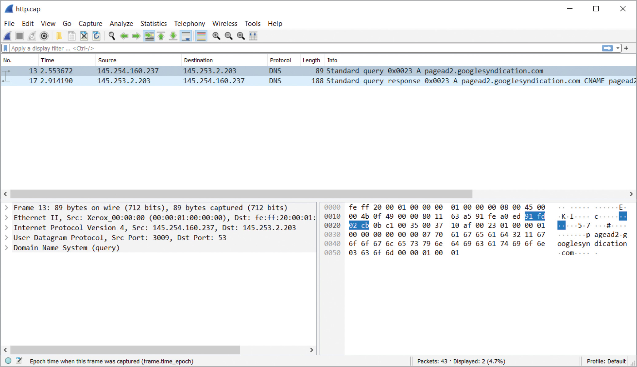
Packet Analyzers (7 of 8)
Figure 10-4 Sample capture file in Wireshark

Slide 21
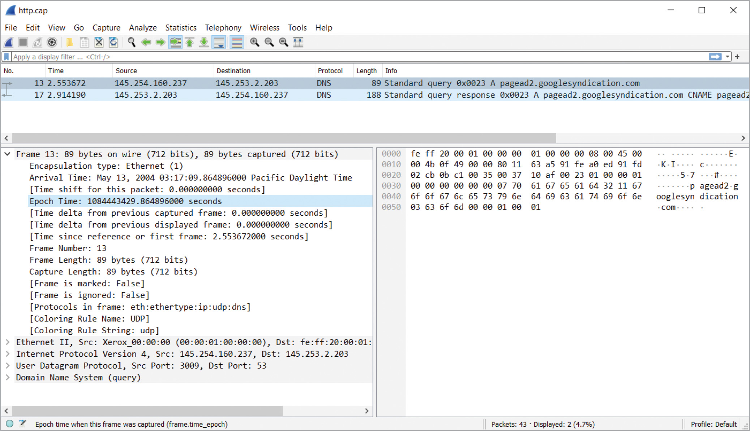
Packet Analyzers (8 of 8)
Figure 10-5 Exploring in Wireshark

Slide 22
Intrusion Detection and Intrusion Prevention Tools
Snort is one of the more powerful network tools
It is an intrusion detection and intrusion prevention tool that can also be used for network forensics
It is Linux based and open source
Snort looks at incoming packets and compares them against set rules
It also looks for malware, does network analysis, and inspects for port scanners
Snort has three modes: sniffer, packet logger, and intrusion detection

Slide 23
Investigating Virtual Networks
A virtual switch is a little different from a physical switch
There’s no spanning tree between virtual switches
Additional complications include the following:
Hypervisors can assign MAC addresses to virtual devices
Devices can have the same MAC address on different virtual networks
Cloud service providers host networks for several to hundreds of companies
Tools that can analyze virtual network are Wireshark and Network Miner

Slide 24
Researching and Investigating Types of Attacks (1 of 2)
The Honeynet Project was developed to make information widely available in an attempt to thwart Internet and network attackers
Provides information about attacks methods and how to protect against them
Objectives are awareness, information, and tools
Distributed denial-of-service (DDoS) attack is a type of attack in which online machines are used, without the owners’ knowledge
Hundreds or even thousands of machines (zombies) can be used in a DDoS attack

Slide 25
Researching and Investigating Types of Attacks (2 of 2)
Zero-day attacks is another major threat
Attackers look for holes in networks and OSs and exploit these weaknesses before patches are available
A honeypot is a computer, set up to look like any other machine on a network, that lures attackers to it
A honeywall is a computer set up to monitor what is happening to honeypots on your network and record what attackers are doing
Honeypots and honeywalls are used to attract intruders and see what they are attempting to do on a network

Slide 26
Knowledge Check Activity 10-2
A honeypot is designed to do which of the following?
Lure attackers to the network
Appear as part of the network
Crash the network
a and b

Slide 27
Knowledge Check Activity 10-2: Answer
A honeypot is designed to do which of the following?
Answer: d. a and b
A honeypot is designed to lure attackers to the network and to appear as part of the network. This allows the network administrator to see how an attacker gained access to the network and gather insights on the changes required to improve the security of the network.

Slide 28
Self Assessment
Packet analyzers are normally used on which layer(s) of the OSI model?
On a type 1 hypervisor, users can have the same IP address on their virtual network as another user without interference. True or False?

Slide 29
Summary
Now that the lesson has ended, you should be able to:
Describe network forensics
Explain the process of a network investigation
Use network forensics tools
Describe virtual network forensics
Describe how to research and investigate types of attacks

