Slide 1
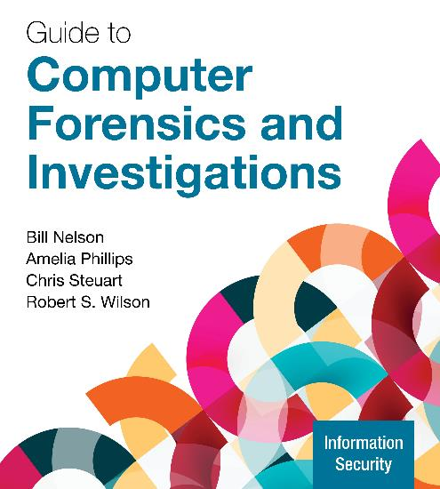
Guide to Computer Forensics and Investigations, 7e
Module 12: Mobile Device Forensics
Nelson/Phillips/Steuart/Wilson, Guide to Computer Forensics and Investigations, 7th Edition. ©2025 Cengage Learning, Inc. All Rights Reserved. May not be scanned, copied or duplicated, or posted to a publicly accessible website, in whole or in part.

Slide 2
Module Objectives
By the end of this module, you should be able to:
Describe the components of mobile devices and cellular networks
Explain mobile device evidence sources
Describe mobile device security features
Explain mobile device acquisition processes
Describe how to extract and analyze mobile device evidence
Describe mobile device forensics tools

Slide 3
Understanding Mobile Devices and Cellular Networks
Mobile device forensics faces many challenges
Police used to look through mobile devices at the time of arrest
The Supreme Court of Oregon and Ohio ruled that a search warrant is needed to examine mobile devices
Because phones often contain private or sensitive information, any information that does not pertain to the case must be redacted from the public record

Slide 4
Types of Mobile Devices
Mobile devices include the following:
Cell phones
Tablets
Drones
Wearable devices
PDA devices
What makes them different from other devices are features such as near-field communications (NFC) and cellular network communications

Slide 5
Cellular Networks (1 of 3)
Cellular networks is the technology that allows mobile devices to communicate wirelessly around the world
They are divided into “generations” where each new generation introduces greater speed and capacity
Fifth-generation (5G) is the newest generation of cellular networks
Sixth-generation (6G) is expected to be available sometime after 2030
Many digital networks are used in the mobile phone industry (see Table 12-1 on the next slide)

Slide 6
Cellular Networks (2 of 3)
Table 12-1 Digital networks
Digital network | Description
Code Division Multiple Access (CDMA) | Developed during WWII, this technology was patented by Qualcomm after the war. One of the most commonly used digital network technologies, CDMA uses the full radio frequency spectrum to define channels. Verizon uses CDMA networks.
Global System for Mobile Communications (GSM) | A second-generation cellular network standard that is currently the most used cellular network standard in the world. It is used by AT&T and T-Mobile.
Time Division Multiple Access (TDMA) | This digital network uses the technique of dividing a radio frequency into time slots; TDMA also refers to a specific cellular network standard covered by IS 136.
Integrated Digital Enhanced Network (IDEN) | This Motorola protocol combines several services, including data transmission, into one network.
Digital Advanced Mobile Phone Service (D-AMPS) | This network is a digital version of the original analog standard for cell phones.
Enhanced Data GSM (EDGE) | This digital network, a faster version of GSM, is designed to deliver data.
Orthogonal Frequency Division Multiplexing (OFDM) | This technology for 4G networks uses energy more efficiently than 3G networks and is more immune to interference.

Slide 7
Cellular Networks (3 of 3)
Specific technologies introduced with 4G networks to improve speed and accuracy include the following:
Orthogonal Frequency Division Multiplexing (OFDM)
Mobile WiMAX
Ultra Mobile Broadband (UMB)
Multiple Input Multiple Output (MIMO)
Long-Term Evolution (LTE)

Slide 8
Cell Phone Tower Communications (1 of 2)
On cellular networks, geographic areas are divided into cells
Three main components are used for communication with these cells:
Base transceiver station (BTS)
Base station controller (BSC)
Mobile switching center (MSC)
When a cell phone powers on, it first connects to the nearest available cell tower
As soon as it connects, it is registered in that cellular network

Slide 9
Cell Phone Tower Communications (2 of 2)
Cell towers typically have three antennas that provide 360 degrees of coverage
The number can vary depending on the cell tower manufacturer and possible obstructions requiring more antennas
Each antenna on a cell tower will point in one of three directions
First antenna, referred to as A (alpha), points north
Second antenna, referred to as B (beta), points southeast
Third antenna, referred to C (gamma), points southwest

Slide 10
Cell Phone Tracking (1 of 3)
Cell phones can be tracked through Bluetooth, cell towers, GPS satellites, and Wi-Fi networks
In the US, all cell phones and smartphones utilize GPS technology
The enhanced 911 (E911) service is now used by all cell phones
When a user calls 911, the phone’s E911 feature switches on the phone’s GPS service and transmits a SMS message to an E911 dispatcher
Cellular providers can ping any cell phone connected to their network, which causes the cell phone to turn on its GPS location service

Slide 11
Cell Phone Tracking (2 of 3)
Law enforcement and the military have devices that can intercept cellular communications by using the International mobile subscriber identity (IMSI) number to track the cell phone
These devices have an active (cell-site simulator) and passive (IMSI catcher) mode
Ways in which an IMSI catcher can be used include the following:
Collect the IMSI number for a specific cell phone
Collect associated metadata such as dialed or texted numbers
Collect the content of text messages, email, attachments, websites
Track the movement of a cell phone in real time

Slide 12
Cell Phone Tracking (3 of 3)
A cell-site simulator has the following additional capabilities:
Determine the exact location of the cell phone in real time using the pinging feature
Divert calls and messages to other telephone numbers
Edit and spoof messages
Divert web browser connections to spoofed websites
Decrypt messages with low-level encryption in real time
IMSI catcher and cell-site simulators can be placed in a vehicle or aircraft

Slide 13
Cell Phone Data Logs
The following are three types of cell phone log files:
Cell detailed records (CDR) log is a list of all calls made from and to a specific cell phone
Cell-site location information (CSLI) log contains a list of one or multiple cell phone numbers that have been registered through specific cell phone towers
Also referred to as a cell tower dump
Cell Phone Pinging Report is a log of the results of the pinging efforts of the cellular network

Slide 14
Inside Mobile Devices (1 of 5)
Mobile device hardware consists of the following:
Microprocessor, ROM, RAM, a digital signal processor, a radio module, a microphone and speaker, hardware interfaces, and an LCD display
Most basic phones have a proprietary OS, although smartphones use the same OSs as PCs
Phones store system data in electronically erasable programmable read-only memory (EEPROM)
The OS for a mobile device is stored in ROM

Slide 15
Inside Mobile Devices (2 of 5)
A subscriber identity module (SIM) card is usually found in GSM devices
GSM refers to mobile phones as “mobile stations” and divides a station into two parts:
The SIM card and the mobile equipment (ME)
A SIM card provides the following functions:
Identifies the subscriber to the network
Stores service-related information
Used to back up the device

Slide 16
Inside Mobile Devices (3 of 5)
SIM cards come in three sizes: standard, micro, and nano
By switching a SIM card between compatible phones, users can move to another cellular provider without notifying the service providers
The file system for a SIM card is a hierarchical structure
It begins with the root of the system (MF)
The next level consists of directory files (DF) and under them are files containing elementary data (EF)
Embedded SIM (eSIM) cards are designed to provide multiple profiles and multiple phone numbers on one smartphone

Slide 17
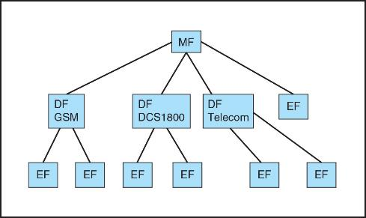
Inside Mobile Devices (4 of 5)
Figure 12-1 SIM file structure

Slide 18
Inside Mobile Devices (5 of 5)
Most mobile devices have onboard (soldered-on) memory storage
Many have user-removeable memory storage (SD cards)
For digital forensics examiners, determining if a mobile device uses soldered-on storage or user-removeable memory cards is important
If it uses user-removeable storage, the forensics examiner should verify that they have seized any memory cards that were used with the mobile device

Slide 19
Mobile Device Data
Email messages can be stored on a mobile device
Accessing email that is stored on a server or in the cloud requires access to the smartphone user’s email account
For most social media accounts, data is stored in the cloud
Collaborative instant messaging services are often used on mobile devices that may only keep the most recently accessed chat messages
Depending on the setup of an iPhone or iPad, message and photo data may be stored in the user’s iCloud account

Slide 20
Apple Advanced Data Protection
Apple Advanced Data Protection is a service that protects a User’s iCloud data with end-to-end encryption
Data remains encrypted during transmission and when stored
The data is encrypted-at-rest while it is hosted at Apple’s datacenters
If this function is enabled, only the user can decrypt the data
The decryption key can be recovered by:
The user’s trusted Apple devices or the “recovery contact” iPhone or iPad
Enter a 28-alphanumeric key presented to the user during setup

Slide 21
SQLite Databases
Mobile devices employ SQLite as the database for storing data
When a user deletes data that is a record, such as a text message, the database marks the record as available for reuse
The SQLite command autovaccum eliminates deleted records
Recovering a deleted record is only possible if a forensics acquisition is performed immediately after the record is deleted
When recovering deleted data, determine if there are alternative locations where the data might be stored

Slide 22
Knowledge Check Activity 12-1
Which of the following are places where mobile device information might be stored?
Internal memory
SIM card
Removable media such as an SD card
All of these choices

Slide 23
Knowledge Check Activity 12-1: Answer
Which of the following are places where mobile device information might be stored?
Answer: d. All of these choices
Information on a mobile device may be stored in internal memory, on a SIM card, or on removable media such as an SD card.

Slide 24
Mobile Device Management (1 of 4)
Mobile device management (MDM) provides administrators with policy and technical controls for managing an organization’s mobile devices
MDM tools allow administrators to do the following:
Enforce appropriate behaviors by users
Install security updates
Create encrypted storage containers on the mobile device
Manage the information stored on the device
Examples include Microsoft Intune and Samsung Knox Manage

Slide 25
Mobile Device Management (2 of 4)
The purpose of MDM tools is to protect an organization’s confidential and trade secret information
For examiners, extracting data from a device that has MDM enabled is difficult or impossible
MDM is designed to resist attempts by a mobile forensics extraction tool such as Cellebrite or XRY
Administrators can also set up MDM software so that data is automatically wiped if there are any attempts to alter the phone’s security features

Slide 26
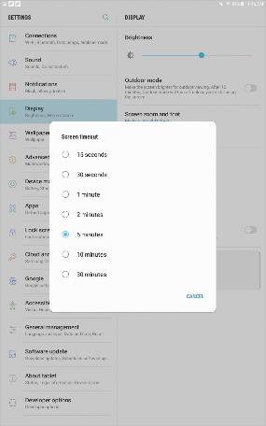
Mobile Device Management (3 of 4)
Figure 12-2 Checking an Android’s Stay awake option

Slide 27
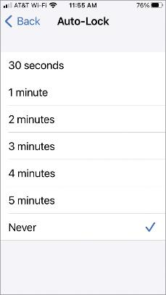
Mobile Device Management (4 of 4)
Figure 12-3 Checking an Apple mobile device’s Auto-Lock: Never option

Slide 28
Apple Lost Mode
Apple Lost Mode can aid users in the recovery of their lost device
It is initiated remotely from the user’s iCloud account or the corporation MDM console
Once the device receives a signal it locks the device and broadcasts its geolocation back to the person who initiated the lost mode
The device can receive a self-erase signal, which will delete all contents from the mobile device
When seizing an Apple mobile device, be aware that data may be destroyed with the Apple Lost mode service

Slide 29
File System Encryption
Encryption falls into two categories: data-in-motion and data-at-rest
Some encryption application vendors provide a backdoor utility for data recovery purposes in the event a user loses their passcode
iPhones have the iMessage utility, which will encrypt all messages between sender and receiver
These messages are stored in iCloud and require a passcode to decrypt them on a user’s iPhone
Google uses end-to-end encryption using the Rich Communication Service (RCS) in their Messages app

Slide 30
Seizing and Securing Mobile Devices
The main concern when working with mobile devices are loss of power, synchronization with cloud services, and remote wiping
All mobile devices have volatile memory
Make sure they do not lose power before you can retrieve RAM data
At the investigation scene, determine if device is on or off
If it is off, leave it off, attempt to find the charger, and connect it as soon as possible
If it is on, check the display for the battery’s current charge level

Slide 31
Isolating the Mobile Device
Any mobile device attached to a PC or tablet should be disconnected
Disconnect them from the Internet to help prevent synchronization that might occur automatically and overwrite data on the device
If it is present, collect the suspect computer and peripheral devices to determine if the hard drive contains any backup data from the mobile device

Slide 32
Protecting the Mobile Device’s Data
Use one of the following to isolate the device from incoming signals:
Turn on airplane mode if available
Place the device in a paint can, preferably one painted with radio wave-blocking paint
Use a Faraday bag, which is a special bag that is made of material that blocks electromagnetic waves (the preferred method)
Turn the device off

Slide 33
Mobile Device Evidence Extraction and Examination
Research the specific features of the mobile device before performing any data extractions
Make sure you have a compatible charger and attach it to the phone
The best method of retrieving information from a mobile device is by acquiring a forensic image
An alternative method is to connect it to a computer’s USB port with a USB writeblocker

Slide 34
Preparing for an Acquisition (1 of 3)
Mobile device acquisitions are more aligned with live acquisitions
Typically, you will need to set the mobile device to debug mode so the examination tool can communicate with it
Forensics Workstation Preparation
Mobile devices use slower USB connections than computers
To prevent disruptions during the acquisition, switch off the workstation’s sleep mode

Slide 35
Preparing for an Acquisition (2 of 3)
Configuring a Suspect Android Mobile Device
The first task is to make sure all communication channels to the device have been shut off (see steps on page 529)
Next, turn off screen timeout features and turn on its debug mode (follow steps starting on page 529)
You may need to perform a web search on how to turn on debug mode for whatever type of device you are working with

Slide 36
Preparing for an Acquisition (3 of 3)
Configuring a Suspect Apple Mobile Device
The first task is to make sure all communication channels to the device have been shut off (see steps on page 530)
Next, turn off screen timeout features (follow steps on page 530)
Mobile Device Storage Needs
To store extracted data, you can use magnetic media or flash media
When using USB flash drives, be sure to use “high-performance, high endurance” drives

Slide 37
Perform the Extraction (1 of 2)
The general procedure for performing an extraction is as follows:
Connect the mobile device to the forensics workstation
Perform the acquisition based on the type of data needed
Monitor the extraction to ensure it is progressing and correct errors
During the extraction, make the effort to ensure nothing touches the screen of the mobile device
When the extraction is completed, restore the device’s original settings
Power off the device and put it back in the evidence locker

Slide 38
Perform the Extraction (2 of 2)
After acquiring internal data, the next step is to acquire any data from SIM or SD cards
If the device lost power, you might need a PIN or other access codes to view files
With most SIM cards, you have three attempts at entering an access code before the device is locked
Which then requires calling the service provider to get the personal unlock key (PUK) and waiting a certain amount of time to try again
Common codes to try are 1-1-1-1 or 1-2-3-4

Slide 39
Apple iOS Encrypted Backup
When performing an extraction of an iOS device, a prompt from the extraction tool may be displayed asking you to enter the user’s password
iOS encrypted backups can include the following:
Saved passwords for other accounts
Wi-Fi settings
Browser history
Health data
Call history

Slide 40
Common Extraction Methods
Manual extraction may include writing your own software tools or taking photographs of each artifact found on the device
A logical extraction utilizes the mobile device’s application programming interface (API) tools to communicate with the mobile device and extract the data to the forensics workstation
A selective logical extraction acquires specific data files such as an SQLite database
Physical extraction is similar to a physical acquisition of a regular computer

Slide 41
Advanced Extraction Methods (1 of 2)
Before trying these methods, make sure nondestructive methods have already been tried
Hex dumping involves using a modified boot loader to access the RAM for analysis
It is invasive and may damage the mobile device
Joint Test Action Group (JTAG) Extraction
An examiner can attach electrical leads to a specific interface on the mobile device circuit board, called a test access port (TAP), to send and receive data from the mobile device

Slide 42
Advanced Extraction Methods (2 of 2)
Chip-Off Extraction
A chip-off extraction is performed by desoldering the physical memory chip from the mobile device circuit board and then placing the chip in a memory chip reader
This method requires specialty hardware engineering skills
Micro-Read Extraction
An examiner uses an electron microscope to manually read each of the logic-gates of the memory cells to extract each bit of data from a memory chip

Slide 43
Workflow Documentation and Verification
The extraction process must be monitored to maintain the integrity and chain of custody of evidence
Once the extraction process is finished you will need to verify its contents
Recovered data will include binary and executable files that will need to be decoded and analyzed
Most mobile device forensics tools are designed to decode this data

Slide 44
Mobile Device Forensics Tools (1 of 5)
Andriller CE is a freeware Python script designed to perform forensics acquisitions and analysis on Android smartphones and tablets
It will run in Windows and Linux
Complete Activity 12-1 to install and explore Andriller CE
Belkasoft Evidence Center X is a commercially sold digital forensics solutions
It contains all the tools an examiner needs to conduct acquisition and analysis on a variety of devices

Slide 45
Mobile Device Forensics Tools (2 of 5)
Cellebrite is a commercial product that includes a field extraction kit and analysis software
Hawk Analytics’ CellHawk is a web-based software-as-a-service platform designed to analyze CDR
DataPilot is a commercial product that can extract data from Android, Apple, and KaiOS mobile devices
FQLite is a freeware Java script designed to locate and recover deleted records in SQLite databases

Slide 46
Mobile Device Forensics Tools (3 of 5)
Magnet Forensics is a commercial product that has the following tools to handle digital forensics investigations:
Magnet Acquire is used for acquiring data from traditional computer media, mobile devices, and cloud sources
Magnet Process is used to convert extracted data into a readable format and creates a database of all the evidence processed
Magnet Examine is used for the examination and analysis of the recovered evidence

Slide 47
Mobile Device Forensics Tools (4 of 5)
Micro Systemation AB is a commercial product that has a family of mobile forensic tools that includes the following:
XRY
XAMN
XEC
MOBILedit Forensic is a commercial product specifically designed for mobile forensics
It has a built-in write-blocker and can connect phones directly via Bluetooth, irDA, or a cable

Slide 48
Mobile Device Forensics Tools (5 of 5)
Oxygen Forensics is a commercial product that has a field acquisition kit with a tablet computer that has the Oxygen Forensics extractor tool
It comes with cables to support numerous mobile devices
Paraben Software is a commercial product that has several digital forensics tools, including mobile forensics application tools named E3:DS
It examines Internet of Things devices, has a bootloader for locked mobile devices, and can perform data parsing and cloud data capture

Slide 49
Knowledge Check Activity 12-2
What is the first step you should take when configuring a suspect mobile device?
Make sure all communication channels are shut off.
Turn off the device’s screen timeout feature.
Configure the device so that it is in debug mode.
Remove any external storage media.

Slide 50
Knowledge Check Activity 12-2: Answer
What is the first step you should take when configuring a suspect mobile device?
Answer: a. Make sure all communication channels are shut off.
Before attempting to process a mobile device, make sure it cannot communicate with a cellular network, Wi-Fi, or a Bluetooth device. After confirming the mobile device’s external communications have been shut off, you can move to turning off the device’s screen saver, placing the device into debug mode, and then removing any external media.

Slide 51
Self Assessment
What mobile forensics product is specifically designed to process CDR data?
What is the preferred method for securing a mobile device when it is seized?

Slide 52
Summary
Now that the lesson has ended, you should be able to:
Describe the components of mobile devices and cellular networks
Explain mobile device evidence sources
Describe mobile device security features
Explain mobile device acquisition processes
Describe how to extract and analyze mobile device evidence
Describe mobile device forensics tools

