Slide 1
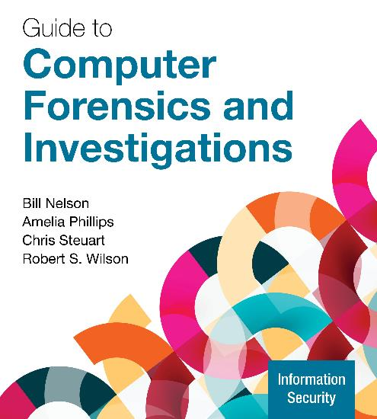
Guide to Computer Forensics and Investigations, 7e
Module 13: Email and Social Media Investigations
Nelson/Phillips/Steuart/Wilson, Guide to Computer Forensics and Investigations, 7th Edition. ©2025 Cengage Learning, Inc. All Rights Reserved. May not be scanned, copied or duplicated, or posted to a publicly accessible website, in whole or in part.

Slide 2
Module Objectives
By the end of this module, you should be able to:
Explain the role of email and social media in investigations
Describe client and server roles in email
Describe tasks in investigating email crimes and violations
Explain the use of email server logs
Describe some specialized email forensics tools
Explain how to apply digital forensics methods to investigating social media communications and channel-based messaging tools

Slide 3
Exploring the Role of Email in Investigations
Investigators need to know how to examine and interpret the unique content of email messages
Phishing emails contain links to text on a webpage
The goal is to get personal information from the recipient
Pharming takes readers to a fake website
Spoofing occurs by changing header info to disguise the sender
Investigators can use the Enhanced/Extended Simple Mail Transfer Protocol (ESMTP) number in the message’s header to check for legitimacy of email

Slide 4
Exploring the Client and Server Roles in Email (1 of 2)
Messages distributed from a central server to many connected client computers is a configuration called client/server architecture
An intranet email system is specific to a company and typically uses a naming convention
Corporate: jsmith@somecompany.com
Public: itty_bitty@gmail.com
Tracing corporate emails is easier because accounts use standard names the administrator establishes
Many companies are migrating their email services to the cloud

Slide 5
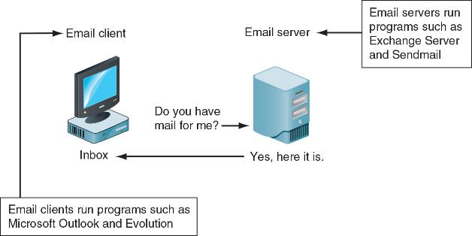
Exploring the Client and Server Roles in Email (2 of 2)
Figure 13-1 Email in a client/server architecture

Slide 6
Investigating Email Crimes and Violations
Goals when investigating email crimes should include the following:
Find out who is behind the crime
Collect the evidence
Present your findings to build a case
Know the applicable privacy laws for your jurisdiction
Electronic Communications Privacy Act (ECPA) and the Stored Communications Act (SCA) apply to email

Slide 7
Understanding Forensic Linguistics
Forensic Linguistics is a field where language and law intersect
The field is divided into the following four categories:
Language and law, language in the legal process, language as evidence, and research/teaching
It trains people to listen to voice recordings to determine who’s speaking or to read email to determine authenticity
Artificial intelligence (AI) may make it more difficult for forensics linguists to correctly identify the author of some emails

Slide 8
Examining Email Messages
Access victim’s computer or mobile device to recover the evidence
Using the victim’s email client, find and copy any potential evidence
Access protected or encrypted material and print emails
You need a warrant for a criminal investigation
You may need to guide the victim on the phone to open and copy email including headers

Slide 9
Copying an Email Message
As part of an email investigation, you need to copy and print the email involved in the crime or policy violation
You might also want to forward the message as an attachment to another email address
Note the steps to copy an email message from Microsoft Outlook to a USB drive starting on page 559
With many GUI email programs, you can copy an email by dragging it to a storage medium or by saving it in a different location

Slide 10
Viewing Email Headers (1 of 2)
Investigators should learn how to find email headers
After you open email headers, copy and paste them into a text document so that you can read them with a text editor
Become familiar with as many email programs as possible
Often more than one email program is installed
Note the steps to find email headers in Gmail and Yahoo found on page 560

Slide 11
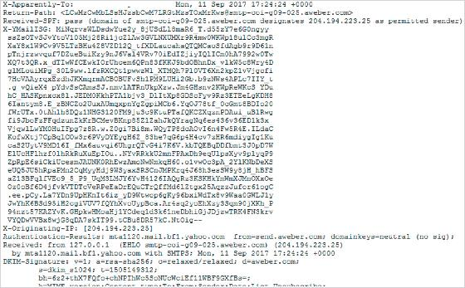
Viewing Email Headers (2 of 2)
Figure 13-2 Viewing a header in Yahoo

Slide 12
Examining Email Headers (1 of 2)
Headers contain useful information
The main piece of information you’re looking for is the originating email’s domain or IP address
Other helpful information includes the following:
Date and time the message was sent
The file names of any attachments
Unique message number (if it’s supplied)

Slide 13
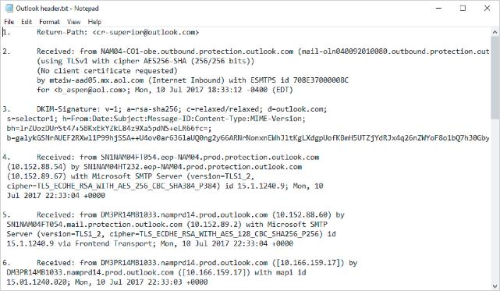
Examining Email Headers (2 of 2)
Figure 13-3 An email header with line numbers added

Slide 14
Examining Additional Email Files
Email messages are saved on the client computer or left on the server
Microsoft Outlook uses .pst and .ost files
Most email programs also include an electronic address book, calendar, task list, and memos
In web-based email, messages are displayed and saved as webpages in the browser’s cache folders
Many web-based email providers also offer instant messaging (IM) services but those messages may not be saved
You may have to search the pagefile.sys to find message fragments

Slide 15
Tracing an Email Message
Determining message origin is referred to as “tracing”
Contact the administrator responsible for the sending server
You can use a registry site to find the point of contact:
www.arin.net
www.internic.com
www.google.com
Verify your findings by checking network email logs against email addresses

Slide 16
Using Network Email Logs (1 of 2)
Router logs record all incoming and outgoing traffic
Use these logs to determine the path a transmitted email has taken
Firewalls filter email traffic
Firewalls logs track Internet traffic destined for other networks
Use these logs to verify whether the email passed through the firewall
You can use text editors or specialized tools to view logs

Slide 17
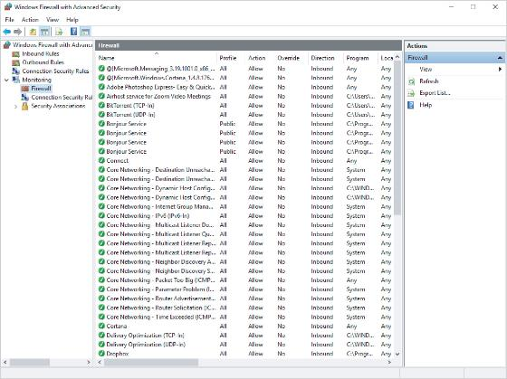
Using Network Email Logs (2 of 2)
Figure 13-4 A Windows firewall log

Slide 18
Knowledge Check Activity 13-1
A phishing email attempts to do which of the following?
Direct the recipient to places to fish.
Direct the recipient to a site that may contain malware.
Attempt to gain personal information from the recipient.
Install a key logger on the recipient’s machine.

Slide 19
Knowledge Check Activity 13-1: Answer
A phishing email attempts to do which of the following?
Answer: c. Attempt to gain personal information from the recipient
Phishing email scams attempt to entice people with false information and promises of money or other rewards to obtain personal information about the recipient that can be used to gain access to accounts such as bank and credit card accounts.

Slide 20
Understanding Email Servers and Server Logs (1 of 2)
An email server contains software that uses email protocols for its services and maintains logs you can examine and use in your investigation
Some email servers use databases that store users’ emails, and others use a flat file system
Some servers are set up to log email transactions by default; others have to be configured to do so
Administrators usually set email servers to continuous logging mode

Slide 21
Understanding Email Servers and Server Logs (2 of 2)
Email logs generally identify the following:
Email messages an account received
Sending IP address
Date and time the server received the email and when the client computer accessed the email
Email contents and system-specific information
After identifying the source of the email, contact the suspect’s network email administrator as soon as possible

Slide 22
Examining UNIX/Linux Email Server Logs (1 of 2)
Common UNIX email servers: Postfix and Sendmail
The configuration file for Sendmail is /etc/sendmail.cf
/etc/syslog.conf specifies how and which events Sendmail logs
Postfix has two configuration files
master. cf and main.cf (found in /etc/postfix)

Slide 23
Examining UNIX/Linux Email Server Logs (2 of 2)
/var/log/maillog records SMTP, POP3, and IMAP4 communications
Contains an IP address and time stamp that you can compare with the header of the email the victim received
Default location for storing log files is /var/log
An administrator can change the log location
Use the find or locate command to find them
Check UNIX man pages for more information

Slide 24
Examining Microsoft Email Server Logs (1 of 3)
Microsoft Exchange Server (generally called Exchange)
It uses an Exchange database and is based on the Microsoft Extensible Storage Engine (ESE)
In older versions of Exchange, useful files in an investigation were .edb database files and checkpoint files
To retrieve Exchange logs, use the following PowerShell script:
GetTransactionLogStats.psl -Gather

Slide 25
Examining Microsoft Email Server Logs (2 of 3)
Exchange servers can also maintain a log called tracking.log that tracks messages
If the Message Tracking feature has been enabled and the email administrator selects verbose (detailed) logging, you can see the timestamp, IP address of the sending computer, and the email’s contents or body
Another log used for troubleshooting and investigating the Exchange environment is the troubleshooting log
Use Windows Event Viewer to view this log

Slide 26
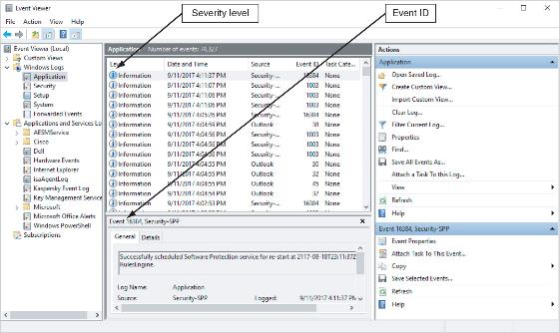
Examining Microsoft Email Server Logs (3 of 3)
Figure 13-5 Viewing a log in Event Viewer

Slide 27
Using Specialized Email Forensics Tools (1 of 3)
Some useful email recovery tools include the following:
DataNumen for Outlook and Outlook Express
FINALeMAIL for Outlook Express and Eudora
Sawmill-Novell GroupWise for log analysis
MailXaminer for multiple email formats and large data sets
Fookes Aid4Mail and MailBag Assistant
Paraben Email Examiner
Exterro FTK for Outlook and Outlook Express

Slide 28
Using Specialized Email Forensics Tools (2 of 3)
Forensics tools enable you to find the following:
Email database files
Personal email files
Offline storage files
Log files
An advantage of using data recovery tools:
You don’t need to know how email servers and clients work to extract data from them

Slide 29
Using Specialized Email Forensics Tools (3 of 3)
After you compare email logs with messages, you should verify the following information:
Email account, message ID, IP address, and date and time stamp to determine whether there’s enough evidence for a warrant
With some tools, you can scan email database files on a suspect’s Windows computer, locate any emails the suspect has deleted and restore them to their original state

Slide 30
Using a Hex Editor to Carve Email Messages
Few vendors have products for analyzing email in systems other than Microsoft
This section shows how to carve emails from Evolution
mbox format stores emails in flat plaintext files
Multipurpose Internet Mail Extensions (MIME) format
Used by vendor-unique email file systems, such as Microsoft .pst or .ost
Follow the steps on page 568 to see how to acquire information from an .evolution file

Slide 31
Recovering Outlook Files (1 of 2)
A forensics examiner recovering email messages from Outlook may need to reconstruct .pst files and messages
With many advanced forensics tools, deleted .pst files can be partially or completely recovered
The scanpst.exe recovery tool comes with Microsoft Office
It can repair .ost files as well as .pst files

Slide 32
Recovering Outlook Files (2 of 2)
Guidance Software uses the SysTools plug-in for Outlook email through version 2013
SysTools extracts .pst files from EnCase Forensic for analysis
DataNumen Outlook Repair is one of the better email recovery tools
It can recover files from VMware and Virtual PC

Slide 33
Email Case Studies
In the Enron Case, more than 10,000 emails contained the following personal information:
60 containing credit card numbers
572 containing thousands of Social Security or other identity numbers
292 containing birth dates
532 containing information of a highly personal nature
Such as medical or legal matters

Slide 34
Applying Digital Forensics Methods to Social Media Communications and Channel-Based Messaging Tools (1 of 2)
A social media platform is an online service that provides a virtual environment where people can create and share text, pictures, and videos
The types of information that can be found on social media includes:
Evidence of cyberbullying and witness tampering
A company’s position on an issue
Whether intellectual property rights have been violated
Who posted information and when

Slide 35
Applying Digital Forensics Methods to Social Media Communications and Channel-Based Messaging Tools (2 of 2)
Social media can often substantiate a party’s claims
Social media sites involve multiple jurisdictions that might even cross national boundaries
A warrant or subpoena is needed to access social media servers
In cases involving imminent danger, law enforcement can file emergency requests for information

Slide 36
Social Media Forensics on Mobile Devices
The majority of social media clients use mobile devices to access channels
Evidence artifacts vary depending on the social media channel and the device
Forensics analysis shows that iPhone and Android devices yielded the most information, and much of the data was stored in SQLite databases

Slide 37
Forensics Tools for Social Media Investigations
Software for social media forensics continues to be developed
Not many tools are available now
There are questions about how the information these tools gather can be used in court or in arbitration
Using social media forensics software might also require getting the permission of the people whose information is being examined
You need a warrant or subpoena to ask a social media site to produce its records

Slide 38
Investigating Channel-Based Messaging Tools
Slack is a communications tool that allows groups and companies to set up private and public discussion channels
Another popular social chat platform is Discord
There was a recent case involving a young National Guardsmen who used Discord to distribute classified documents
Tools such as Magnet Axiom can be used by corporate investigators to perform investigations on some of these platforms
More tools will certainly become available over time

Slide 39
Knowledge Check Activity 13-2
Email servers keep track of which of the following information?
IP address of the computer that sent the message
Timestamp
a and b
None of these choices

Slide 40
Knowledge Check Activity 13-2: Answer
Email servers keep track of which of the following information?
Answer: c. a and b
Email servers keep track of the data that passes through them. This includes the IP addresses and the timestamp.

Slide 41
Self Assessment
Where is social media information stored on an iPhone?
Why is it important to know extensions of files?

Slide 42
Summary
Now that the lesson has ended, you should be able to:
Explain the role of email and social media in investigations
Describe client and server roles in email
Describe tasks in investigating email crimes and violations
Explain the use of email server logs
Describe some specialized email forensics tools
Explain how to apply digital forensics methods to investigating social media communications and channel-based messaging tools

