Slide 1
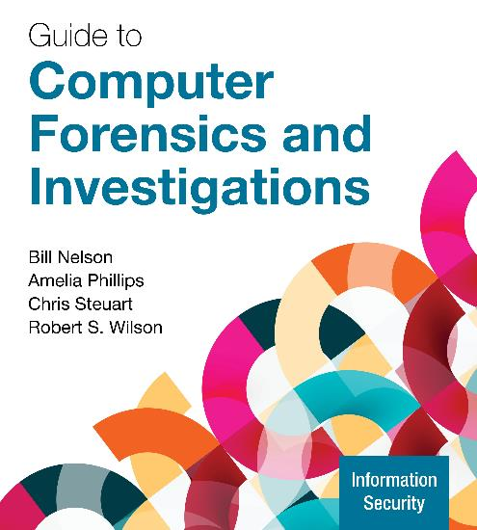
Guide to Computer Forensics and Investigations, 7e
Module 14: e-Discovery
Nelson/Phillips/Steuart/Wilson, Guide to Computer Forensics and Investigations, 7th Edition. ©2025 Cengage Learning, Inc. All Rights Reserved. May not be scanned, copied or duplicated, or posted to a publicly accessible website, in whole or in part.

Slide 2
Module Objectives
By the end of this module, you should be able to:
Describe e-discovery and its relationship to digital forensics
Explain the impact of case law on e-discovery
Outline the phases of Electronic Discovery Reference Model and the e-discovery case flow
List some common e-discovery tools

Slide 3
Overview of e-Discovery, Rules, and Policies
Digital data is often referred to as electronically stored information (ESI)
This refers to any information that is created or stored electronically
ESI can include data and metadata
Data refers generally to information, such as documents, spreadsheets, graphics, and email, stored on digital devices
Metadata refers to data about data
Optical character recognition (OCR) is a text-recognition technology used to convert handwritten or typed text into searchable characters

Slide 4
The Relationship between e-Discovery and Digital Forensics (1 of 2)
In e-discovery, one party will ask the opposing party for data specifically related to the subject of the litigation
In digital forensics, the investigator is typically looking for information related to a criminal matter, corporate espionage, or a civil suit
In e-discovery, the investigators know that they are looking for information related to a contract dispute, intellectual property rights, product defect, or false financial information
e-Discovery processes can be part of corporate lawsuits as well as civil, criminal, and bankruptcy cases

Slide 5
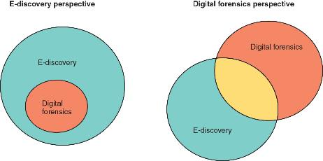
The Relationship between e-Discovery and Digital Forensics (2 of 2)
Figure 14-1 The relationship between e-discovery and digital forensics

Slide 6
Rules, Laws, and Regulations Impacting e-Discovery (1 of 2)
A wide range of rules, laws, and regulations influence e-discovery processes at the state and federal level
Today, many companies have offices in different states and countries
You must be aware of what laws are in effect when you are identifying and preserving data during e-discovery
In the US, many employers require employees to acknowledge that the company has the right to monitor company email accounts
This is not true in all countries, which can raise questions about what emails can and should be included in e-discovery

Slide 7
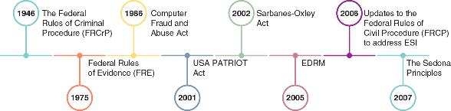
Rules, Laws, and Regulations Impacting e-Discovery (2 of 2)
Figure 14-2 Timeline of laws and developments related to e-discovery

Slide 8
Federal Rules (1 of 2)
The Federal Rules of Criminal Procedure (FRCrP) were established by the Supreme Court in 1944 and took effect in 1946
They were intended to standardize the methods used for criminal proceedings in all states
Rule 41 of the FRCrP addresses how evidence can be obtained in criminal investigations
Federal Rules of Evidence (FRE) went into effect in 1975 to ensure consistency in federal proceedings in both civil and criminal cases

Slide 9
Federal Rules (2 of 2)
The Federal Rules of Civil Procedure (FRCP) consist of 86 rules created in 1938 to provide “just, speedy and inexpensive” resolution of federal cases
Rule 34 of the FRCP was introduced in 1970 to include ESI as part of discoverable material
In 2006, the FRCP was updated to address additional issues related to ESI
Because of technology and case law changes, additional updates were made in 2016

Slide 10
Computer Fraud and Abuse Act
The Computer Fraud and Abuse Act (CFAA) was passed to expand the scope of computer crimes covered by federal law to include those related to the unauthorized access of networks and computers
It was passed in 1986
The CFAA became important as hackers became more active
e-Discovery is commonly used in CFAA cases

Slide 11
USA PATRIOT Act
The USA PATRIOT Act was passed into law on October 26, 2001, as a result of the terrorist attacks on September 11, 2001
Title II of this act expanded how digital evidence is collected and directly affects e-discovery
It expanded what data could be seized and expanded wiretap laws
Wiretaps could be used for a year, and they were allowed to follow the person, not the device

Slide 12
Sarbanes-Oxley Act (1 of 2)
The Sarbanes-Oxley Act was passed in 2002 after accounting scandals at companies such as Enron and WorldCom left employees unemployed and without their pensions
It addresses document and email retention
The act created the Public Company Accounting Oversight Board (PCAOB), a nonprofit organization

Slide 13
Sarbanes-Oxley Act (2 of 2)
The PCAOB has the following responsibilities:
Register accounting firms that audit companies
Perform inspections of registered accounting firms
Establish standards for auditing, ethics, and quality control of same
Investigate and discipline registered accounting firms for violations

Slide 14
International Laws and Regulations Related to e-Discovery
The United Nations Model Law was targeted to e-commerce investigations across multiple borders
It primarily addresses civil procedures
In 2011, Canada created its own best practices for e-discovery
The European Union created the General Data Protection Regulation (GDPR), which addresses the protection of its citizens’ PII (personal identifiable information) even when they are living in another country

Slide 15
The Sedona Principles
The Sedona Principles provide recommendations for managing e-discovery
They were published in 2007
They are comprised of 14 principles that map to the Federal Rules of Civil Procedure (FRCP)
They offer well-regarded guidelines and best practices for conducting e-discovery

Slide 16
The Impact of Case Law on e-Discovery
The body of law created by prior judicial decision regarding a particular legal issue is referred to as case law
In a common-law system, evolving case law can establish a precedent that may alter existing laws and practices
The United States and approximately 40% of the countries in the world use common law
In civil law nations, if a law specifically pertaining to the issues in dispute does not exist, the case cannot be tried

Slide 17
Case Law in the United States (1 of 2)
One example of the impact of case law in the United States is Olmstead v. United States
In this case, which took place in 1924, law enforcement wiretapped Olmstead’s phone without a warrant
The U.S. Supreme Court ruled in that case that obtaining evidence through the use of wiretapping without a warrant did not violate the defendant’s Constitutional rights
The outcome upheld the use of warrantless wiretapping

Slide 18
Case Law in the United States (2 of 2)
Another example of the impact of case law in the United States is Katz v. United States, which took place in 1967
This case raised the question: was there an expectation of privacy and was the expectation reasonable?
The Supreme Court ruled that Katz had a reasonable expectation of privacy when using an enclosed public phonebooth
They determined that the FBI violated his Constitutional rights because they did not obtain a warrant before recording his calls
This case overrode Olmstead and established a new precedent for interpreting the right to privacy under the Fourth Amendment

Slide 19
Legal Research Tools
Legal archivists and publishers were consolidated and became a company known now as LexisNexis
It began offering access to its legal database in the 1970s
In 1997, they launched an online search engine for legal and business research
In 1872, James West founded Westlaw
Which created the American Digest System to categorize cases by number and topic
They founded the Federal Reporter, which tracked rulings at the federal and circuit court levels

Slide 20
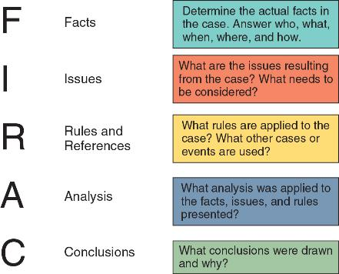
The FIRAC Method
Figure 14-4 FIRAC method
This method can be a useful tool for evaluating cases and determining their relevance to the specific issues you are facing as a digital forensics investigator.

Slide 21
Enron e-Discovery (1 of 2)
Several factors led to the collapse of Enron Corporation including:
Deregulation in the energy trading sector
The use of mark-to-market accounting method, which is easier to manipulate and harder to track
These factors allowed top executives to hide the company’s debt and ongoing losses
More than 20,000 people lost their jobs and Enron employees and retirees lost over $3 billion from their retirement and pension funds

Slide 22
Enron e-Discovery (2 of 2)
The e-discovery process followed in the Enron case holds an example of what can go wrong
PII included in many documents was not protected and made public
The database of Enron emails was available to the public for several years before it was sanitized and re-released
Many lawsuits resulted from the disclosure of the personal information
The lawsuits brought heightened awareness of some of the sensitive issues that must be considered as part of e-discovery

Slide 23
Knowledge Check Activity 14-1
Case law applies in which of the following?
Civil-law nations
Religious-law nations
Common-law nations
None of these choices

Slide 24
Knowledge Check Activity 14-1: Answer
Case law applies in which of the following?
Answer: c. Common-law nations
Common-law nations use case law, which refers to the body of law created by prior judicial decisions regarding a particular legal issue. In civil-law nations, if a law specifically pertaining to the issues in dispute does not exist for a particular crime, the case cannot be tried.

Slide 25
EDRM and e-Discovery Case Flow (1 of 2)
The Electronic Discovery Reference Model (EDRM) is a conceptual framework created to address how to process ESI in a legal case or investigation
The current model is shown on the following slide
It was created specifically for e-discovery and a large international group maintains the model
It was developed to ensure ESI makes its way to court in both civil and criminal cases

Slide 26
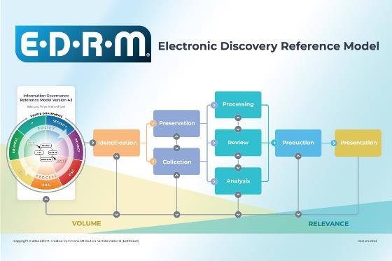
EDRM and e-Discovery Case Flow (2 of 2)
Figure 14-11 Electronic Discovery Reference Model (EDRM)

Slide 27
Information Governance Reference Model (1 of 2)
The Information Governance Reference Model (IGRM) is a framework and set of guidelines to help companies manage their information resources
It feeds into the steps of the EDRM
IGRM addresses stakeholders and factors that impact information governance, including users, security, privacy, legal, and risk
Information governance refers to an organization’s framework and guidelines for managing its information resources

Slide 28
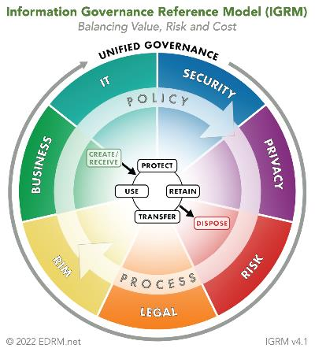
Information Governance Reference Model (2 of 2)
Figure 14-12 Information Governance Reference Model (IGRM)

Slide 29
Stages of the EDRM (1 of 4)
The EDRM has the following eight stages:
Identification
Preservation
Collection
Processing
Review
Analysis
Production
Presentation

Slide 30
Stages of the EDRM (2 of 4)
Identification and preservation may begin before a legal case has started
When an organization is notified it may be involved in a lawsuit, it’s legal team should issue a litigation hold
A litigation hold informs employees that they must stop overwriting backups, deleting files, and performing other tasks that could destroy evidence related to an anticipated litigation
Information gathered during the collection stage must be readily accessible as well as legally defensible, meaning it will stand up to a challenge in court

Slide 31
Stages of the EDRM (3 of 4)
During the processing, review, and analysis stage, redaction and deduplication work occurs
Deduplication reduces the amount of data included as part of e-discovery by identifying and removing duplicate documents, emails, and other types of data
After data has been retrieved, the files need to be scanned for viruses
Documents that include content that is covered by attorney-client privilege or is an attorney work product must be removed unless the client grants permission to include them
A log of withheld documents must be kept

Slide 32
Stages of the EDRM (4 of 4)
The review and analysis processes continue as the team moves into the production phase, which involves generating the ESI in the manner agreed upon
The final phase of the EDRM model is the presentation phase
Presentation may occur at a deposition or hearing, during mediation, or at a trial with a judge and jury present

Slide 33
Common e-Discovery Tools (1 of 4)
e-Discovery software can be quite expensive for the enterprise level
Forensics software can be used in some e-discovery cases
The desired outcomes are not always the same
Digital forensics software acquires the data, searches for deleted data, validates data using hash values, and preserves evidence
e-Discovery software typically does not look for deleted files

Slide 34
Common e-Discovery Tools (2 of 4)
Logickull performs redactions at the bulk level and on PII
It searches on key terms, names, emails, and other items
Digital WarRoom has a free trial version and is geared to law firms
Nextpoint is cloud-based software used by legal teams for all items leading up to presentation
It uses data analytics to help expedite data search and retrieval
CaseFleet analyzes evidence and identifies connections that might be otherwise missed

Slide 35
Common e-Discovery Tools (3 of 4)
iConect offers an e-discovery platform that has components related to government, incident response, and data governance
Ipro and Everlaw are web-based e-discovery products
Discovery Attender and Sherpa Software were acquired by Gimmal
Sherpa was known for its information governance and adherence to the GDRP and the California Consumer Privacy Act
Discovery Attender is an e-discovery tool that can be used in-house by small businesses

Slide 36
Common e-Discovery Tools (4 of 4)
Exterro’s e-discovery software is purely cloud based
It does an application-level hold, which allows you to look specifically at Google Drive, OneDrive, SharePoint, and similar resources
Within Extero, each person is listed along with their role and what they have access to in the organization’s data structure
Extero uses OCR to search PDF documents and other scanned items
Applications such as Slack, Discord, and other social media and chat applications can be searched

Slide 37
Knowledge Check Activity 14-2
What must happen as part of a litigation hold?
Company A employees cannot speak with company B employees.
All digital work must stop.
Some regular processes, such as overwriting backups must cease.
The opposing lawyers cannot speak to each other.

Slide 38
Knowledge Check Activity 14-2: Answer
What must happen as part of a litigation hold?
Answer: c. Some regular processes, such as overwriting backups must cease.
When a litigation hold is issued, employees must stop overwriting backups, deleting files, and performing other tasks that could destroy evidence related to an anticipated litigation.

Slide 39
Self Assessment
What are the eight stages of the EDRM model?
What are some differences between digital forensics software and e-discovery software?

Slide 40
Summary
Now that the lesson has ended, you should be able to:
Describe e-discovery and its relationship to digital forensics
Explain the impact of case law on e-discovery
Outline the phases of Electronic Discovery Reference Model and the e-discovery case flow
List some common e-discovery tools

