Slide 1
Chapter 1: Fulfilling Pre-ATT&CK Objectives

Slide 2
What is MITRE Pre-ATT&CK
Originally a standalone matrix
Now merged into Reconnaissance and Resource Development (2020)
Focuses on attacker preparation before exploitation

Slide 3
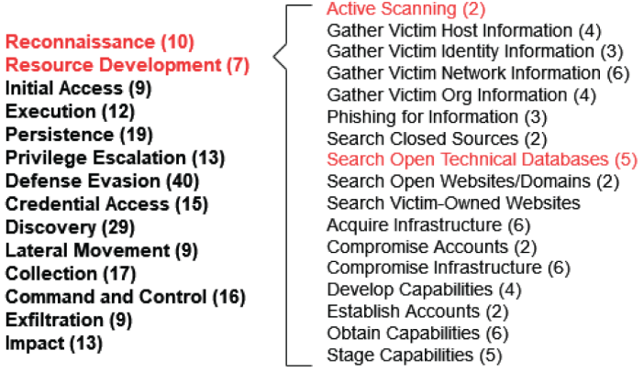
What is MITRE Pre-ATT&CK
Let’s talk about this process
Foundation of cyberattacks

Slide 4
Importance of Reconnaissance
Attackers gather intelligence before exploitation
Defenders must anticipate and detect reconnaissance

Slide 5
Why Python for Scripting?
Popular and widely used
Easy to learn (you should be familiar with Python) and implement
Powerful libraries (scapy, dnspython, dnslib)

Slide 6
Active vs Passive Reconnaissance
Active: Direct interaction with targets (scanning)
Passive: Collecting publicly available information
Active Recon is more detectable but reveals deeper insights

Slide 7
Active Scanning in MITRE ATT&CK
Identifies active IPs, services, vulnerabilities
Common techniques: Port and Vulnerability Scans
MITRE categorizes it under Reconnaissance

Slide 8
SYN Scan Theory
Uses TCP 3-way handshake
SYN → SYN/ACK = Open Port
SYN → RST/ACK or Timeout = Closed/Filtered

Slide 9
Python Example: PortScan.py
Implements SYN and DNS scans
Uses scapy for packet crafting
Scans common ports (25, 80, 53, 443, 445, 8080, 8443)

Slide 10
DNS Scan with scapy
Checks if DNS server is active on port 53
Uses DNS queries (qd = DNSQR)
Quick way to identify DNS servers in target network

Slide 11
Demo Output
Example: 8.8.8.8 (Google DNS)
Open ports: 53, 443
DNS Server at 8.8.8.8

Slide 12
Introducing HoneyScan
Defensive tool to mislead attackers
Makes closed ports look open, open look closed
Redirects traffic to honeypots

Slide 13
How HoneyScan Works
Monitors traffic with sniff()
Analyzes packets with analyzePackets()
Crafts deceptive responses (RST/ACK, SYN/ACK)

Slide 14
Limitation of HoneyScan
Race conditions (legit system vs HoneyScan)
Best run inline on firewall/IPS
Still useful to delay and trap attackers

Slide 15
Passive Reconnaissance
No direct interaction with target
Takes advantage of public data (DNS, WHOIS, etc.)
Less detectable than active scanning

Slide 16
DNS as a Goldmine
Maps domain names to IPs
Subdomain enumeration reveals services
Reverse lookups reveal hidden relationships

Slide 17
Python Example: DNSExploration.py
Uses dnspython library
Performs subdomain lookups
Performs reverse DNS queries

Slide 18
Default Subdomains Table
www, mail, vpn, ftp, admin, smtp
Common naming conventions reveal purpose
HostSearch brute-force with dictionary + numbers

Slide 19
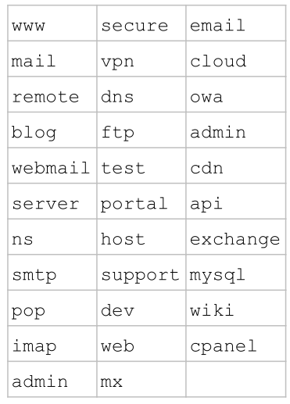
Default Subdomains Table
Some organization might use slight variations e.g.
ns1.example.com
ns2.example.com

Slide 20
Introducing HoneyResolver
DNS server deception tool
Returns real IPs for valid subdomains
Redirects others to honeypot IP

Slide 21
How HoneyResolver Works
Implements Resolver class in dnslib
Valid subdomain = real IP
Invalid subdomains = honeypot

Slide 22
Key Takeaways
Reconnaissance = Foundation of Cyberattacks
Python enables both offensive and defensive automation
HoneyScan and HoneyResolver provide deception capabilities

Slide 23
Going Above and Beyound
The SYNScan function in PortScan.py currently checks only if a port is open, based on if it returns a SYN/ACK packet. Modify the code to differentiate between closed ports (which return a RST) and ports filtered by a firewall (which return nothing).

Slide 24
Going Above and Beyound
Currently, PortScan.py implements SYN and DNS scans. Modify it to include additional types of scans, such as ACK and XMAS scans.

Slide 25
Going Above and Beyound
Revise DNSExploration.py to group results by IP address rather than domain name. This helps to identify systems with multiple functions within an organization.

Slide 26
Going Above and Beyound
Currently HoneyResolver.py makes it easy to differentiate real and fake results because all fake results resolve to the same IP address. Modify the code to only resolve certain fake subdomains with unique IP addresses assigned to each.

Slide 27
Going Above and Beyound
HoneyResolver.py only sends responses containing A records, which are inappropriate for some requests. Extend the code to send the correct type of record for each request.

