Slide 1
Chapter 1: Fulfilling Pre-ATT&CK Objectives

Slide 2
What is MITRE Pre-ATT&CK
Originally a standalone matrix
Now merged into Reconnaissance and Resource Development (2020)
Focuses on attacker preparation before exploitation

Slide 3
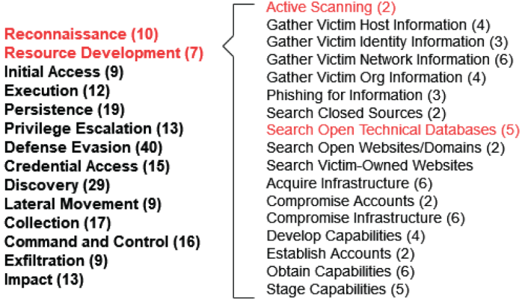
What is MITRE Pre-ATT&CK
Let’s talk about this process
Foundation of cyberattacks

Slide 4
Importance of Reconnaissance
Attackers gather intelligence before exploitation
Defenders must anticipate and detect reconnaissance

Slide 5
Why Python for Scripting?
Popular and widely used
Easy to learn (you should be familiar with Python) and implement
Powerful libraries (scapy, dnspython, dnslib)

Slide 6
Active vs Passive Reconnaissance
Active: Direct interaction with targets (scanning)
Passive: Collecting publicly available information
Active Recon is more detectable but reveals deeper insights

Slide 7
Active Scanning in MITRE ATT&CK
Identifies active IPs, services, vulnerabilities
Common techniques: Port and Vulnerability Scans
MITRE categorizes it under Reconnaissance

Slide 8
SYN Scan Theory
Uses TCP 3-way handshake
SYN → SYN/ACK = Open Port
SYN → RST/ACK or Timeout = Closed/Filtered

Slide 9
Python Example: PortScan.py
Implements SYN and DNS scans
Uses scapy for packet crafting
Scans common ports (25, 80, 53, 443, 445, 8080, 8443)

Slide 10
DNS Scan with scapy
Checks if DNS server is active on port 53
Uses DNS queries (qd = DNSQR)
Quick way to identify DNS servers in target network

Slide 11
Demo Output
Example: 8.8.8.8 (Google DNS)
Open ports: 53, 443
DNS Server at 8.8.8.8

Slide 12
Introducing HoneyScan
Defensive tool to mislead attackers
Makes closed ports look open, open look closed
Redirects traffic to honeypots

Slide 13
How HoneyScan Works
Monitors traffic with sniff()
Analyzes packets with analyzePackets()
Crafts deceptive responses (RST/ACK, SYN/ACK)

Slide 14
Limitation of HoneyScan
Race conditions (legit system vs HoneyScan)
Best run inline on firewall/IPS
Still useful to delay and trap attackers

Slide 15
Passive Reconnaissance
No direct interaction with target
Takes advantage of public data (DNS, WHOIS, etc.)
Less detectable than active scanning

Slide 16
DNS as a Goldmine
Maps domain names to IPs
Subdomain enumeration reveals services
Reverse lookups reveal hidden relationships

Slide 17
Python Example: DNSExploration.py
Uses dnspython library
Performs subdomain lookups
Performs reverse DNS queries

Slide 18
Default Subdomains Table
www, mail, vpn, ftp, admin, smtp
Common naming conventions reveal purpose
HostSearch brute-force with dictionary + numbers

Slide 19
Introducing HoneyResolver
DNS server deception tool
Returns real IPs for valid subdomains
Redirects others to honeypot IP

Slide 20
How HoneyResolver Works
Implements Resolver class in dnslib
Valid subdomain = real IP
Invalid subdomains = honeypot

Slide 21
Key Takeaways
Reconnaissance = Foundation of Cyberattacks
Python enables both offensive and defensive automation
HoneyScan and HoneyResolver provide deception capabilities

