Slide 1
Grappa on Scale-Out NUMA for In-Memory Data-Intensive Applications

Slide 2
Introduction
Bird's eye view of Grappa and soNUMA
Incorporation
Grappa Background
soNUMA Background
Implementation
Pitfalls
Future Work

Slide 3
Introduction
Grappa
- Software Distributed Shared Memory
- Cluster, programmed as single, large, NUMA machine
- Designed for data intensive applications
soNUMA
- Low latency, distributed in-memory processing
- RDMA on top of NUMA via stateless messaging protocol
- Interactions done through RMC

Slide 4
Incorporation
Leverage Grappa on viewed as single node in a soNUMA model
Utilize soNUMA as commodity network with soNUMA nodes as Grappa DSM
Measure latency between soNUMA nodes (currently one-sided primitives remote read/write, no latency numbers yet)
Goal is to run more in-memory data-intensive applications (still in progress)

Slide 5
1.
Grappa
https://www.usenix.org/conference/atc15/technical-session/presentation/nelson

Slide 6
Grappa - Background
DSM 25 years ago were using the same techniques to scale up for single nodes, exploiting locality
Apps were compute-focused and coarse-grained
Paging hardware for cache hit (large cache blocks)

Slide 7
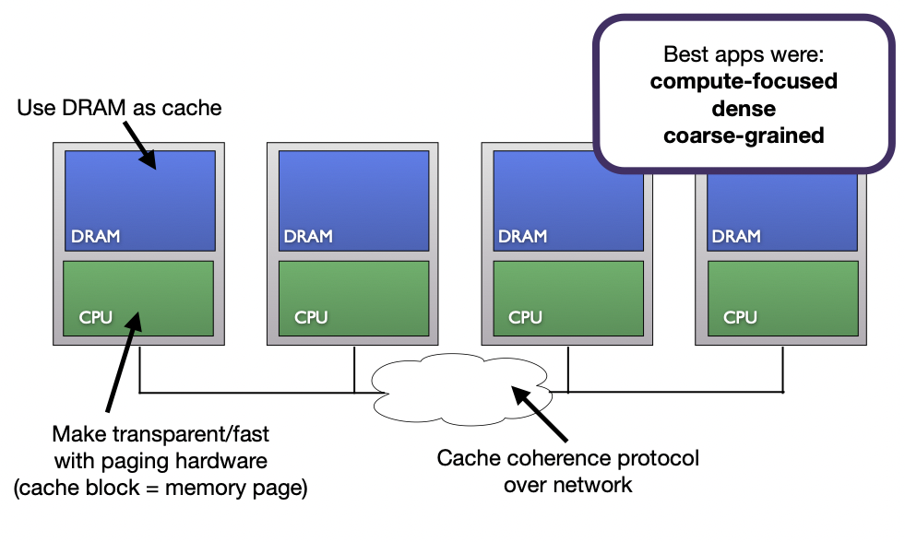

Slide 8
Grappa - Background
DSM are now data-intensive focus for their applications
Data access is the bottleneck, not computation anymore
Locality is hard to find in data accesses
Grappa supports data-intensive applications, low level infrastructure doesn't have to optimizes POSIX API - 3 challenges

Slide 9
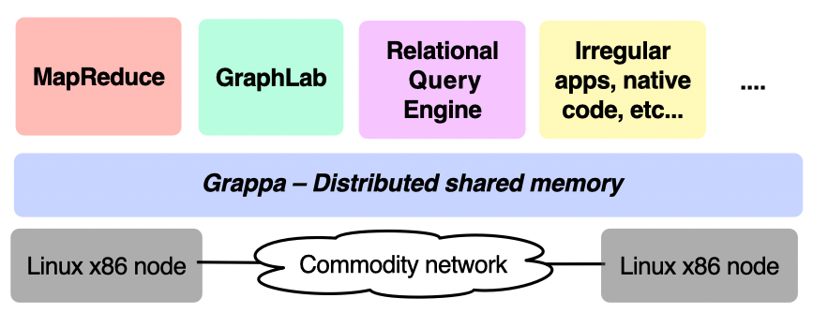
Lack of Locality -> Use parallelism to hide latency
Small Messages -> Trade latency for more throughput
Small Tasks -> Make context switching fast

Slide 10
Grappa - Core Features
DSM: Provides fine-grain access to data anywhere in the system with strong consistency guarantees
Tasking System: Supports million of lightweight threads and global distributed work stealing for load balancing
Communication Layer: Supports high throughput even for extremely small messages by delaying and aggregating them into larger network packets

Slide 11
2.
soNUMA
https://dl.acm.org/doi/pdf/10.1145/2541940.2541965

Slide 12
soNUMA - Background
Datasets are kept in DRAM to minimize latency
Server-to-server communications ~ 100 microsec, while local memory ~ 60ns
Irony: moving data from disk to main memory is faster than distributing the memory
RDMA reduces communication latency but still >10x over local DRAM operations

Slide 13
soNUMA - Background
soNUMA relies on RMC
soNUMA use stateless request/reply protocol running over a NUMA memory fabric
Integrate the protocol controller into the node's local coherence hierarchy (avoids PCIe replications + data movement)

Slide 14
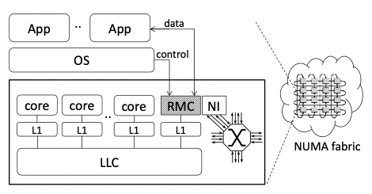

Slide 15
soNUMA - Contribution
RMC - operations converted into a set of stateless requests and replies
Exposed through lightweight libraries, implementing communications and synchronized primitives
soNUMA achieve latiences within a small factor of local DRAM

Slide 16
3.
Implementation

Slide 17
Initial Set Up
Debian w/ Xen Hypervisor
Nested virtualization, Type-1 hypervisor, each VM ran an instance of Debian Weezy
soNUMA
Required xen hypervisor, implemented one-side primitives, currently at two nodes
Linux Kernel
soNuma needs version 4.12.1 with patches for R_X86_64_PLT32 and -fno-pie for KBUILD_CFLAGS and xen configurations
Grappa
Set up according to github. This will need to be done for each soNUMA node.
Running soNUMA
Create .cfg for xen hypervisor for and run VMs using paravirtualization while installing Grappa on each
Micro-Benchmarks
CPP implementations,
one-sided primitives for read/write remote memory using sync/async ops

Slide 18
Implementation
RMC is used in software (no available hardware)
RMC mapped to VCPU to distinct NUMA domains
Lots of overhead, due to emulation and nested virtualization
Primitive send and receive between two nodes
Grappa on top of each VM

Slide 19
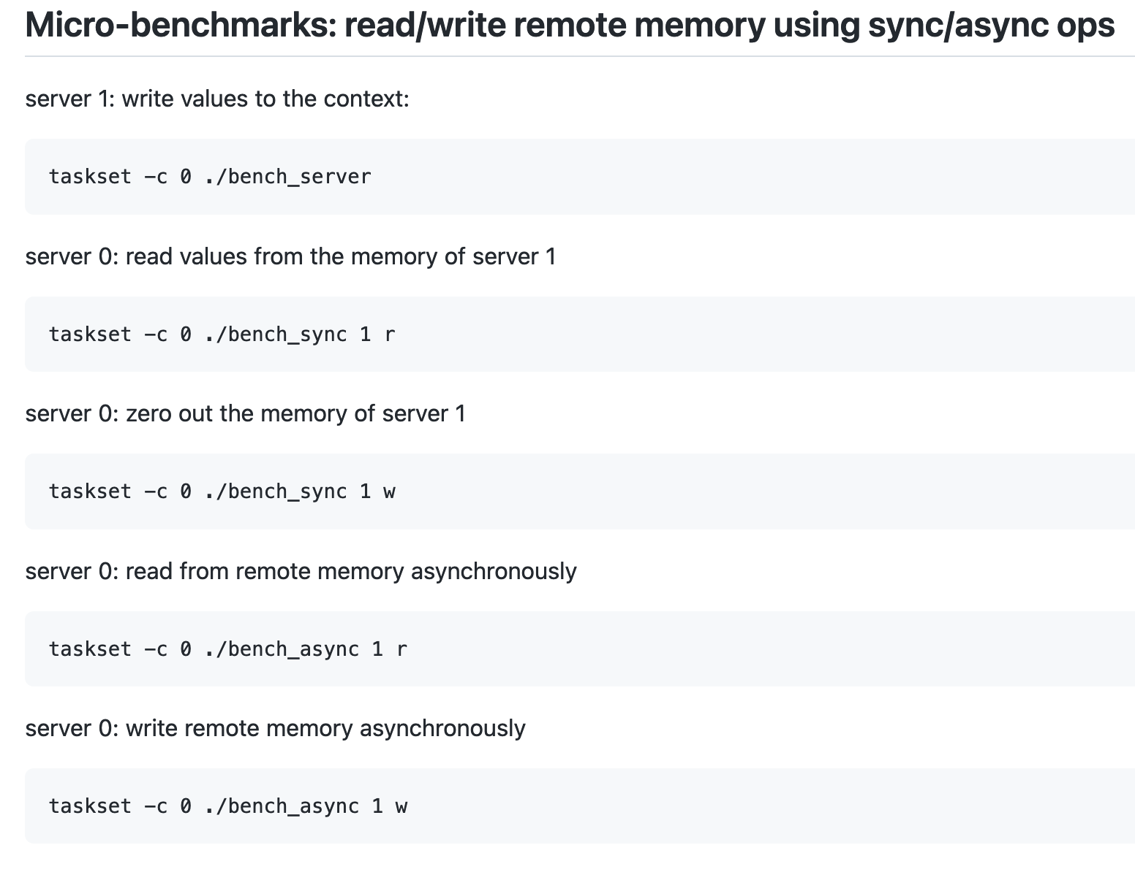
Implementation

Slide 20
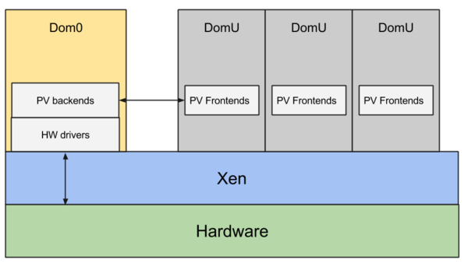
Implementation

Slide 21
Implementation
Grappa on top of each VM
Grappa has multiple data intensive benchmarks that will be run before the paper submission
After running data intensive applications, send to remote machine

Slide 22
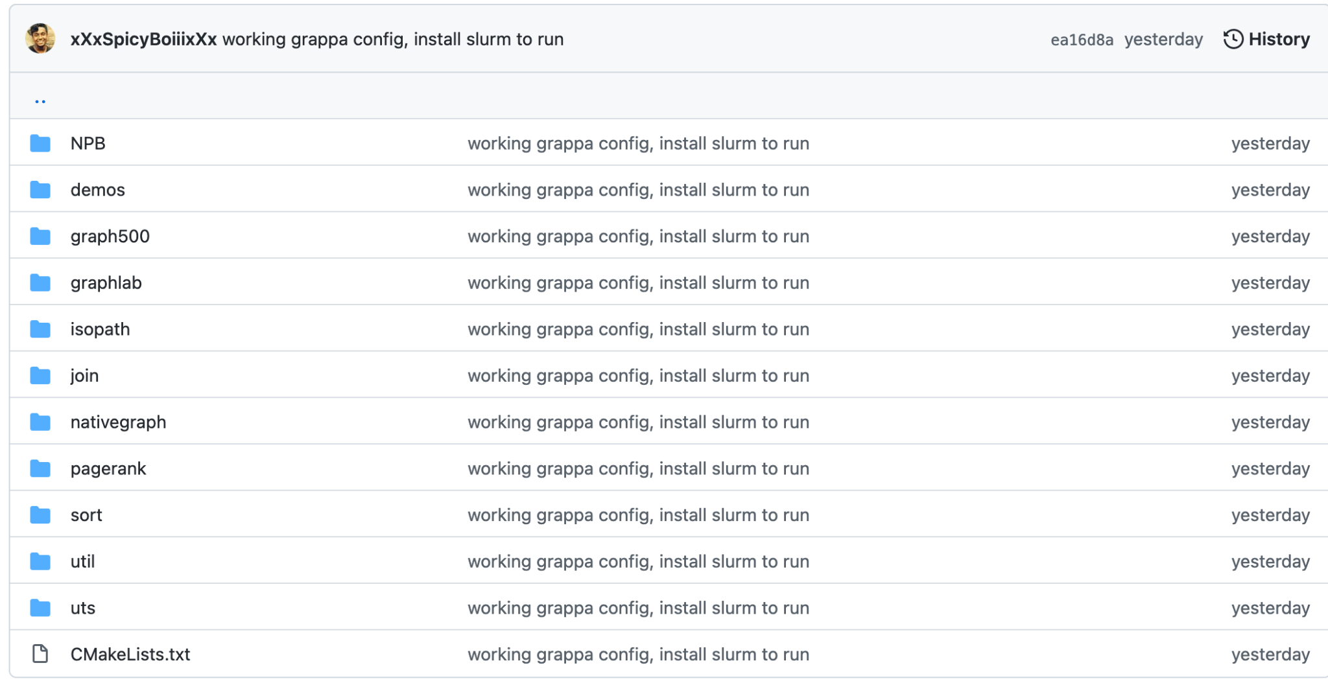
Data Intensive Applications

Slide 23
Pitfalls
Code rot
Communicating between nodes in soNUMA
Memory usage in Grappa within applications
Latency due to multiple layers of emulations/virtualization

Slide 24
Future Work
Implementation of Coalscent Computing environment
Communication latency is important
Can this proposed system be viable for IoT devices

Slide 25
Conclusion
Grappa
soNUMA
Implementation of Grappa on top of soNUMA
Primitive benchmarks for this system
Pitfalls
Future work

Slide 26

Thanks!
Any questions?
mali54@hawk.iit.edu

