Slide 1
Nonparametric Techniques
Huynh Trung Hieu

Slide 2
Introduction
Fundamental techniques
Parzen Windows
Nearest Neighbors

Slide 3

Introduction
Neither probability distribution nor discriminant function is known
All we have is labeled data
=> Estimate the probability distribution from the labeled data

Slide 4
Introduction
Parametric methods– known “forms of the density functions”
The sad part → in most PR applications this assumption is NOT sure
What is needed → to examine nonparametric procedures/techniques
  that can be used with arbitrary distributions, and
  without the assumption that the forms of density functions are known

Slide 5
Introduction
Nonparametric techniques:
  Parzen windows:
  => Estimate likelihood p(x|C_{j})
  Nearest neighbors
  => Bypass likelihood and go directly to posterior estimation p(x|C_{j})

Slide 6
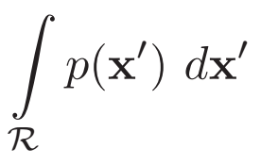
Introduction
Nonparametric techniques: Attempt to estimate the underlying density functions from the training data
  Idea: the more data in a region, the larger is the density function
p(x)
x
Avarage of p(x) on R
P_{r}(xЄR)=

Slide 7
Introduction
P_{r}(xЄR)=
How can we estimate P_{r}(xЄR₁), P_{r}(xЄR₂)?
=>????
The density curves above R1 and R2 are equally high?
  No, since R1 smaller than R2
  To get density, normalize by region size
p(x)
R₁
R₂
x

Slide 8
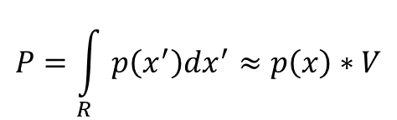
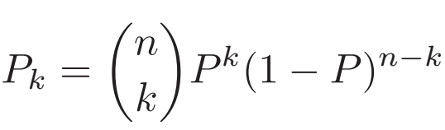

Fundamental techniques
The fundamental techniques
  The fact that: the probability P that a vector x will fall in a region R
P is smoothed/averaged version of density function p(x)➔ p can be estimated by estimating P
If k of n i.i.d samples are drawn to fall in R → probability follows the binomial law
The expected value for k

Slide 9
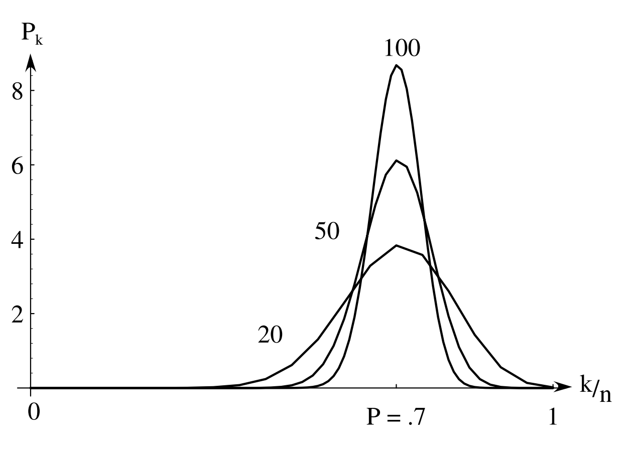
Density Estimation
The probability Pk of finding k patterns in a volume where the space averaged probability is P as a function of k/n. Each curve is labelled by the total number of patterns n. For large n, such binomial distributions peak strongly at k/n = P (here chosen to be 0.7)
the ratio k/n will be a very good estimate for the probability P

Slide 10
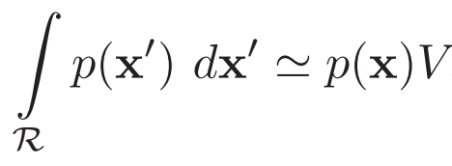
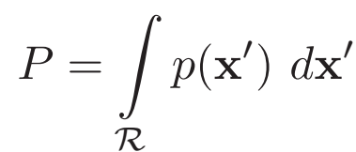
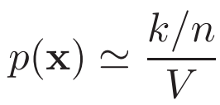
Density Estimation
For continuous p(x); very small R, p does not vary appreciably within R

Slide 11
Density Estimation
p(x)
₁₀
₄₀
₅₀
x
R₁
R₂
R₃
p(x)=5/16/10
p(x)=3/16/30
p(x)=8/16/10
If regions R_{i}‘s do not overlap, we have a histogram

Slide 12
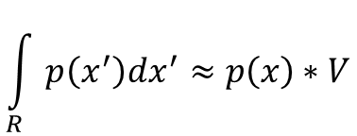
Density Estimation
Problem with:
How accurate is density approximation?
Two approximations:
  k/n → converge (in probability): as n increase, this estimate becomes more accurate.
  , as R shrinks smaller, the estimate
  becomes more accurate. As we shrink R we have to make sure it contains samples, otherwise our estimated p(x) = 0 for all x in R

Slide 13
Density Estimation
Thus in theory, if we have an unlimited number of samples, to we get convergence as we simultaneously increase the number of samples n, and shrink region R, but not too much so that R still contains a lot of samples

Slide 14
Density Estimation
In practice, the number of samples is fixed.
Thus, an available option is to decrease the size of R (V).
  If V is too small, p(x)=0 for most x, because most regions will have no samples
  => Have to find a compromise V
    not too small so that it has enough samples
    but also not too large so that p(x) is approximately constant inside V

Slide 15
Density Estimation
Parzen Windows
  Choose a fixed value for volume V and determine the corresponding k from the data.
K-nearest neighbors
  Choose a fixed value for k and determine the corresponding
  volume V from the data
Both the methods converge, BUT
Their finite-sample behavior can’t be easily predicted

Slide 16
Parzen Windows
The size and shape of region R are fixed
Let us assume that the region R is a d-dimensional hypercube with side length h thus it’s volume is h^{d}
1 dimension
2 dimensions
3 dimensions

Slide 17
Parzen Windows
To estimate the density at point x, simply center the
region R at x, count the number of samples in R, and substitute everything in our formula
p(x)
R
x
_{P(x)=5/18/10}

Slide 18
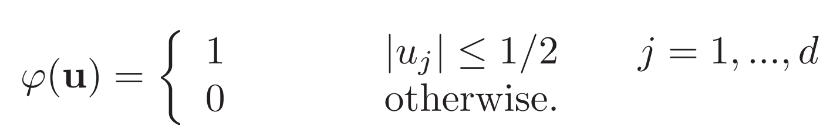
Parzen Windows
Let us define a window function
u2
φ(u)
u1
u

Slide 19
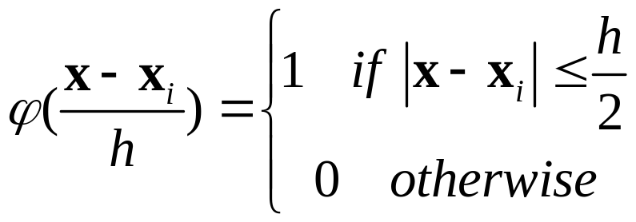
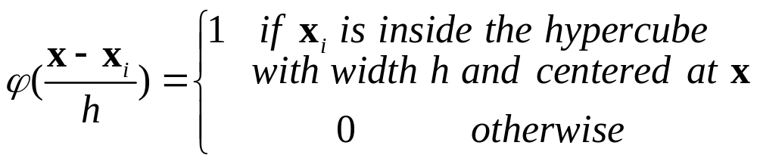
Parzen Windows
If we have samples x₁, x₂,…, x_{n}
then
x
x_{i}

Slide 20
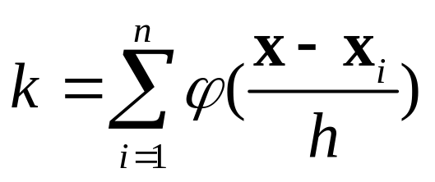
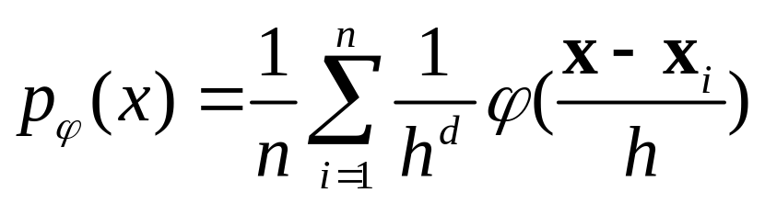
Parzen Windows
How do we count the total number of sample points
x₁, x₂,…, x_{n} which are inside the hypercube with
size h and centered at x
we also have
Thus, the estimation of density:

Slide 21
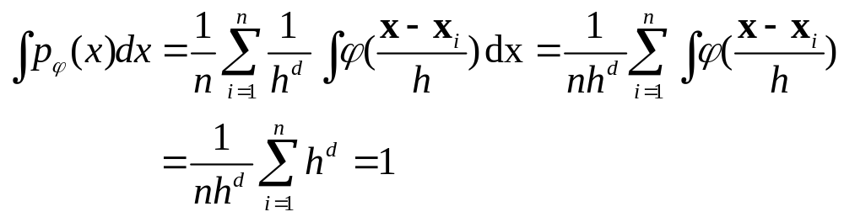
Parzen Windows
Is it a density?
  p_{φ}(x)>=0 Ɐx

Slide 22
Parzen Windows
Example: Assume that we have 8 samples:
D={2, 2, 3, 4, 9, 13, 14, 15}
Let window width h=3, estimate density at x=1?

Slide 23
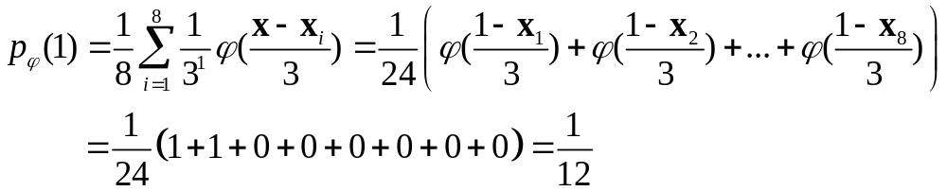
Parzen Windows
D={2, 2, 3, 4, 9, 13, 14, 15}
p_{φ}(x)
1/12
1
2
3
4

Slide 24
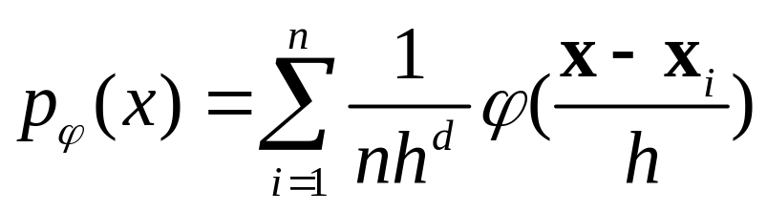
Parzen Windows
1 inside square centered at x_{i}
0 otherwise
Thus p_{φ}(x) is just a sum of n “box like” functions each of height 1/(nh^{d})

Slide 25
Parzen Windows
D={2, 2, 3, 4, 9, 13, 14, 15}
p_{φ}(x)
1/12
1
2
3
4
We need to generate 8 boxes and add them up
The width is h=3 and the height is 1/(nh^{d})=1/24

Slide 26
Parzen Windows
p_{φ}(x)
1/12
1
2
3
4
In essence, the window function φ is used for interpolation: each sample x_{i} contributes to the resulting density at x if x is close enough to x_{i}

Slide 27
Parzen Windows
Drawbacks of Hybecube φ
  As long as sample x_{i} and x are in the same hypercube, the contribution of x_{i} to the density at x is constant, regardless of how close x_{i} is to x.
  The resulting density p_{φ}(x) is not smooth, it has discontinuities.
x₁
x
x₂
p_{φ}(x)

Slide 28
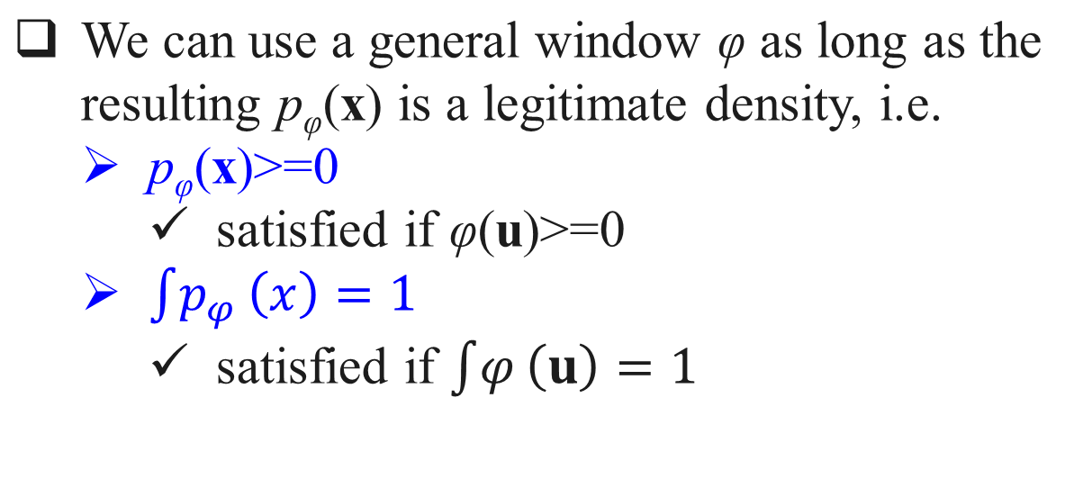
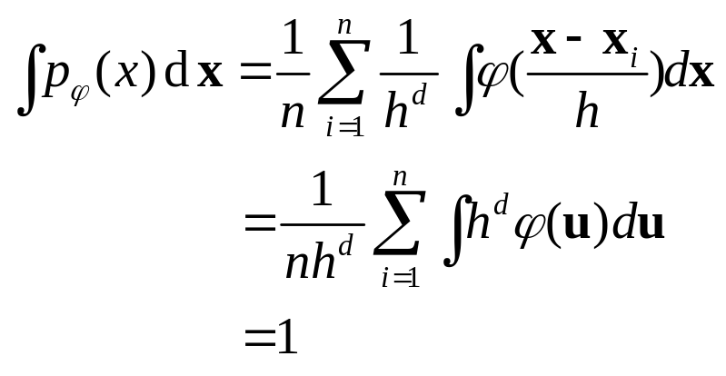

Parzen Windows: General φ
φ₂(u)
φ₁(u)
u

Slide 29
Parzen Windows: General φ
We are no longer counting the number of samples inside R.
We are counting the weighted average of potentially every single sample point
φ₂(u)
φ₁(u)
u

Slide 30
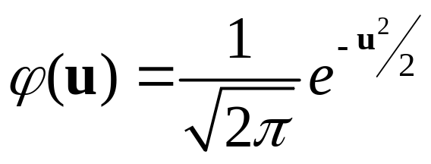
Parzen Windows: General φ
Popular choice for φ if N(0,1) density
φ(u)
u

Slide 31
Parzen Windows: General φ
φ(u)
u
Solves both drawbacks of the “box” window:
  Points x which are close to the sample point x_{i} receive higher weight
  Resulting density p_{φ}(x) is smooth

Slide 32
Parzen Windows
p_{φ}(x)
1/12
1
2
3
4
p_{φ}(x) is the sum of 9 Gaussians, each centered at one of the sample points, and each scaled by 1/9

Slide 33
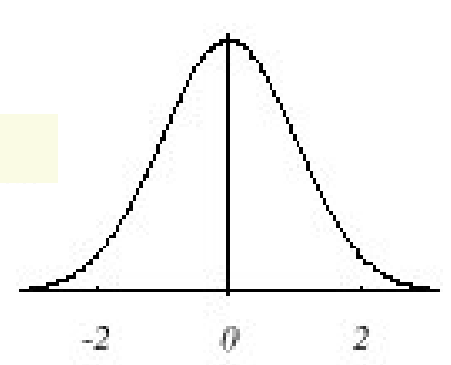
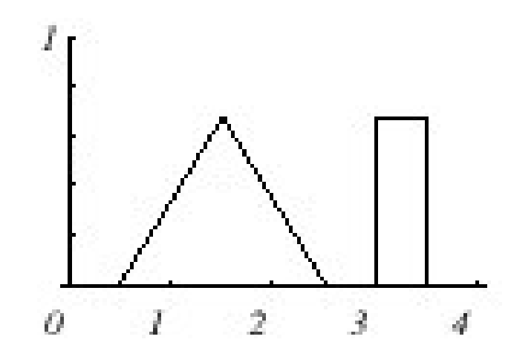

Parzen Windows
Let’s test if we solved the problem
  Draw samples from a known distribution
  Use our density approximation method and compare with the true density
We will vary the number of samples n and the window size h
We will play with 2 distributions:
N(0,1)
triangle and uniform mixture

Slide 34
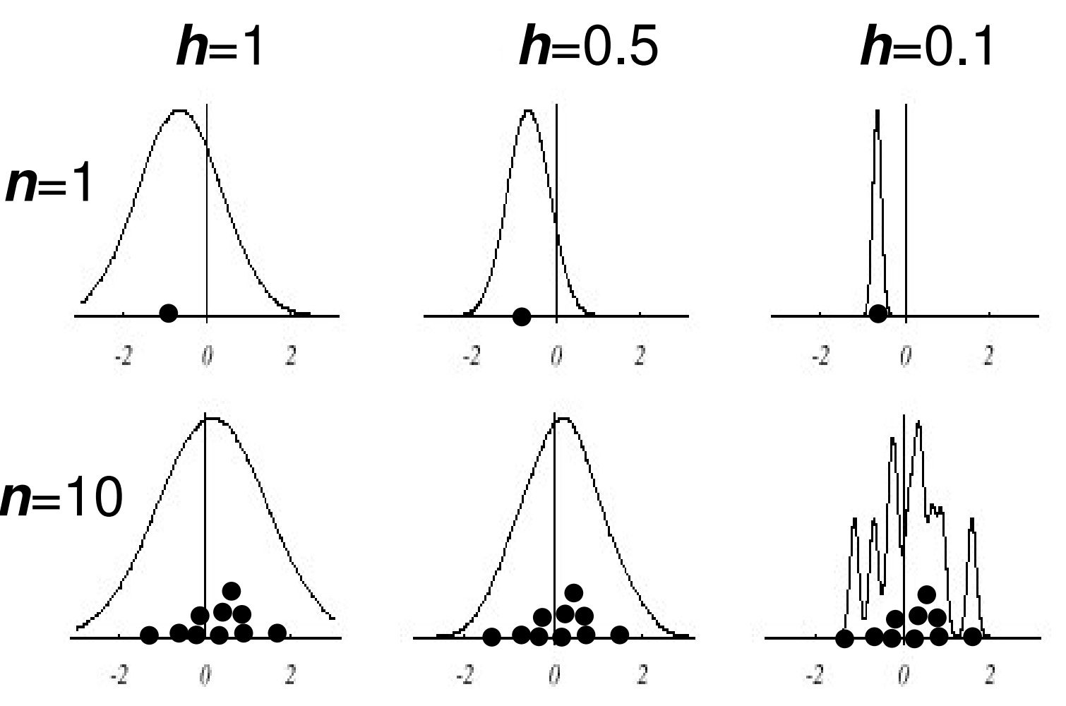
Parzen Windows: True density N(0,1)

Slide 35
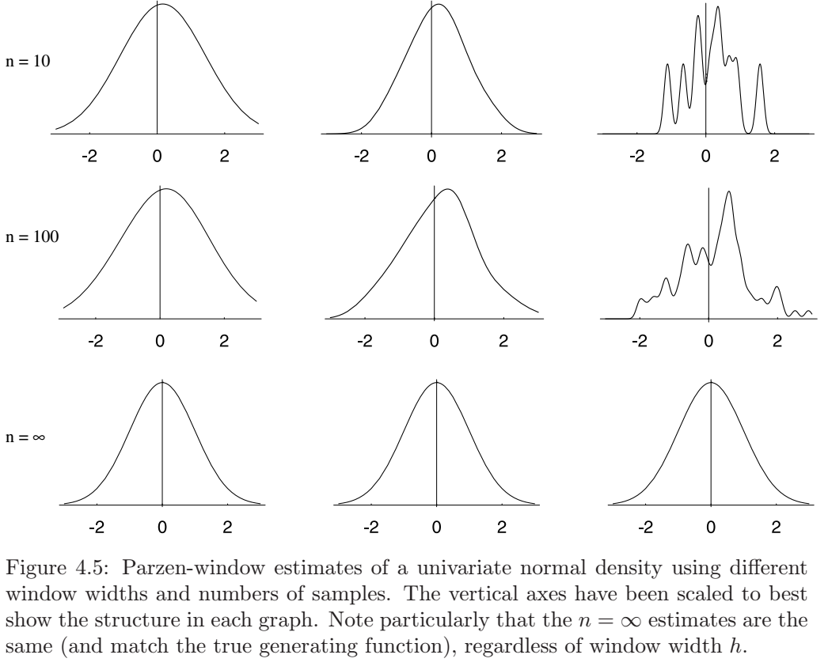
Parzen Windows: True density N(0,1)

Slide 36
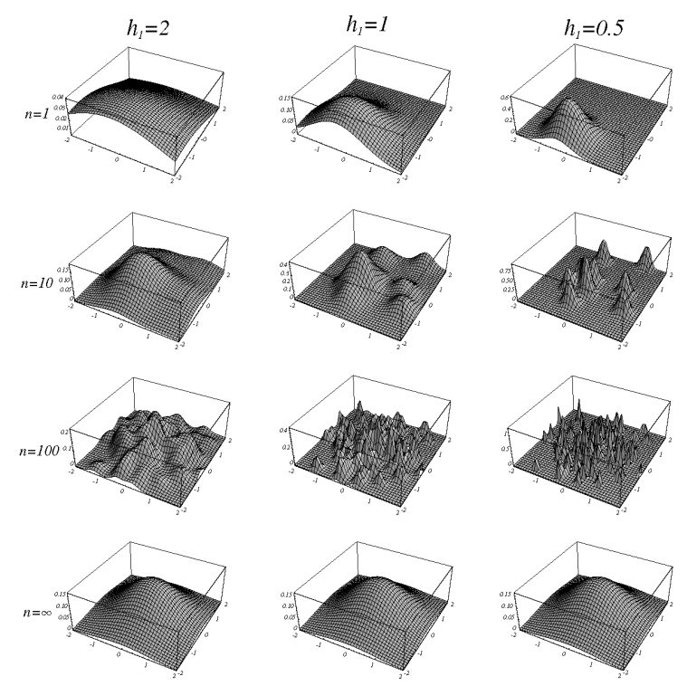
Parzen Windows

Slide 37
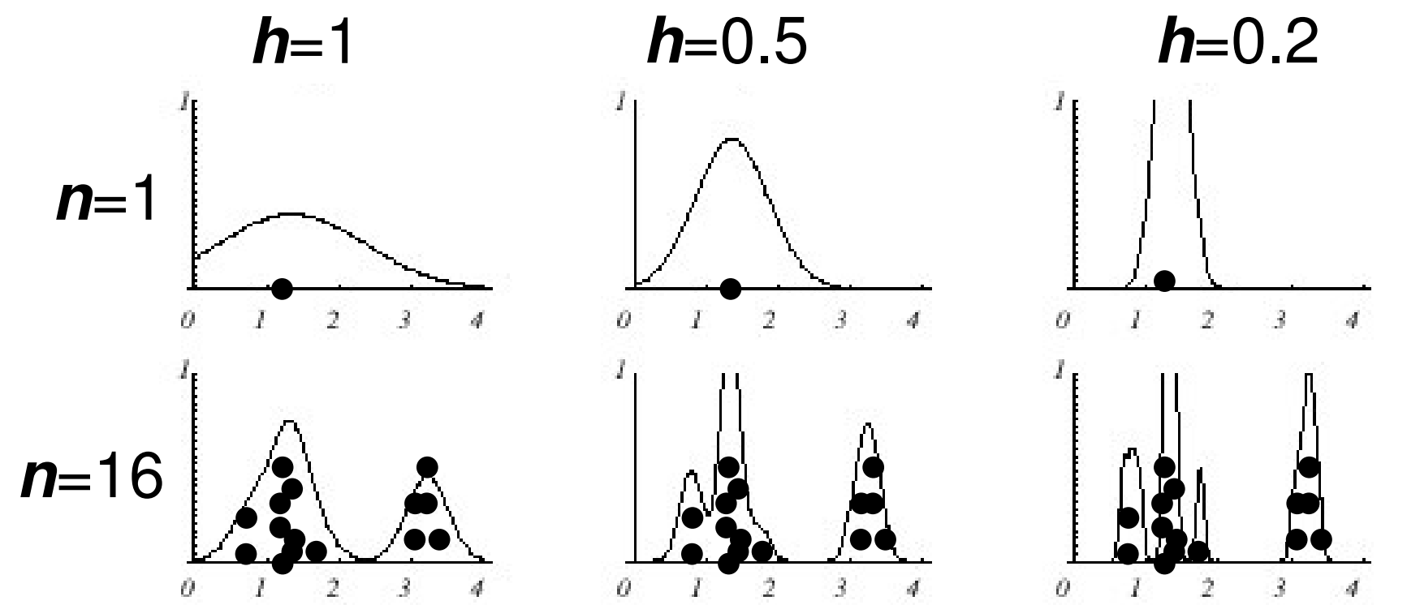
Parzen Windows: triangle and uniform mixture

Slide 38
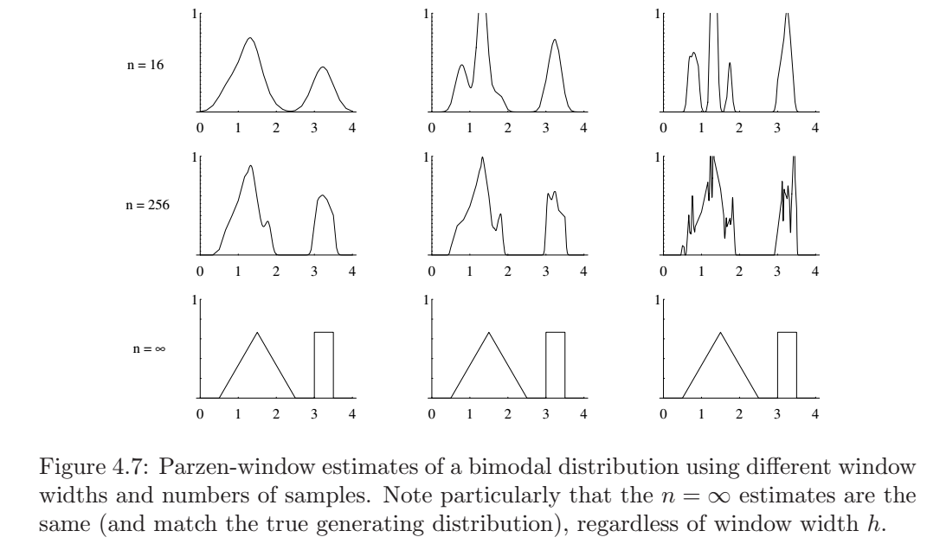
Parzen Windows: triangle and uniform mixture

Slide 39
Parzen Windows: Effects of window width h
If h is small, we superimpose n sharp pulses centered at the data
  Each sample point x_{i} influences too small range of x
  Smoothed too little: the result will look noisy and not smooth enough
If h is large, we superimpose broad slowly changing
functions,
  Each sample point x_{i} influences too large range of x
  Smoothed too much: the result looks oversmoothed
Finding the best h is challenging, and indeed no single h may work well
However we can try to learn the best h to use from the test data

Slide 40
Parzen Windows: Classification example
In classifiers based on Parzen-window estimation:
  We estimate the densities for each category and classify a test point by the label corresponding to the maximum posterior
  The decision region for a Parzen-window classifier depends upon the choice of window function as illustrated in the following figure

Slide 41
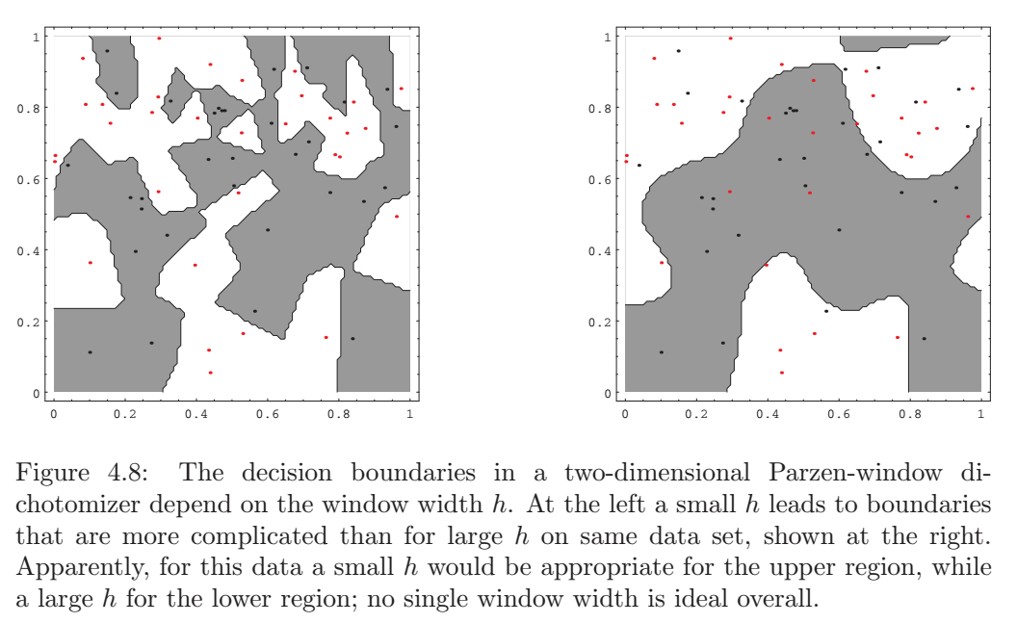
Parzen Windows: Classifier

Slide 42
Parzen Windows: Summary
Advantages
  Can be applied to the data from any distribution
  In theory can be shown to converge as the number of samples goes to infinity.
Disadvantages
  Number of training data is limited in practice, and so choosing the appropriate window size h is difficult
  May need large number of samples for accurate estimates
  Computationally heavy, to classify one point we have to compute a function which potentially depends on all samples

Slide 43
Density Estimation
K-nearest neighbor approach

Slide 44
Density Estimation: kNN
Parzen Windows
  Choose a fixed value for volume V and determine the corresponding k from the data.
K-nearest neighbors
  Choose a fixed value for k and determine the corresponding
  volume V from the data

Slide 45
Density Estimation: kNN
K-nearest neighbors:
  Let the cell volume be a function of the training data
  Center a cell about x and let it grows until it captures k samples
  k is called the k nearest-neighbors of x
2 possibilities may occur:
  Density is high near x; therefore the cell will be small which provides a good resolution.
  Density is low; therefore the cell will grow large and stop until higher density regions are reached

Slide 46
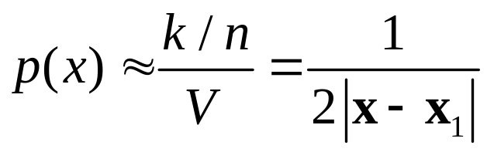
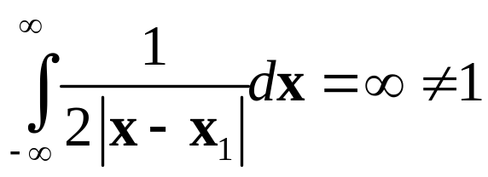
Density Estimation: kNN
Let’s look at 1-D example:
  We have one sample, i.e. n=1
  |x-x₁|
  But the estimated p(x) is not even close to a density function

Slide 47
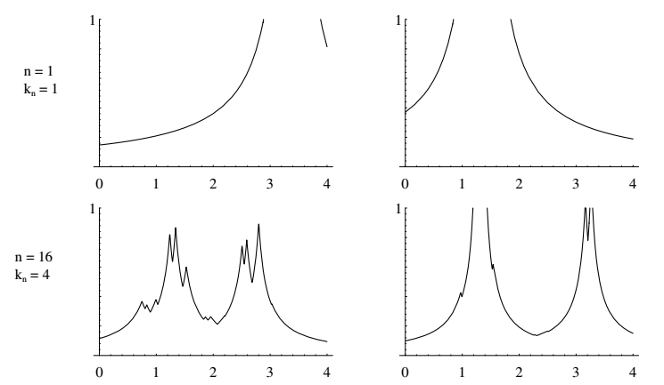
Density Estimation: kNN

Slide 48
Density Estimation: kNN

Slide 49
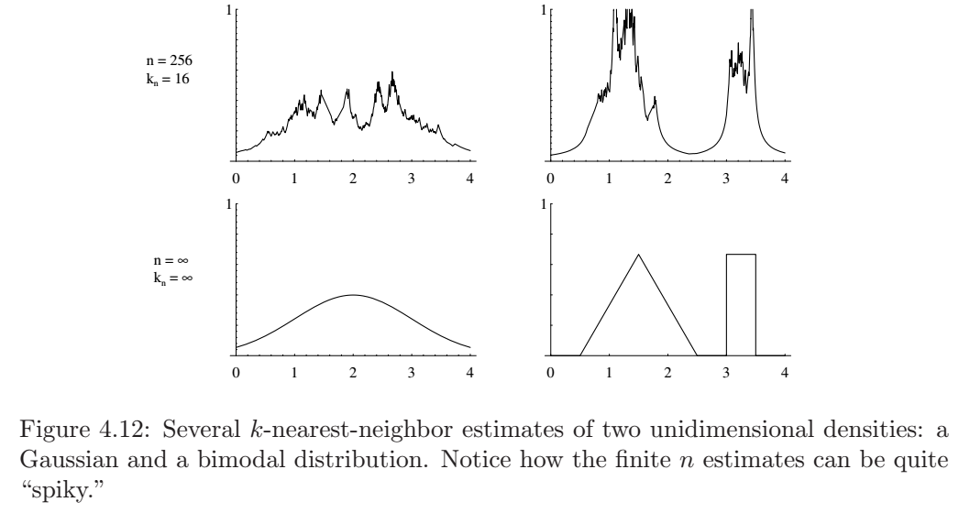
Density Estimation: kNN

Slide 50
Density Estimation: kNN
Instead of approximating the density p(x), we can use kNN method to approximate the posterior distribution P(C_{i}|x)
We don’t even need p(x) if we can get a good estimate on P(C_{i}|x)

Slide 51
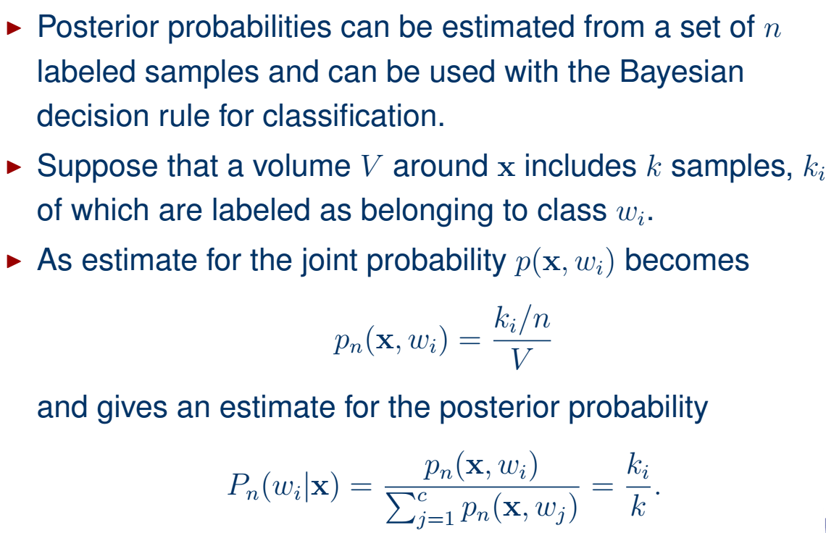
Density Estimation: kNN

Slide 52
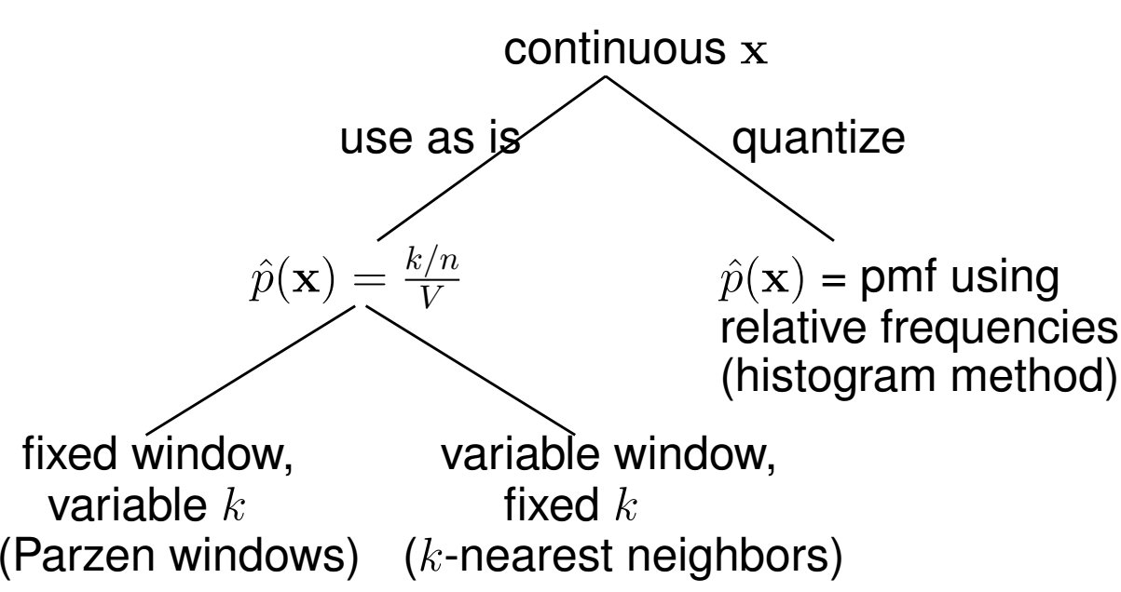
Density Estimation

Slide 53
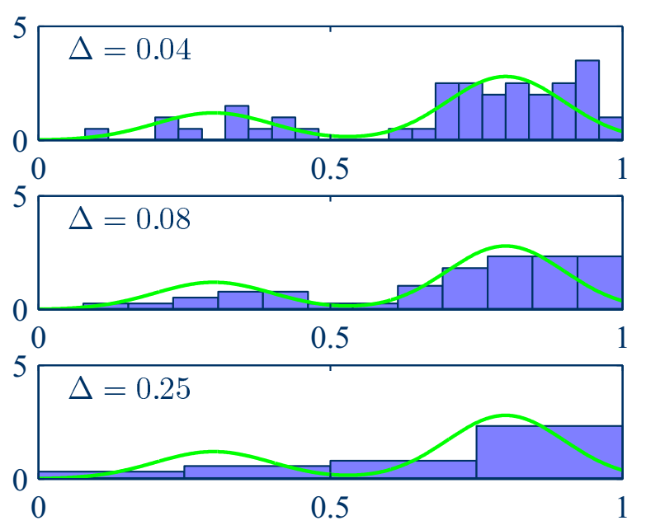
Density Estimation
An illustration of the histogram approach to density estimation, in which a data set of 50 points is generated from the distribution shown by the green curve. Histogram density estimates are shown for various values of the cell volume (∆).

Slide 54
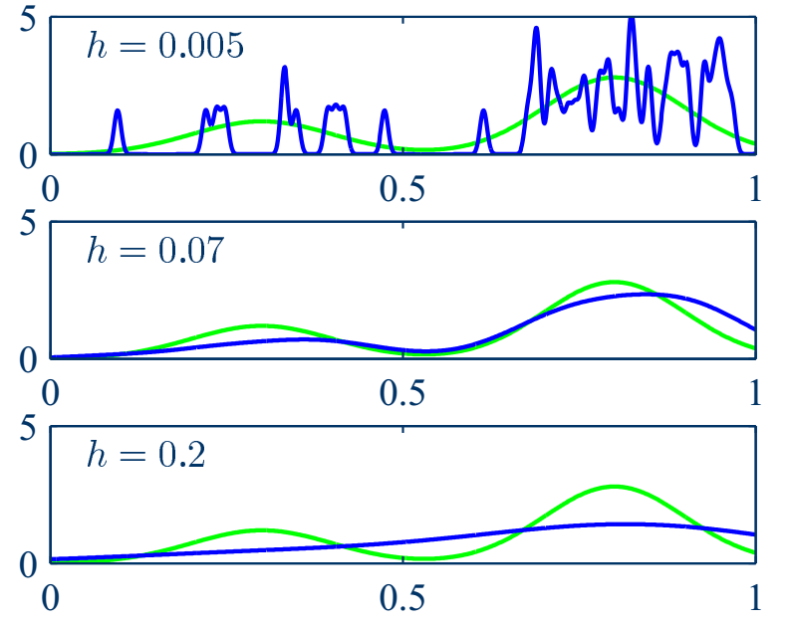
Density Estimation
Illustration of the Parzen density model. The window width (h) acts as a smoothing parameter. If it is set too small (top), the result is a very noisy density model. If it is set too large (bottom), the bimodal nature of the underlying distribution is washed out. An intermediate value (middle) gives a good estimate.

Slide 55
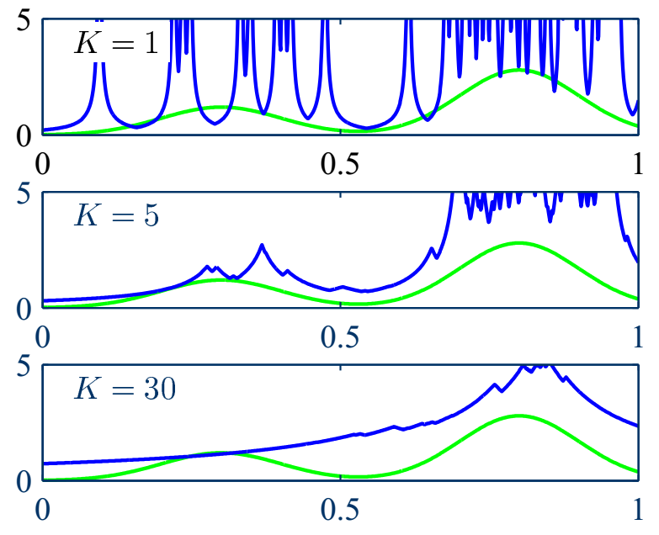
Density Estimation
Illustration of the k-nearest neighbor density model. The parameter k governs the degree of smoothing. A small value of k (top) leads to a very noisy density model. A large value (bottom) smoothes out the bimodal nature of the true distribution.

Slide 56
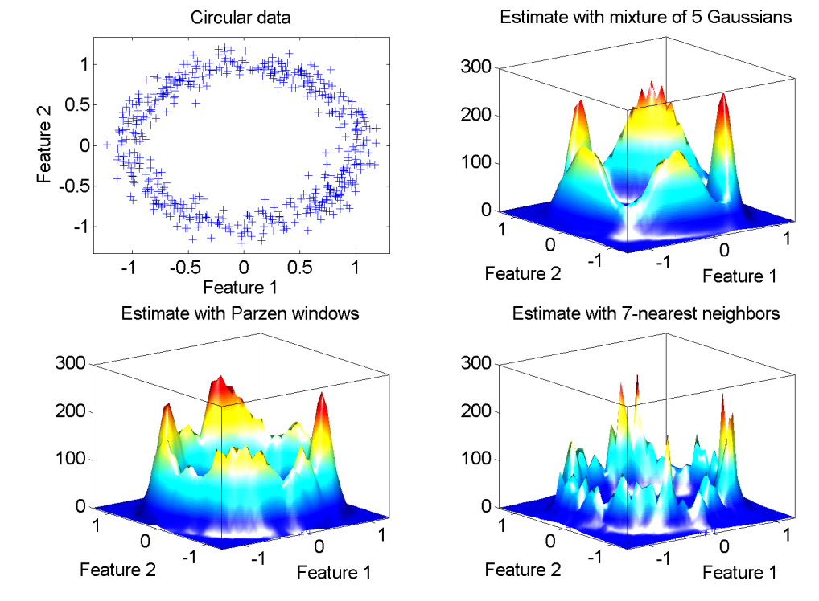
Density Estimation

Slide 57
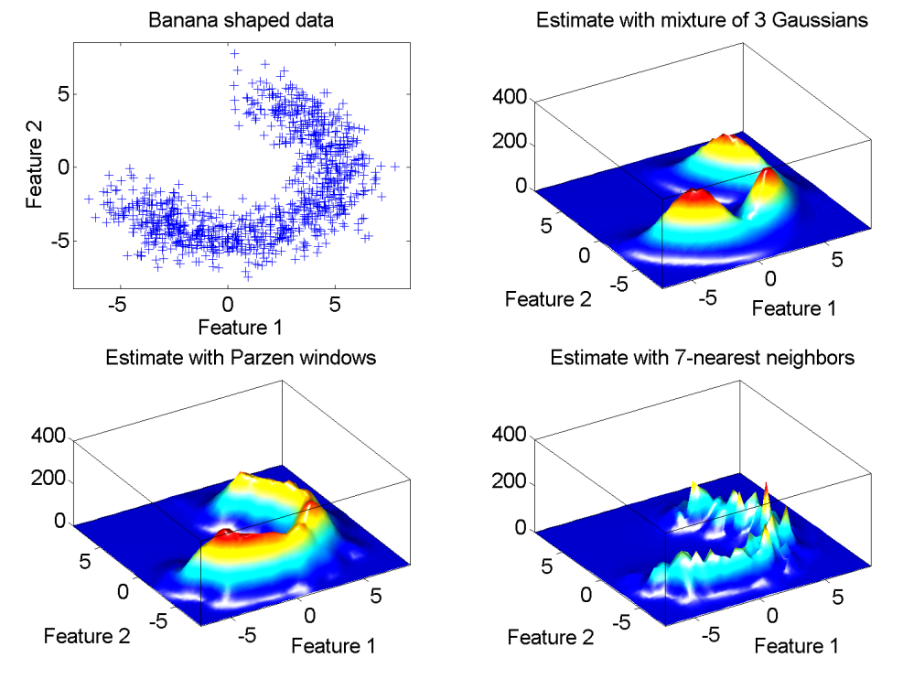
Density Estimation

