Slide 1
Naïve Bayes Classifier
Associate Prof. Huỳnh Trung Hiếu

Slide 2
Classes at IUH
Let us assume the classes in IUH start from 7am. Our house are 5 kms far from the IUH. If we leave home by 6:30 am we will in time for classes otherwise depending on the traffic conditions. Following lists ‘in_time’ (coming classes in time) and ‘too_late’ (coming classes is lated) are data showing the situation over some weeks. The first component of each tuple shows the minutes after 6:30 am that we leave home for classes, and the second component shows the number of time this occurred.
what is the probability for lately coming class if leaving home at 6:32?
Today I leave home at 6:38 am, what is the probability for lately coming class?

Slide 3
Classes at IUH
in_time = [(0, 27), (1, 25), (2, 16), (3, 19), (4, 26), (5, 20), (6, 19), (7, 17), (8, 10), (9, 5), (10, 4), (11, 4), (12,2)]
cls_late = [(5,3), (6, 5), (7, 8), (8, 15), (9, 17), (10, 18), (11, 19), (12,16), (13, 9), (14, 8), (15, 8)]

Slide 4
Classes at IUH (Lec2_Ex1.py)
Visualize data:
X, Y = zip(*in_time)
X2, Y2 = zip(*cls_late)
bar_width = 0.9
plt.bar(X, Y, bar_width, color="blue", alpha=0.75, label="Đúng giờ")
bar_width = 0.8
plt.bar(X2, Y2, bar_width, color="green", alpha=0.75, label="Trể")
plt.legend(loc='upper right')
plt.show()

Slide 5
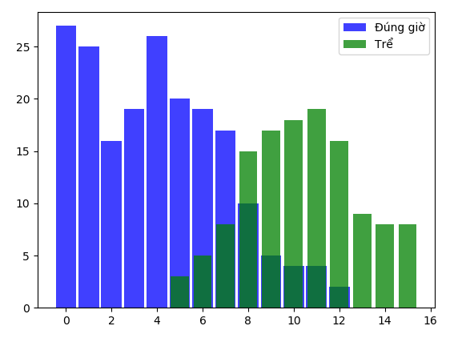
Classes at IUH

Slide 6
Classes at IUH
From this data we can deduce that the probability of lately coming classes when leaving home at 6:32 is 1, because we had 16 successful cases experienced and no late, i.e. there is no tuple with 2 as the first component in ‘cls_late’.
We will denote the event “Coming classes in time" with S(success) and the event " Coming classes lately" with L(late).

Slide 7
Classes at IUH
S: “Coming classes in time"
L: “Coming classes lately”.
The probability “coming classe in time that we leave home at 6:32” can be defined fomally:
P(S|2)=16/16=1

Slide 8
Classes at IUH
Leaving home on 6:38 am:
Number of cases in “in_time” list: 10
Number of cases in “cls_late” list: 15
=> P(S|8)=10/(10+15)=0.4
P(L|8)=15/(10+15)=0.6

Slide 9
Classes at IUH
We can write a 'classifier' function, which will give the probability for coming classes in time:
in_time_dict = dict(in_time)
too_late_dict = dict(cls_late)
def catch_the_train(min):
s = in_time_dict.get(min, 0)
if s == 0:
return 0
else:
m = too_late_dict.get(min, 0)
return s / (s + m)
for minutes in range(0, 15):
print(minutes, catch_the_train(minutes))

Slide 10
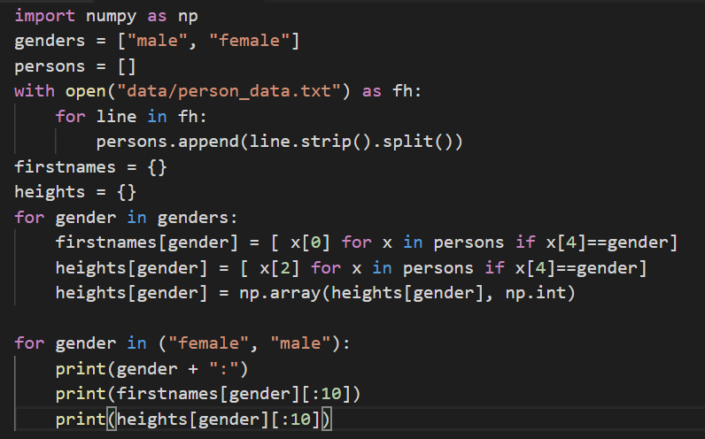
Person Data
We will use a file called 'person_data.txt'. It contains 100 random person data, male and female, with body sizes, weights and gender tags.

Slide 11
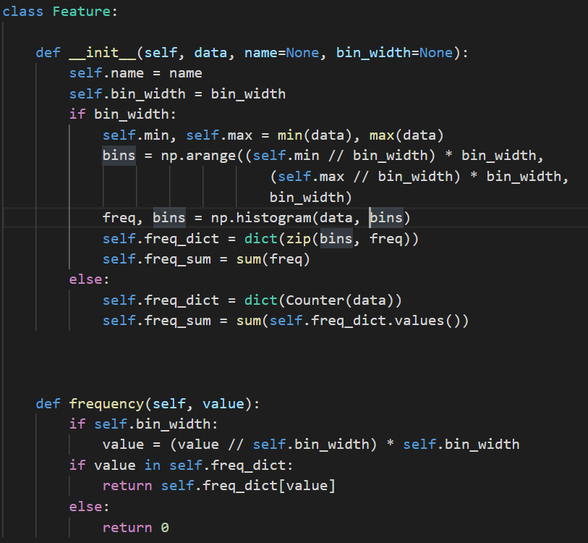
Person Data
We will now define a Python class "Feature" for the features, which we will use for classification later.
If the feature values are numerical we may want to "bin" them to reduce the number of possible feature values.

Slide 12
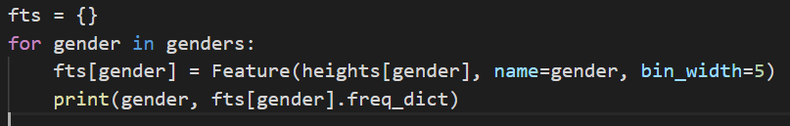
Person Data
We will create now two feature classes Feature for the height values of the person data set. One Feature class contains the height for the Naive Bayes class "male" and one the heights for the class "female":

Slide 13
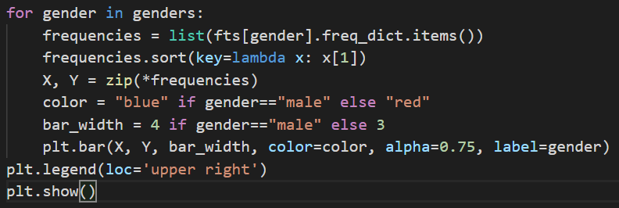
Person Data
We printed out the frequencies of our bins, but it is a lot better to see these values dipicted in a bar chart

Slide 14
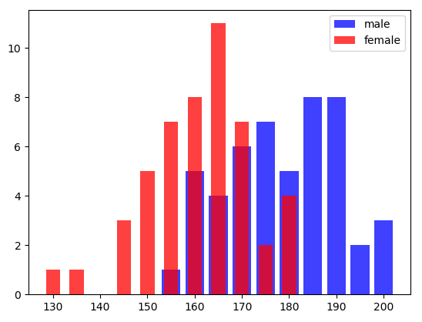
Person Data
We printed out the frequencies of our bins, but it is a lot better to see these values dipicted in a bar chart

Slide 15
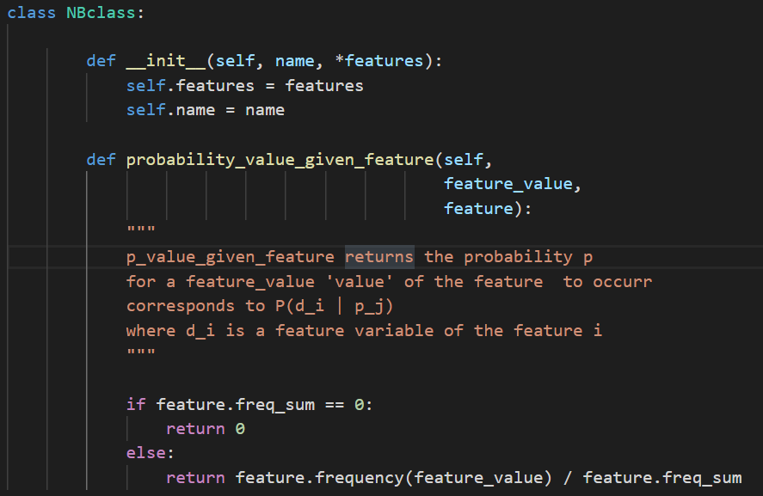
Person Data
We have to design now a Naive Bayes class

Slide 16

Person Data
We will create NBclasses with one feature, i.e. the height feature. We will use the Feature classes of fts, which we have previously created:

Slide 17
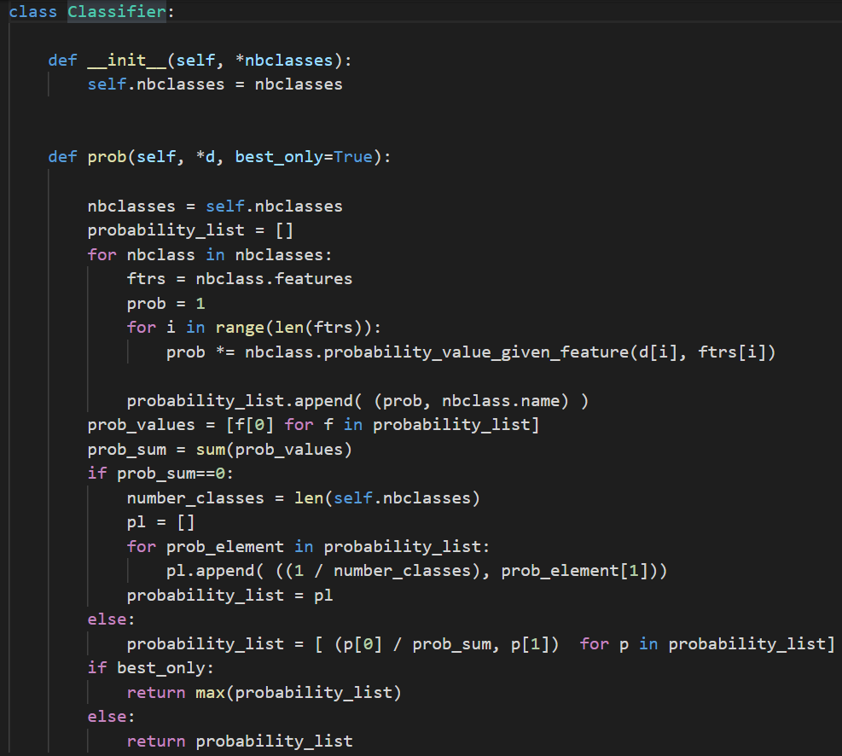
Person Data
The final step for creating a simple Naive Bayes classifier consists in writing a class 'Classifier', which will use our classes 'NBclass' and 'Feature'.

Slide 18
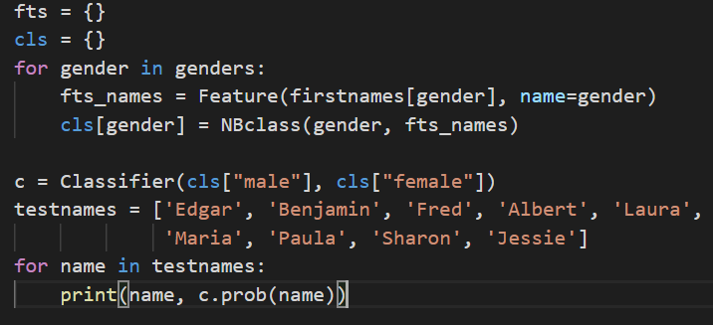
Person Data
We can also train a classifier with our firstnames:

Slide 19
Person Data
We can also train a classifier with our firstnames:
Edgar (0.5, 'male')
Benjamin (1.0, 'male')
Fred (1.0, 'male')
Albert (1.0, 'male')
Laura (1.0, 'female')
Maria (1.0, 'female')
Paula (1.0, 'female')
Sharon (1.0, 'female')
Jessie (0.6666666666666667, 'female')

Slide 20
Person Data
We can also train a classifier with our firstnames:
Edgar (0.5, 'male')
Benjamin (1.0, 'male')
Fred (1.0, 'male')
Albert (1.0, 'male')
Laura (1.0, 'female')
Maria (1.0, 'female')
Paula (1.0, 'female')
Sharon (1.0, 'female')
Jessie (0.6666666666666667, 'female')
The name "Jessie" is an ambiguous name.

Slide 21
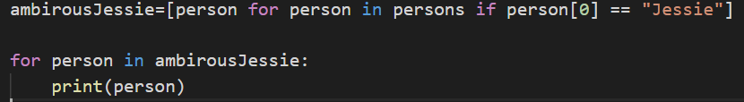
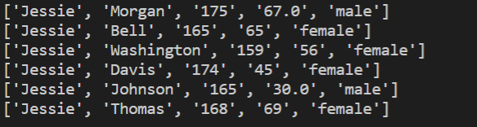
Person Data
The name "Jessie" is an ambiguous name.

Slide 22
Person Data
The name "Jessie" is an ambiguous name.
Jessie Washington is only 159 cm tall. If we have a look at the results of our Classifier, trained with heights, we see that the likelihood for a person 159 cm tall of being "female" is 0.875. So what about an unknown person called "Jessie" and being 159 cm tall? Is this person female or male?

Slide 23
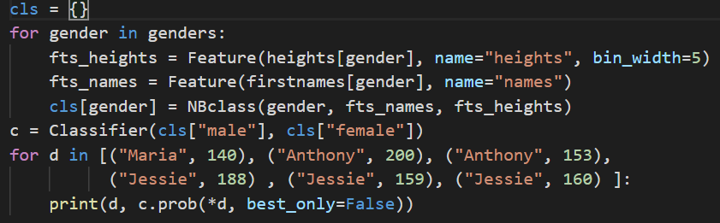
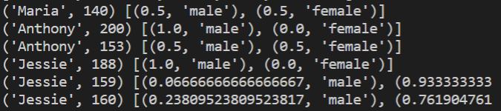
Person Data
To answer this question, we will train an Naive Bayes classifier with two feature classes, i.e. heights and first names:

