Slide 1
Bayesian Decision Theory
Dr. Huynh Trung Hieu

Slide 2
1. Introduction
Bayesian Decision Theory
Fundamental statistical approach to the problem of pattern classification
State of nature
Unpredictable state, don’t know what will emerge next
A priori probability
Sum of a priori probability is one. P(ω1)+P(ω2)=1
Decision rule
Provided that only a priori information is given,
Decide ω1 if P(ω1) > P(ω2) ; otherwise decide ω2

Slide 3
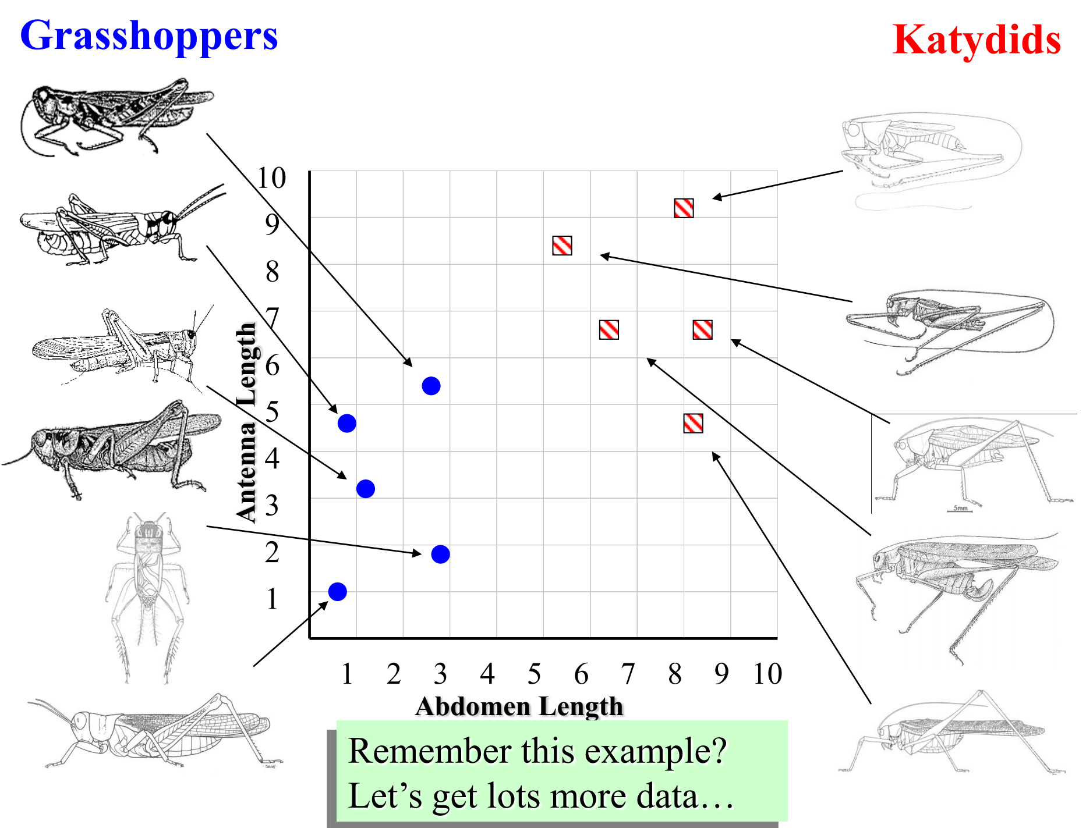
1. Introduction

Slide 4
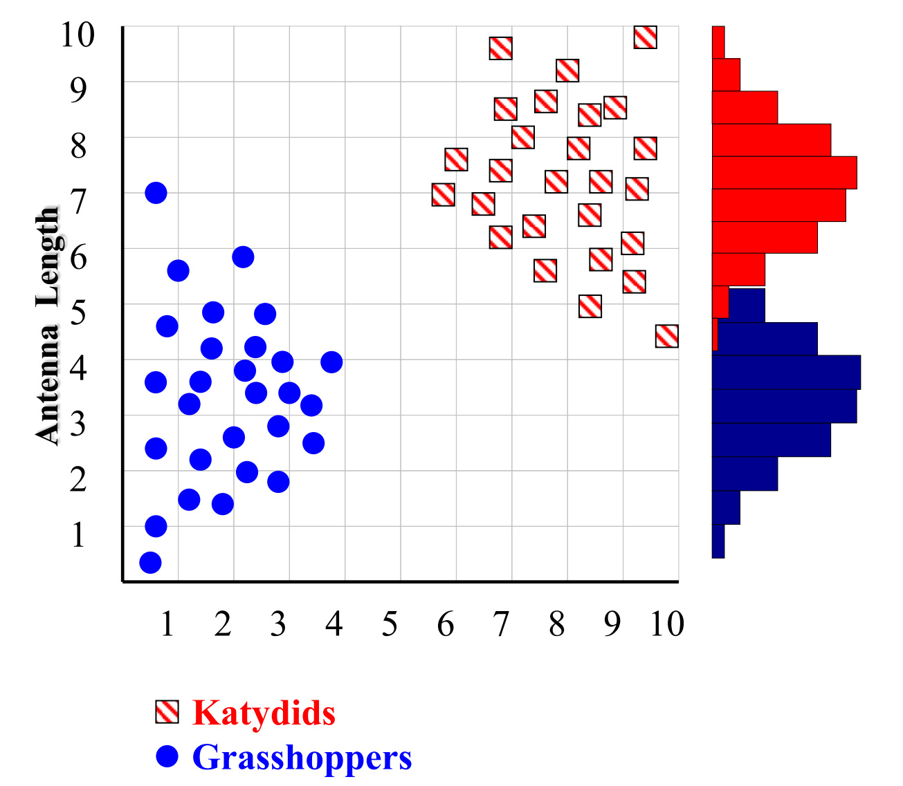
1. Introduction
With a lot of data, we can build a histogram. Let us just build one for “Antenna Length” for now…

Slide 5
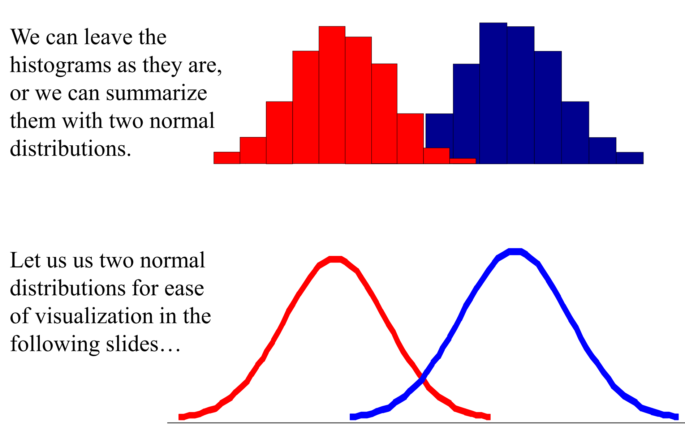
1. Introduction

Slide 6
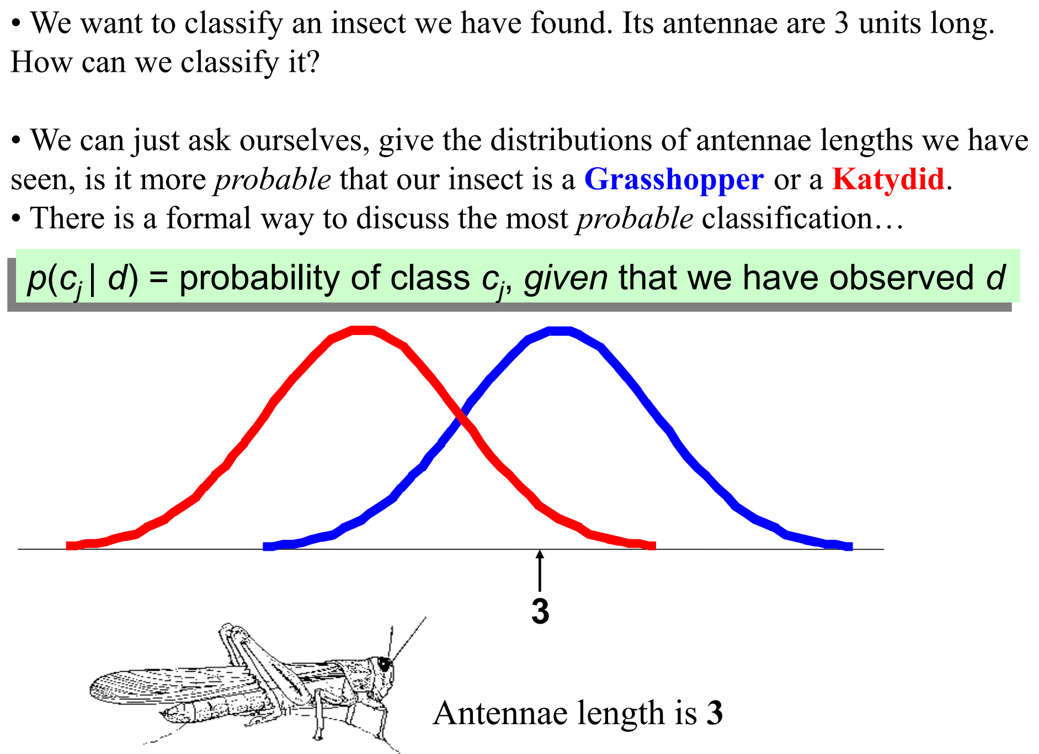
1. Introduction

Slide 7
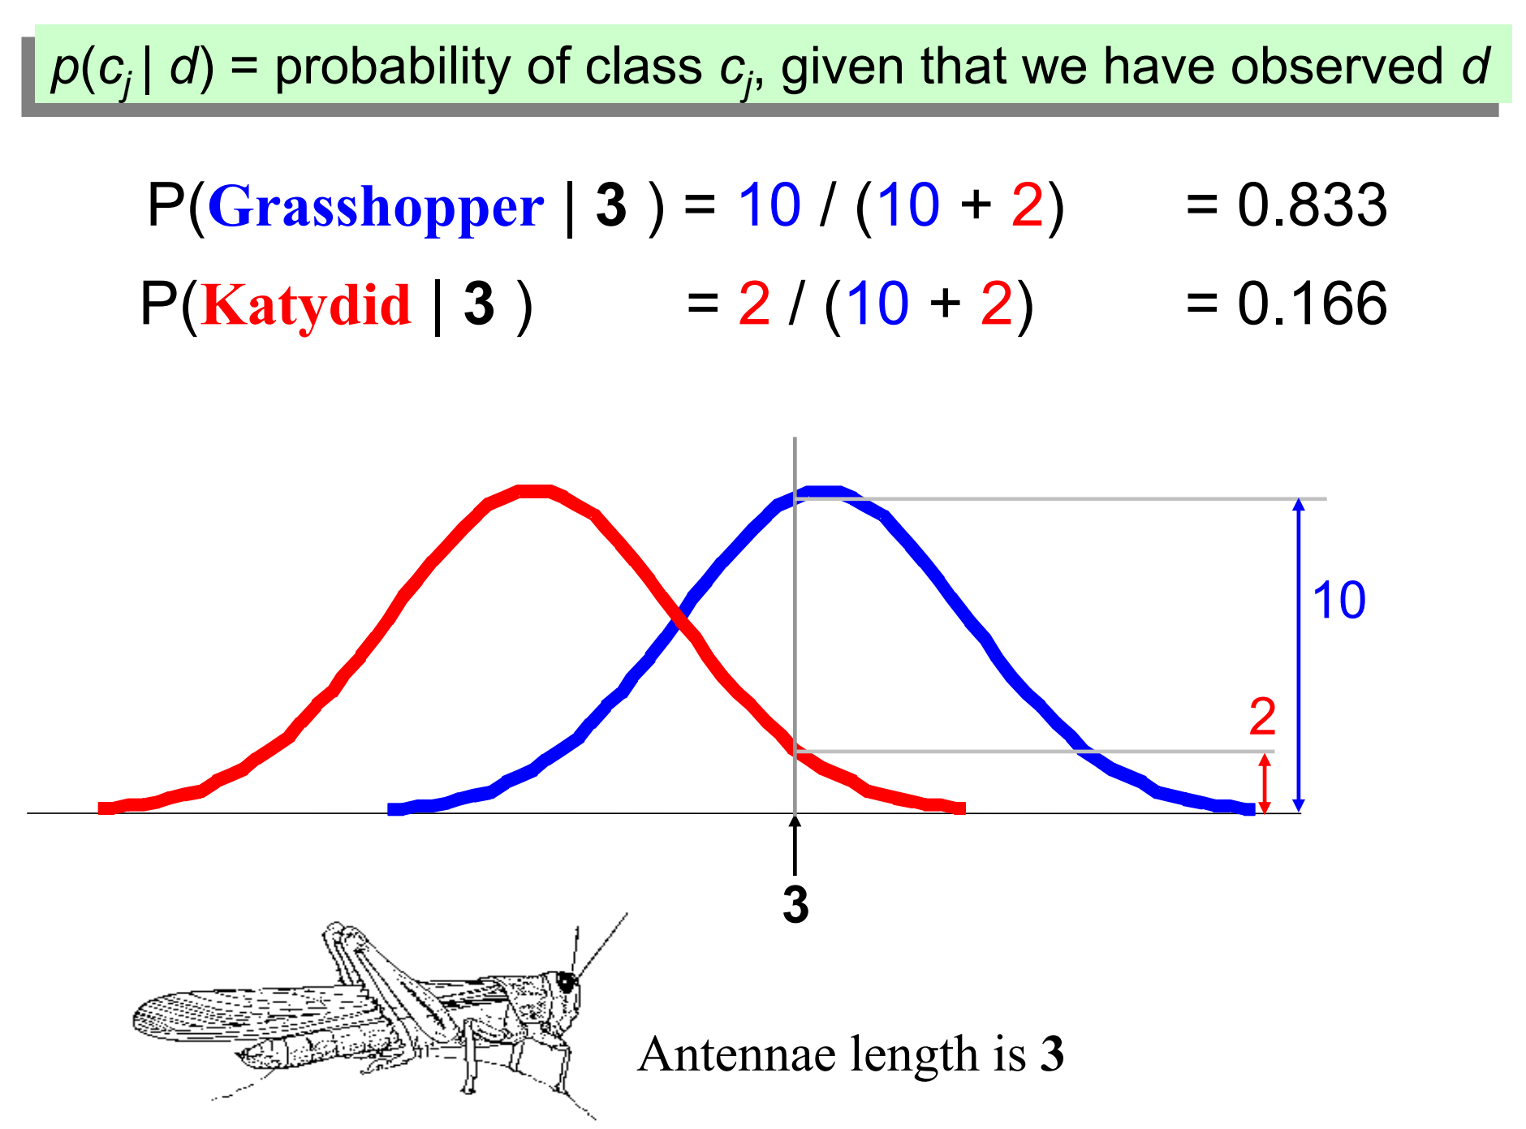
1. Introduction

Slide 8
1. Introduction
Class conditional probability density function, p(x|ω)
The probability density function for x given ω

Slide 9
1. Introduction
Bayes formula
Given both the prior probability and the conditional probability
Choose index which produces maximum
Likelihood * prior
________________
Posterior =
Evidence (not important)

Slide 10
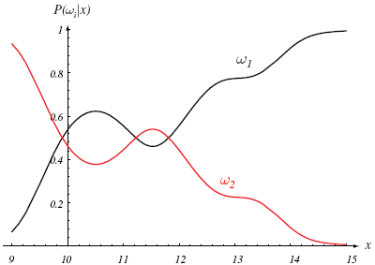
1. Introduction
Bayes Decision Rule (for minimizing the probability of error)
When value x is 14,
if we choose ω1
probability of error
must be low.
So, decide ω1
if P(ω1|x) > P(ω2|x);
otherwise decide ω2

Slide 11
2. Bayes decision theory
Generalization in 4 ways
By allowing the use of more than one feature
Replacement of scalar x with vector x
By allowing more than two x states of nature x
By allowing actions other than merely deciding the state of nature
Such as rejection in close cases
By introducing a loss function more general than the probability of error
Introduction of cost function

Slide 12
2. Bayes decision theory
Bayes risk (R : the minimum overall risk)
A posteriori probability
Conditional risk (minimized overall risk R)
Action is selected for which is minimum

Slide 13
2. Bayes decision theory
Two category classification :
Decide if

Slide 14
2. Bayes decision theory
Two category classification – cont’d
Assumption that
Decide if
Likelihood ratio : decide if

Slide 15
2. Bayes decision theory
Likelihood ratio : example

Slide 16
3. Minimum error rate classification
Zero one loss :
Conditional risk
Minimization of the average probability of error is equal to maximization of a posteriori probability.

Slide 17
4. Classifiers, discriminant functions …
Discriminant functions
Classifier with discriminant functions
Assign to class if
In Bayes classifier,

Slide 18
4. Classifiers, discriminant functions …
For minimum error rate classification
Many kinds of discriminant functions are possible
Two category case : decide

Slide 19
5. Normal (Gaussian) density
Remind:
Expectation of a scalar function f(x)
Continuous
Discrete
Univariate density
Entropy (continuous distribution)
; Variance

Slide 20
5. Normal density (cont.)
Multivariate density: (x d-dimensions feature vector)
Components of Σ
Central limit theorem
The sum of a large number of independent random distribution leads to a Gaussian distribution
; Covariance Matrix

Slide 21
5. Normal density (cont.)
Linear combination of multivariate density
A is a d-by-k matrix.
If k=1, in case (a projection onto a line with direction of vector a)
Whitening transform: eigenvector decomposition(EVD) always possible
Φ: orthogonal matrix of eigenvector
Λ: the diagonal matrix of the eigenvalues

Slide 22
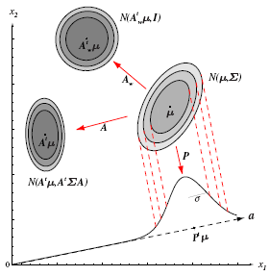
5. Normal density (cont.)
An example of transformed multivariate Gaussian distribution

Slide 23
6. Discriminant functions for the normal …
Discriminant function (d.f) for minimum-error-rate
For Gaussian (d.f will be easily evaluated)

Slide 24
6. Discriminant functions … (special cases)
Case 1 :
The features are statistically independent and have the same variance regardless of their class
We have new linear discriminant function
Two category problem: hyperplane decision boundary

Slide 25
6. Discriminant functions for the normal …
Case 1 – cont’d
For the same priori probabilities => ignore
For the same priori probabilities => ignore
(Minimum distance classifier: assign x to the category of the nearest mean)

Slide 26
6. Discriminant functions for the normal …
Case 1 – cont’d
for various priori probabilities

Slide 27
6. Discriminant functions for the normal …
Case 2 :
The features are statistically dependent but the covariance matrices are the same for all classes
We have new linear discriminant function

Slide 28
6. Discriminant functions for the normal …
Case 2 – cont’d
Two category problem: hyperplane decision boundary
For the same priori probabilities => ignore
(Squared Mahalanobis minimum distance classifier for the same a priori distribution)

Slide 29
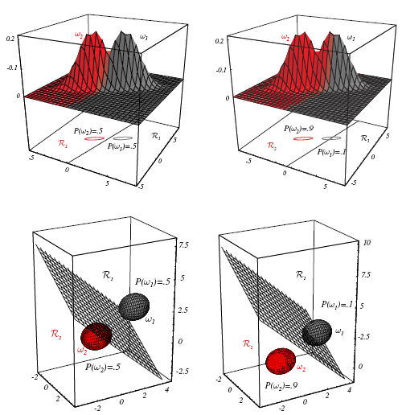
6. Discriminant functions for the normal …
Case 2 – example
Boundary is not orthogonal to the line between class means
see eq. 64.

Slide 30
6. Discriminant functions for the normal …
Case 3 :
covariance matrices are different for each category
Quadratic discriminant function
Two category problem: hyperquadratic decision boundary (hyperplane, pairs of hyperplane, hyperspheres, hyperparaboloids…)

Slide 31
6. Discriminant functions for the normal …
Case 3 – 2D example

Slide 32
6. Discriminant functions for the normal …

Slide 33
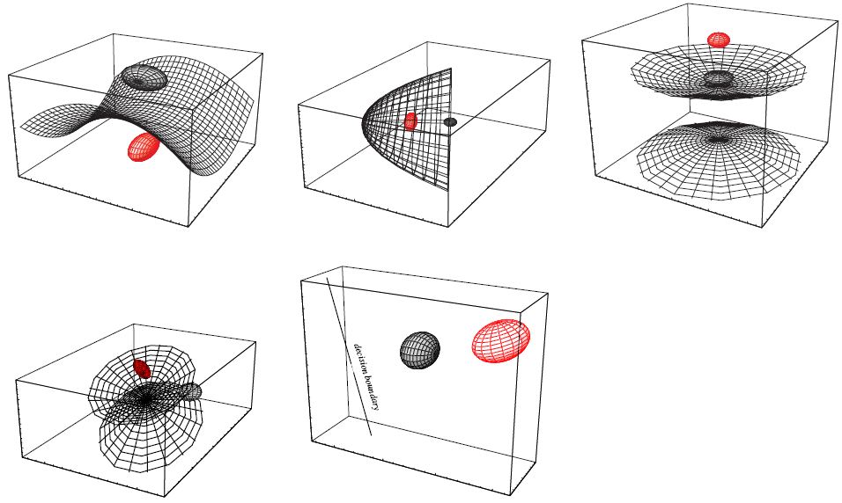
6. Discriminant functions for the normal …

Slide 34
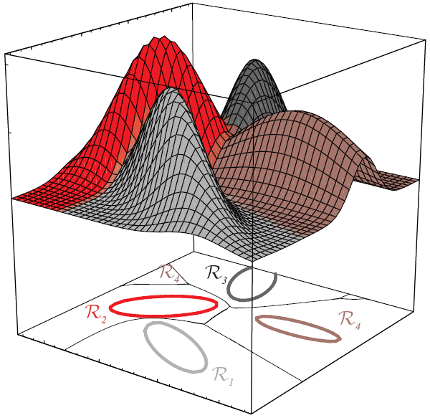
6. Discriminant functions for the normal …
Case 3 – boundary 4 category
Rather complex boundary

Slide 35
7. Bayes decision theory – discrete features
A posteriori probability for discrete features
Binary-valued components
Class 1:
Class 2:

Slide 36
9. Bayes decision theory – discrete features
Binary trial – cont’d
Likelihood ratio
Linear discriminant function
For the same
Remark: There is a large range in positions of the decision boundary for the discrete case.

Slide 37
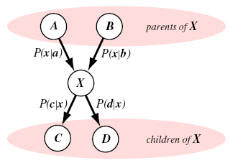
11. Bayesian belief networks
Bayesian belief nets, causal networks, belief nets
Node : a kind of state with probabilities
Discrete or continuous
Parent: node giving influence
Children: influenced node
See example 4 and p. 60-61.

Slide 38
APENDIX
Steps to construct a Naïve Bayes

Slide 39
Steps to construct a Naïve Bayes
Handle data
Summarize data
Make prediction
Evaluate accuracy

Slide 40
Steps to construct a Naïve Bayes
Handle Data
Load data file. The data is in CSV format without a header line or any quotes

