Slide 1

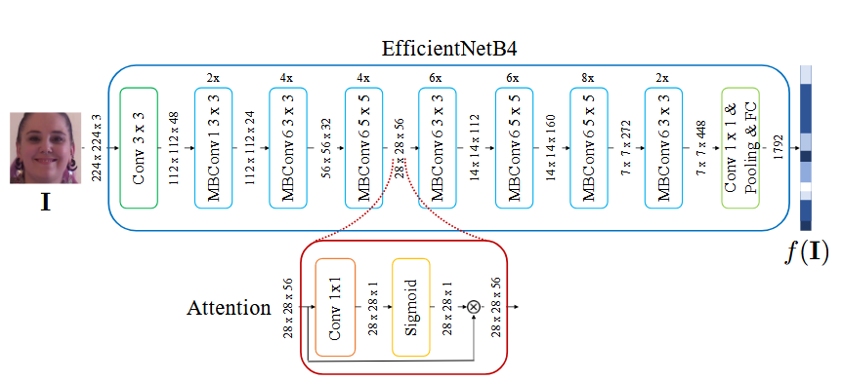
EfficientNetB4AttST Architecture Overview
Team: Winking😉
Core Components
The proposed architecture builds on EfficientNetB4 as the backbone, enhanced with two key modifications:
Attention Mechanism (EfficientNetB4Att): Adds a lightweight attention block after the 3rd MBConv layer.
Siamese Training: Implements triplet margin loss for feature space optimization.
[1] N. Bonettini, E. D. Cannas, S. Mandelli, L. Bondi, P. Bestagini, and S. Tubaro, “Video Face Manipulation Detection Through Ensemble of CNNs,” Apr. 16, 2020, arXiv: arXiv:2004.07676. doi: 10.48550/arXiv.2004.07676.

Slide 2
EfficientNetB4AttST Functional Modules
Base Network (EfficientNetB4)
Team: Winking😉
Structure: 16 MBConv blocks with channel scaling ratios (1.4×) and depth scaling (2.2×) from original EfficientNet
Key Parameters:
19M parameters vs XceptionNet's 23M
4.2B FLOPS vs XceptionNet's 8.4B FLOPS
Advantages:
Achieves 83.8% ImageNet top-1 accuracy with 55% fewer FLOPS than XceptionNet
Mobile inverted bottleneck convolution (MBConv) enables better feature reuse
Attention Module (EfficientNetB4Att)
Position: Inserted after 3rd MBConv layer (output: 28×28×56)
Design Rationale:
Captures mid-level semantic features before excessive Downsampling
1×1 convolution preserves spatial resolution while reducing channel dimension
Sigmoid activation emphasizes salient regions (eyes/mouth)
Siamese Training Head
Loss Function:
Batch Construction:
12 triplets per batch: 6 (real-fake-fake) + 6 (fake-fake-real)
Hard negative mining through online triplet selection

Slide 3
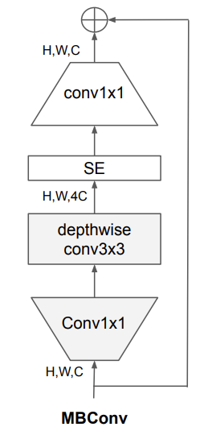
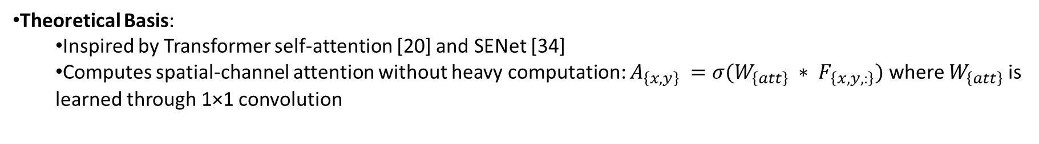
EfficientNetB4AttST Sub-Architecture Analysis
MBConv Block (Base Unit)
Team: Winking😉
Attention Mechanism
Theoretical Basis:
Inspired by Transformer self-attention [20] and SENet [34]
Computes spatial-channel attention without heavy computation: $A_{\left\{x,y\right\}} =σ(W_{\left\{att\right\}} ∗ F_{\left\{x,y,:\right\}})$ where $W_{\left\{att\right\}}$ is learned through 1×1 convolution
Triplet Loss Dynamics
Feature Space Optimization:
Forces intra-class distance < inter-class distance by margin $\gamma$
t-SNE visualization (Fig.5) shows clear separation between real/fake clusters
Theoretical Support:
Follows metric learning principles from FaceNet [35]
Addresss class imbalance in DFDC (84% fake samples)

Slide 4
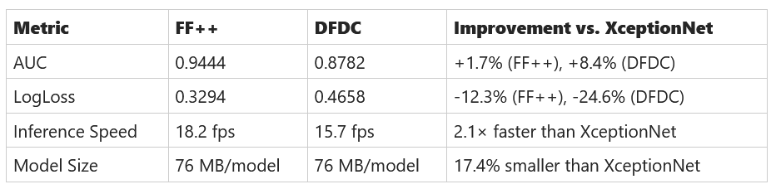
EfficientNetB4AttST Innovation & Performance
Core Innovations
Team: Winking😉
Attention-Enhanced EfficientNet
First integration of lightweight spatial attention (1×1 conv + sigmoid) within EfficientNetB4, enabling localized artifact detection (e.g., eye/mouth anomalies) while maintaining computational efficiency.
Provides interpretable saliency maps (Fig. 4), aligning model focus with known forensic cues (e.g., inconsistent lighting reflections).
Hybrid Training Paradigm
Combines end-to-end classification (LogLoss) and Siamese metric learning (Triplet Margin Loss), addressing class imbalance in DFDC (84% fake samples) while improving feature separability.
Hardware-Aware Design
Replaces MTCNN with BlazeFace detector (3 ms/frame vs. 120 ms/frame) for real-time face cropping.
Benchmark Performance

Slide 5
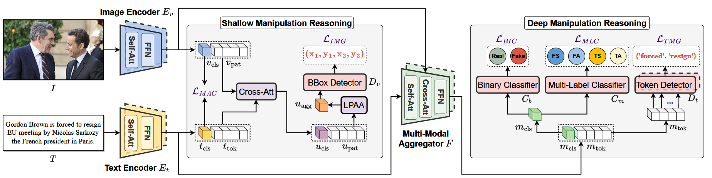
HAMMER Architecture Overview
Core Components
Team: Winking😉
HierArchical Multi-modal Manipulation rEasoning tRansformer (HAMMER) is designed to address the DGM4 task through a dual-phase reasoning framework:
Shallow Manipulation Reasoning: Aligns image-text embeddings via contrastive learning and performs initial manipulation grounding.
Deep Manipulation Reasoning: Aggregates multi-modal features via cross-attention for fine-grained detection and grounding.
Key Components: Uni-Modal Encoders, Multi-Modal Aggregator, Detection/Grounding Heads.
[2] R. Shao, T. Wu, and Z. Liu, “Detecting and Grounding Multi-Modal Media Manipulation,” Apr. 05, 2023, arXiv: arXiv:2304.02556. doi: 10.48550/arXiv.2304.02556.

Slide 6
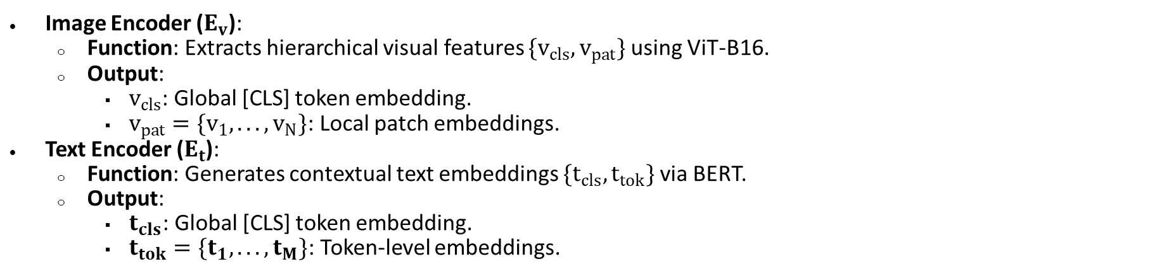
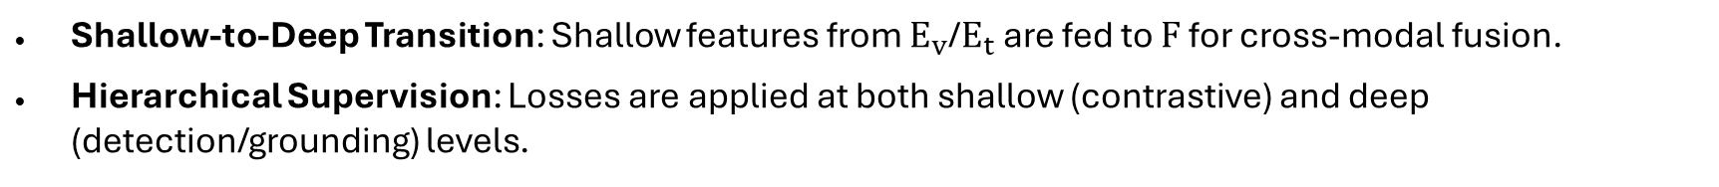
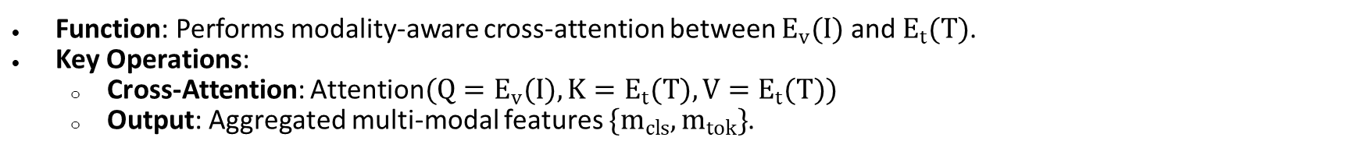
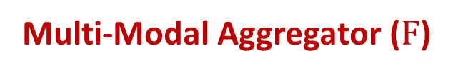
HAMMER Functional Modules
Uni-Modal Encoders
Team: Winking😉
Image Encoder ($E_{v}$):
Function: Extracts hierarchical visual features $\{v_{cls},v_{pat}\}$ using ViT-B16.
Output:
$v_{cls}$: Global [CLS] token embedding.
$v_{pat}=\{v_{1},...,v_{N}\}$: Local patch embeddings.
Text Encoder ($E_{t}$):
Function: Generates contextual text embeddings $\{t_{cls},t_{tok}\}$ via BERT.
Output:
$t_{cls}$: Global [CLS] token embedding.
$t_{tok}=\{t_{1},...,t_{M}\}$: Token-level embeddings.
Multi-Modal Aggregator ($F$)
Function: Performs modality-aware cross-attention between $E_{v}(I)$ and $E_{t}(T)$.
Key Operations:
Cross-Attention: $\text{Attention}(Q=E_{v}(I),K=E_{t}(T),V=E_{t}(T))$
Output: Aggregated multi-modal features $\{m_{cls},m_{tok}\}$.
Detection/Grounding Heads
Shallow-to-Deep Transition: Shallow features from $E_{v}$/$E_{t}$ are fed to $F$ for cross-modal fusion.
Hierarchical Supervision: Losses are applied at both shallow (contrastive) and deep (detection/grounding) levels.

Slide 7
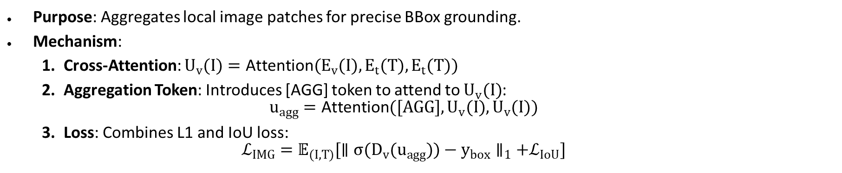
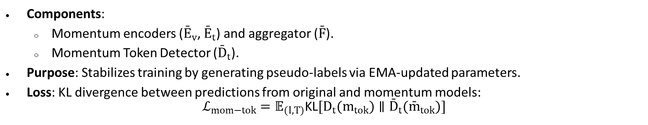
HAMMER Sub-Architecture Analysis
Team: Winking😉
Local Patch Attentional Aggregation (LPAA)
Purpose: Aggregates local image patches for precise BBox grounding.
Mechanism:
Cross-Attention: $U_{v}(I)=\text{Attention}(E_{v}(I),E_{t}(T),E_{t}(T))$
Aggregation Token: Introduces [AGG] token to attend to $U_{v}(I)$: $u_{agg}=\text{Attention}([AGG],U_{v}(I),U_{v}(I))$
Loss: Combines L1 and IoU loss: $ℒ_{IMG}=𝔼_{(I,T)}[∥σ(D_{v}(u_{agg}))−y_{box}∥_{1}+ℒ_{IoU}]$
Momentum Regularization
Components:
Momentum encoders (${\overset{ˉ}{E}}_{v}$, ${\overset{ˉ}{E}}_{t}$) and aggregator ($\overset{ˉ}{F}$).
Momentum Token Detector (${\overset{ˉ}{D}}_{t}$).
Purpose: Stabilizes training by generating pseudo-labels via EMA-updated parameters.
Loss: KL divergence between predictions from original and momentum models: $ℒ_{mom−tok}=𝔼_{(I,T)}\text{KL}[D_{t}(m_{tok})∥{\overset{ˉ}{D}}_{t}({\overset{ˉ}{m}}_{tok})]$

Slide 8
HAMMER Innovation & Performance
Team: Winking😉
Core Innovations
1.Task Formulation:
Introduced DGM4 (Detecting and Grounding Multi-Modal Manipulation), the first task to jointly detect and localize manipulations in both image (bounding boxes) and text (token-level) modalities.
2.Hierarchical Reasoning Architecture:
Shallow Reasoning: Contrastive learning with manipulation-aware negatives aligns image-text pairs while preserving modality-specific features.
Deep Reasoning: Cross-modal attention layers fuse features for fine-grained detection and grounding.
3.Technical Breakthroughs:
LPAA (Local Patch Attentional Aggregation): Dynamically aggregates spatial image features via a dedicated [AGG] token, improving IoU by 17% over [CLS]-based methods.
Momentum Regularization: Stabilizes text token grounding via pseudo-labels from momentum encoders, reducing noise sensitivity.
Benchmark Performance
Detection Accuracy:
Achieved 93.19% AUC on binary classification, outperforming ViLT (85.16%) and CLIP (82.37%).
91.5% F1 on text manipulation detection (TS/TA), surpassing BERT-based baselines by 12%.
2. Localization Precision:
83.75% IoU50 for image manipulation grounding (vs. 65.18% for ViLT).
89.7% token-level F1 for text manipulation grounding.
3. Ablation Insights:
Removing LPAA reduced image IoU by 24%.
Omitting momentum regularization dropped text F1 by 7.3%.
4. Cross-Modal Synergy:
Multi-modal fusion improved detection AUC by 8.2% over single-modality baselines.

Slide 9
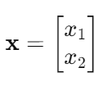
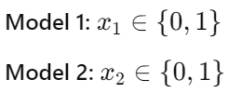
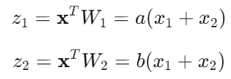
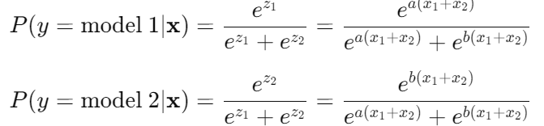
EfficientNetB4AttST-HAMMER Pipeline
Team: Winking😉
Model 1: EfficientNetB4AttSt
Video
Encoder
Decoder
Classifier
Real
Or
Fake
Model 2:
HAMMER
Decision Rule:
Softmax Probabilities:
Final Output: Choose the model with the higher probability.

Slide 10
EfficientHAMMER Innovation & Performance
Core Innovations
Team: Winking😉
Modular Architecture:
The design allows for modular replacement of individual models.
New models can be easily integrated or swapped without redesigning the entire system.
2. Expandability & Pretraining:
The framework supports incorporating pretrained models to leverage large-scale learned representations.
It is extendable to include various model architectures, making it flexible for different tasks.
3.Dynamic Edge Decision Making:
In critical scenarios (e.g., TF, FT cases), the ensemble uses a softmax-based fusion.
The system automatically selects the model with the higher probability, ensuring a robust decision at the edge.
Performance
Superior Accuracy:
By combining the strengths of multiple models, the ensemble outperforms single-model systems.
It reduces individual model biases and errors, leading to higher overall prediction accuracy.
2. Robustness in Edge Cases:
In scenarios where one model might struggle (e.g., uncertain or ambiguous outputs), the ensemble’s dynamic selection ensures the optimal model is chosen.
This adaptive mechanism is especially useful in edge decision contexts (TF, FT), where performance and reliability are critical.

Slide 11
EfficientHAMMER Takeaway
Team: Winking😉
Feasibility & Real World Impacts
Cost-Effective: Lower cost than large language models.
Efficiency: Faster runtime makes it suitable for real-time applications.
Impact: Helps combat the harmful effects of fake news and fake faces in media.
Uniqueness
Modular Design: Easily swap or integrate pretrained models.
Adaptive Fusion: Uses a softmax-based ensemble to dynamically select the best model in edge cases.
Measurable Results
Performance: Outperforms single models in FakeFaces Detection tasks.
Reliability: Provides higher accuracy and robustness in critical decision scenarios.
Real-World Benefit: Demonstrated potential to reduce the spread of misleading media content.

