Slide 1
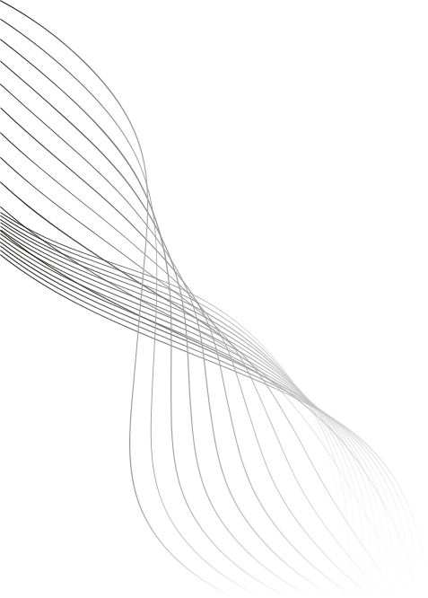

Prediction Markets Probabilties as a Quant Data Source
Characterizing Kalshi 15-minute BTC Contracts
Project Lead: Xavier Vortigern
Quantitative Developer: Zoe Tomlinson
5/27/26
Oregon Quant Group

Slide 2
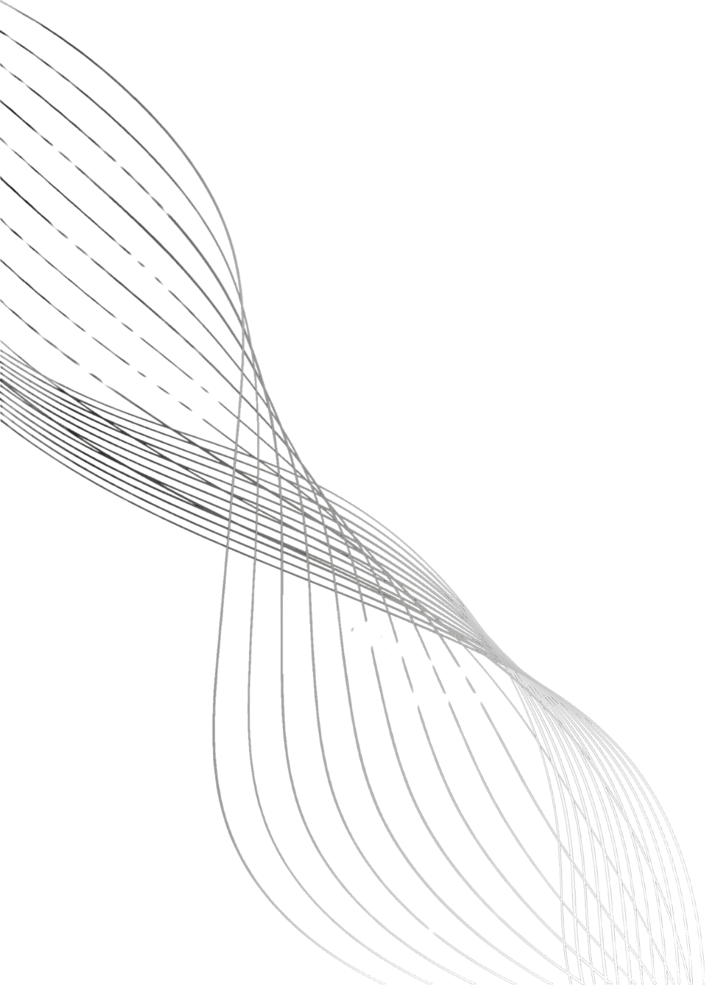


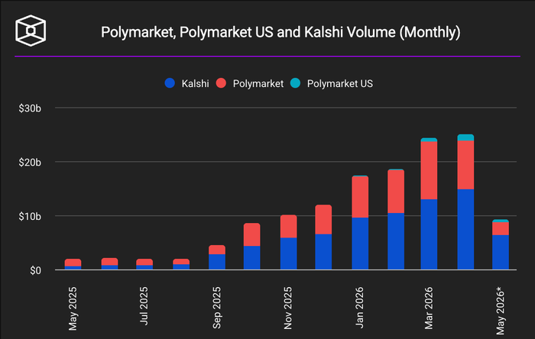

What are Prediction Markets?
Marketplaces where participants trade contracts on the outcome of future events, aggregating beliefs into prices.
Binary Contracts, trading price reflects implied probability. A contract trading at $0.62 means that the market estimates a 62% chance that the event resolves to YES.
Contracts spanning politics, weather, economics, sports
Ex: Recession this year?
Will 2026 be the hottest year ever?
Will Elon win his case against OpenAI?
"Wisdom of the Crowd" — aggregation works best when participants are independent, diverse, and bear the cost of error (Surowiecki, 2004)
Notes:
A binary contract pays $1 if the event happens and $0 if it doesn't. The contract's current trading price is therefore the market's implied probability of that outcome. A contract trading at $0.62 means the market collectively estimates a 62% chance the event resolves YES.
Participants buy and sell these contracts with real capital. Traders who price events accurately profit; those who don't lose money. Prices update continuously as new information arrives and as traders react.

Slide 3
Prediction Markets as a Quant Signal
Institutional Adoption has already begun to take place

Slide 4
Data & Signals
Kalshi 15-min BTC Contracts
Per-Contract Observation
Binary contracts on whether BTC will end above or below a given spot price over the following 15-minute window
At 10 second intervals, compute the midpoint of best bid and ask price. These are averaged into 1-minute buckets, yielding a 15-point time series of P(UP) per contract.
Dataset:
Sourced from Kalshi’s Trade API
Collected over a six-week opportunistic window
Covers ~2,200 BTC contracts
Drop contracts with <15 observations, unresolved, or zero-volume
Figure here
Notes:
Dataset:
Sourced from Kalshi’s Trade API
Collected over a six-week opportunistic window
Covers ~2,200 BTC contracts
Drop contracts with <15 observations, unresolved, or zero-volume
Fields logged per minute
P(UP), P(DOWN)
Momentum - ΔP(UP) from prior minute
Majority prediction
Market ticker & timestamp
Final outcome and volume (post-resolution)

Slide 5
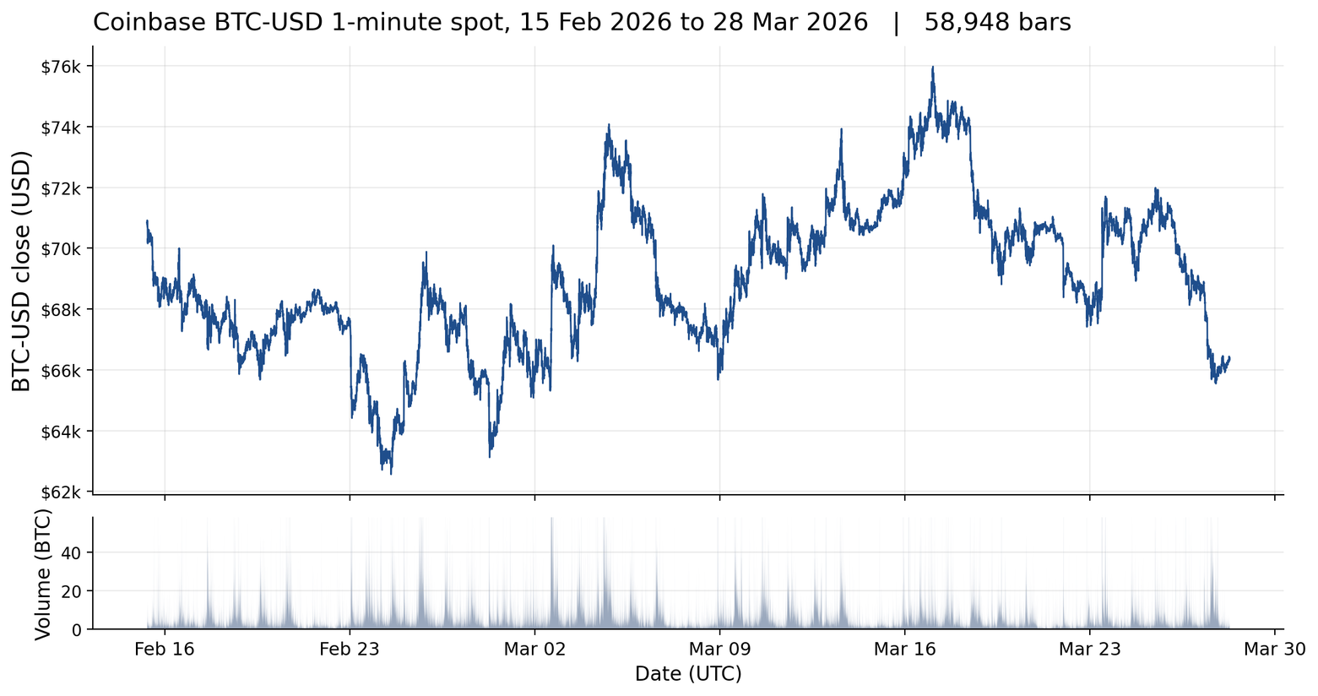
Coinbase API Data
Coinbase BTC 1-minute candles, public Exchange API at 60-second granularity
Window: 15 Feb to 28 Mar 2026, 58,948 bars matched to the Kalshi panel
Coinbase chosen over Binance, which had 45% zero-volume bars at this granularity
Joined to Kalshi by UTC minute timestamp: 31,658 matched minute-level observations

Slide 6
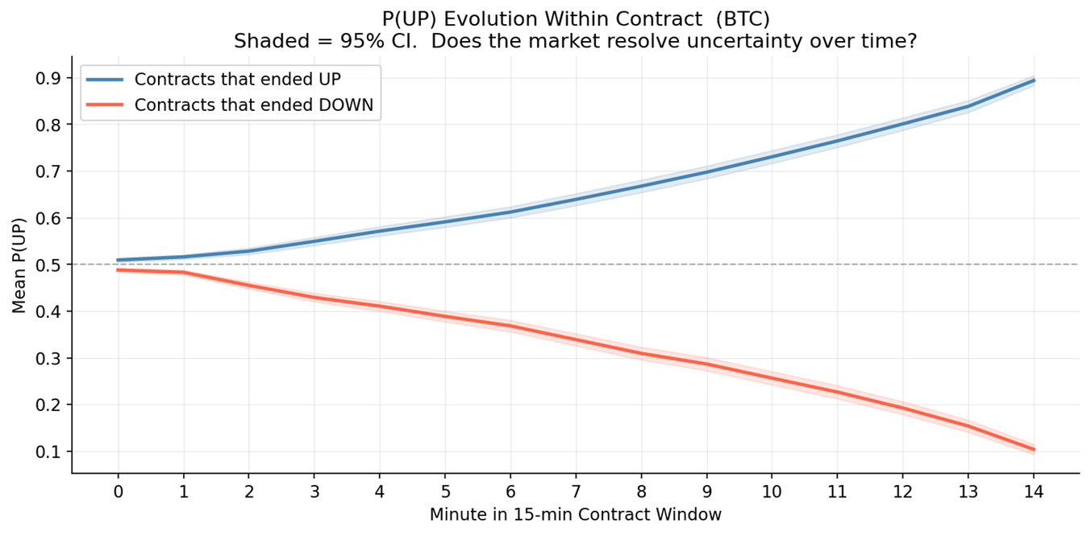
Probability Convergence Within Contracts
How the Market Resolves
Majority prediction accuracy starts at 54% and rises monotonically to 94% by minute 14
As the contract nears expiry, BTC price has largely determined its final direction
Any predictive signal must be drawn from early-window data, otherwise we conflate convergence with information
Figure 1 — BTC majority-prediction accuracy by minute within contract (n=2,264). Rises from 54% at open to 94% by minute 14 as the underlying price approaches resolution.

Slide 7
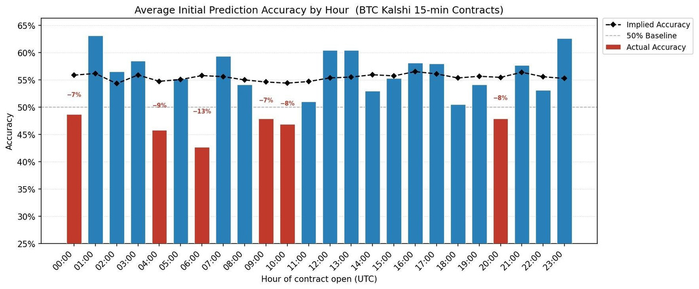
Intraday Variability in Realized Accuracy
Implied accuracy is roughly flat at 55–56% across all hours.
Realized accuracy varies substantially — eight hours show an overconfidence gap exceeding 5 percentage points (red bars).
Figure 1 — BTC majority-prediction accuracy by minute within contract (n=2,264). Rises from 54% at open to 94% by minute 14 as the underlying price approaches resolution.

Slide 8
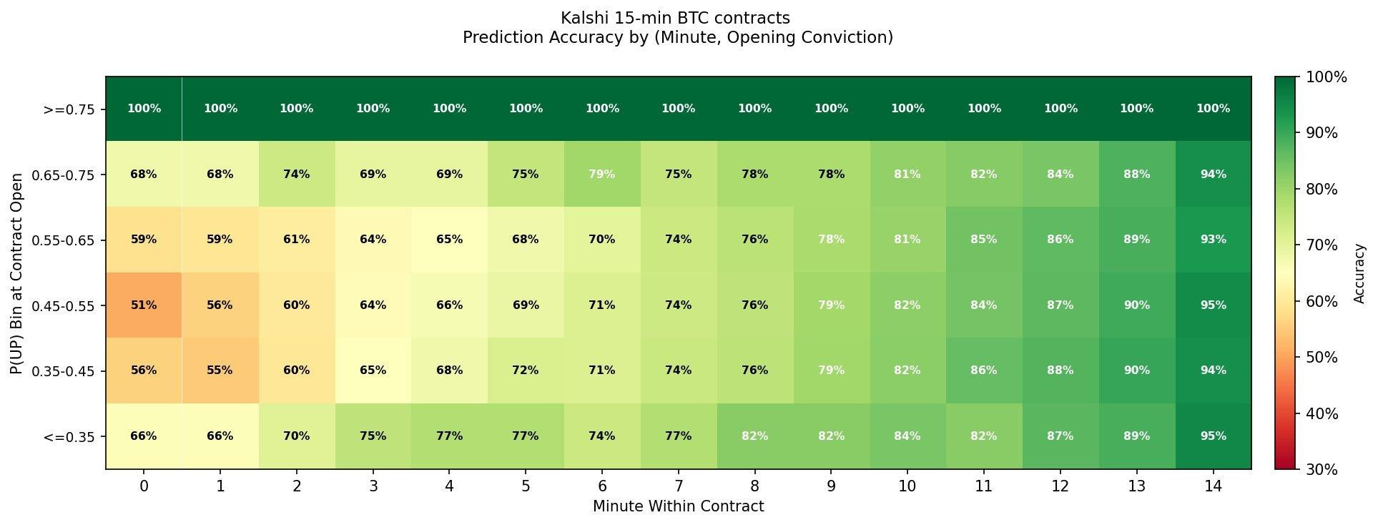
Intraday Variability in Realized Accuracy
Implied accuracy is roughly flat at 55–56% across all hours.
Realized accuracy varies substantially — eight hours show an overconfidence gap exceeding 5 percentage points (red bars).

Slide 9
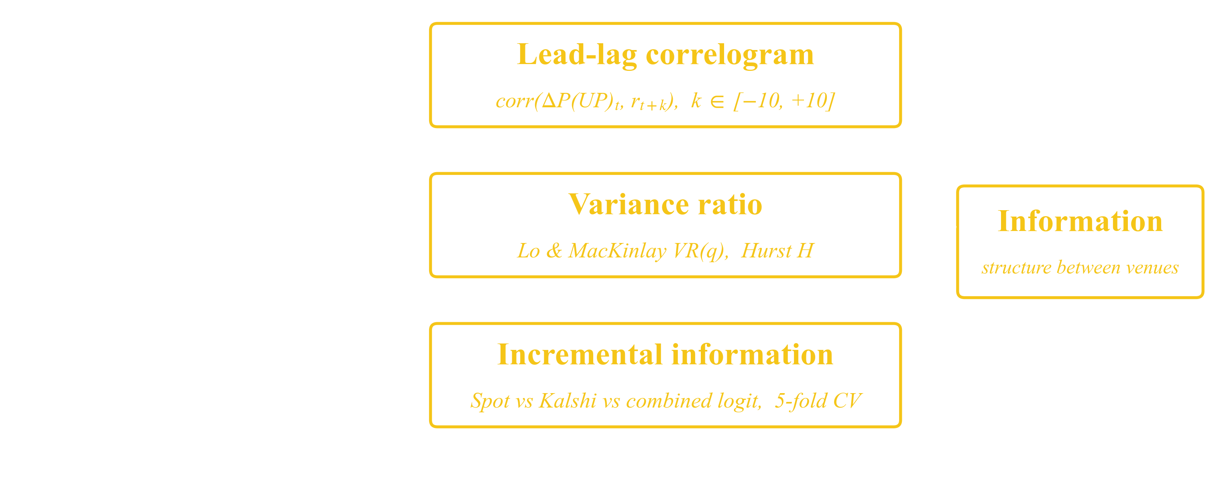
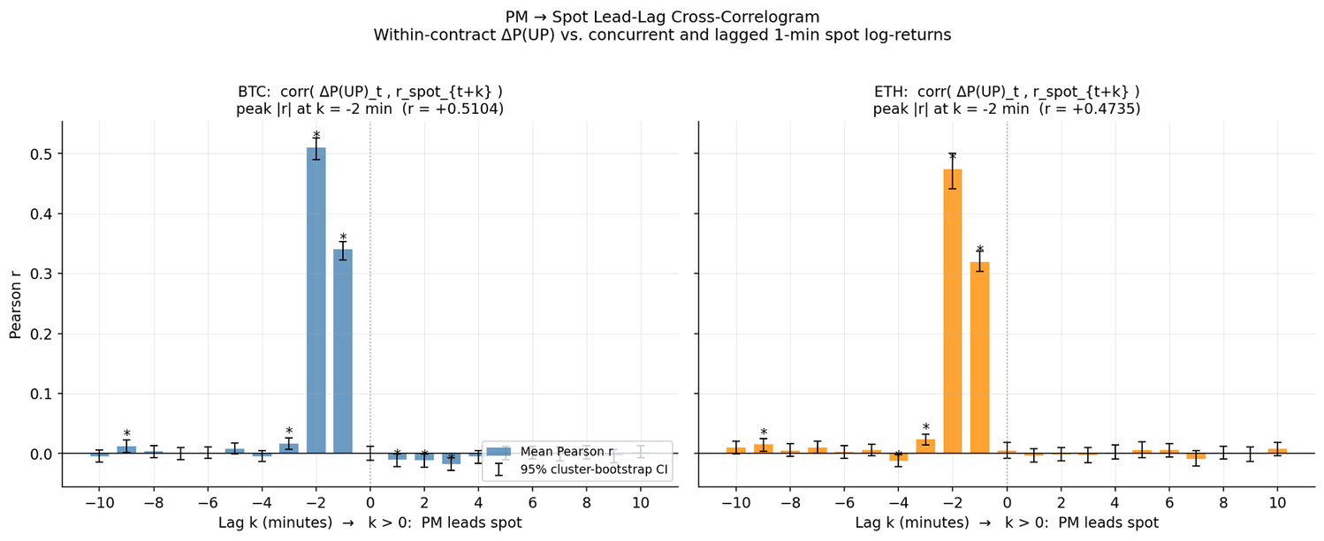

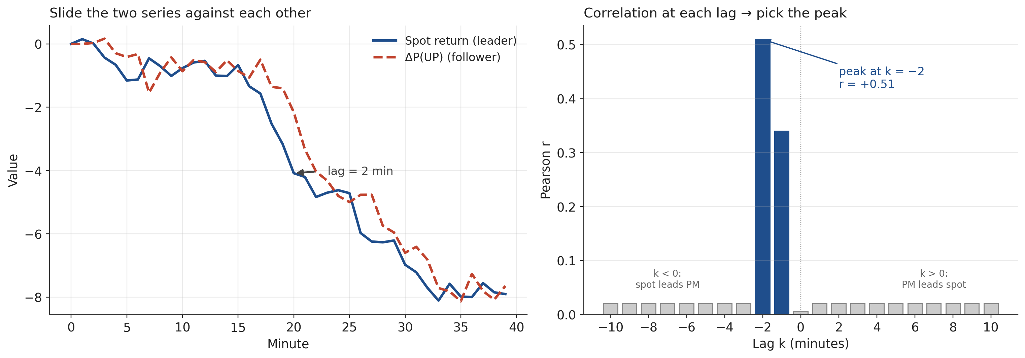
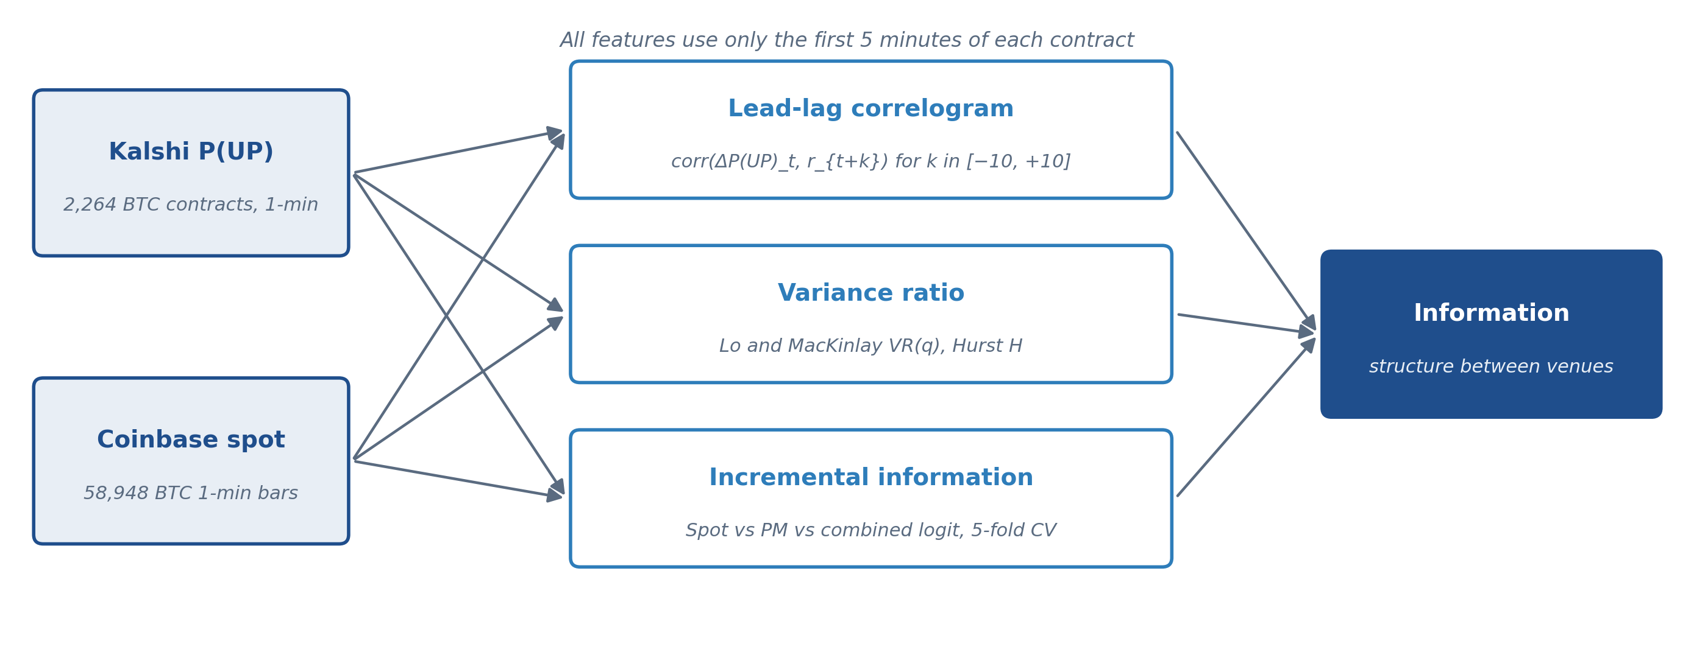
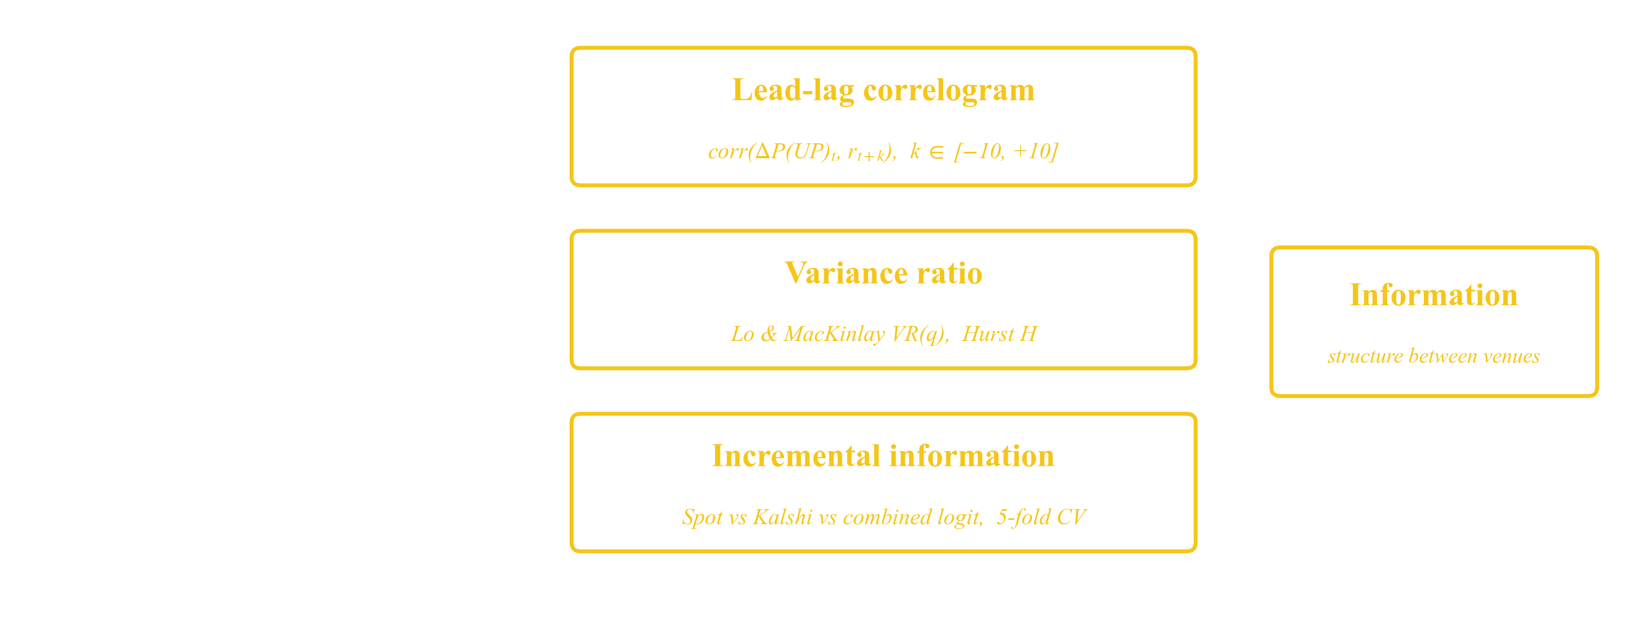
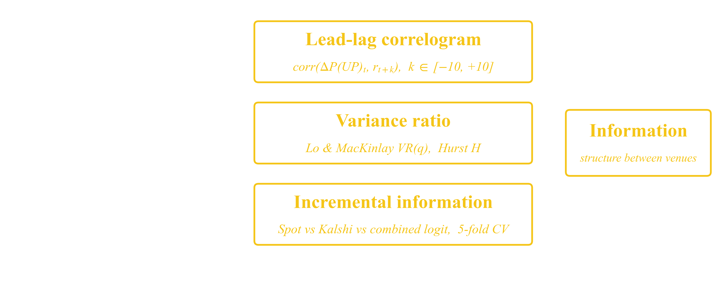
Testing the Signal Against the Underlying
Section roadmap
Coinbase BTC 1-min spot joined to Kalshi by UTC minute
Xavi: signal development on the Kalshi panel
Me: testing whether that signal carries information above the asset it predicts
Every Kalshi contract resolves on BTC spot — the natural benchmark
Question: does Kalshi P(UP) add directional information above the spot tape?
Three diagnostics ahead: lead-lag, variance ratio, incremental information

Slide 10
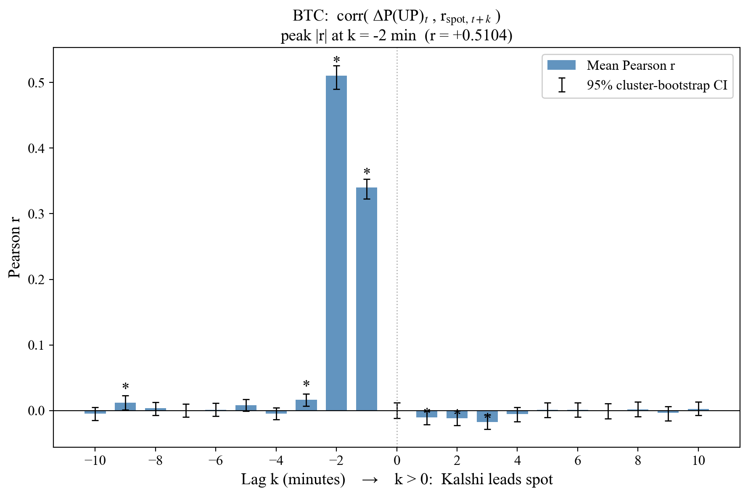
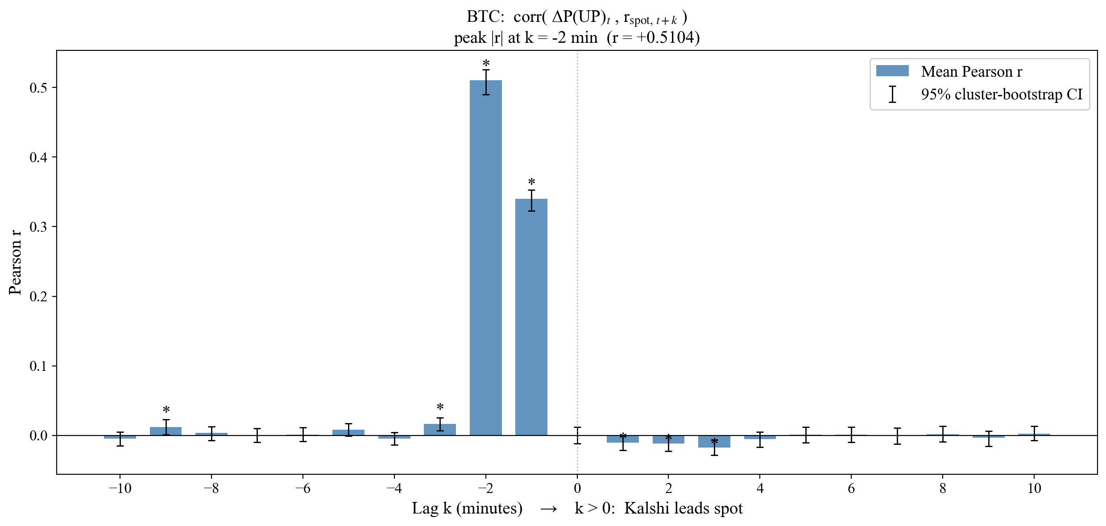
Spot Leads P(UP) by Two Minutes
Pearson correlation at minute lag k
Positive k: PM leads spot
Negative k: spot leads PM
Cluster bootstrap CIs over 2,264 contracts
Lead-Lag Correlogram
for k ∈ [−10, +10] minutes
Peak at lag k = −2: r = +0.510 BTC, +0.474 ETH
Contemporaneous correlation (k = 0) is statistically zero
Every PM-leading lag (k ≥ 0) is zero or negative
Cameron, Gelbach & Miller (2008). Bootstrap-based improvements for inference with clustered errors. doi.org/10.1162/rest.90.3.414

Slide 11


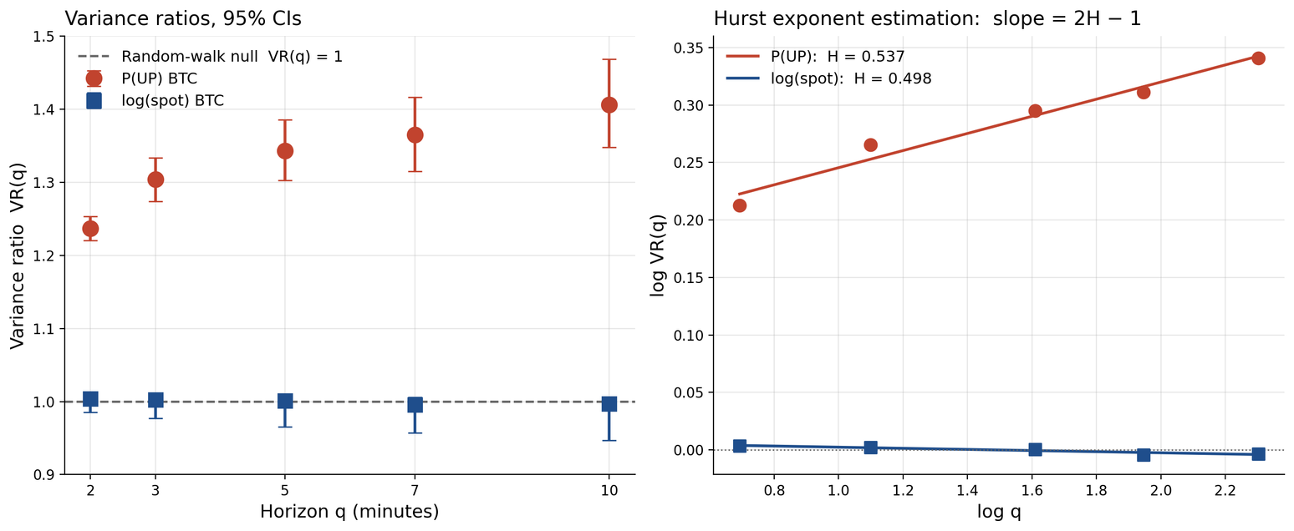
P(UP) Deviates from the Martingale Null
Variance Ratio
(Lo and MacKinlay 1988)
Tests random-walk null on each series separately
Inputs: P(UP) changes, log spot returns
VR > 1: positive serial correlation (under-reaction)
Hurst H from slope of log VR(q) vs log q
q ∈ {2, 3, 5, 7, 10} minutes
Null: VR(q) = 1 at every horizon q
Spot VR(q) within 1% of 1.00 at every horizon; Hurst H = 0.498
P(UP): VR(2) = 1.24, VR(10) = 1.41; Hurst H = 0.537 (CI excludes 0.5)
P(UP) under-reacts to its own information at the 1 to 10 minute horizon
Lo & MacKinlay (1988). Stock market prices do not follow random walks. doi.org/10.1093/rfs/1.1.41

Slide 12
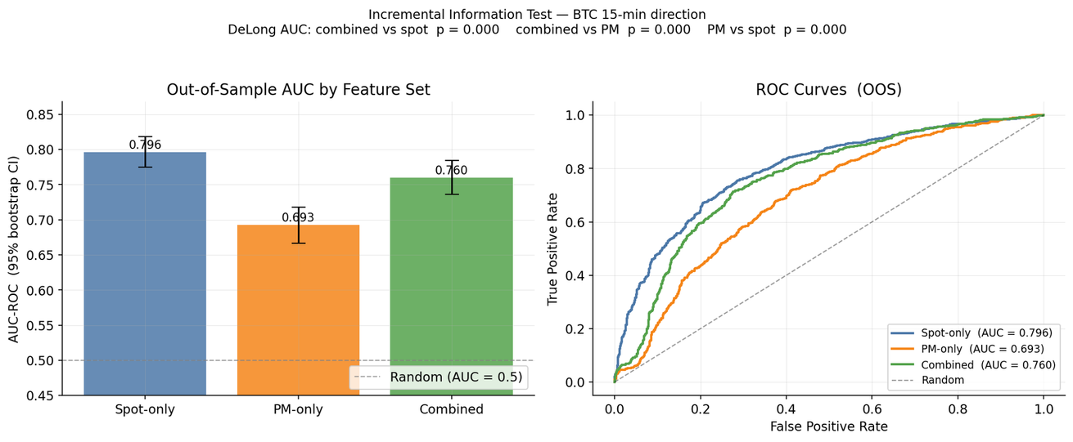
Kalshi Features Add No Content Above Spot
Incremental Information
Logistic regression on 1,595 OOS contracts
Spot-only: 8 features (returns, vol, volume)
Kalshi-only: 11 features from the Kalshi panel
Combined: union, 19 features
Bootstrap 95% CIs on out-of-sample AUC
AUC: Spot vs Kalshi vs Combined
5-fold time-series CV
DeLong p-values
Spot-only AUC = 0.796 [0.78, 0.82] on 1,595 OOS contracts (73% accuracy)
PM-only AUC = 0.693; Combined AUC = 0.760
Adding PM degrades a spot-only model (DeLong p < 0.001)
DeLong, DeLong & Clarke-Pearson (1988). Comparing the areas under two or more correlated ROC curves. doi.org/10.2307/2531595

Slide 13
Limitations & Next Steps
Identification: Coinbase candle aggregation, scraper averaging, and substantive reaction confound the 2-min lag (bounded ≥ 1 min); tick-level spot would tighten the bound
Inference: cluster bootstrap by contract may understate dependence across overlapping contracts; calendar-time block bootstrap would be more conservative
Generalizability: six-week sample is one regime; replication during stress events (CPI releases, BTC-specific news shocks) is essential
Next: Hasbrouck (1995) information share in a VECM of Kalshi-implied price and spot; conviction spread vs HAR-RV and GARCH for realized volatility

Slide 14
References
Wolfers, J., and Zitzewitz, E. (2004). Prediction markets. Journal of Economic Perspectives, 18(2), 107–126. DOI: 10.1257/0895330041371321
Cameron, A. C., Gelbach, J. B., and Miller, D. L. (2008). Bootstrap-based improvements for inference with clustered errors. Review of Economics and Statistics, 90(3), 414–427. DOI: 10.1162/rest.90.3.414
Lo, A. W., and MacKinlay, A. C. (1988). Stock market prices do not follow random walks: Evidence from a simple specification test. Review of Financial Studies, 1(1), 41–66. DOI: 10.1093/rfs/1.1.41
DeLong, E. R., DeLong, D. M., and Clarke-Pearson, D. L. (1988). Comparing the areas under two or more correlated receiver operating characteristic curves: A nonparametric approach. Biometrics, 44(3), 837–845. DOI: 10.2307/2531595

Slide 15
Questions?
Add citations, names, and emails here

