Slide 1
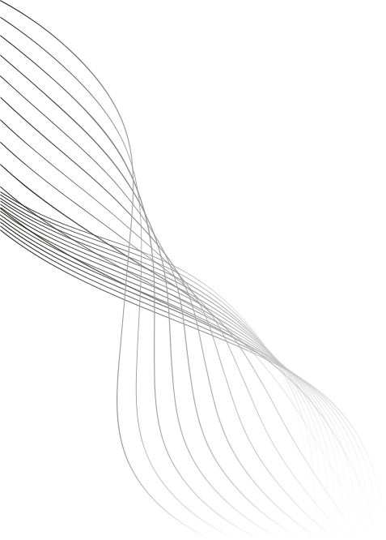

Prediction Markets Probabilties as a Quant Data Source
Characterizing Kalshi 15-minute BTC Contracts
Project Lead: Xavier Vortigern
Quantitative Developer: Zoe Tomlinson
5/27/26
Oregon Quant Group

Slide 2
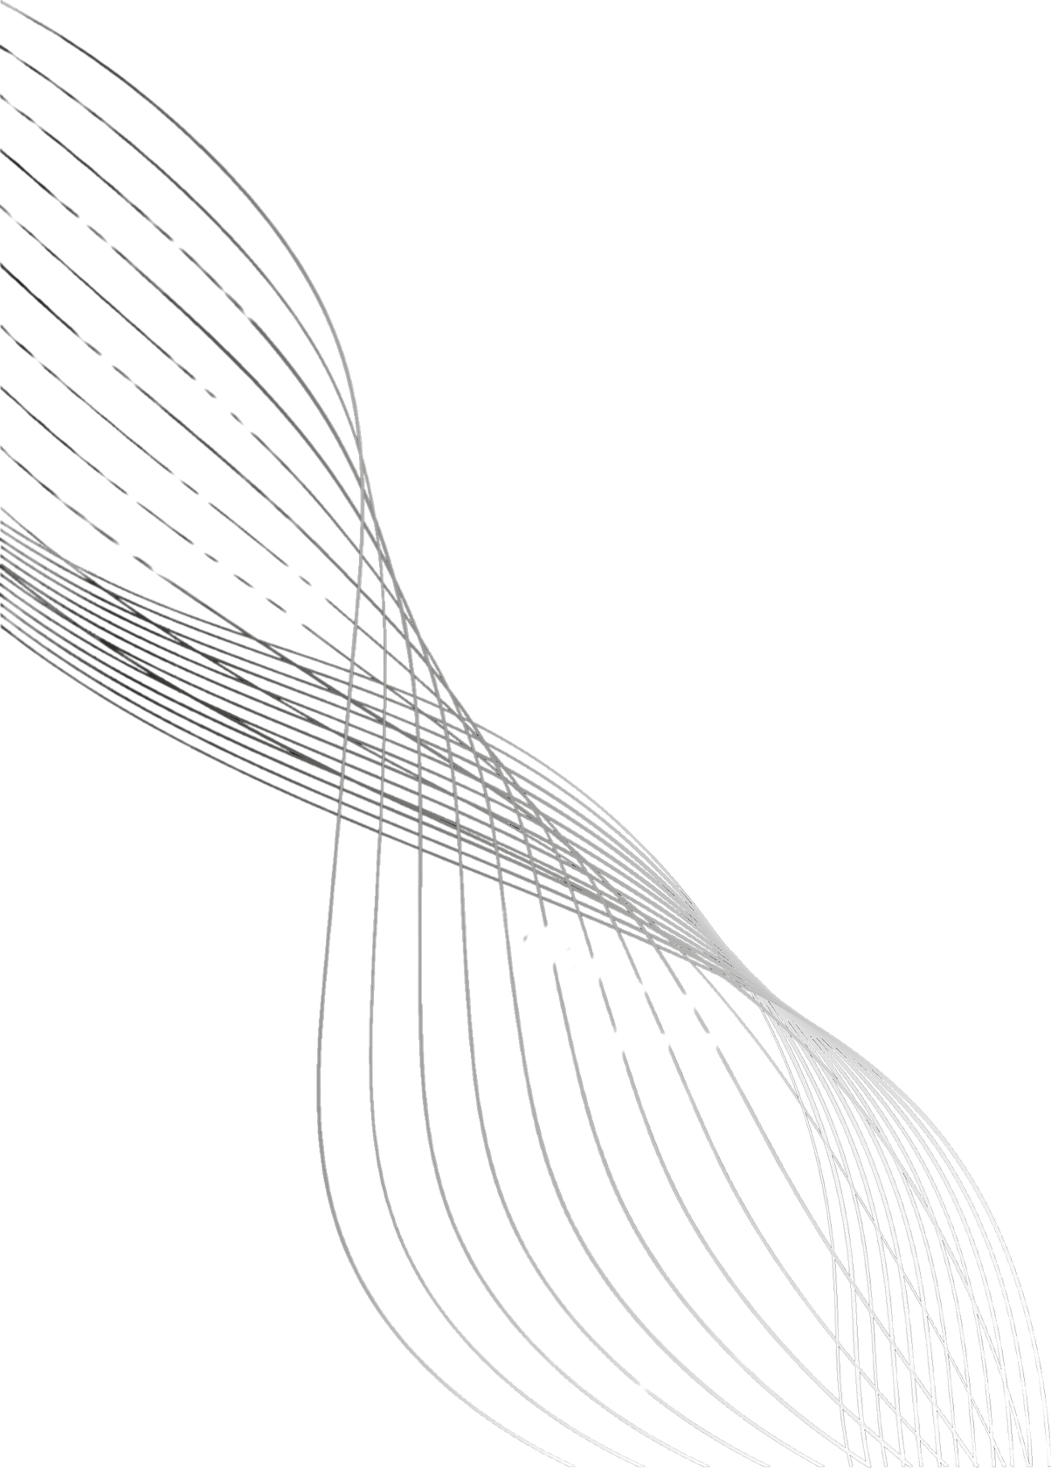



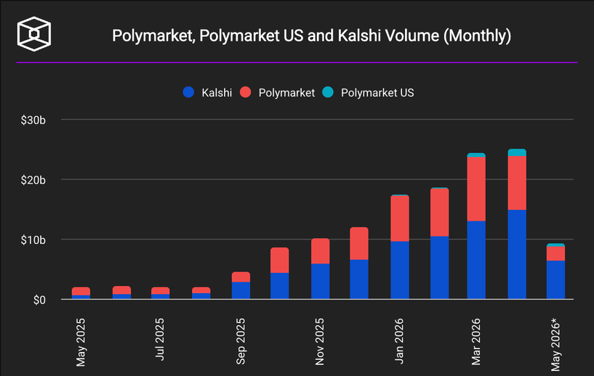
What are Prediction Markets?
Marketplaces where participants trade contracts on the outcome of future events, aggregating beliefs into prices.
Binary Contracts, trading price reflects implied probability.
Contracts spanning politics, weather, economics, sports
Recession this year?
Will 2026 be the hottest year ever?
"Wisdom of the Crowd" — aggregation works best when participants are independent, diverse, and bear the cost of error (Surowiecki, 2004)
Notes:
A binary contract pays $1 if the event happens and $0 if it doesn't. The contract's current trading price is therefore the market's implied probability of that outcome. A contract trading at $0.62 means the market collectively estimates a 62% chance the event resolves YES.
Participants buy and sell these contracts with real capital. Traders who price events accurately profit; those who don't lose money. Prices update continuously as new information arrives and as traders react.
A contract trading at $0.62 means the market estimates a 62% chance that the event resolves to YES.

Slide 3
Theoretical Foundation
Prediction markets aggregate dispersed private information into a price. With real capital at risk, traders are incentivized toward true probabilities. (Wolfers & Zitzewitz, 2004)
Agarwal et al. (2025)
292M trades, 327K contracts across Kalshi and Polymarket; calibration varies by market category.
Why it matters:
Crypto contracts need to be characterized as a distinct category.
Mohanty & Krishnamachari (2026)
Daily Kalshi macro contract probabilities forecast crypto realized volatility.
Why it matters:
This study examines each contract's own price as a signal, looking at direction rather than volatility.
Gap:
No prior work characterizes short-horizon crypto event contracts as a standalone data source at intraday resolution.

Slide 4
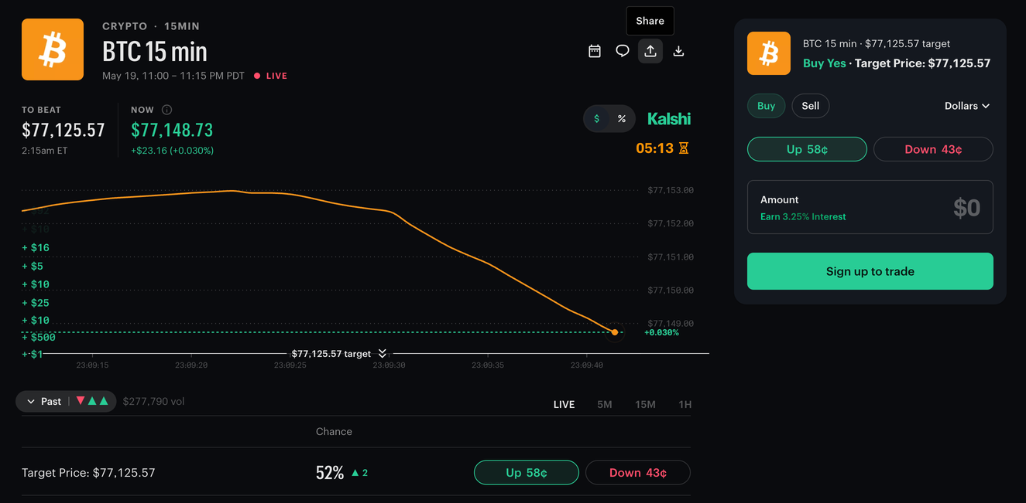
Data & Signals
Kalshi 15-min BTC Contracts
Per-Contract Observation
Binary contracts on whether BTC will end above or below a given spot price over the following 15-minute window
At 10 second intervals, compute the midpoint of best bid and ask price. These are averaged into 1-minute buckets, yielding a 15-point time series of P(UP) per contract.
Dataset:
Sourced from Kalshi’s Trade API
Collected over a six-week opportunistic window
Covers ~2,200 BTC contracts
Drop contracts with <15 observations, unresolved, or zero-volume
Notes:
Dataset:
Sourced from Kalshi’s Trade API
Collected over a six-week opportunistic window
Covers ~2,200 BTC contracts
Drop contracts with <15 observations, unresolved, or zero-volume
Fields logged per minute
P(UP), P(DOWN)
Momentum - ΔP(UP) from prior minute
Majority prediction
Market ticker & timestamp
Final outcome and volume (post-resolution)

Slide 5
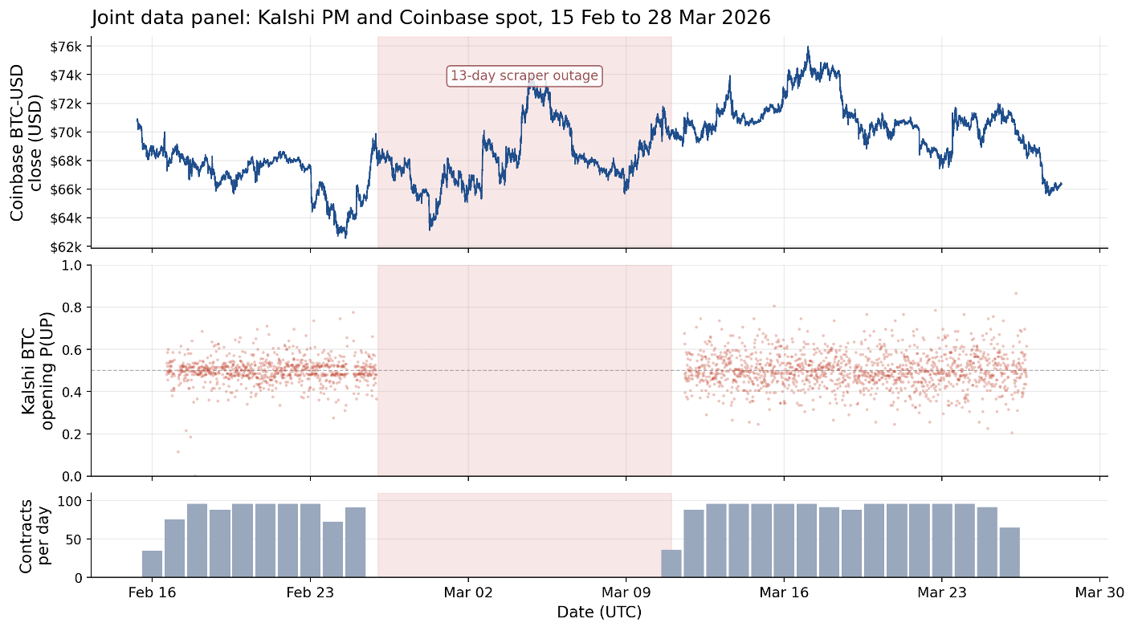
Spot Price Data Sourced from Coinbase API
Coinbase API
Coinbase BTC 1-minute candles,
Public Exchange API
60-second granularity
Window
15 Feb - 28 Mar 2026
58,948 bars
Joined to Kalshi by UTC minute timestamp
31,658 joined minute-level observations
Notes:
We looked at some other options for spot price data, such as binance, but coinbase ultimately provided the most consistent data

Slide 6
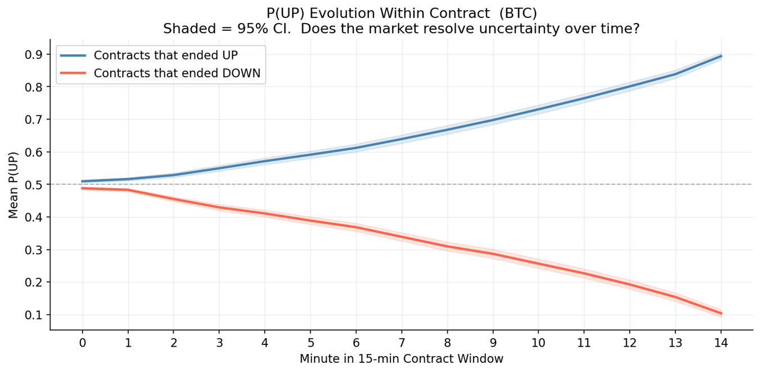
Probability Convergence Within Contracts
How the Market Resolves
Majority prediction accuracy starts at roughly 50/50 and rises monotonically to ~95% by minute 14
As the contract nears expiry, BTC price has largely determined its final direction
Any predictive signal must be drawn from early-window data, otherwise we conflate convergence with information

Slide 7
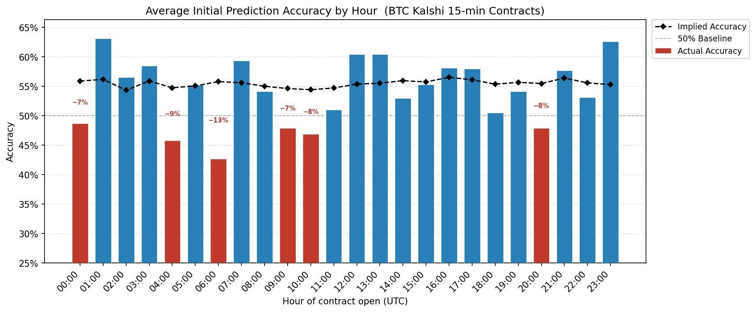
Intraday Variability in Realized Accuracy
Implied accuracy is roughly flat at 55–56% across all hours.
Realized accuracy varies substantially — eight hours show an overconfidence gap exceeding 5 percentage points (red bars)

Slide 8
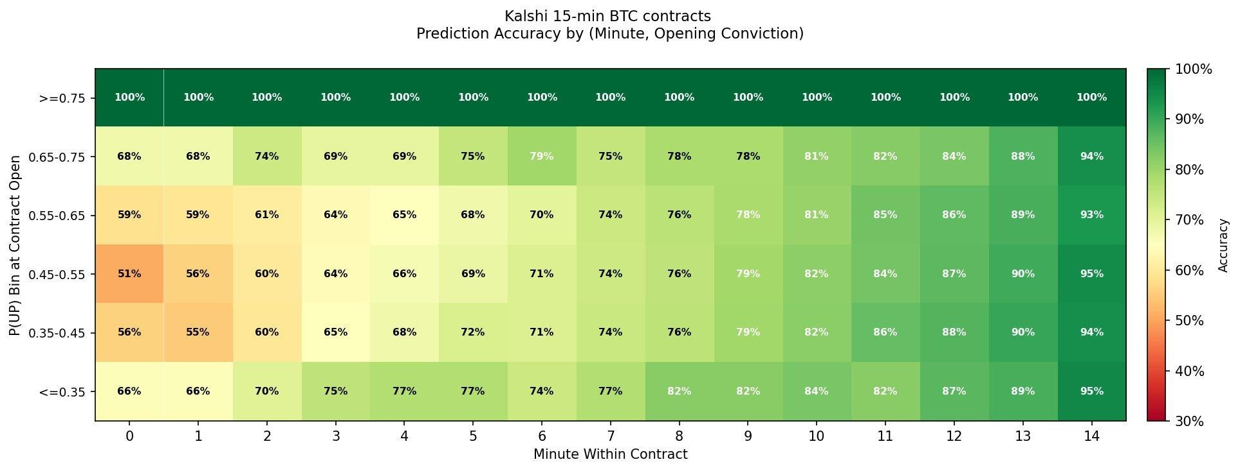
Intraday Variability in Realized Accuracy
Conviction at Open Matters: Within any minute, accuracy increases with opening conviction. Contracts opening at P(UP) ≥ 0.75 are 100% accurate from minute 0, near 50% contracts only cross 60% by minute 2.

Slide 9
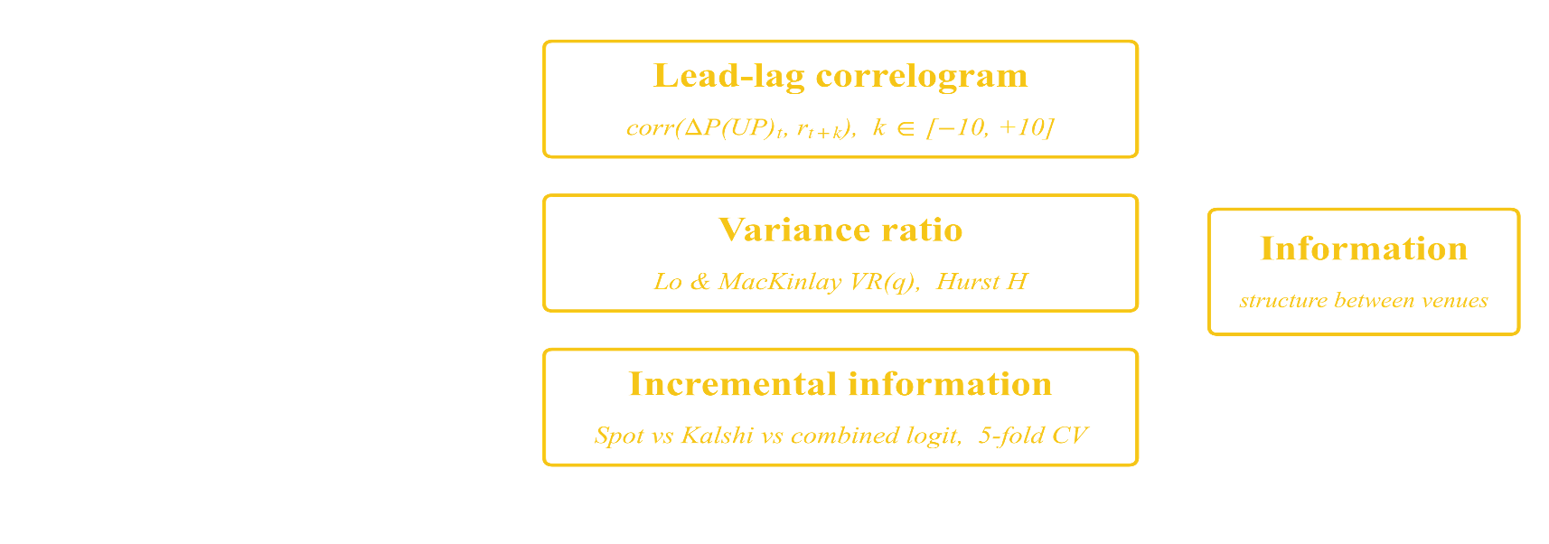
Testing the Signal Against the Underlying
Does Kalshi P(UP) carry directional information beyond what is already in BTC spot?

Slide 10
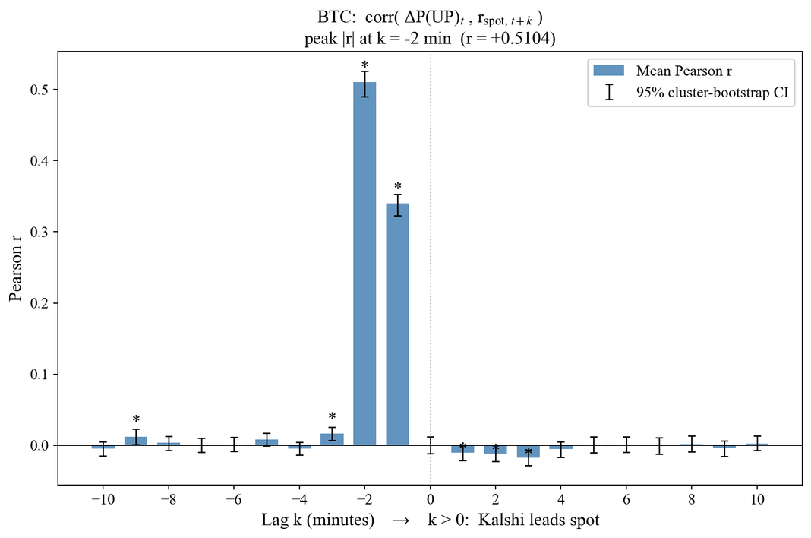
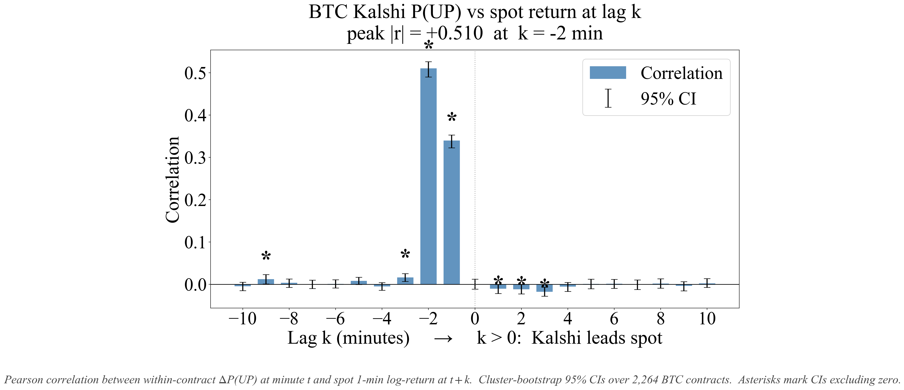

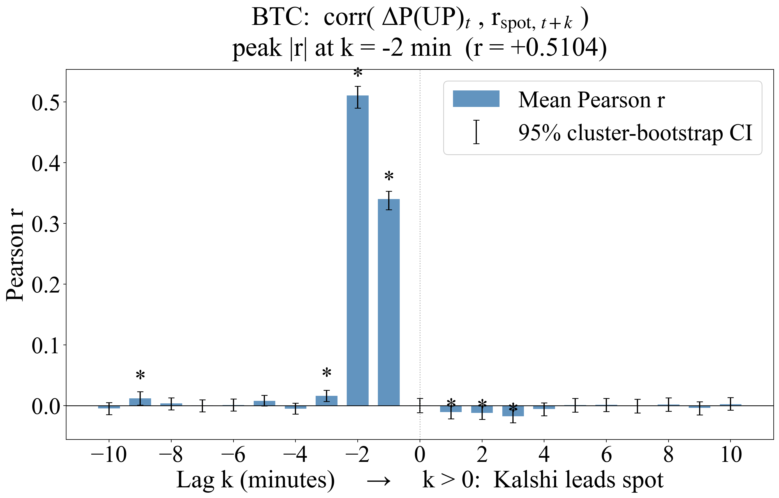
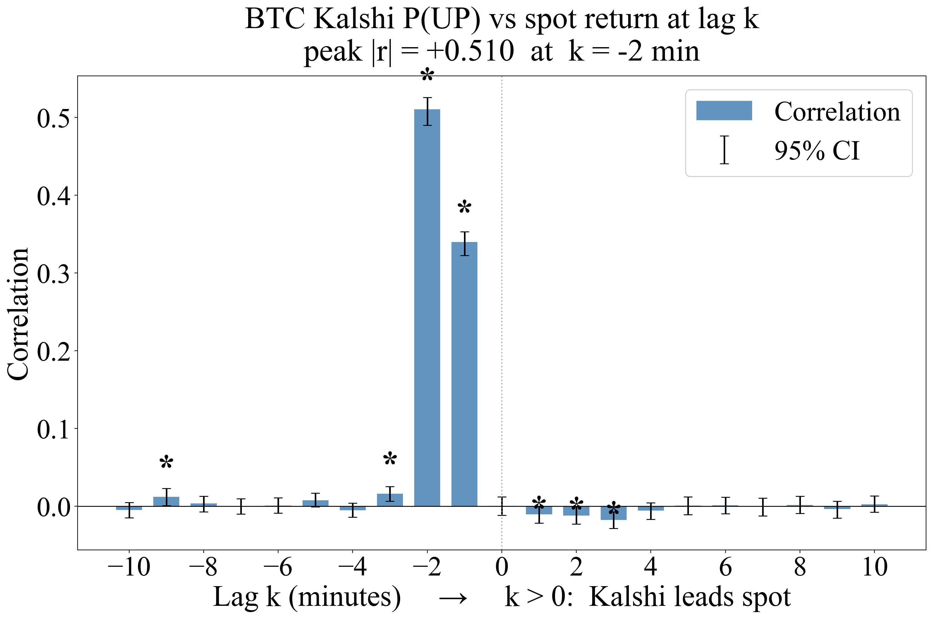
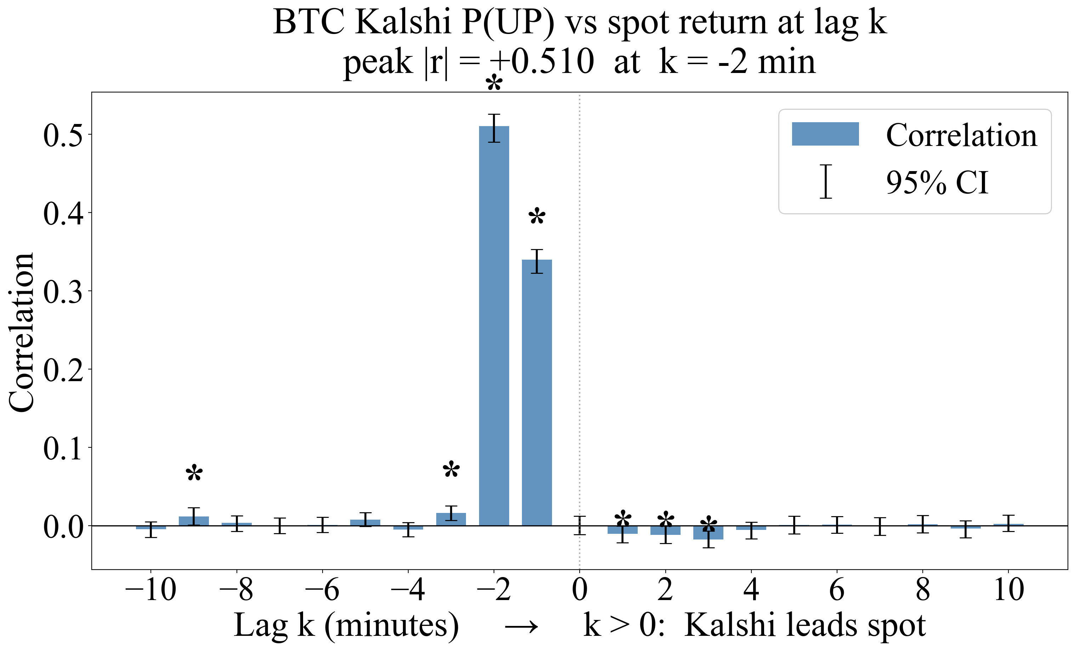
Identifying Lag with Pearson Cross-Correlation
Correlation with Lag k
Spot leads Kalshi P(UP) by Two Minutes
Peak at lag k = −2
Every Kalshi-leading lag (k ≥ 0) is zero or negative
Pearson correlation at minute lag k
Positive k: Kalshi leads spot
Negative k: spot leads Kalshi
Cluster bootstrap CIs over 2,264 contracts
Equation
for k ∈ [−10, +10] minutes
Cameron, Gelbach & Miller (2008). Bootstrap-based improvements for inference with clustered errors. doi.org/10.1162/rest.90.3.414

Slide 11
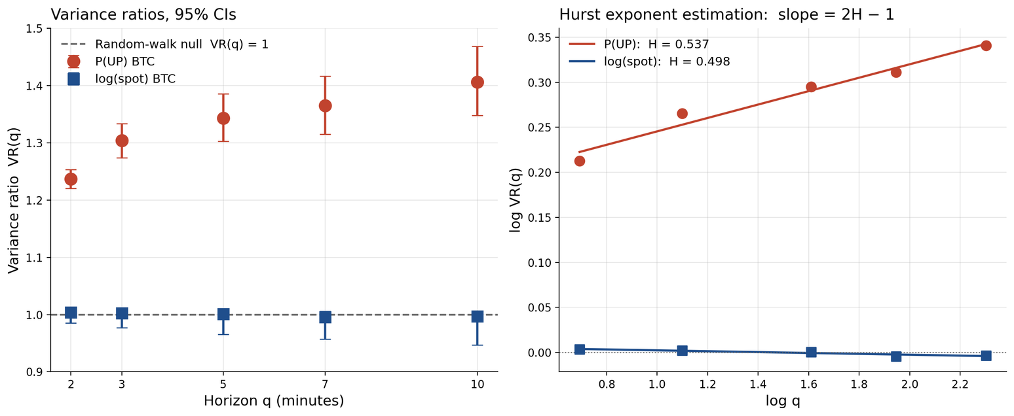
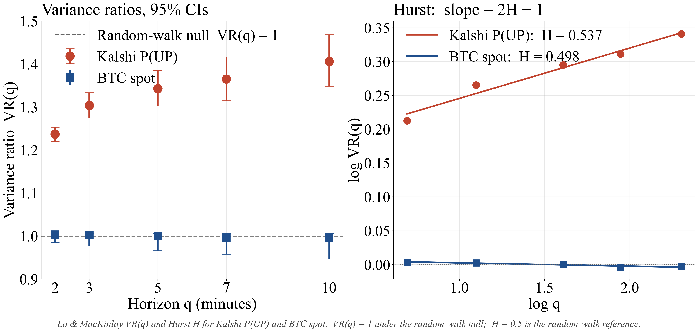

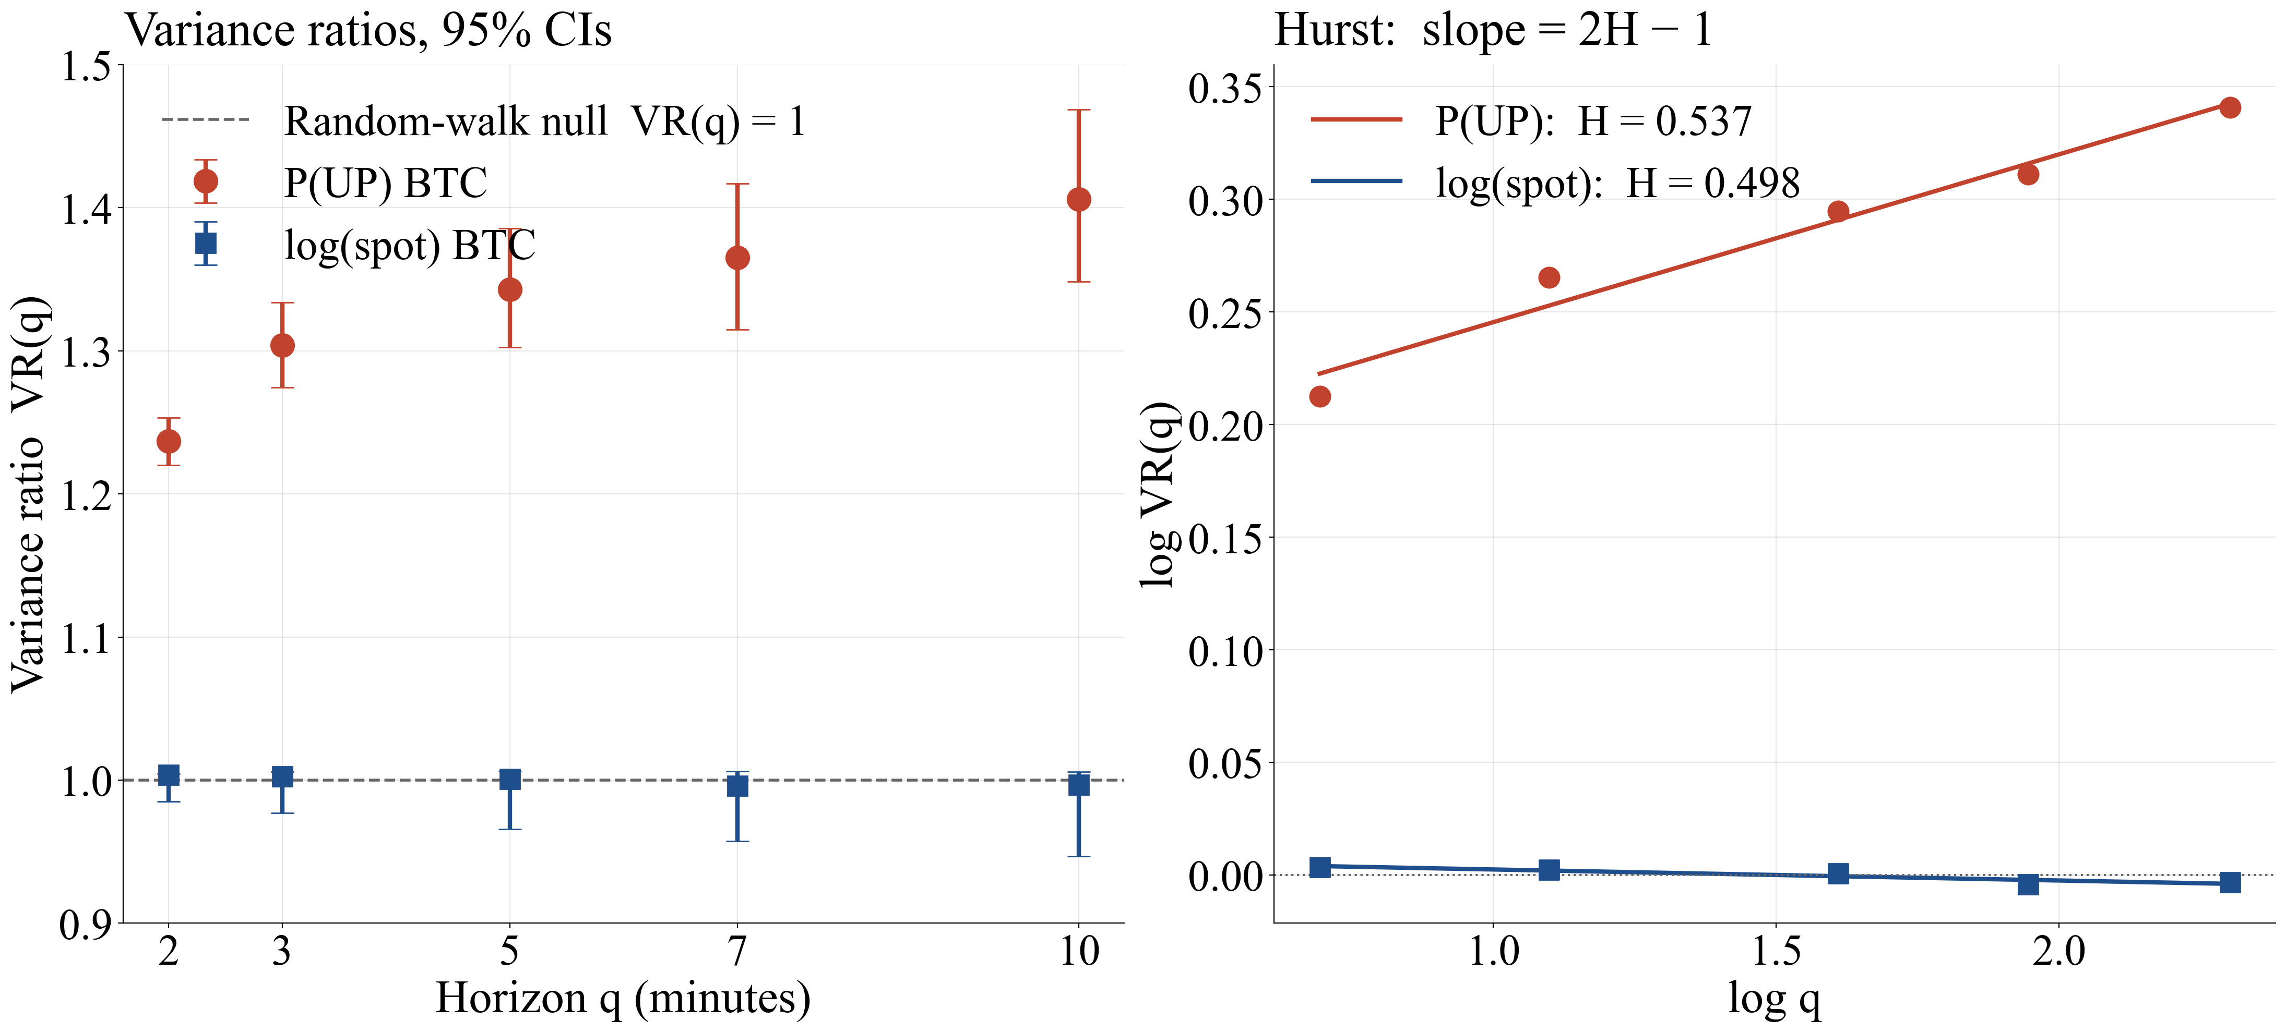
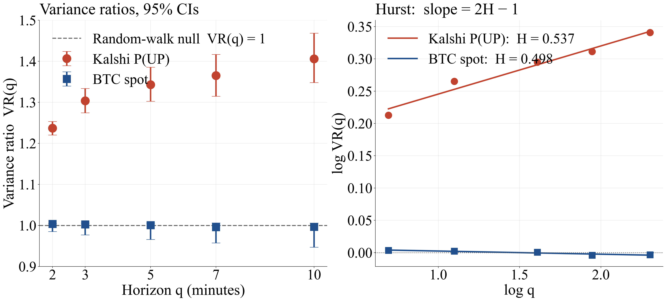
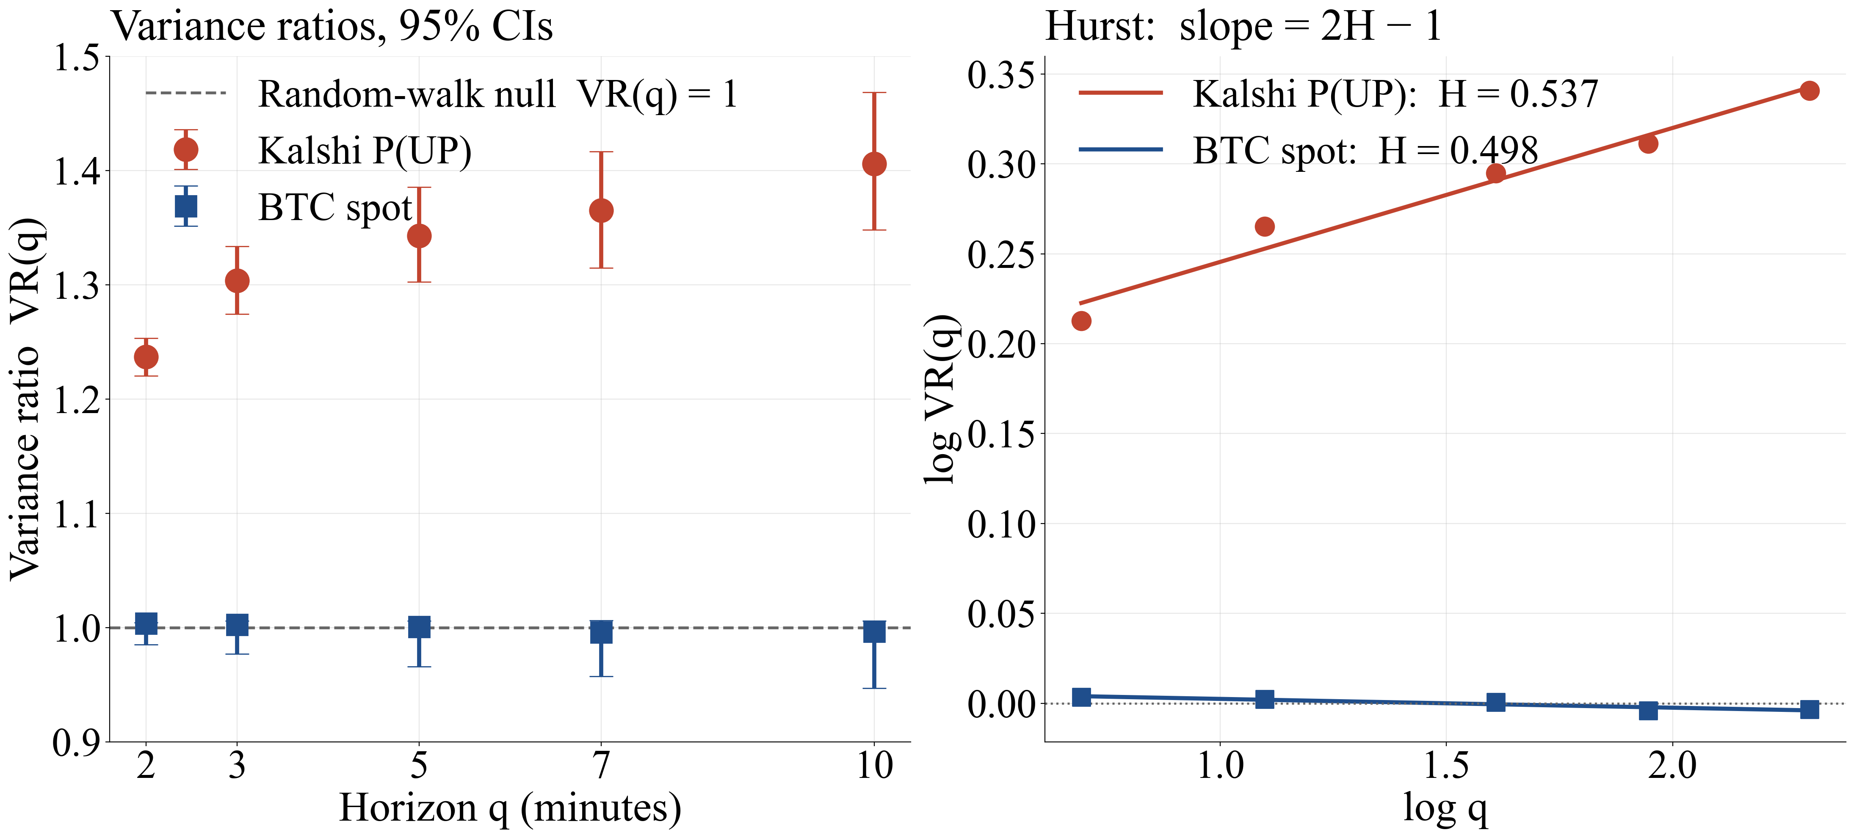
Variance Ratio (VR) Test for Efficient Pricing
Random-Walk Null
P(UP) Deviates from the Martingale Null
Variance is linear w.r.t. time
VR > 1: under-reaction
VR < 1: mean reversion
Hurst H: one-number summary of the log VR(q) vs log q slope
H = 0.5 is the null
Spot passes the null
VR(q) within 1% of 1.00 and H = 0.498
P(UP) fails the null
VR(2) = 1.24, VR(10) = 1.41 and H = 0.537
Equation
equals 1 under the martingale null
Lo, A. W., and MacKinlay, A. C. (1988). Stock market prices do not follow random walks: Evidence from a simple specification test. Review of Financial Studies, 1(1), 41–66. DOI: 10.1093/rfs/1.1.41

Slide 12
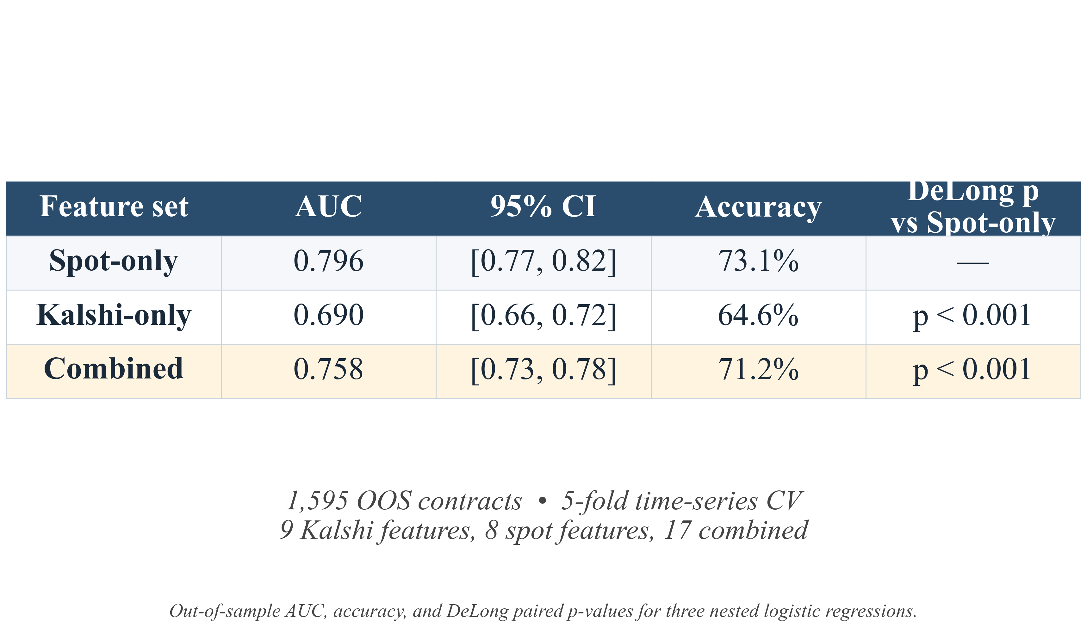
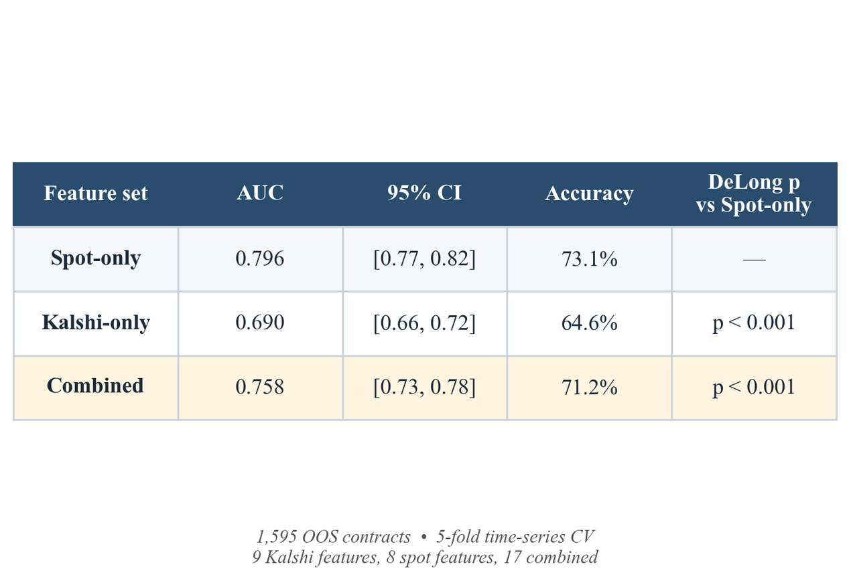
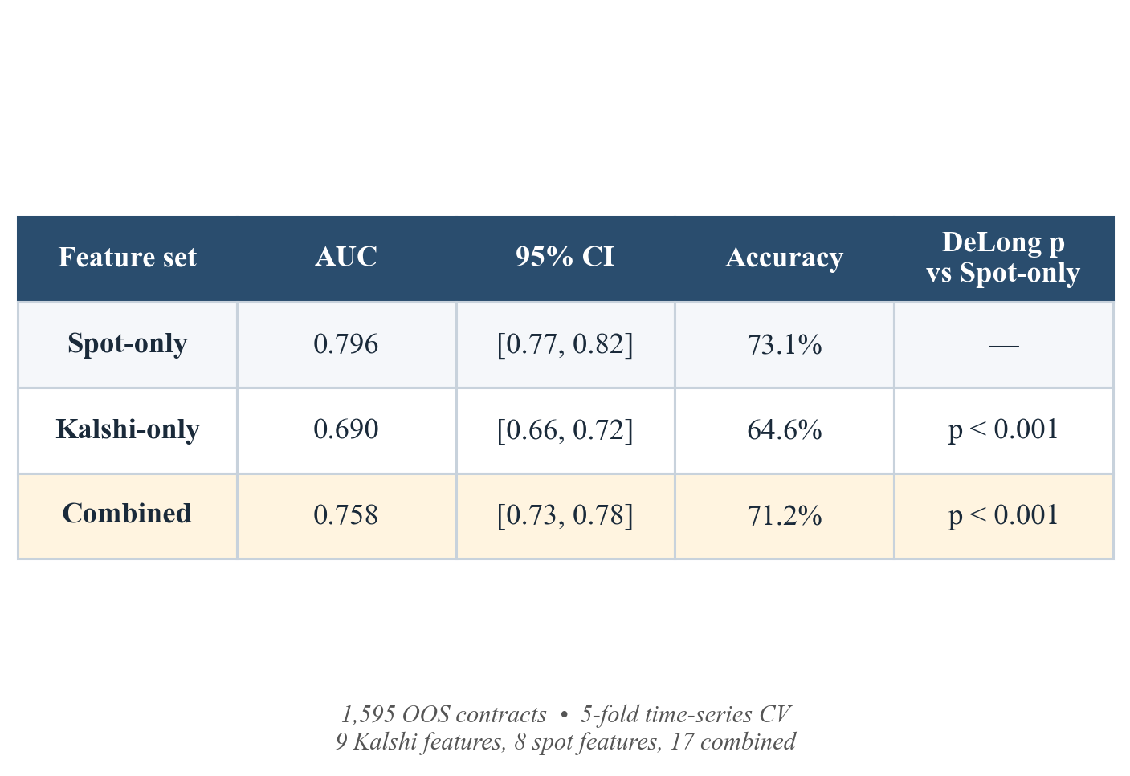
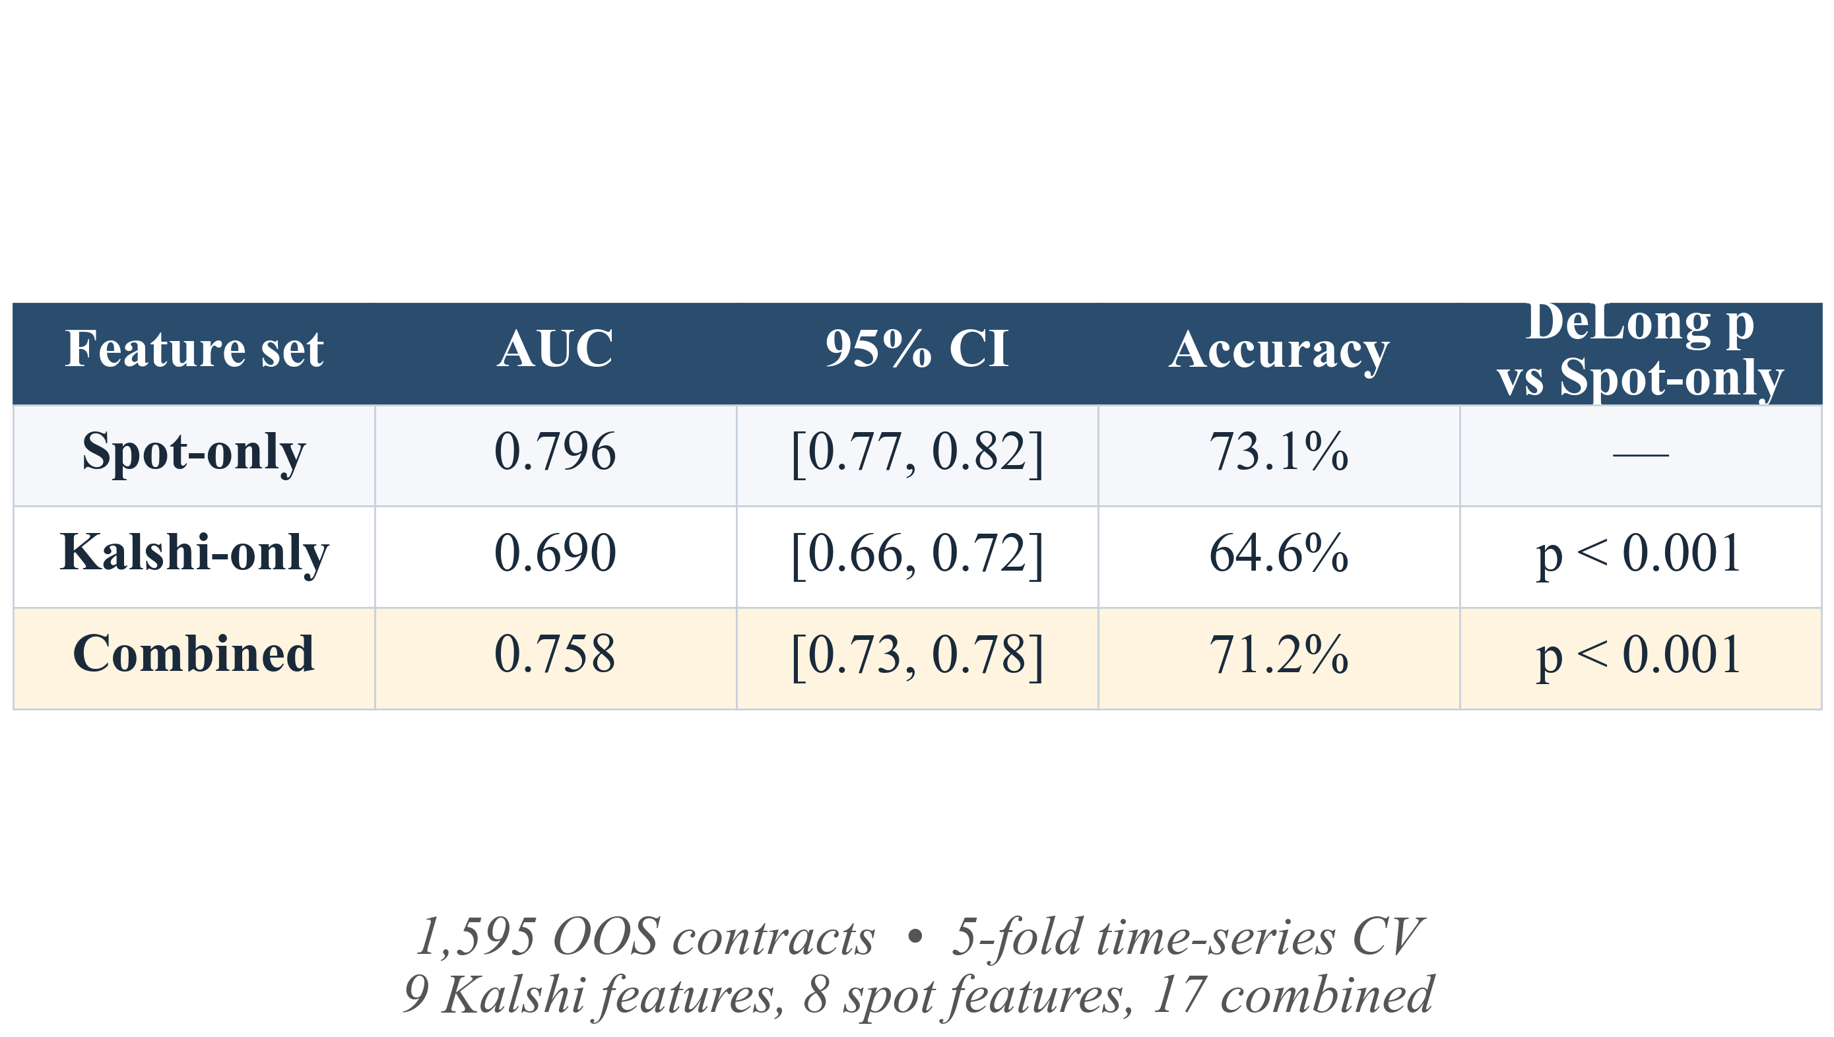
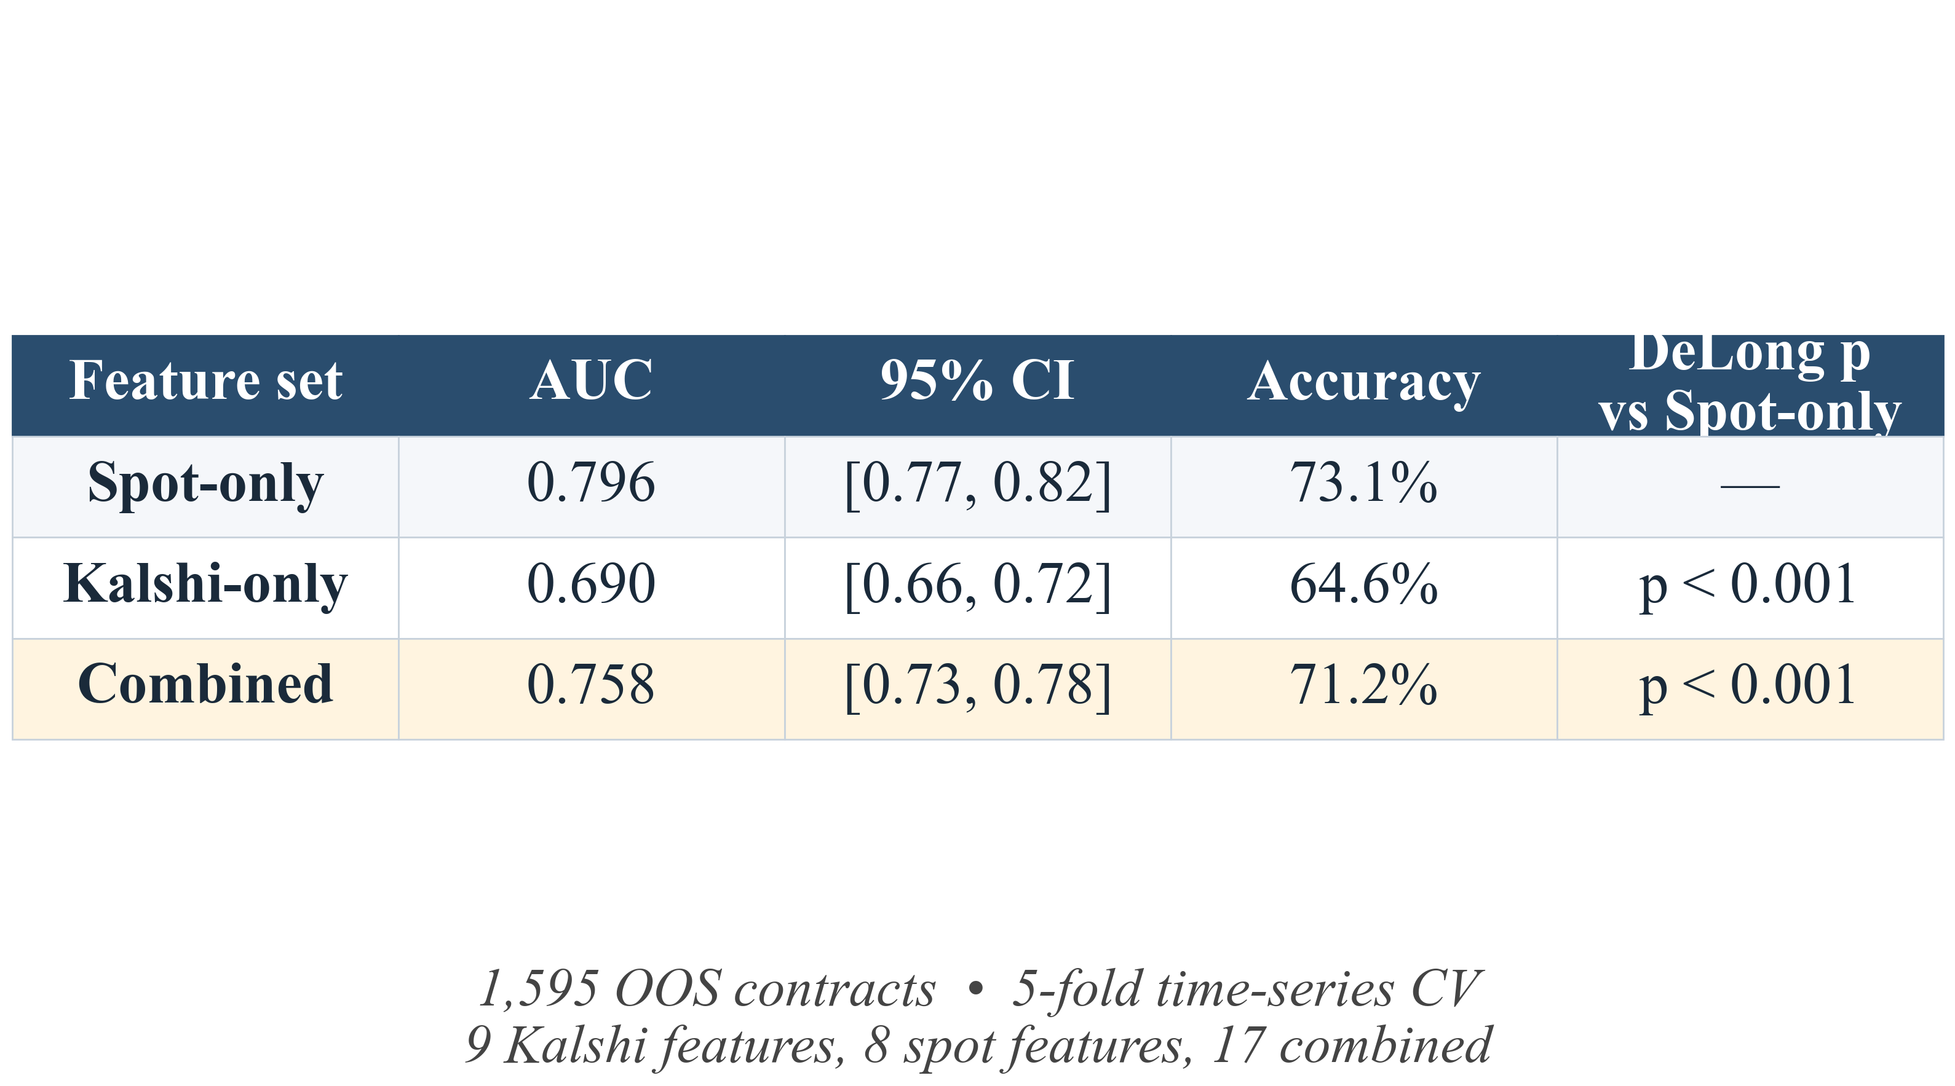
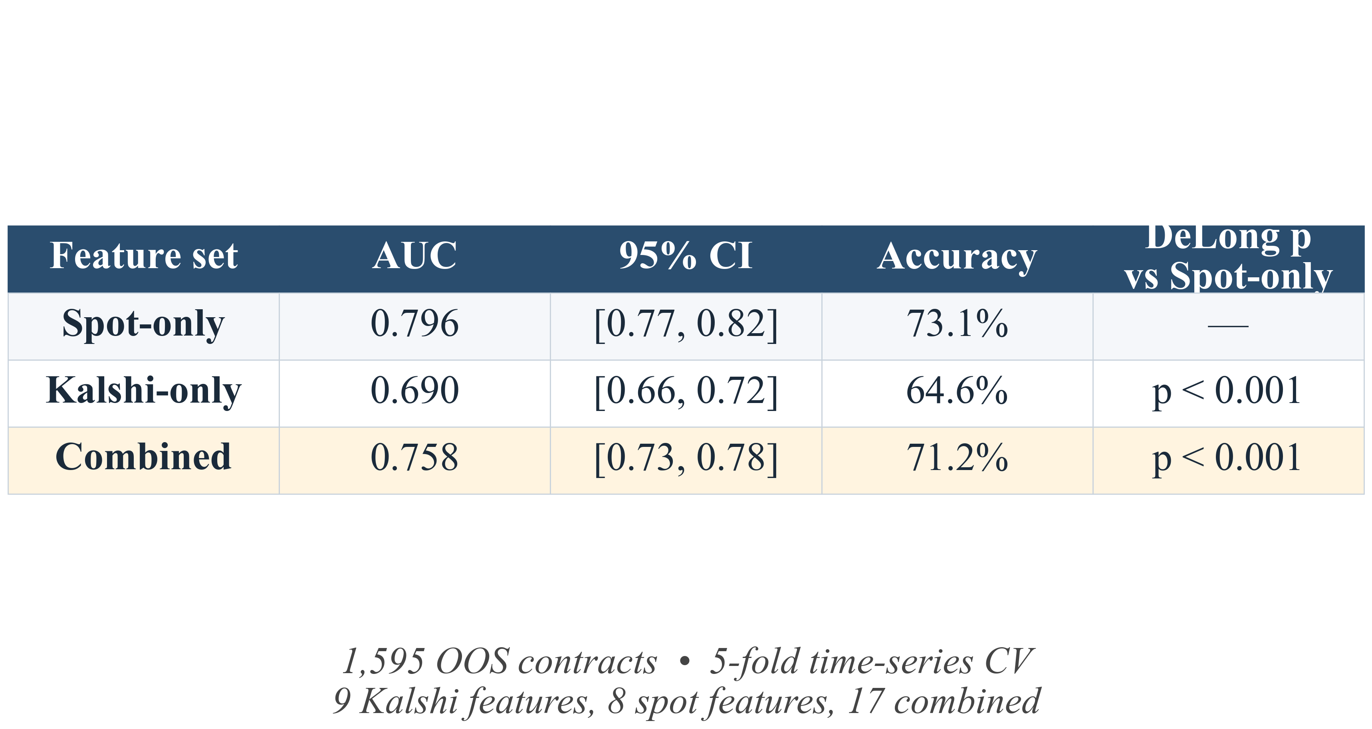
Linear Classification on Out-of-Sample Contracts
Feature Sets
Kalshi Features Add No Content Above Spot
Spot-only: 8 features (returns, vol, volume)
Kalshi-only: 9 features from the Kalshi panel
Combined: union, 17 features
Spot-only AUC = 0.796 [0.78, 0.82] on 1,595 OOS contracts (73% accuracy)
PM-only AUC = 0.693; Combined AUC = 0.760
Adding PM degrades a spot-only model (DeLong p < 0.001)
Logistic Regression
5-fold time-series CV on 1,595 OOS contracts
DeLong paired non-parametric test
Bootstrap 95% CIs on out-of-sample AUC
DeLong, E. R., DeLong, D. M., and Clarke-Pearson, D. L. (1988). Comparing the areas under two or more correlated receiver operating characteristic curves: A nonparametric approach. Biometrics, 44(3), 837–845. DOI: 10.2307/2531595

Slide 13
Limitations & Next Steps
Identification
Inference
Coinbase candle aggregation, scraper averaging, and substantive reaction confound the 2-min lag (bounded ≥ 1 min); tick-level spot would tighten the bound
Cluster bootstrap by contract may understate dependence across overlapping contracts; calendar-time block bootstrap would be more conservative
Generalizability
Next Steps
Six-week sample is one regime; the 2-min lag and the 0.10 AUC gap should not be treated as structural until they replicate during stress events (CPI releases, BTC-specific news shocks).
1. Price-discovery decomposition — Hasbrouck (1995) information share in a VECM of Kalshi-implied price and spot.
2. Second-moment forecasting — conviction spread |P(UP) − 0.5| vs HAR-RV and GARCH for realized volatility.
3. Stress-event replication — rerun the three diagnostics during high-vol windows (CPI releases, BTC news shocks) to test whether the lag and the null incremental result hold under stress.

Slide 14
References
Wolfers, J., and Zitzewitz, E. (2004). Prediction markets. Journal of Economic Perspectives, 18(2), 107–126. DOI: 10.1257/0895330041371321
Cameron, A. C., Gelbach, J. B., and Miller, D. L. (2008). Bootstrap-based improvements for inference with clustered errors. Review of Economics and Statistics, 90(3), 414–427. DOI: 10.1162/rest.90.3.414
Lo, A. W., and MacKinlay, A. C. (1988). Stock market prices do not follow random walks: Evidence from a simple specification test. Review of Financial Studies, 1(1), 41–66. DOI: 10.1093/rfs/1.1.41
DeLong, E. R., DeLong, D. M., and Clarke-Pearson, D. L. (1988). Comparing the areas under two or more correlated receiver operating characteristic curves: A nonparametric approach. Biometrics, 44(3), 837–845. DOI: 10.2307/2531595

Slide 15
Questions?
Add citations, names, and emails here

