Slide 1
PHASES 1–3 · OSU LARGE WAVE FLUME · TEAMER REVIEW RESPONSE
Station-keeping mooring in the flume
for 1 buoy, 1 cluster and the 4×4 platform
Which mooring we need, and how the flume size influences it
Answer: four soft horizontal lines at the waterline, T_surge ≈ 15 s. On the coupled models the heave period shifts ≤ 0.45 %, pitch < 1 %, the buoy-tilt mode ≤ 2.4 %, with zero trim.

Slide 2
SCOPE
The question, and what the mooring has to do
▪ Reviewer: which mooring do we need, and how could the flume size influence it?
▪ Role: station-keeping only. Hold each article in the test section against the mean wave drift, without changing what we measure (free decay, heave/pitch response, accelerations).
▪ Field site is deep water: a 2.7 m-deep flume cannot hold a scale model of the field mooring → an equivalent soft mooring, characterised and put in the model.
▪ Test waves: H = 0.2–0.5 m, T = 1.4–4.0 s. Flume: OSU LWF, 3.66 m wide, 2.7 m deep, 104 m long.
Article
Mass
Surge inertia M+A₁₁
Span / wall gap
1 buoy
22 kg
40 kg
0.29 m / 1.69 m
1 cluster
88 kg
167 kg
0.88 m / 1.39 m
4×4 platform
358 kg
669 kg
2.06 m / 0.80 m
Articles at the 45° test orientation: the 4×4 grid and the cluster sit square to the flume, two (cluster) or four (platform) buoys facing the waves. Each buoy is the OSU spar + heave plate (0.159 m spar, 2.52 s heave, 2.11 s pitch).

Slide 3
METHOD
Approach: size it simply, then check it on the full models
1 Hold it
2 Keep it soft
3 Don't couple
Mean drift sets the offset: δ = F / Kx. Drift from splash-zone drag on every spar, taken for a fixed body (an upper bound).
Surge period well above the waves: T_surge ≥ 3–5 × 4 s, so the mooring barely resists wave-frequency motion. Baseline 15 s.
Lines horizontal at the waterline, where the drift acts: no heave or pitch stiffness, no lever arm, no trim.
Kx = (M + A₁₁)(2π / T_surge)² F_drift = (2 / 3π) ρ Cd D A U², U = Aω coth kh
▪ Then check on the real FloatSim models — 6-DOF buoy, 30-DOF cluster, 126-DOF platform, with the pinned joints and full inter-buoy hydrodynamics: natural periods moored vs unmoored, and the static response to the drift, for every realistic attachment point.
▪ Finally refine the drift with the article moving (drag-limited time domain, relative velocity at each spar's waterline).

Slide 4
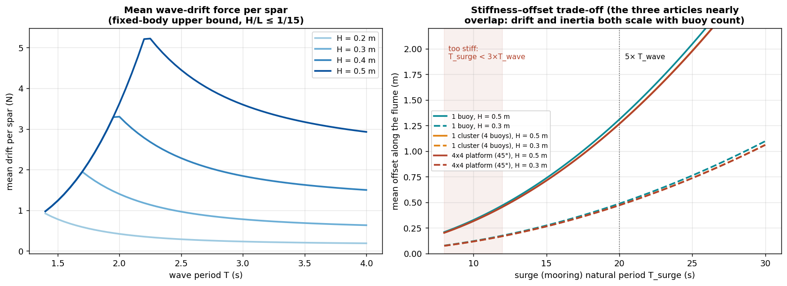
LOAD
Design load: the mean wave drift
Left: drift per spar, fixed-body upper bound; it peaks at the steepness limit (H/L = 1/15): 5.2 N at H = 0.5 m, 1.9 N at H = 0.3 m. Right: offset vs mooring softness — identical for all three articles, because drift and inertia both scale with the number of buoys.

Slide 5
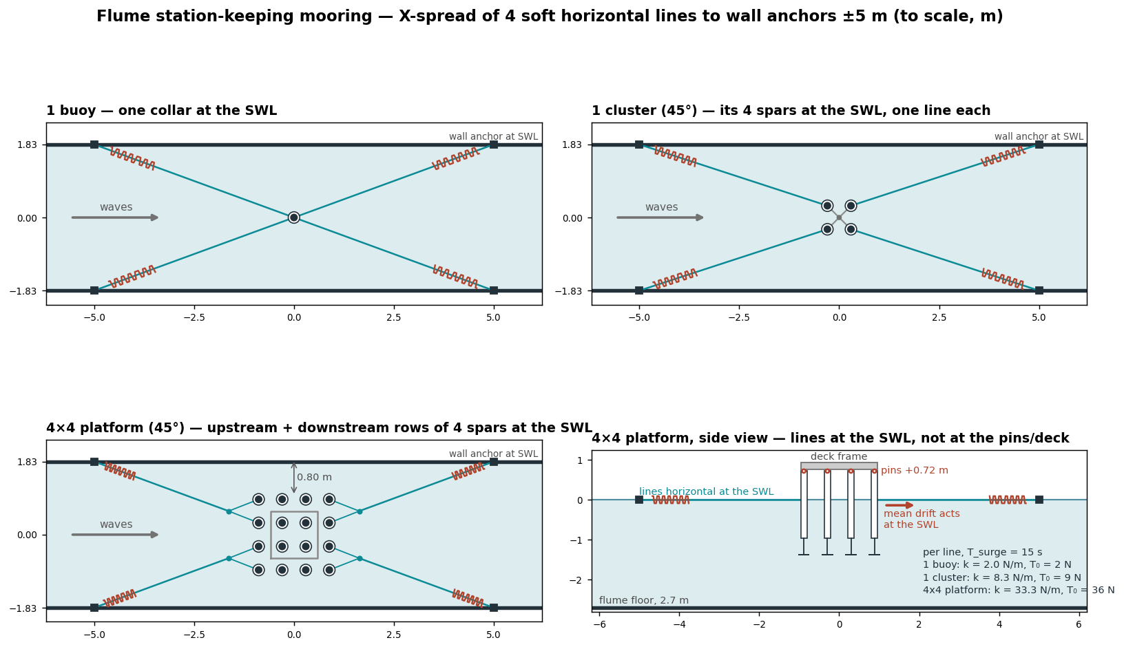
DESIGN
Recommended mooring: X-spread of 4 soft lines at the waterline
T_surge = 15 s
1 buoy
1 cluster
4×4
Kx (N/m)
7.1
29.3
117.4
Line k (N/m)
2.0
8.3
33.3
Pretension (N)
2.2
9.0
36.1
Max tension (N)
4
16
66
Offset H 0.5 (m)
0.74
0.71
0.71
Spring stroke (m)
2.0
2.0
2.0
▪ Attach at the waterline: buoy — one collar on the spar; cluster — its 4 spars, one line each; platform — bow + stern rows, 8 spars (bridles).
▪ Anchors on the walls, ±5 m; soft linear spring + low-stretch rope; same design scaled by buoy count.
Line stiffness and pretension scale with the article; the geometry, the offset and the ~2 m spring stroke are the same for all three.

Slide 6
VERIFICATION METHOD
Checking it on the full FloatSim models
▪ Models: single buoy (6 DOF); cluster = 4 buoys + hub, pinned (yaw-locked KKT joints), 30 DOF; platform = 16 buoys + 4 hubs + deck, 126 DOF. Coupled Capytaine BEM for each.
▪ Mooring as an anisotropic point stiffness (the deck spring element is isotropic and would add Kx to heave):
K_moor = Bᵀ diag(Kx, Ky, Kz,geo) B , B = [ I −[r]× ] at each attachment r
▪ Natural periods: constrained eigenproblem on the joint null space, iterated on A(ω); each mode identified unmoored and tracked into the moored model (MAC ≥ 0.9).
▪ Static drift response: KKT solve [K Gᵀ; G 0] — offset, deck trim, and each buoy's tilt about its pin.
▪ Attachments compared: spar top / waterline / CoG depth (buoy); pin plane (hub or deck, +0.72 m) vs spars at the waterline or CoG depth (cluster, platform); platform corners only.

Slide 7
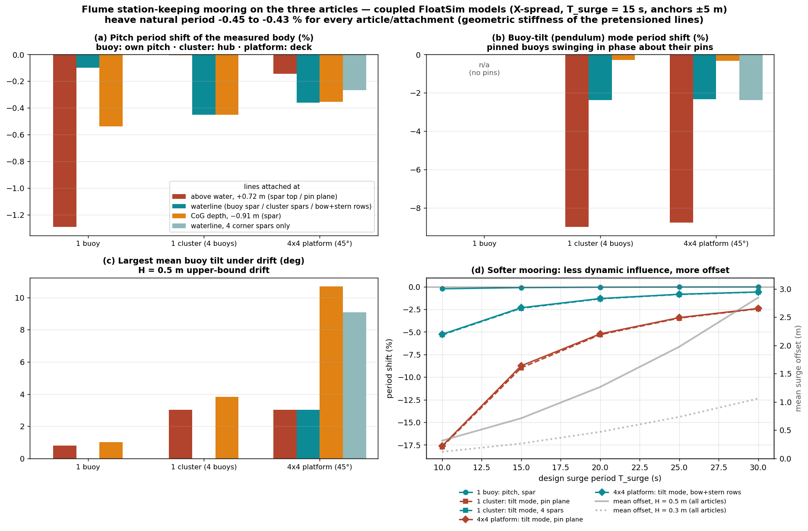
COUPLED CHECK, T_SURGE = 15 S
Result: attach at the waterline
▪ Heave: −0.45 % everywhere (line pretension).
▪ Waterline attachment: pitch −0.10 % (buoy), −0.45 % (cluster), −0.36 % (platform); zero trim. The cluster's buoys do not tilt at all: each spar holds its own drift.
▪ Pin plane (deck/hub): no trim, but it holds the light deck still → the buoys' tilt mode shifts −8.7 %.
▪ Avoid: platform corners only (9° corner tilt) and below the waterline (11°).
▪ The 3° platform buoy tilt is inherent (drift 0.72 m below each pin), not caused by the mooring.

Slide 8
STIFFNESS
How soft: the surge-period trade-off
T_surge
10 s
15 s
20 s
25 s
30 s
Tilt-mode shift, waterline
−5.26 %
−2.33 %
−1.30 %
−0.83 %
−0.58 %
Tilt-mode shift, pin plane
−17.62 %
−8.75 %
−5.22 %
−3.42 %
−2.40 %
Offset, H = 0.5 m (bound)
0.35 m
0.75 m
1.30 m
2.02 m
2.88 m
Offset, H = 0.3 m (bound)
0.13 m
0.28 m
0.48 m
0.75 m
1.07 m
▪ 15 s is the compromise: every period shift ≤ 2.4 %, offset < 0.8 m, spring stroke ~2 m.
▪ 20 s halves the tilt-mode shift, at 1.3 m offset and ~3.1 m stroke.
▪ A single bridle at the deck would need ≥ 25 s for the same effect, with a 2 m offset.

Slide 9
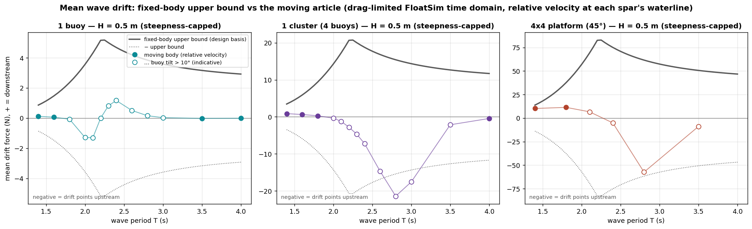
DRIFT, RELATIVE VELOCITY
Refinement: the drift on a moving article
▪ Away from resonance the articles move with the water; where the model is valid the drift is ≤ 0.1 / 0.9 / 11 N (buoy / cluster / platform) vs a design bound of 5 / 21 / 84 N.
▪ Near the buoys' pitch / tilt resonances it reverses (upstream) and can approach the bound's magnitude — with 30°+ buoy tilts, beyond the model's small-angle range (open markers, indicative).
▪ Design stays on the bound, both directions: the symmetric X-spread holds the same offset up- or downstream.

Slide 10
FACILITY
How the flume size influences the mooring
Depth 2.7 m
Width 3.66 m
Length 104 m
▪ The deep-water field mooring cannot be scaled → equivalent soft mooring.
▪ Lines must be horizontal: to a floor anchor 5 m away a line dips ~27°, adding vertical stiffness ≈ 0.3 Kx and pulling the article down.
▪ Depth raises long-wave drift (×1.9 at 4 s), but the design drift peaks near 2.2 s where depth adds only ~5 % → not design-driving.
▪ Sets the X-spread angle (20°): sway stiffness ≈ ⅓ of surge, T_sway ≈ 26 s.
▪ A 10 % lateral load moves the platform 0.21 m; wall gap 0.80 m.
▪ ±10 m anchors would halve the heave coupling but double the sideways excursion → the width fixes the anchors at ~±5 m.
▪ Not a constraint: offsets < 0.8 m and a ±5.3 m line footprint fit easily.
▪ Wave gauges referenced to the mean moored position.
The width is the binding constraint (anchor spread and lateral clearance); the depth only forbids short floor-anchored lines.

Slide 11
CONFIDENCE
Limits, and how we verify in the flume
▪ Drift is a bound: fixed bodies, no shielding, steepest waves. The moving-body refinement is lower off-resonance but indicative near resonance (large tilts).
▪ Linear check: eigen-analysis + static equilibrium; regular waves give only a mean drift (irregular waves would add slow drift near T_surge).
▪ Deep-water BEM for the coupled models (as the field site); the flume depth effect is covered in the sidewall study.
▪ In the flume: static pull test (stiffness, pretension) before testing; load cells on the four lines measure the real mean drift; the measured mooring goes into the numerical model.
▪ Open with HWRL: wall anchor points at the waterline (or a beam / the carriage), springs with ~2 m linear stroke, load cells, motion-tracking coverage.
▪ Test-matrix note: in H = 0.5 m waves near the pinned buoys' tilt resonance (2.6–3.0 s) the linear model predicts 30°+ buoy tilts — check the gimbal range.

Slide 12
SUMMARY
Answer, per article
1 buoy
1 cluster
4×4 platform
Lines attach at (SWL)
one collar on the spar
its 4 spars, one line each
bow + stern rows, 8 spars (bridles)
Per line: k / pretension
2.0 N/m / 2 N
8.3 N/m / 9 N
33.3 N/m / 36 N
Moored surge period
15.0 s
15.4 s
15.8 s
Heave period shift
−0.43 %
−0.45 %
−0.45 %
Pitch period shift
−0.10 %
−0.45 %
−0.36 %
Buoy-tilt mode shift
n/a
−2.38 %
−2.33 %
Offset, H 0.5 / 0.3 m (bound)
0.74 / 0.27 m
0.71 / 0.27 m
0.75 / 0.28 m
Trim / largest buoy tilt (H 0.5)
0° / 0.0°
0° / 0.0°
0° / 3.0°
One design, scaled by buoy count: four soft waterline lines, T_surge ≈ 15 s, wall anchors ±5 m. Decay tests can run with the mooring connected.

