Slide 1
PLAIN-ENGLISH SUMMARY
Will the flume walls spoil
our platform test?
Short answer: no. The 2.5 m, 16-buoy platform is fine in the OSU wave flume.
Here is the concern, how we checked it, and what we found — in simple terms.

Slide 2
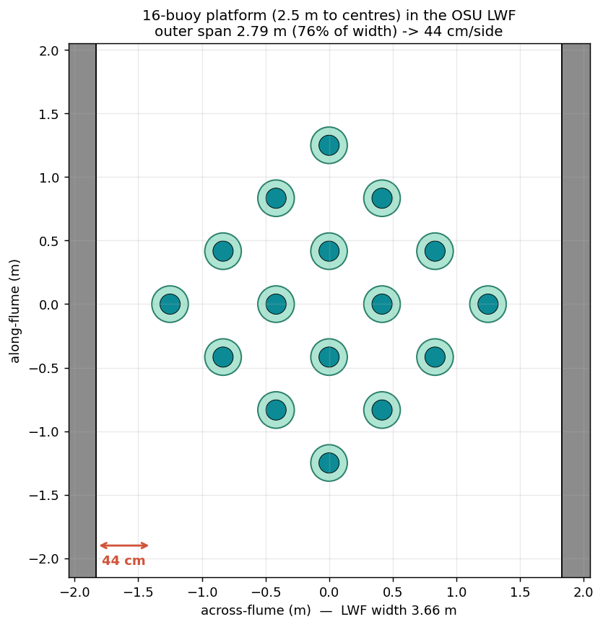
THE QUESTION
The concern a reviewer raised
• We want to test a floating platform — 16 buoys on a 2.5 m frame — in OSU's wave flume (a long tank, 3.66 m wide).
• The platform nearly fills the width. A reviewer worried:
  – “the platform makes waves, they bounce off the side walls, come back, and corrupt the measured data.”
• Fair question. So we tested it.

Slide 3
WHY IT'S OK
The key idea — our platform barely makes waves
• “Wall reflections” only matter if the platform makes strong waves to reflect.
• Ours doesn't. It's a sparse cluster of thin floats with drag plates — a poor wavemaker.
• When it bobs, almost all its energy goes into water friction (drag), not into radiated waves.
• No waves out → nothing to bounce off the walls and come back. That's the whole story.
In numbers: only about 3–4% of the bobbing energy leaves as waves — the rest is friction. So even perfect wall reflections could barely touch the result.

Slide 4
THE METHOD
How we checked it — three ways, each more thorough
• 1. Pen-and-paper physics — where reflections could build up, and by how much.
• 2. A computer flow-simulation of one buoy, with and without the walls.
• 3. A full simulation of the whole 21-piece platform inside the flume — every buoy, every joint, the real drag — walls in vs walls out.
• The full-platform model (3) is the one we trust; the simpler checks point the same way near the platform's natural bobbing period.

Slide 5
THE MODEL
What is the “21-piece” platform?
• The platform is not one solid raft — it's an articulated (jointed) structure:
  – 16 buoys — the floats (spar + drag plate)
  – 4 cluster hubs — each holds 4 buoys on gimbal pins
  – 1 central deck — the 4 arms connect to it
• 16 + 4 + 1 = 21 pieces. The gimbal pins let each buoy tilt on its own — that's why we model all 21, not one rigid block.

Slide 6
RESULTS
Result 1 — the up-and-down bobbing
• We push the platform down and let it bob back (a “free-decay” test).
• With the walls in vs out, the bobbing speed changes by about half a percent …
• … and how fast it settles doesn't change at all (the friction is unchanged by the walls).
• The buoys' tilting on their gimbals is barely affected too.
Half a percent is far smaller than the ±3–5% you'd expect just from run-to-run scatter in a physical test.

Slide 7
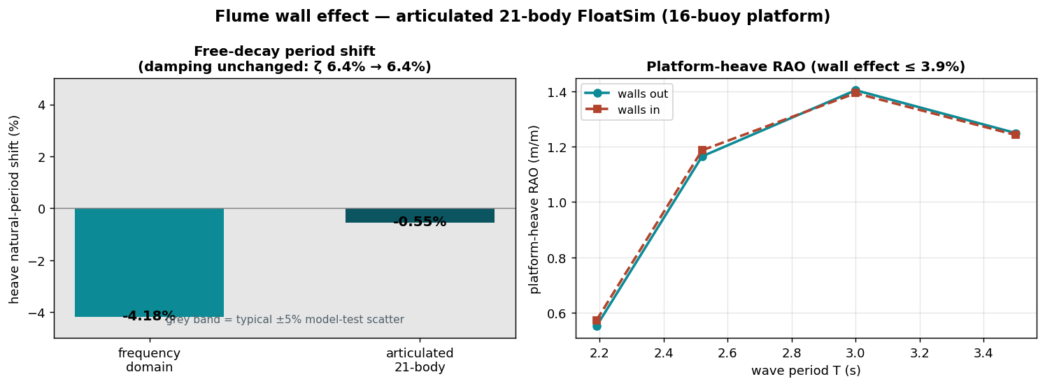
RESULTS
Result 2 — the response to waves
Across every wave period we'll test, the full articulated-platform simulation shows the walls change the response by at most about 4% — and it doesn't grow at long waves.

Slide 8
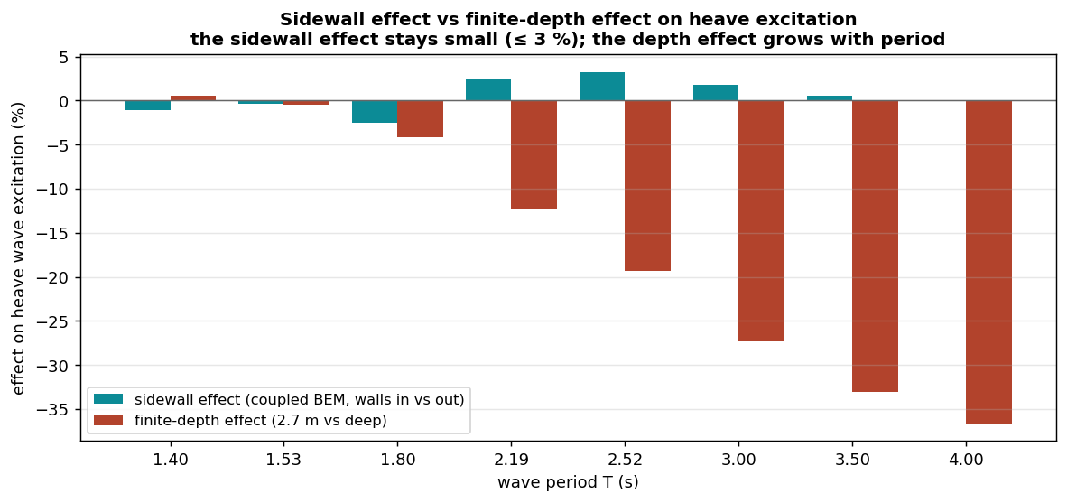
RESULTS
Result 3 — the shallow water matters more than the walls
The walls (teal) stay small at every wave period; it's the shallow 2.7 m water (red) that grows at long waves — and that's a known, routine correction every flume test already applies.

Slide 9
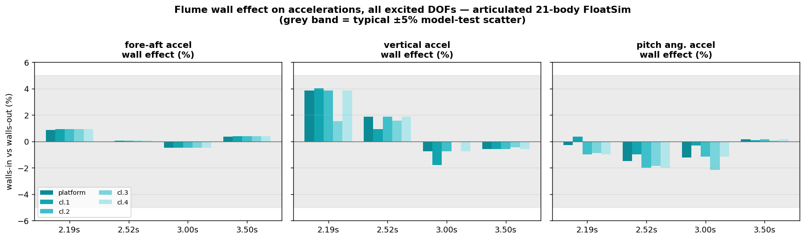
RESULTS
Result 4 — every direction, not just up-down
We checked the accelerometers in every direction they can move — fore-aft, up-down, and tilt (pitch). Near the natural period, walls in vs out changes each one by about 4% or less, at the deck centre and all four cluster points. Side-to-side and twist stay essentially zero (the waves come straight down the flume).

Slide 10
THE CAVEAT
The one thing to watch
• A flume can “ring” sideways like a bathtub at a few special wave periods (≈ 2.2, 1.5, 1.25 s).
• Near those, the walls do matter — so we simply avoid parking a test exactly there.
• They're narrow, known in advance, and easy to step around in the test plan.
• And for very long waves (slower than ~3 s), the shallow water depth is the bigger effect — corrected as standard, just like any flume test.

Slide 11
CONCLUSION
Bottom line
• The 2.5 m, 16-buoy platform is compatible with the OSU wave flume.
• The side walls change the measured bobbing speed by about ½%, the damping not at all, and the near-resonance wave response by only a few percent.
• The bigger flume factor is the shallow water depth (not the walls) — a routine, corrected effect.
• Reason, in one line:
  – the platform barely makes waves, so there's almost nothing for the walls to reflect — the flume test measures the real behaviour once depth is accounted for.

