Slide 1
DIFFRACTION & RADIATION ANALYSIS
How we compute the buoy's
hydrodynamics in Capytaine
OSU Test Buoy · potential-flow BEM → time-domain FloatSim (Cummins)
Two sub-problems (radiation + diffraction), their outputs, and how they drive the simulation

Slide 2
THE TOOL
What Capytaine computes
• Boundary-element (panel) solver for linear potential-flow hydrodynamics.
• In: the wetted hull as a mesh of panels. Out: the flow (velocity potential φ) around it in regular waves at each frequency ω.
• “Potential flow” = inviscid, irrotational, small (linear) waves & motions — the one assumption that sets both the outputs and the limits.
• Key idea — superposition: the wave-body problem splits into two sub-problems, solved separately and added:
  – Radiation — the body wavemaking in still water
  – Diffraction — the body held fixed under incoming waves

Slide 3
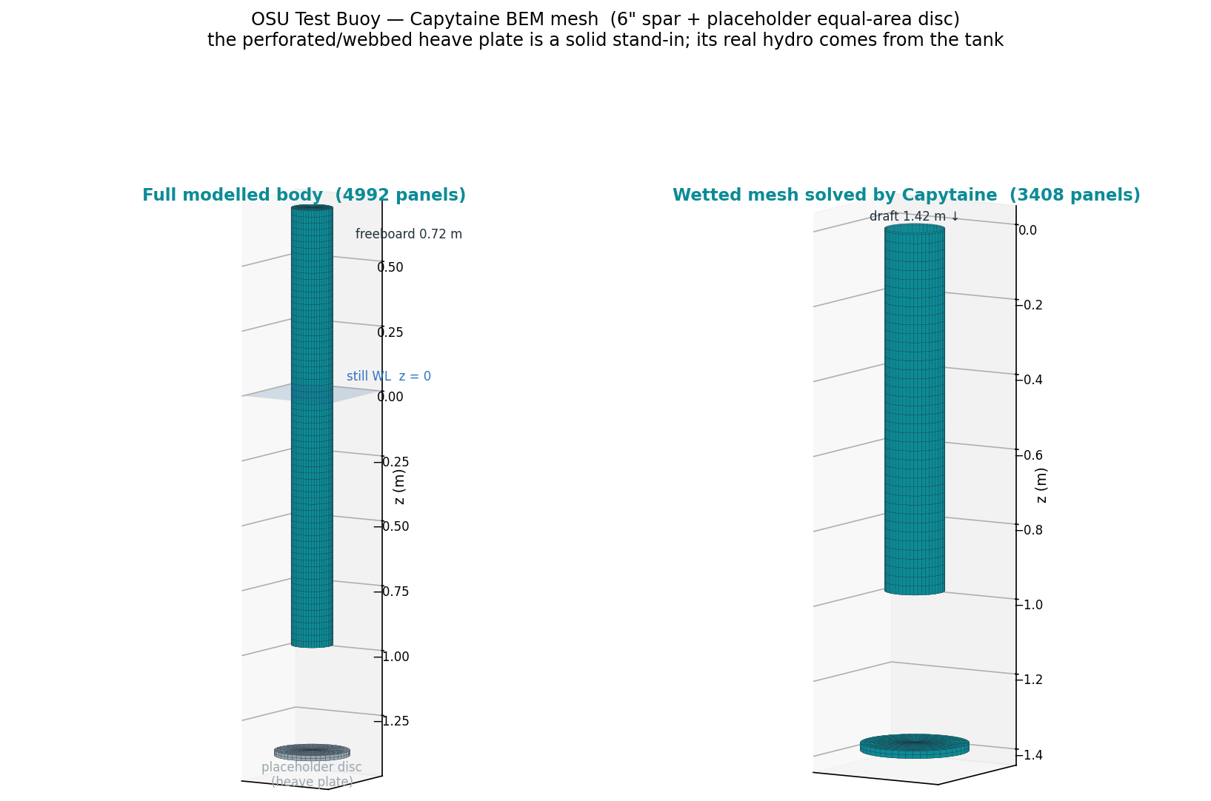
THE MODEL
The mesh we solve on
6″ spar cylinder + a placeholder solid equal-area disc for the perforated heave plate. Capytaine meshes the wetted part (z < 0, 3408 panels); the plate’s real hydro comes from the tank.

Slide 4
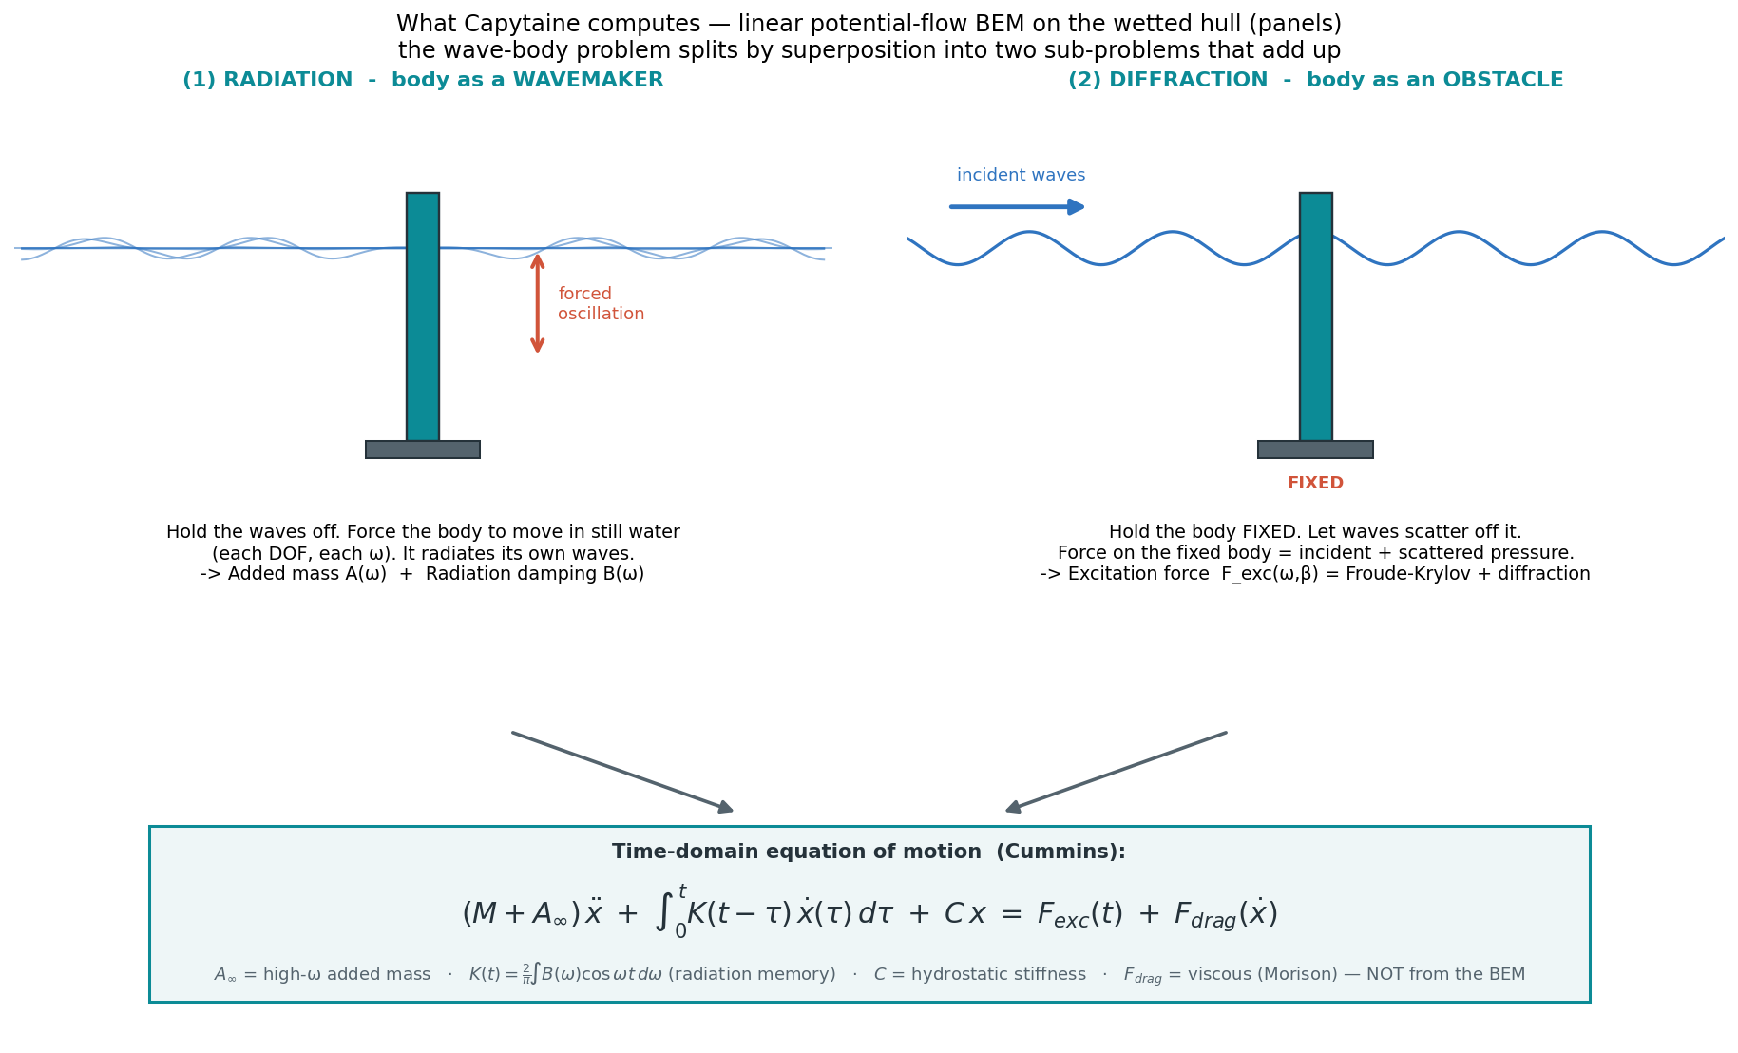
OVERVIEW
The two sub-problems — and how they combine

Slide 5
SUB-PROBLEM ①
Radiation — “body as a wavemaker”
• Turn incident waves off. Force the body to oscillate in still water — one DOF at a time, at each ω.
• It radiates its own waves; the reaction force has two pieces:
  – Added mass A(ω) — in phase with acceleration (virtual mass of entrained water).
  – Radiation damping B(ω) — in phase with velocity (energy carried off as radiated waves).
• 6×6 matrices per ω — captures cross-DOF coupling (e.g. heave → pitch).
• → This run produces the A(ω) and B(ω) curves.

Slide 6
SUB-PROBLEM ②
Diffraction — “body as an obstacle”
• Hold the body fixed. Let incident waves scatter off it.
• Net wave-pressure force on the fixed hull = excitation force F_exc(ω, β) (β = wave heading):
  – Froude–Krylov — force from the undisturbed incident-wave pressure.
  – Diffraction — correction because the body scatters the waves.
• → This run produces the wave forcing F_exc(ω) that drives the motion.
• Plus the hydrostatic stiffness C (buoyancy / waterplane) from the geometry.

Slide 7
THE BRIDGE
From frequency domain to time-domain simulation
• A(ω), B(ω) can’t go straight into a time-stepper — a transient contains all frequencies at once. Bridge = the Cummins equation:
(M + A∞) ẍ + ∫₀ᵗ K(t−τ) ẋ(τ) dτ + C x = F_exc(t) + F_drag(ẋ)
• A∞ = infinite-frequency added mass.
• K(t) = (2/π)∫ B(ω) cos(ωt) dω — the retardation kernel = fluid memory of previously radiated waves.
• Mapping: Radiation → A∞ + K(t) · Diffraction → F_exc · Hydrostatics → C. FloatSim integrates this in time.

Slide 8
DIVISION OF LABOUR
Who computes what — Capytaine vs FloatSim
CAPYTAINE
FLOATSIM
run once · frequency domain · linear + inviscid
per simulation · time domain
• Panel mesh of the wetted hull
• Radiation problem → A(ω), A∞ and B(ω)
• Diffraction problem → F_exc(ω, β)
• Hydrostatic stiffness C (buoyancy)
⇒ Outputs: hydrodynamic coefficients
• Retardation kernel K(t) from B(ω)
• Body mass & inertia M (structure)
• Assemble (M+A∞), C + gravity m·g·z_G
• Viscous Morison drag F_drag — not in BEM
• Static equilibrium solve
• Time-integrate the Cummins EoM → x(t)
⇒ Output: decay period T & damping ζ
capytaine_
osu_buoy.nc
Capytaine = the hydrodynamic coefficients · FloatSim = the equation of motion in time (adds mass, viscous drag, mooring, equilibrium; converts B(ω)→K(t)). Decay T and ζ are a FloatSim output.

Slide 9
CAVEATS
Limits — and why the heave plate needs the tank
• Potential flow is inviscid and linear. Two consequences for us:
  – No viscous drag in the BEM → all quadratic / viscous damping is added separately as Morison drag F_drag — not from Capytaine.
  – Panels treat every surface as solid → over-predicts added mass for the open/perforated heave-plate frame (it blocks flow the real perforations pass).
• Practical split for the OSU buoy:
  – Spar (6″ pipe) — a clean cylinder → the BEM is reliable.
  – Heave-plate / ballast frame — A and B are BEM stand-ins until the tank test measures them.

Slide 10
WHAT WE ASSUMED, AND WHY
Modelling assumptions & their basis
Assumption | Value | Basis / support
Spar drag Cd (transverse) | 1.2 | Smooth circular cylinder (Morison). Standard 1.0–1.2 (DNV-RP-C205; Sarpkaya). Sets surge & pitch drag; negligible in heave.
Heave-plate normal Cd_n | 5.0 | Flat disc at low KC (≈ 2–3 at a 100 mm release): flow separates, published Cd ≈ 4–8. Dominates heave damping. Placeholder → the tank pins it.
Heave-plate tangential Cd_t | 1.5 | Edge / skin friction on the rim; small contribution.
Plate added mass | solid disc, Ø0.287 m | Potential-flow UPPER bound — the perforated/webbed frame passes flow, so it adds less (porous-disk theory, Molin). Bracket → the tank pins A33.
Mass / CoG | 21.52 kg; −0.907 m | Spreadsheet structure 8.16 kg + measured unloaded waterline 967 mm. Independent geometry check (cyl + frame + lead) agrees within ~1.5%.
Pitch / roll inertia | 10.2 kg·m² | gmsh per-part inertia tensors + uniform effective density; the deep lead ballast dominates, so it is robust to the internal mass split. CATIA would refine.
Water & BEM | fresh; deep; linear | OSU Hinsdale lab is fresh (ρ = 998); period is density-independent for a free body. Potential flow is inviscid — viscous drag added via Morison. Confirm tank depth vs 1.42 m draft.
Red = placeholder the tank measures (period → plate added mass, decay rate → plate Cd). Coefficient ranges per DNV-RP-C205 & Sarpkaya; perforated-plate reduction per porous-disk theory.

Slide 11
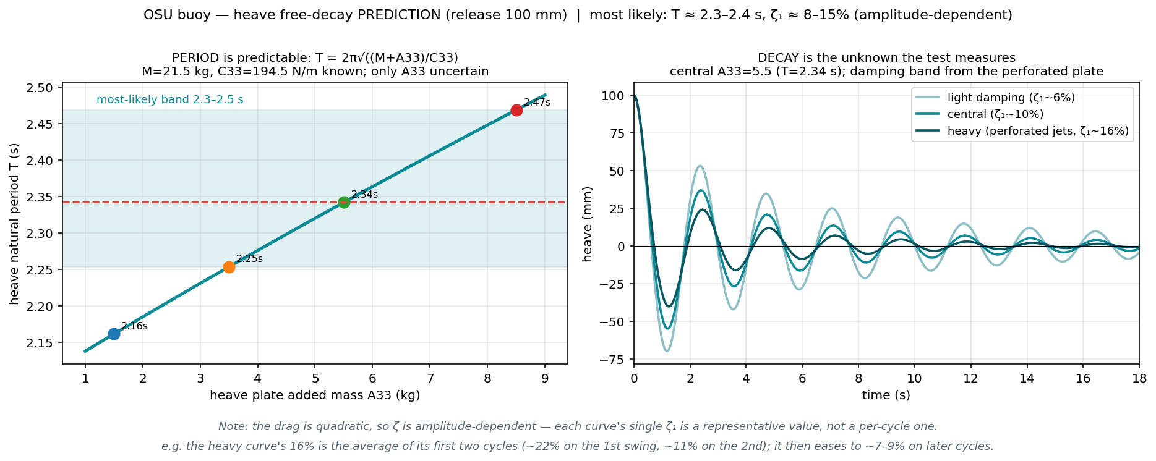
WHAT TO EXPECT
Pre-test heave decay prediction
Period is predictable → T ≈ 2.3–2.4 s (M, C₃₃ known; only plate added mass uncertain). Damping is the measurement → ζ₁ ≈ 8–15% at 100 mm. Test pins: period→added mass, decay→drag Cd.

Slide 12
THE PHYSICS ①
Where does T = 2.5 s come from? — first, without added mass
• Heave is a one-DOF oscillator — the buoy bobs vertically on the waterplane buoyancy spring.
• Stiffness C₃₃ = ρ g A_wp: the restoring buoyancy per metre of submergence (A_wp = 6″ spar waterplane area).
• The naive “dry” period uses the structural mass M alone — no water entrained:
T₀ = 2π √( M / C₃₃ )
M = 21.52 kg C₃₃ = 194.5 N/m → T₀ = 2.09 s
But the field test measured 2.50 s. The buoy behaves ~45% heavier than its structure — it drags a slug of water with it as it accelerates. That missing inertia is added mass.

Slide 13
THE PHYSICS ②
Added mass — how Capytaine computes it, and how it sets T
HOW CAPYTAINE COMPUTES A
HOW A SETS THE PERIOD
radiation problem · one run · per frequency ω
extra inertia → longer period
• Force the hull to oscillate in still water at ω (heave DOF, no incoming waves).
• Integrate the flow pressure over the hull → the hydrodynamic reaction force.
• Split that force by phase:
– ∝ acceleration → added mass A(ω)
– ∝ velocity → radiation damping B(ω)
⇒ F_rad = −A(ω)·ẍ − B(ω)·ẋ
⇒ A∞ (ω→∞ limit) = 9.7 kg ≈ 45% of M — mostly the broad plate.
• Add A to the mass in the same oscillator:
• T = 2π √( (M + A) / C₃₃ )
• Period-stretch factor = √((M+A)/M)
• = √(31.2 / 21.5) = 1.205
⇒ 2.09 s × 1.205 = 2.52 s
• Heave inertia is ~45% water — A moves the period; C₃₃ is known, so the period is a clean prediction, the damping is the measurement.
The field test (2.50 s) lands on the WET period 2.52 s — not the dry 2.09 s. Direct evidence the entrained-water added mass (~9.7 kg) is real and correctly sized.

Slide 14
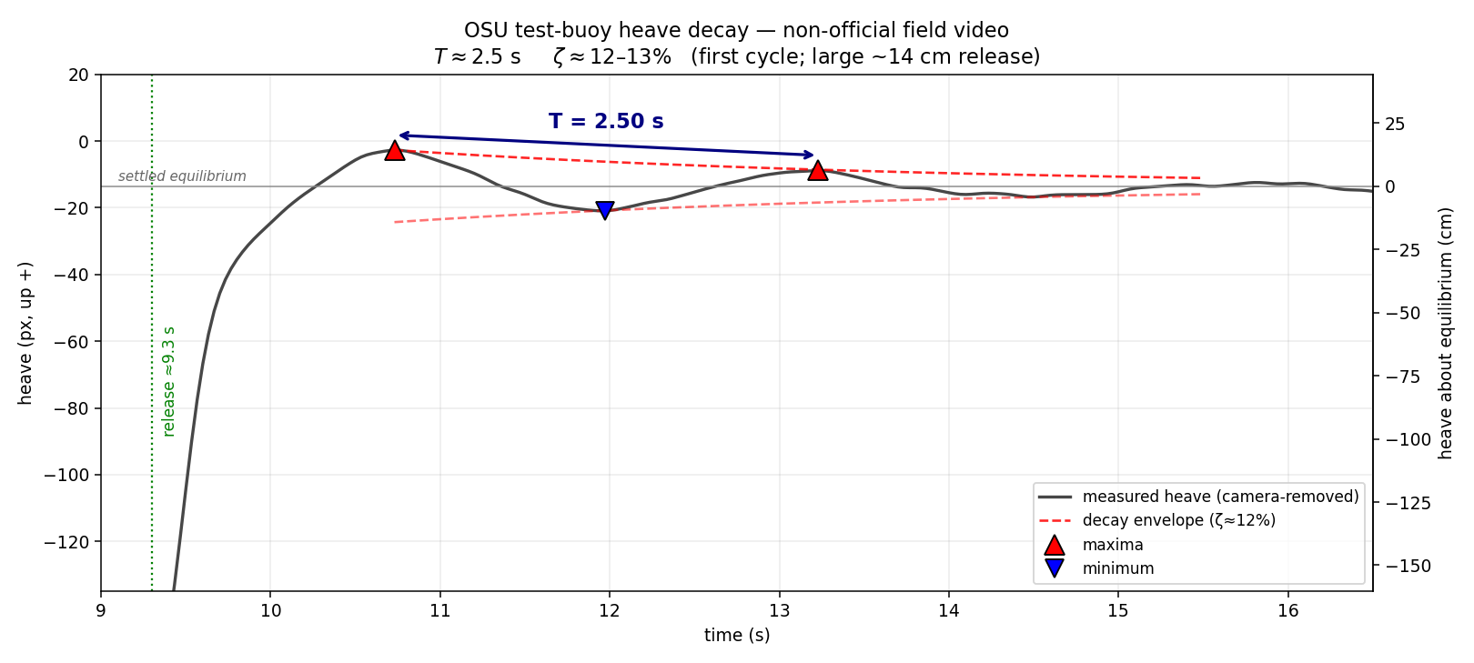
VALIDATION
Field heave-decay test — a first real-world check
DAMPING → DECAY
how ζ shrinks each swing
• Envelope e^(−ζωₙt) — each swing shrinks by a fixed ratio.
• That ratio is the log-decrement δ:
⇒ δ = 2πζ / √(1−ζ²) ≈ 2πζ
⇒ Aₙ₊₁ / Aₙ = e^(−δ)
⇒ ζ = 13% → e^(−0.82) = 0.44 (~55% off/cycle)
• The 2π turns a “small” 13% into a near-halving each bob.
Non-official handheld video, motion-tracked frame-by-frame; the camera pan (~95 px ≫ the heave) is removed by referencing the fixed horizon. Buoy released ≈9.3 s, then rings down — heavily damped, so ~1½ cycles resolve. Period & damping are scale-free.

Slide 15
VALIDATION
Model vs field test — period & damping match
Quantity | Model (FloatSim / Capytaine) | Field video | How measured
Heave period T | 2.52 s | ≈ 2.50 s | max→max 2.50; half-periods ×2 = 2.47 & 2.53 s
Heave damping ζ | 8–15 % | ≈ 12–13 % | log-dec: two maxima → 13 %; max→min half-cycle → 12 %
Both match — period within ~1 % of the simulation, damping inside the predicted band. A first independent, real-world corroboration of the heave model.
• Large release (~14 cm first swing) → first-cycle Morison quadratic drag is high, so ζ sits at the upper end of the 8–15 % band; it should fall on smaller cycles.
• The analytic hand-estimate on the prior slide (2.3–2.4 s) low-bracketed the plate added mass; the full decay sim gives 2.52 s — which the test confirms.
• Still non-official & handheld — the instrumented tank test remains the source of truth for the perforated plate's added-mass / drag split.

Slide 16
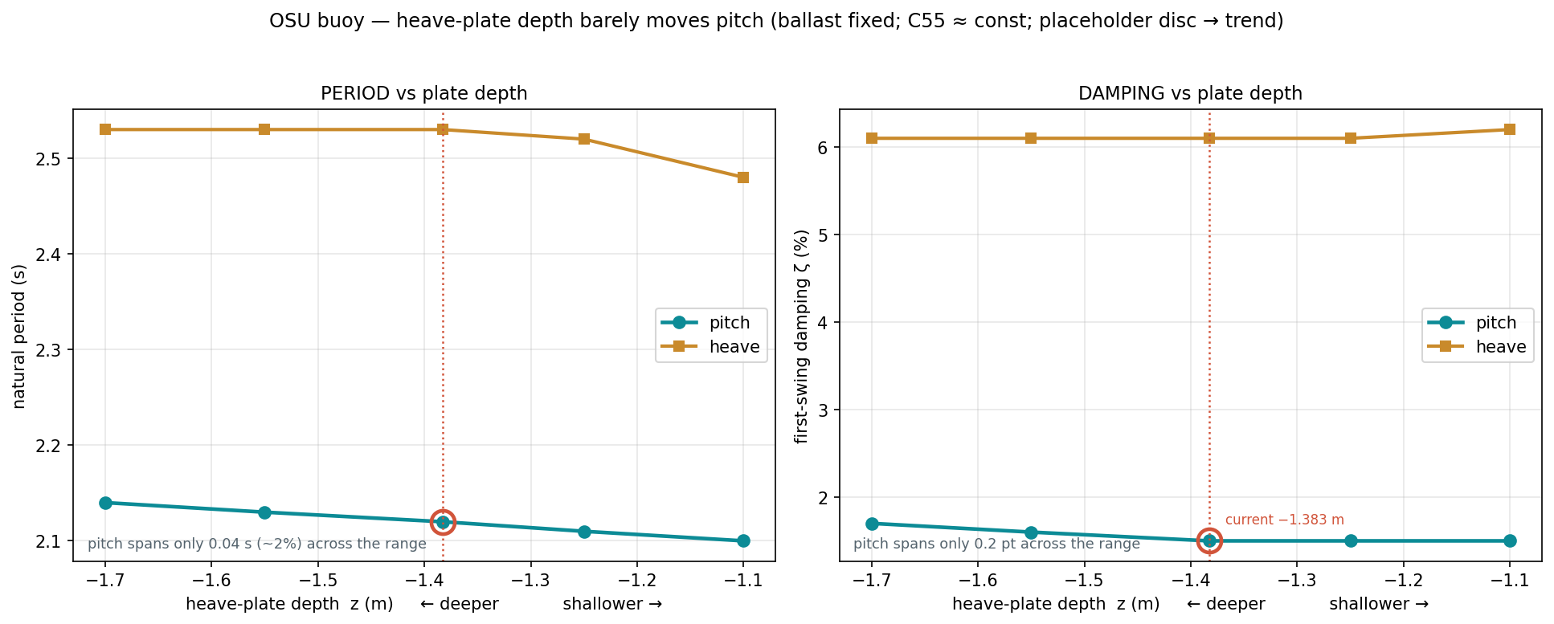
DESIGN STUDY
Where to put the heave plate? — pitch performance
Plate depth barely moves pitch (2.10 → 2.14 s over a 4× lever-arm change) or heave — an axial plate meets pitch EDGE-ON, so its broadside added mass & drag (which dominate heave) hardly engage it. Deck tilt is a ballast/CoG job, not a plate-depth job.

Slide 17
PLATFORM STUDY
Do the buoy gimbals help the platform? — pin vs rigid
• Scaling up: 16 buoys on a shared platform — a still, level deck for rockets / datacenters / hotels.
• Each buoy joins the platform through the gimbal at its top (a pin: roll/pitch free). Does that beat welding the assembly rigid?
• Same 16-buoy deck, same hydro / drag / geometry — only the joint type changes:
  – Articulated — every joint a pin (the current design)
  – Whole-chain rigid — every joint welded → one rigid raft
• Metrics: deck tilt (pitch), heave, and the moment carried at each buoy→platform joint.

Slide 18
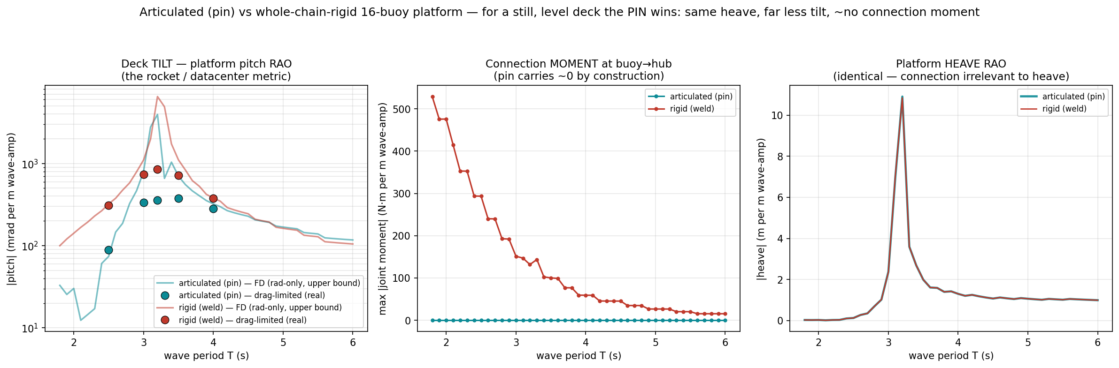
PLATFORM STUDY
Pin vs rigid — the pin wins on every axis
Same heave; the rigid raft tilts 1.3–3.5× more; and the pin carries ~zero connection moment vs the weld's hundreds of N·m/m. The gimbals absorb buoy tilt instead of dumping it into the deck.

Slide 19
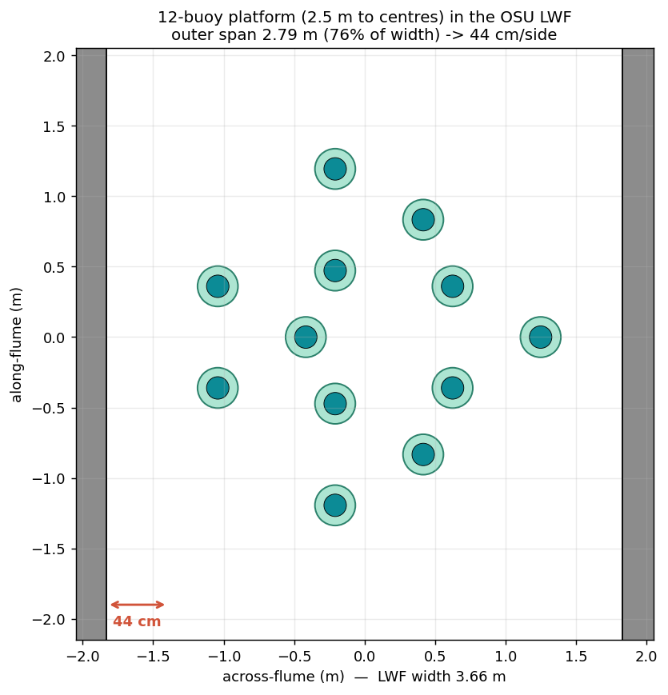
FLUME TEST · REBUTTAL
Phase-3 platform in the HWRL flume — is it too big?
THE REVIEW COMMENT
TEAMER Phase-3 review
“2.50 m platform inside HWRL's 3.67 m flume leaves 0.6 m side clearance, inducing severe sidewall reflections that will corrupt dynamic data.”
• Phase 3 = the platform (12 buoys); free-decay + wave sweeps.
• 2.5 m is to buoy CENTRES; with the plates the outer span is 2.79 m = 68% of the width → ~44 cm/side (tighter than the 0.6 m assumed).
⇒ Assessed walls-in vs walls-out at the same 2.7 m depth — isolates the walls.

Slide 20
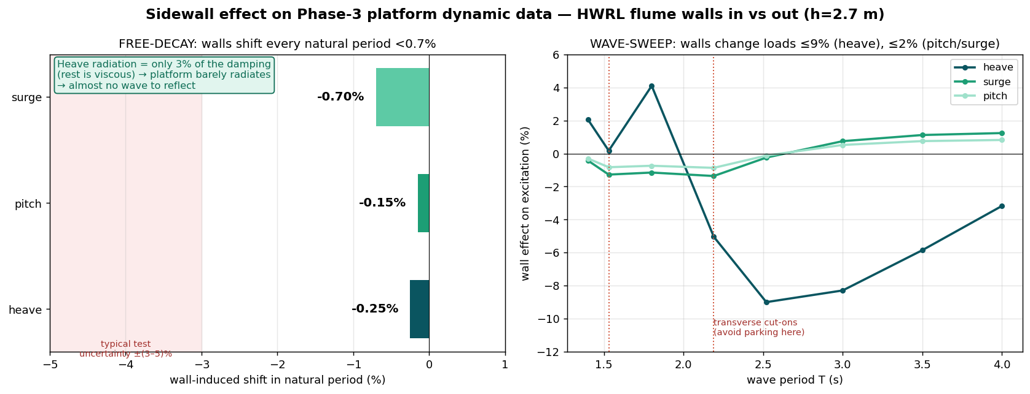
FLUME TEST · REBUTTAL
Sidewall reflections do not corrupt the data
The platform barely radiates (heave radiation = only 3.5% of the damping) → almost no wave to reflect. Walls-in vs walls-out shifts every natural period <0.7% and every wave load ≤9% — inside test uncertainty. Only caveat: avoid the transverse cut-ons (2.19 / 1.53 / 1.25 s).

