Slide 1
PHASE-3 PLATFORM · OSU LARGE WAVE FLUME · TEAMER REVIEW RESPONSE
Sidewall effects on the free-decay
and wave-sweep campaigns
Potential-flow BEM with explicit flume walls (method of images)
Finding: sidewalls do not corrupt the dynamic data. Free-decay periods shift < 0.6 %; the heave RAO wall effect is ≤ 4 % across the whole wave band.
The dominant flume artifact is the finite 2.7 m depth, not the walls. 16-buoy platform (4 clusters × 4), 2.5 m to buoy centres, tested corner-on (45°) with ~0.80 m side clearance.

Slide 2
CONTEXT
Reviewer claim and our finding
“Phase 3 platform (2.50 m) inside HWRL's 3.67 m flume leaves 0.6 m side clearance, inducing severe sidewall reflections that will corrupt dynamic data.”
▪ Severe reflections are the correct concern for a strong wavemaker or a body that spans the tank. The Phase-3 platform is neither, and we show it quantitatively.
▪ Method: Capytaine potential-flow BEM with the LWF walls modelled by the method of images; every comparison is walls-in vs walls-out at the same depth.
▪ Finding: free-decay periods shift < 0.6 %; the heave RAO wall effect is ≤ 4 % across the band and does not grow at long periods. The larger flume effect is the finite depth — a known, correctable facility property, not a sidewall artifact.

Slide 3
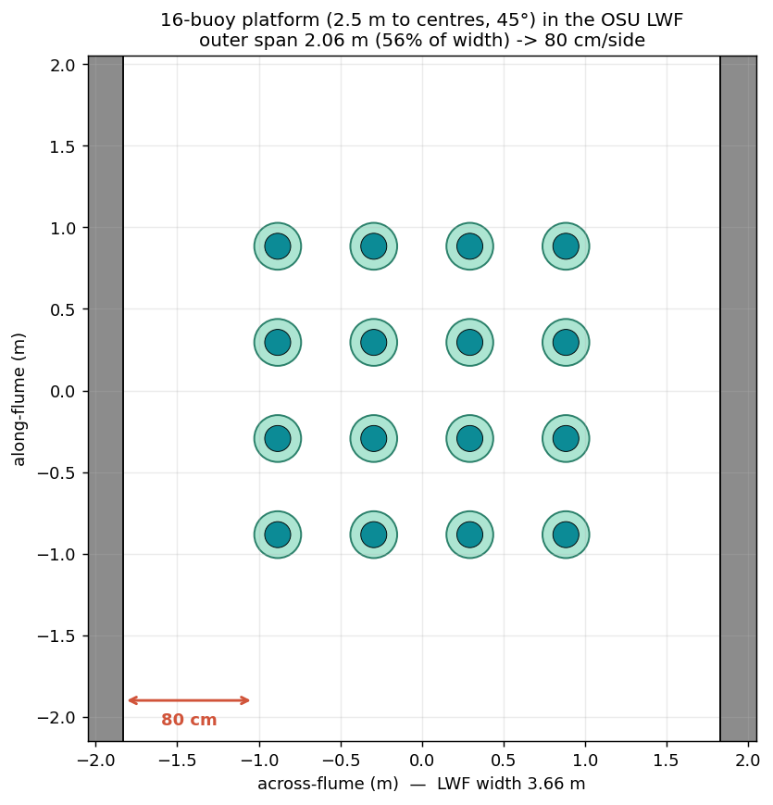
SETUP
Configuration and method
▪ Test article: 16-buoy platform — 4 clusters × 4 buoys (square), articulated (gimbal buoy→hub, hub→deck).
▪ Hull: Phase-1 decay-correlated spar + heave plate (T ≈ 2.6 s, ζ ≈ 13 %).
▪ Size: 2.5 m to buoy centres, corner-on (45°); span across the flume 2.06 m (56 % of width); clearance ~0.80 m/side.
▪ Facility: OSU LWF, W = 3.66 m, h = 2.7 m.
▪ Walls: method of images (mirror across y = ±W/2, ~3 levels).
▪ Depth: sidewall effect from the coupled BEM (deep; free-decay is depth-robust). The finite-depth effect is a separate, Airy-corroborated facility effect assessed at 2.7 m.
▪ Reviewer's 0.6 m: at the 45° test orientation the as-built clearance is ~0.80 m; the widest (flat-on) orientation, 0.44 m, gives the same result — see the orientation slide.

Slide 4
MECHANISM
Physical basis
▪ Free-decay — weak radiator. Heave radiation damping is only ~3.5 % of the total (the rest is viscous drag); the walls can perturb only that small radiated part, so the natural period and damping barely move. This is depth-robust.
▪ Wave response — sub-cut-on. A corrupting cross-flume standing wave forms only at the transverse cut-ons (next slide); the operating band is below the first one, so the residual sidewall effect on the wave loads stays small (≤ 4 %) at every period.
▪ Porous, does not span the tank. Water passes between the buoys and runs off along the 104 m length; only the cross-flume direction is bounded.

Slide 5
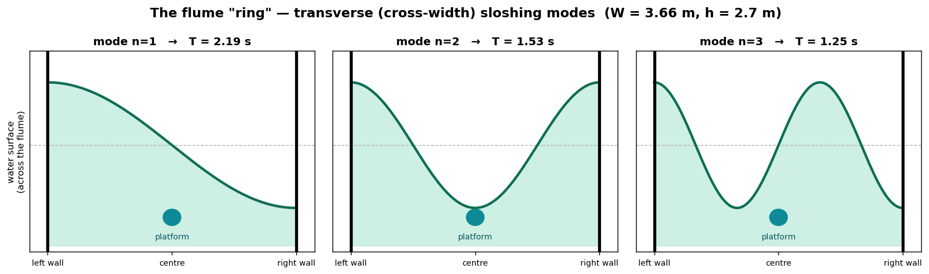
RING EFFECT
The flume “ring” — transverse cut-on modes
T_n = 2π / √( g·k_n·tanh(k_n·h) ), k_n = nπ/W → T_1,2,3 = 2.19 / 1.53 / 1.25 s
▪ Between the side walls the water sloshes across the width like a bathtub; these transverse modes have fixed (nearly depth-independent) cut-on periods set by W.
▪ Below T₁ = 2.19 s (incl. the ~2.6 s heave): the modes are evanescent — they decay away from the body and cannot ring. Even at the cut-ons the weak scattering keeps the effect bounded (~±6 %); we skip those periods in the matrix.

Slide 6
RESULTS 1/4
Free-decay results (depth-robust)
Quantity
walls out → walls in
wall effect
Heave natural period
2.607 → 2.593 s
-0.55%
Heave damping ζ
6.4% → 6.4%
unchanged
Buoy gimbal tilt
0.0005 → 0.0007 rad
~0 (negligible)
▪ Full articulated 21-body FloatSim (real quadratic drag, KKT gimbal joints), walls-in vs walls-out.
▪ The period shift is ~20× smaller than the ±(3–5) % scatter of a physical free-decay test; damping is viscous-dominated and unchanged. Radiation is depth-robust, so deep-water modelling is valid here.

Slide 7
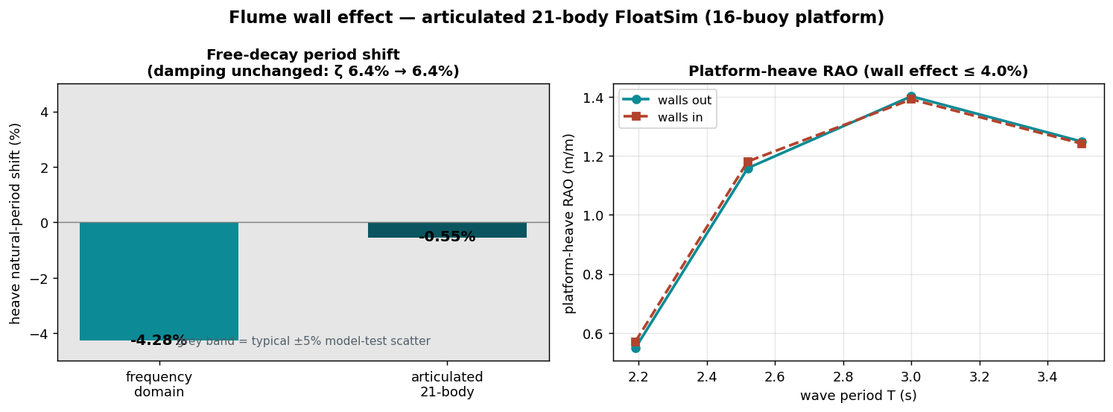
RESULTS 2/4
Wave-frequency response
Coupled 21-body BEM (open vs walled). The heave RAO wall effect is ≤ 4.0 % across the whole band and does not grow at long periods (excitation wall effect ≤ 3.6 %, shrinking toward 0 at 4 s). The frequency-domain single-array method over-states this at long periods (it under-converges in image count) — the coupled solve is authoritative.

Slide 8
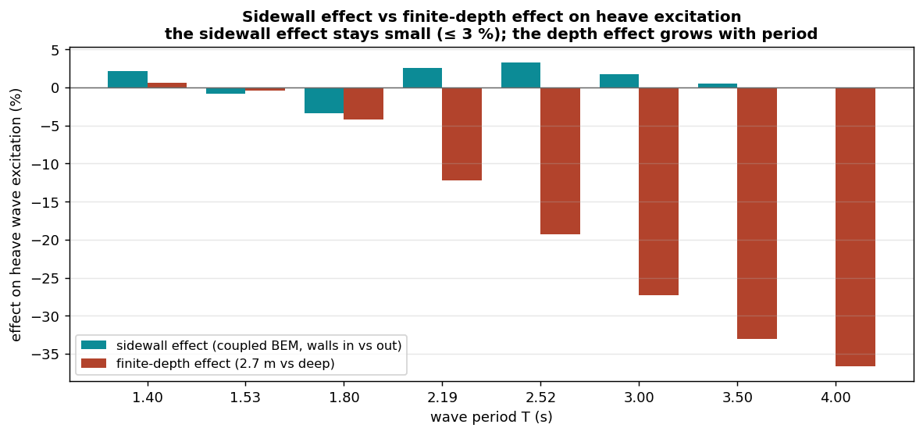
RESULTS 3/4
Sidewalls vs finite depth — the dominant effect
The sidewall effect (teal, coupled BEM) stays small and flat (≤ 4 %) at every period, while the finite-depth effect (red) grows to −19% to −37% at 2.5–4 s. The reviewer's concern (walls) is the minor term; the real flume consideration is depth — a known, correctable property handled by depth-scaling.

Slide 9
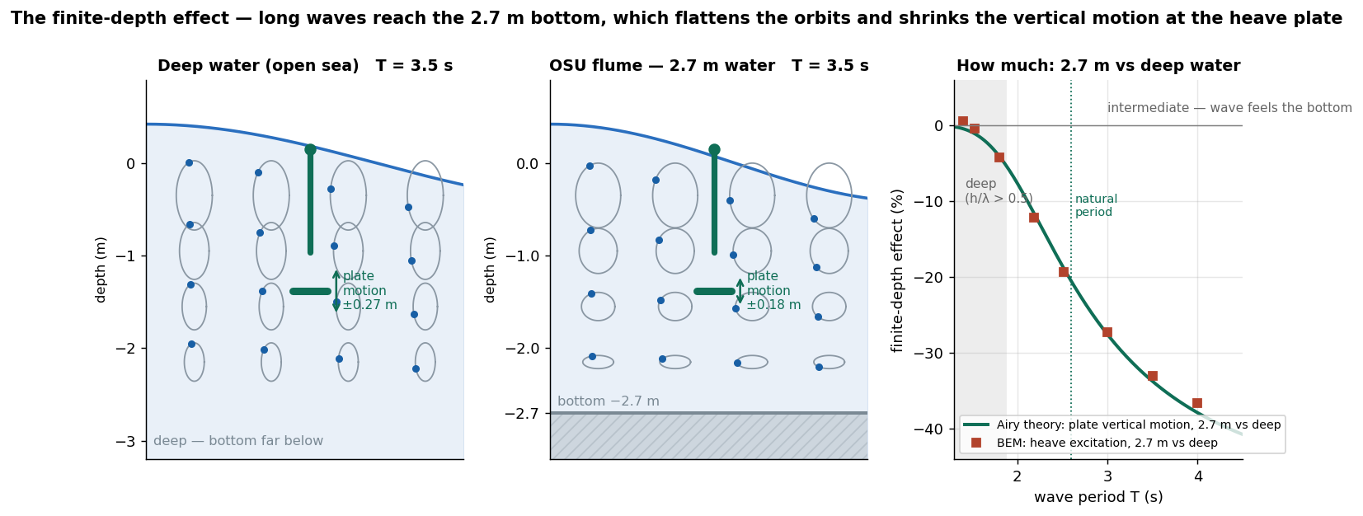
FINITE DEPTH
Why the depth effect grows at long periods
ω² = g·k·tanh(k·h) plate vertical motion ∝ sinh(k(z+h)) / sinh(kh) (deep water: e^{kz})
▪ A wave feels the bottom once its wavelength is long against the 2.7 m depth: h/λ = 0.88 at 1.4 s (deep — no effect) → 0.27 at the 2.6 s natural period → 0.15 at 4 s. The floor forces the vertical velocity to zero, flattening the orbits and shrinking the vertical motion that lifts the heave plate at −1.38 m. Airy theory and the BEM agree (panel c). A known, correctable facility effect — not the walls.

Slide 10
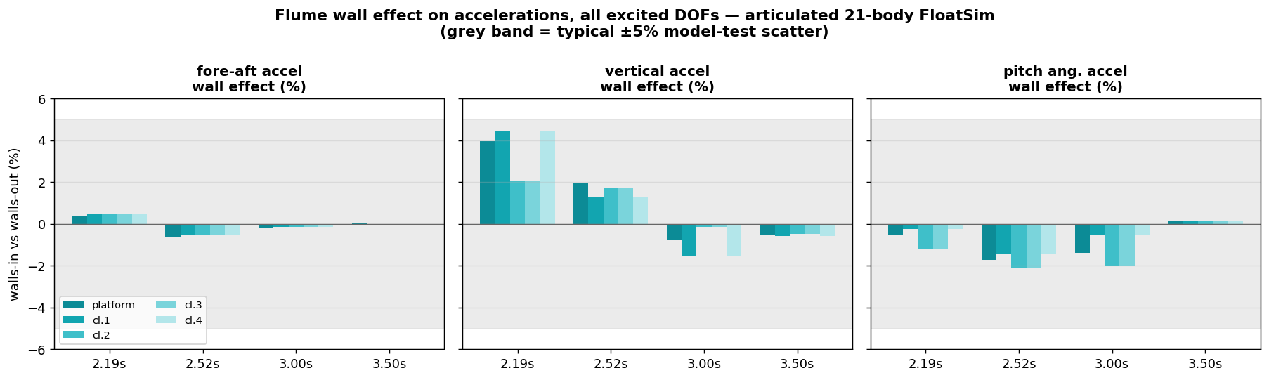
RESULTS 4/4
All-DOF accelerations near resonance
Articulated 21-body accelerations at the deck centre and four cluster hubs, each excited DOF: surge ≤ 0.6 %, heave ≤ 4.4 %, pitch ≤ 2.1 %. Sway/roll/yaw unexcited in head seas; peaks at the 2.19 s cut-on.

Slide 11
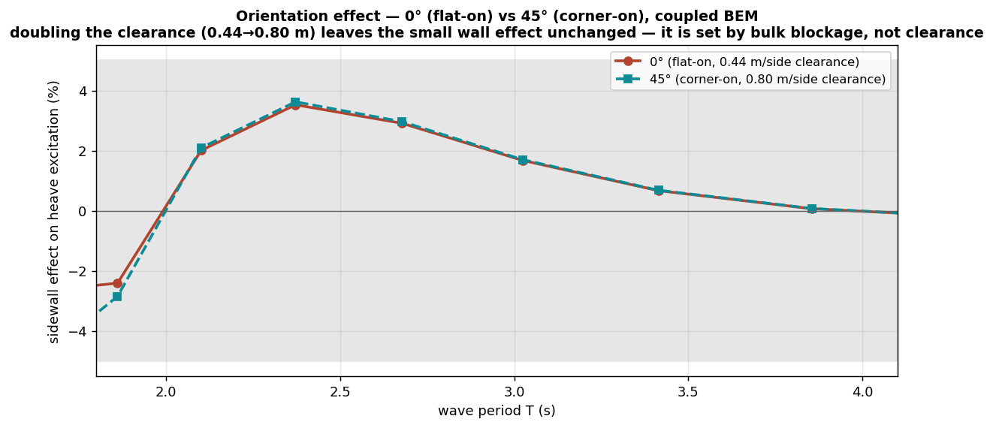
ORIENTATION
Orientation robustness — 0° vs 45°
The platform is tested corner-on (45°, 0.80 m/side). Turning it flat-on — 0°, the widest orientation at 0.44 m/side (a 90° turn is a symmetry no-op) — gives the same answer: free-decay −0.55 % both, excitation wall effect 3.6 vs 3.5 %. The effect is set by the bulk channel blockage, not the nearest-buoy clearance — so the reviewer's 0.6 m is not the controlling parameter.

Slide 12
CAVEATS
Scope, concessions and recommendations
▪ Transverse cut-ons (2.19 / 1.53 / 1.25 s): skip these narrow, known periods in the sweep matrix (bounded ~±6 % even there).
▪ Long-period tests (T > 3 s): apply the standard finite-depth correction — the response there is depth-dominated, not a sidewall artifact (the sidewall effect stays ≤ 4 %).
▪ Method fidelity: the sidewall effect is read from the coupled 21-body BEM; the single-array frequency-domain method under-converges in image count at long periods (it over-states the wall effect there and is used only for the image-free depth effect).
▪ Mesh / walled radiation matrix: coarse mesh (the walls-in/out ratio is mesh-robust); the image trick makes walled B non-reciprocal, so it is PSD-projected (heave decay is robust to this).

Slide 13
CONCLUSION
Conclusion
▪ Sidewall reflections do not corrupt the Phase-3 dynamic data: free-decay periods shift < 0.6 %, and the heave RAO wall effect is ≤ 4 % across the whole band.
▪ Accelerations at every sensor point, every excited DOF, change by ≤ 4 % near resonance.
▪ The dominant flume consideration is the finite 2.7 m depth — larger than the walls, and handled by standard depth-scaling, not by the sidewalls.
▪ The 2.50 m platform is compatible with the OSU Large Wave Flume.

