Slide 1
PLAIN-ENGLISH SUMMARY
Will the flume walls spoil
our platform test?
Short answer: no. The 2.4 m, 16-buoy platform is fine in the OSU wave flume.
Here is the concern, how we checked it, and what we found — in simple terms.

Slide 2
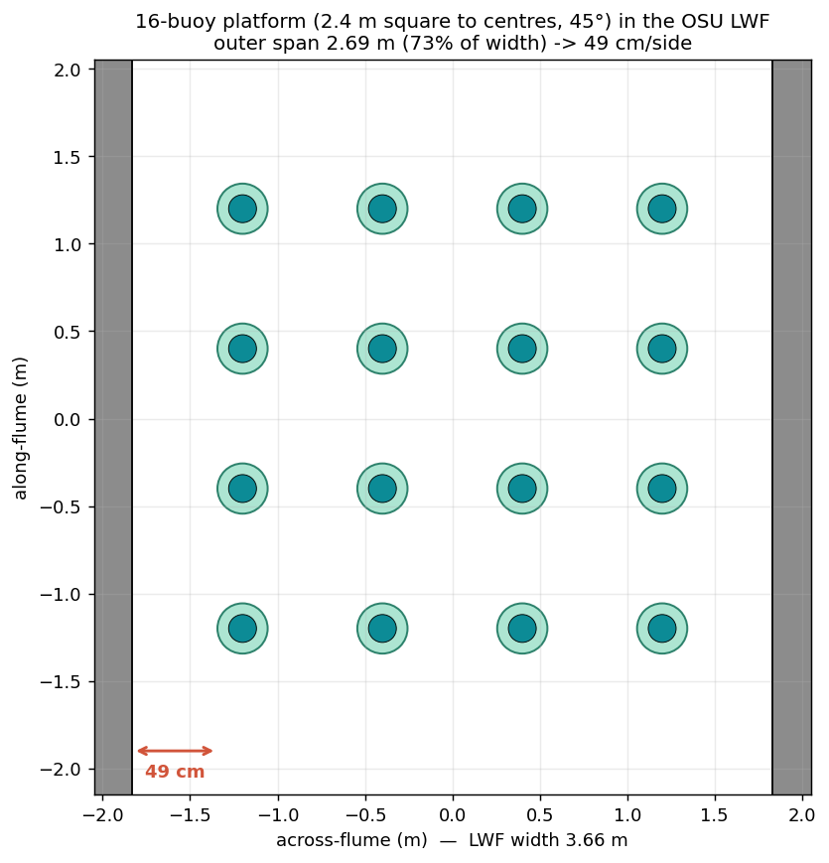
THE QUESTION
The concern a reviewer raised
• We want to test a floating platform — 16 buoys on a 2.4 m square frame — in OSU's wave flume (a long tank, 3.66 m wide).
• It sits square to the tank in the middle, about half a metre (0.49 m) from each wall. A reviewer worried:
  – “the platform makes waves, they bounce off the side walls, come back, and corrupt the measured data.”
• Fair question. So we tested it.

Slide 3
WHY IT'S OK
The key idea — our platform barely makes waves
• “Wall reflections” only matter if the platform makes strong waves to reflect.
• Ours doesn't. It's a sparse cluster of thin floats with drag plates — a poor wavemaker.
• When it bobs, almost all its energy goes into water friction (drag), not into radiated waves.
• No waves out → nothing to bounce off the walls and come back. That's the whole story.
In numbers: only about 6–7% of the bobbing energy leaves as waves — the rest is friction. So even perfect wall reflections could barely touch the result.

Slide 4
THE METHOD
How we checked it — three ways, each more thorough
• 1. Pen-and-paper physics — where reflections could build up, and by how much.
• 2. A computer flow-simulation of one buoy, with and without the walls.
• 3. A full simulation of the whole 21-piece platform inside the flume — every buoy, every joint, the real drag — walls in vs walls out.
• The full-platform model (3) is the one we trust; the simpler checks point the same way near the platform's natural bobbing period.

Slide 5
THE MODEL
What is the “21-piece” platform?
• The platform is not one solid raft — it's an articulated (jointed) structure:
  – 16 buoys — the floats (spar + drag plate)
  – 4 cluster hubs — each holds 4 buoys on gimbal pins
  – 1 central deck — the 4 arms connect to it
• 16 + 4 + 1 = 21 pieces. The gimbal pins let each buoy tilt on its own — that's why we model all 21, not one rigid block.

Slide 6
RESULTS
Result 1 — the up-and-down bobbing
• We push the platform down and let it bob back (a “free-decay” test).
• With the walls in vs out, the bobbing speed changes by about half a percent …
• … and how fast it settles doesn't change at all (the friction is unchanged by the walls).
• The buoys' tilting on their gimbals is barely affected too.
Half a percent is far smaller than the ±3–5% you'd expect just from run-to-run scatter in a physical test.

Slide 7
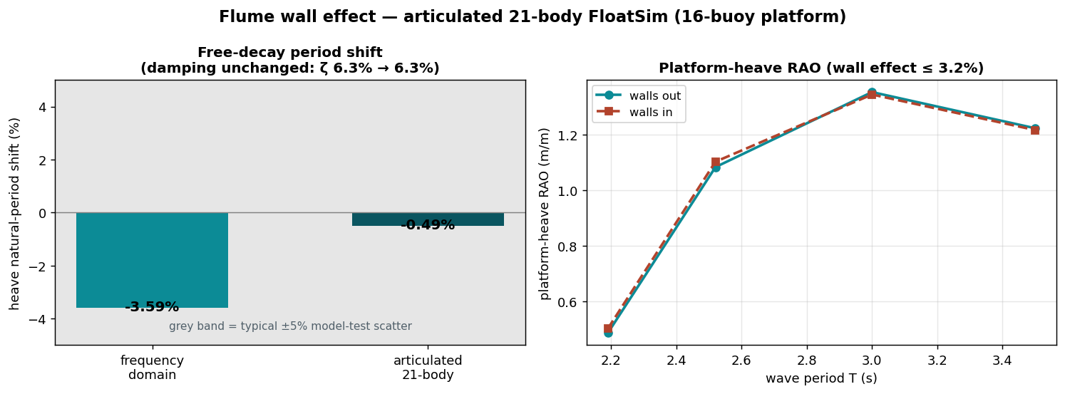
RESULTS
Result 2 — the response to waves
Across every wave period we'll test, the full articulated-platform simulation shows the walls change the response by at most about 3% — and it doesn't grow at long waves.

Slide 8
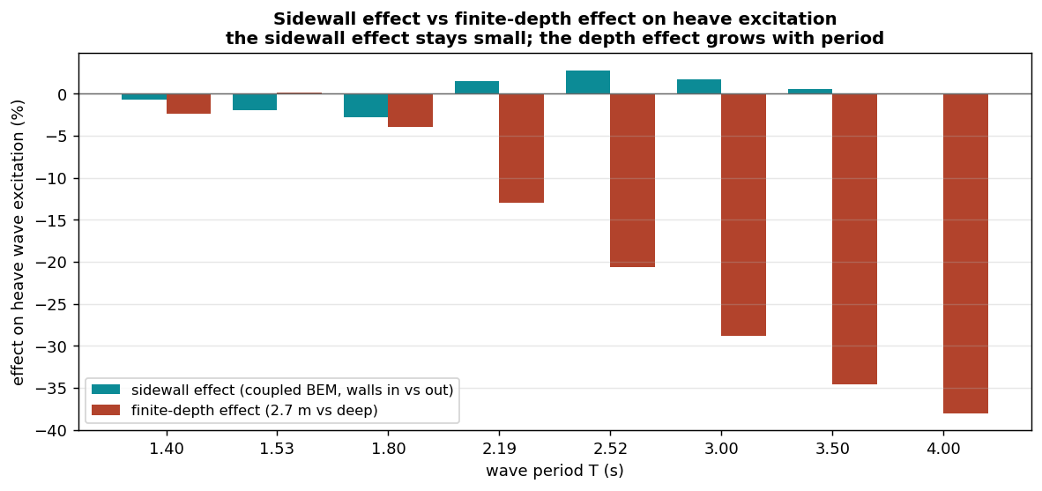
RESULTS
Result 3 — the shallow water matters more than the walls
The walls (teal) stay small at every wave period; it's the shallow 2.7 m water (red) that grows at long waves — and that's a known, routine correction every flume test already applies.

Slide 9
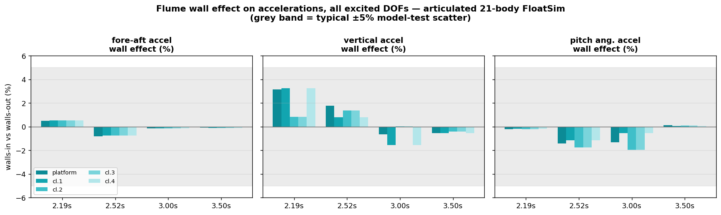
RESULTS
Result 4 — every direction, not just up-down
We checked the accelerometers in every direction they can move — fore-aft, up-down, and tilt (pitch). Near the natural period, walls in vs out changes each one by about 3% or less, at the deck centre and all four cluster points. Side-to-side and twist stay essentially zero (the waves come straight down the flume).

Slide 10
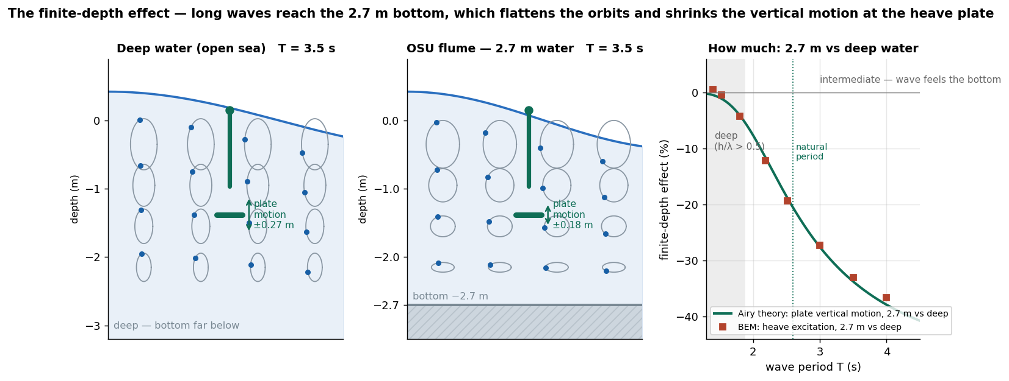
THE DEPTH EFFECT
Why long waves feel the bottom
Under a wave, the water moves in little loops. Short waves only stir the top layer, so the flume feels like the open sea. Long waves reach all the way down, and the 2.7 m floor squashes the loops flat — so there's less up-and-down push on the buoys' plates. That's the depth effect: well understood, and corrected as standard.

Slide 11
THE CAVEAT
The one thing to watch
• A flume can “ring” sideways like a bathtub at a few special wave periods (≈ 2.2, 1.5, 1.25 s).
• Near those, the walls do matter — so we simply avoid parking a test exactly there.
• They're narrow, known in advance, and easy to step around in the test plan.
• And for very long waves (slower than ~3 s), the shallow water depth is the bigger effect — corrected as standard, just like any flume test.

Slide 12
CONCLUSION
Bottom line
• The 2.4 m, 16-buoy platform is compatible with the OSU wave flume.
• The side walls change the measured bobbing speed by about ½%, the damping not at all, and the near-resonance wave response by only a few percent.
• The bigger flume factor is the shallow water depth (not the walls) — a routine, corrected effect.
• Reason, in one line:
  – the platform barely makes waves, so there's almost nothing for the walls to reflect — the flume test measures the real behaviour once depth is accounted for.

