Slide 1
Student Productivity & Burnout Risk Dashboard
Presented by: Abhisek K

Slide 2
Project Objectives
Objectives:
Analyze student study behavior and wellbeing
Measure productivity using calculated KPIs
Identify students at burnout risk
Provide insights for early intervention
Problem Statement:
Students face high academic pressure leading to reduced productivity and burnout.
Traditional analysis focuses only on marks, ignoring behavior and wellbeing.
There is a need to analyze study habits and health factors together.

Slide 3
Dataset Overview
StudentMaster
StudentID, Stream, Year
StudySessions
Subject, Study Duration, Focus Level, Distractions, Breaks
Wellbeing
Sleep Hours, Stress Level, Mood, Energy Level
Data Model:
Star schema
Relationships using StudentID

Slide 4
Data Processing
Data Preparation Steps:
Data cleaning using Power Query
Corrected data types
Created Time of Day column
Built relationships between tables

Slide 5
DAX Functions Used
DAX (Data Analysis Expressions) is used to create dynamic calculations and KPIs.
Key Functions Used
SUM() – Calculate total study hours
AVERAGE() – Measure average focus, sleep, and stress
VAR – Store intermediate values in complex formulas
SWITCH() – Classify burnout risk levels
COUNT() – Count study sessions for analysis
Custom Measures Created
Total Study Hours
Productivity Score
Burnout Risk Score
Burnout Risk Category

Slide 6
Key KPIs (DAX Measures)
Key Performance Indicators:
Total Study Hours
Average Focus Level
Average Sleep Hours
Productivity Score
Burnout Risk Score
Burnout Score Logic:
Study Hours
Sleep Deficit
Stress Level
Low Focus

Slide 7
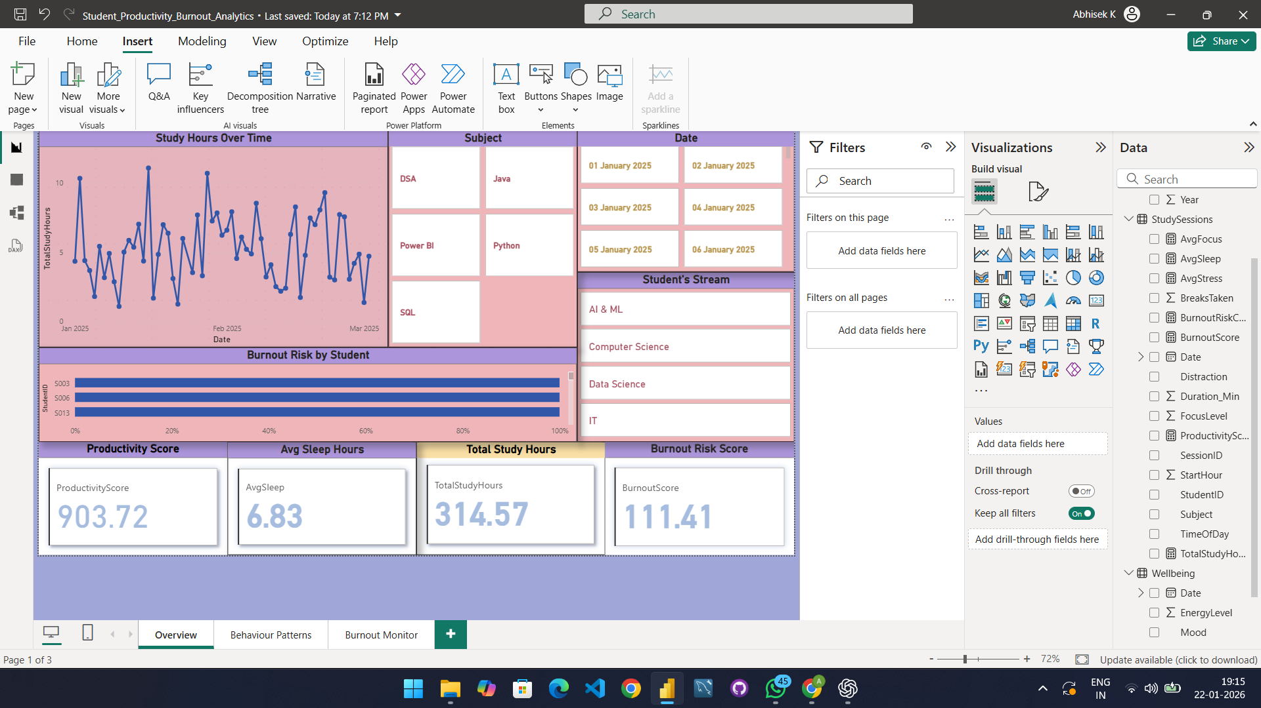
Dashboard Pages
Overview
KPIs, trends, filters

Slide 8
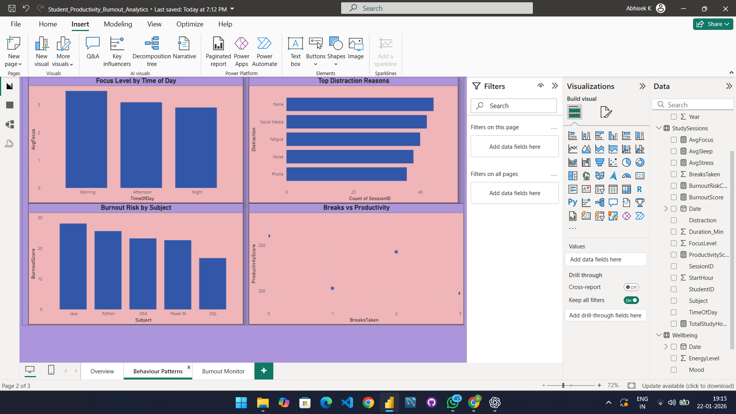
Behavior Patterns
Focus, distractions, subject-wise burnout

Slide 9
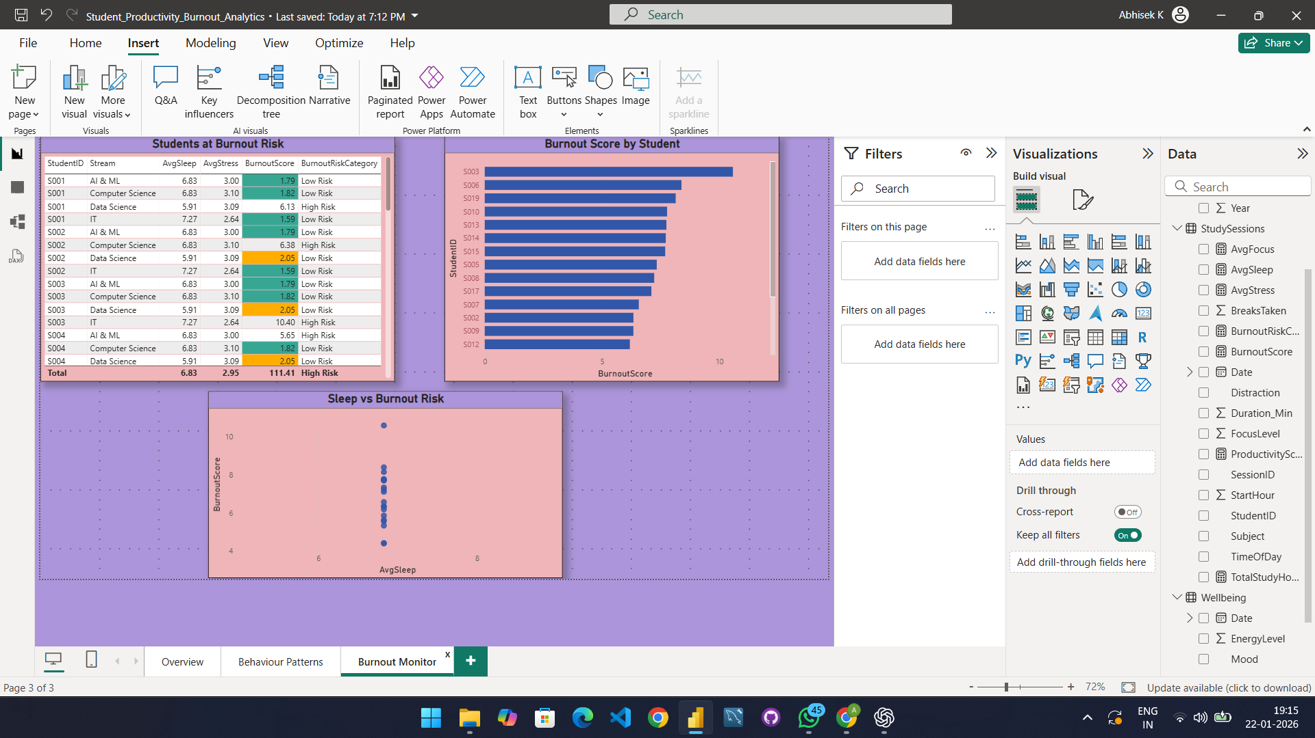
Burnout Monitor
High-risk students, sleep vs burnout

Slide 10
Insights
Morning study sessions show the highest focus levels, indicating better productivity during early hours.
Lower sleep duration is strongly associated with higher burnout risk, highlighting sleep as a critical wellbeing factor.
Java and Python subjects exhibit higher burnout scores compared to other subjects, suggesting increased cognitive load.
Phone usage and social media are the most common distractions, significantly impacting study effectiveness.
Frequent breaks correlate with reduced productivity, indicating loss of study continuity.
The burnout monitoring dashboard successfully identifies high-risk students, enabling early intervention and support.

Slide 11
Conclusion
Demonstrates Power BI skills in data modeling, DAX, and visualization
Introduces a custom burnout scoring system
Provides actionable insights using interactive dashboards

