Slide 1
Model Persistence scikit-learn and ONNX
Xavier Dupré
Senior Data Scientist at Microsoft
Professor at ENSAE

Slide 2
Open Source
Everything in this presentation is open source (MIT license) and hosted on github.

Slide 3
Plan
Persistence and predictions
ONNX specifications
Conversion to ONNX
Runtime / Benchmark
Future Plans

Slide 4
Persistence and Prediction

Slide 5
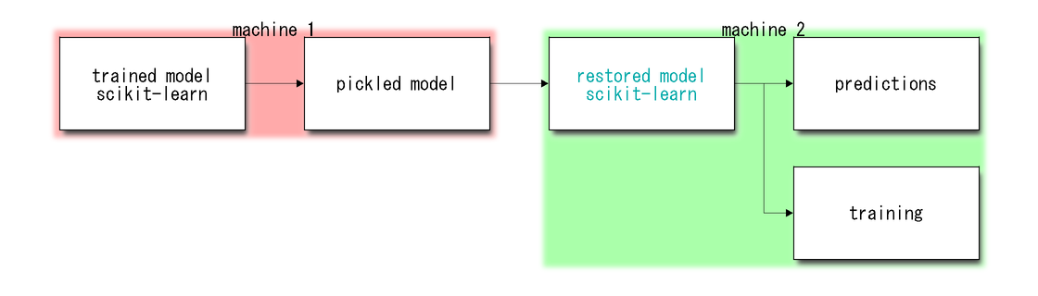
Persistence with pickle
Issues:
Unpickle is unstable (python version…)
Predictions are not fast (scikit-learn is optimized for batch predictions)

Slide 6
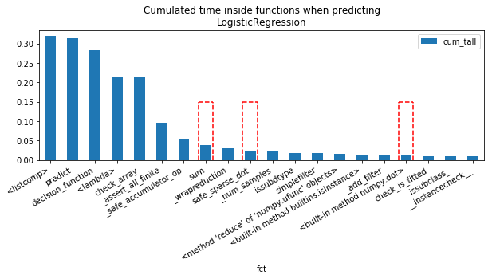
With Iris: python >> cython
clr.predict(X)

Slide 7
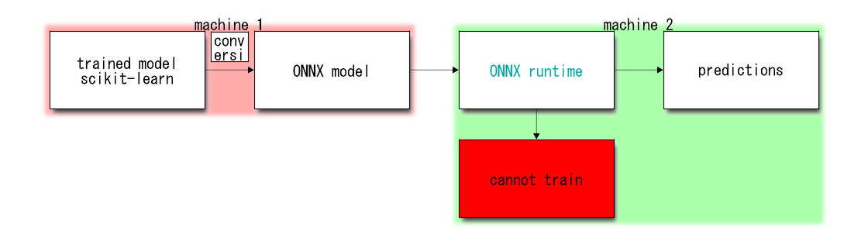
Persistence with ONNX
ONNX…
Is a serialization format based on protobuf
Aims at describing any prediction function from machine learned models

Slide 8
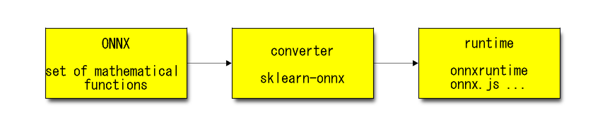
Three components for ONNX

Slide 9
ONNX
ONNX = Set of mathematical operations assembled into a graph.
It is versioned and stable: backward compatibility.
It is optimized for deep learning, it works with single float

Slide 10
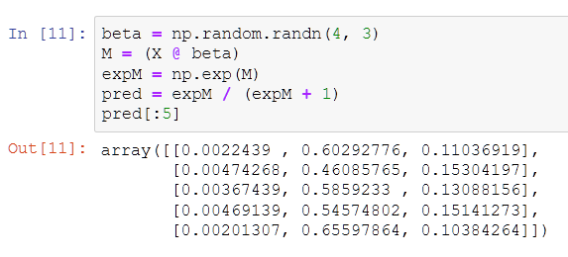

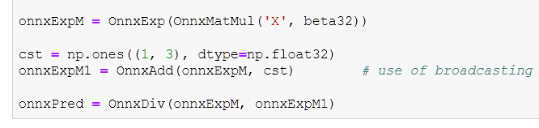
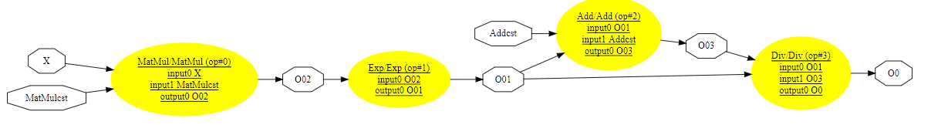
Simple function in ONNX
f(X)=…

Slide 11

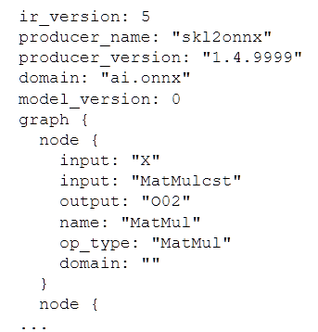

Serialization, metadata

Slide 12
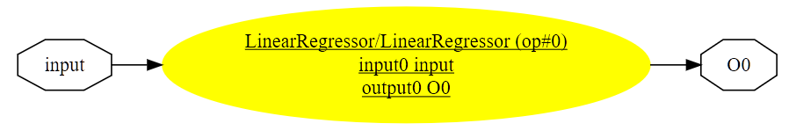
Machine learning functions
lin_reg = OnnxLinearRegressor('input’,
coefficients=beta, targets=2)

Slide 13
Conversion to ONNX
Each library gets its converter libraries
sklearn-onnx for scikit-learn

Slide 14
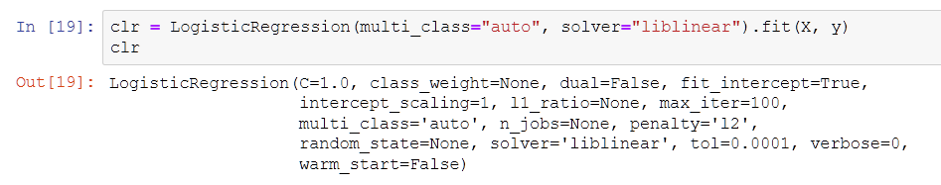
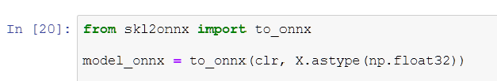
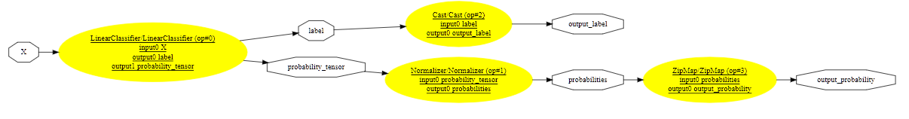
Logistic Regression to ONNX

Slide 15
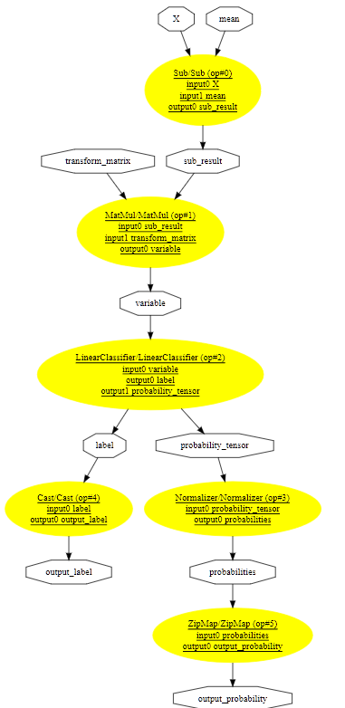
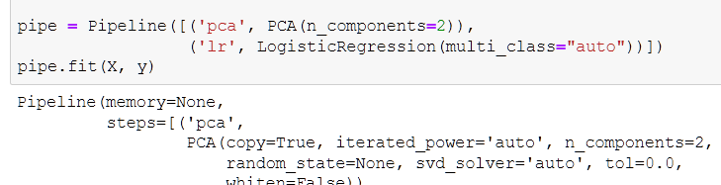
Pipeline to ONNX

Slide 16
Runtime
Predict anywhere (CPU, GPU, ARM, js, …)
No dependency on the training framework
A runtime implements a subset of the mathematical functions defined in ONNX.

Slide 17
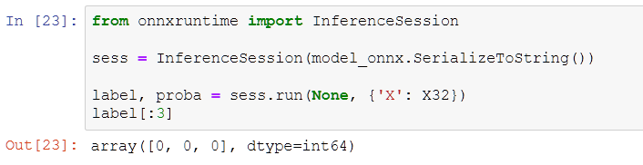
onnxruntime (by Microsoft)
Runtime written in C++
Available for CPU, GPU, ARM
Binding for C, C++, C#, Python
Use openmp, mkldnn, tensorrt, tvm, ngraph…

Slide 18
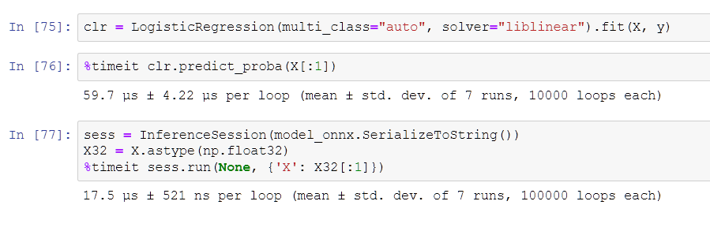
Benchmark: one-off prediction LR

Slide 19
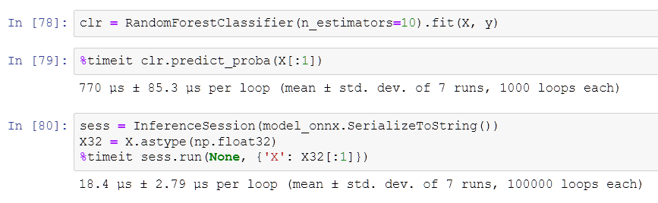
Benchmark: one-off prediction RF

Slide 20
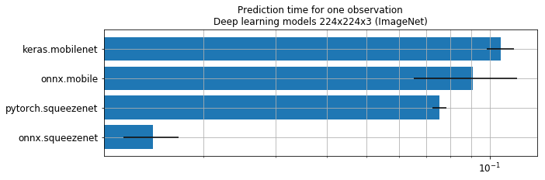
Benchmark: deep learning (CPU)

Slide 21
Future plans

Slide 22
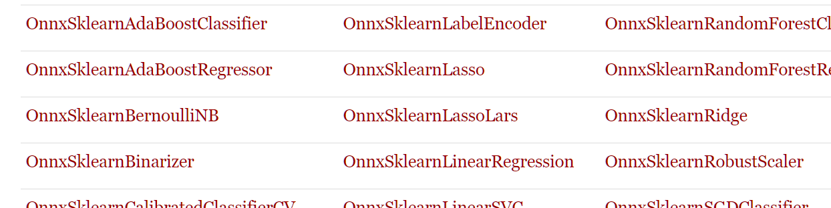
Today
Next
Converters for main machine learned models in scikit-learn
Possibility to add custom converters
Support for sparse tensors
Speed improvments
Better documentation

Slide 23
Thank you. Any question: xadupre@microsoft.com

