Slide 1
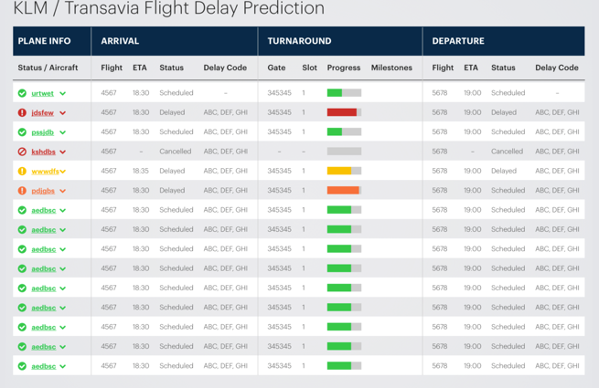


Explainable On-Time Performance – Transportation
Challenge: Globally 323,454 flights are delayed every year. Airline-caused delays totaled 20.2 million minutes last year, generating huge cost for the company. Existing in-house technique reaches 53% accuracy for predicting flight delay, does not provide any time estimation (in minutes as opposed to True/False) and is unable to capture the underlying reasons (explanation).
AI Technology: Integration of AI related technologies i.e., Machine Learning (Deep Learning / Recurrent neural Network), Reasoning (through semantics-augmented case-based reasoning) and Natural Language Processing for building a robust model which can (1) predict flight delays in minutes, (2) explain delays by comparing with historical cases.
XAI Technology: Knowledge graph embedded Sequence Learning using LSTMs
Jiaoyan Chen, Freddy Lécué, Jeff Z. Pan, Ian Horrocks, Huajun Chen: Knowledge-Based Transfer Learning Explanation. KR 2018: 349-358
Nicholas McCarthy, Mohammad Karzand, Freddy Lecue: Amsterdam to Dublin Eventually Delayed? LSTM and Transfer Learning for Predicting Delays of Low Cost Airlines: AAAI 2019

Slide 2
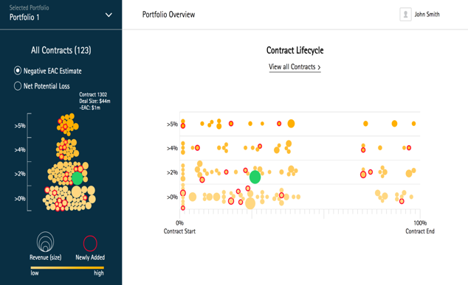
Explainable Risk Management – Finance
Challenge: Accenture is managing every year more than 80,000 opportunities and 35,000 contracts with an expected revenue of $34.1 billion. Revenue expectation does not meet estimation due to the complexity and risks of critical contracts. This is, in part, due to the (1) large volume of projects to assess and control, and (2) the existing non-systematic assessment process.
AI Technology: Integration of AI technologies i.e., Machine Learning, Reasoning, Natural Language Processing for building a robust model which can (1) predict revenue loss, (2) recommend corrective actions, and (3) explain why such actions might have a positive impact.
XAI Technology: Knowledge graph embedded Random Forrest
Jiewen Wu, Freddy Lécué, Christophe Guéret, Jer Hayes, Sara van de Moosdijk, Gemma Gallagher, Peter McCanney, Eugene Eichelberger: Personalizing Actions in Context for Risk Management Using Semantic Web Technologies. International Semantic Web Conference (2) 2017: 367-383
Alvaro H. C. Correia, Freddy Lécué: Human-in-the-Loop Feature Selection. AAAI 2019: 2438-2445

