Slide 1
INTRODUCTION TO PYTHON
General applications in engineering and basic syntax
ALI KHAJEZADE
PHD CANDIDATE-UBC-2020

Slide 2
OUTLINES
Python Application in different areas
Why should we learn Python?
Background check
Python Introduction : Basic Syntax
  IDLE environment +Jupyter notebook
  Data types and Data Handling
  Conditional Statements
  Looping and iteration
  Function definition
  Loading and using libraries
Example: Numpy Library and Visualization of Data using Matplotlib and Plotly

Slide 3
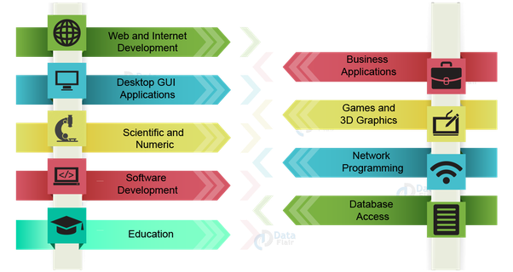
PYTHON APPLICATION IN DIFFERENT AREAS

Slide 4
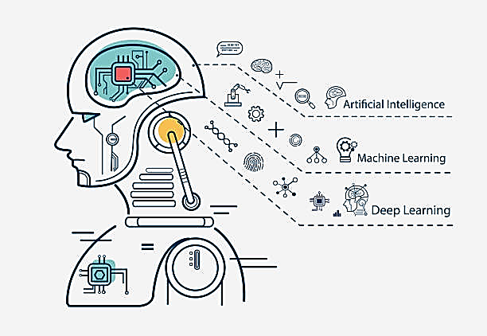
APPLICATION IN DATA SCIENCE AND MACHINE LEARNING
Data classification
Regression
Data and image processing
Prediction and decision making
https://www.facebook.com/PlargueDoctor/

Slide 5
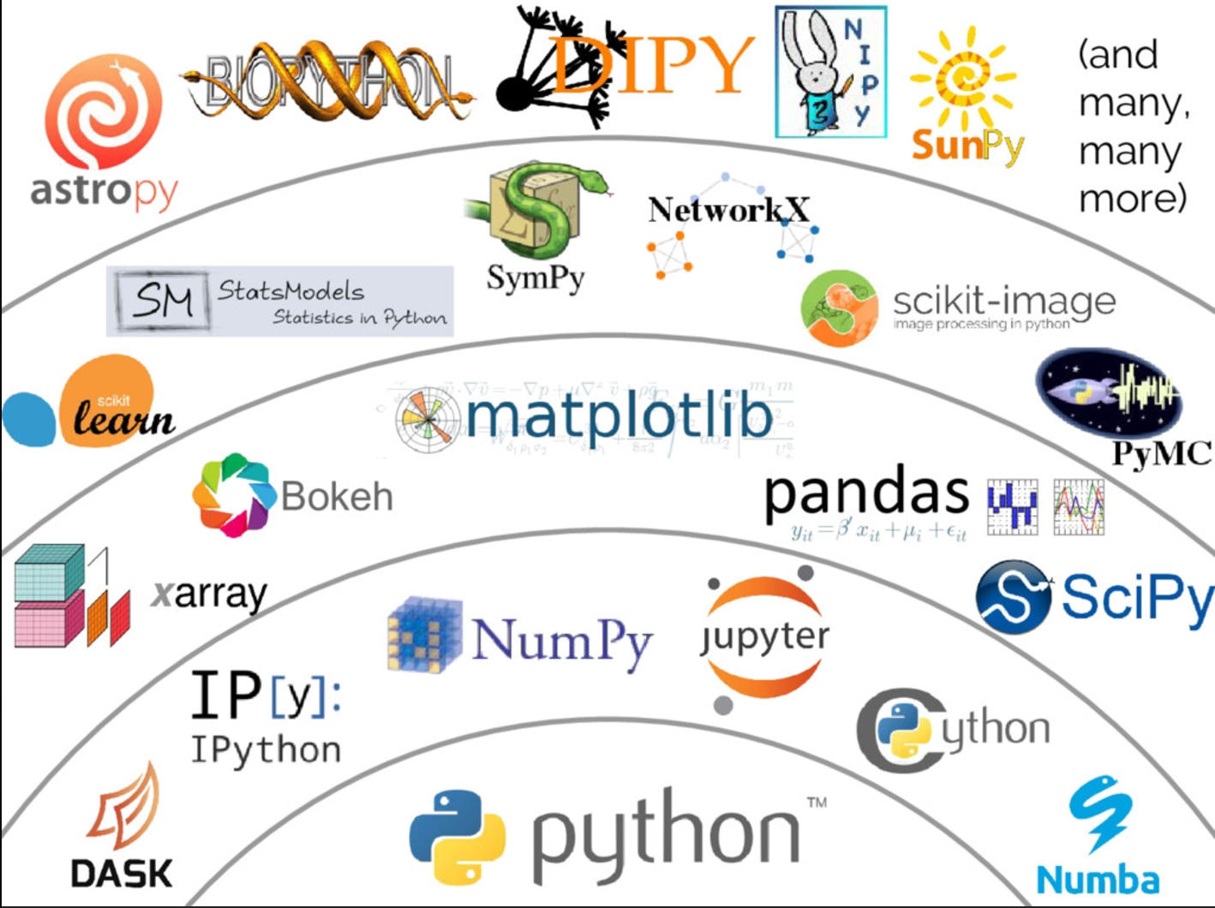


SCIENTIFIC AND NUMERICAL APPLICATION
https://www.youtube.com/watch?v=s-oBE-QWuGo

Slide 6
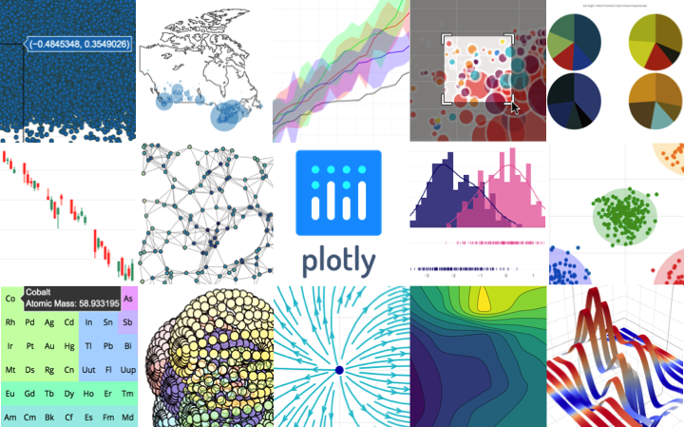
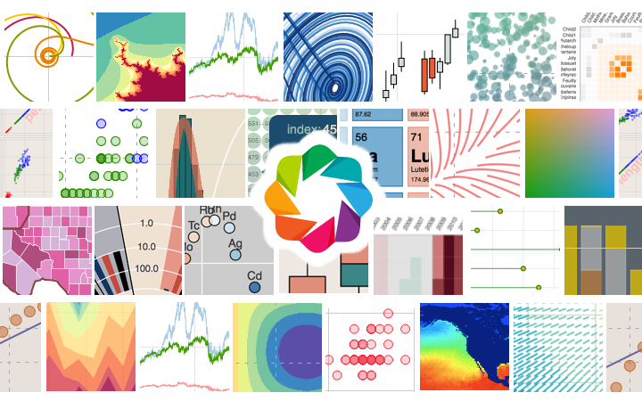
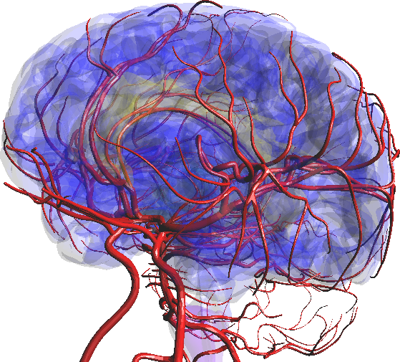

VISUALIZATIONS

Slide 7
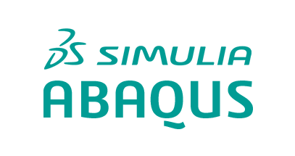

SCRIPTING TOOL FOR LOT OF SCIENTIFIC SOFTWARES

Slide 8
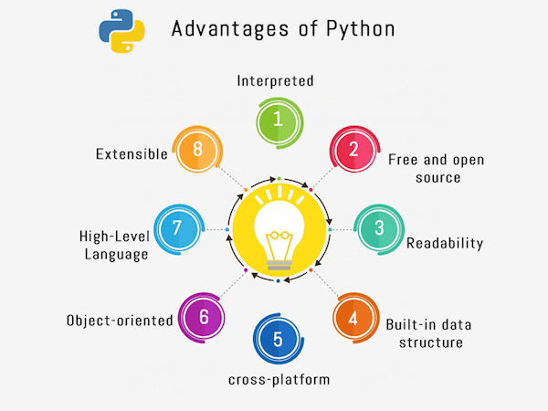
WHY SHOULD WE LEARN PYTHON?
https://ramsatt.com/2019/03/22/python-interview-questions/

Slide 9
AND…
Lot of big companies want a person who knows python!
BUT REMEMBER…
A native python code is 80-200 times slower than C++!
but batteries included!

Slide 10
BACKGROUND CHECK!

Slide 11
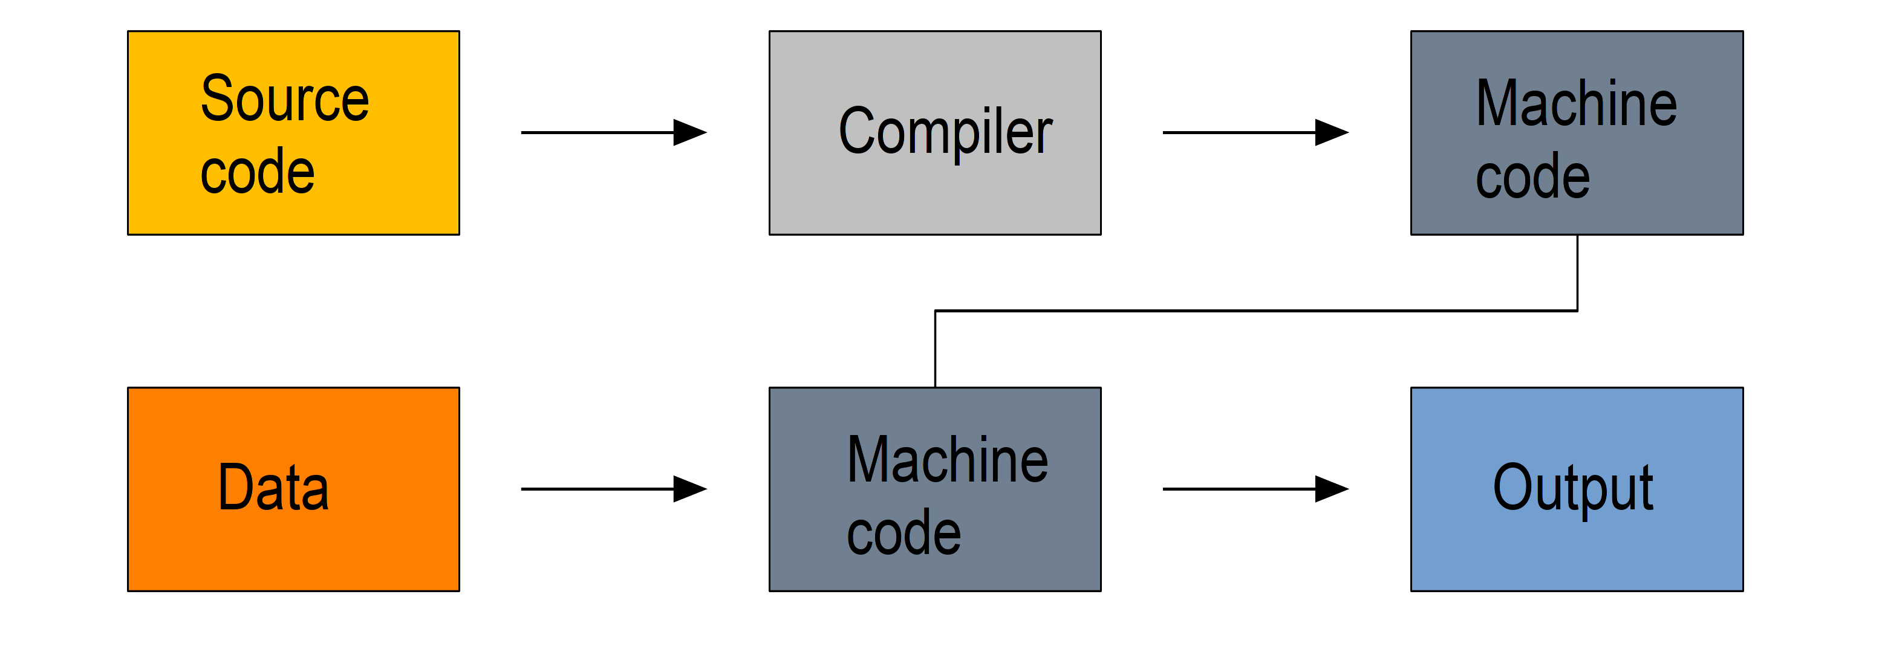
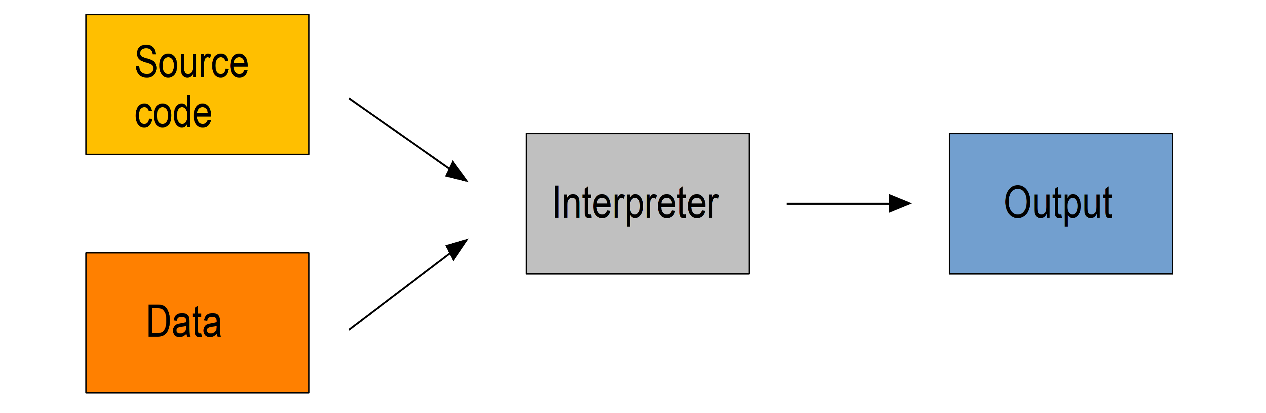
COMPILER VS INTERPRETER
Compiler
Very fast
No user-friendly
A nightmare to debug
C/C++, FORTRAN, CHAPEL
Slow (100 times)
User-friendly
Super easy to debug
Interpreter
R, Python, Perl, and JavaScript

Slide 12
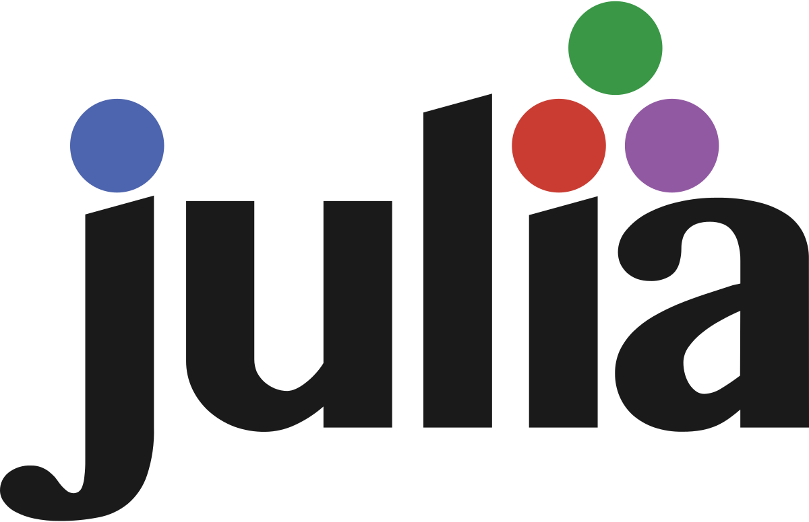
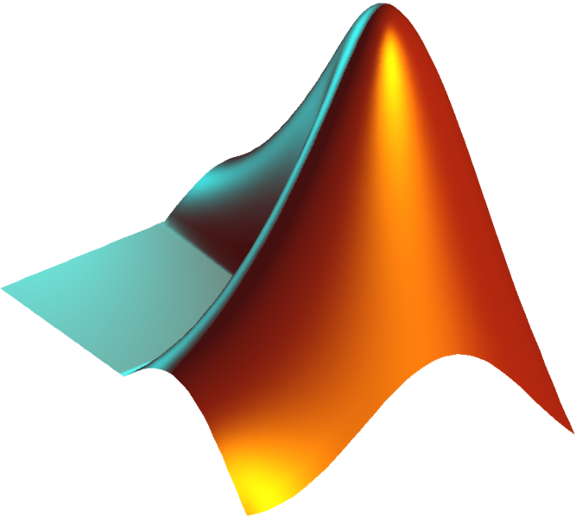

JIT COMPILED LANGUAGES (SOMETHING IN BETWEEN)
They are compiler languages but codes are compiled at the run time! (10 times slower than compilers)

Slide 13
LET’S GET STARTED!

Slide 14
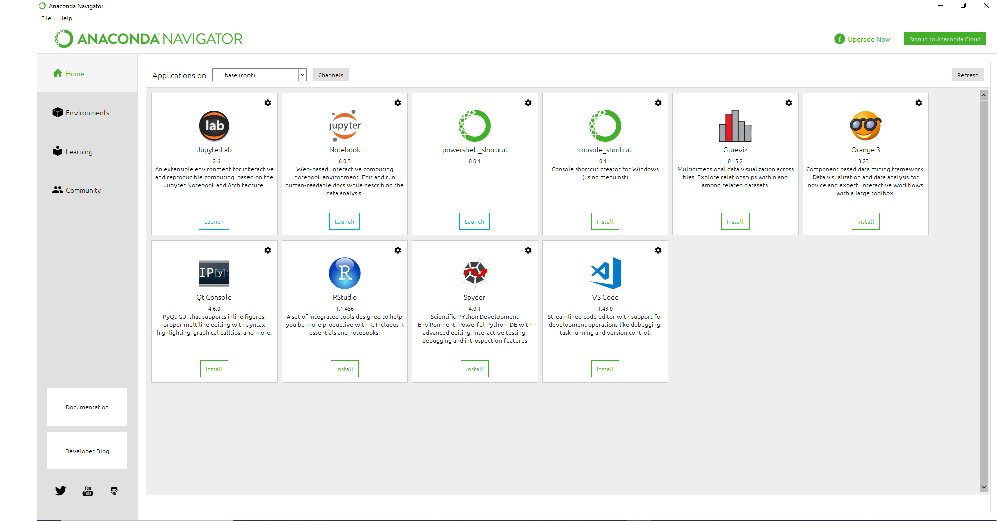
ANACONDA

Slide 15
THE REST IS IN PYTHON ENVIRONMENT!

Slide 16
Let’s get Started!

