Slide 1
GSM Network Structure and Network Planning

Slide 2
Contents of thesis
Introduction
Chapter 1 - GSM
1.1 What is GSM?.
1.2 History of GSM
1.3 Principle of cellular network
Chapter 2 - GSM-Network Structure
2.1 The Mobile Station
2.2 Base Station Subsystem, BSS
2.3 Switching and Management Subsystem, SMSS
2.4 Operation and Maintenance Subsystem, OMSS

Slide 3
Chapter 2 - Geographical structures in a mobile communication network
2.1 GSM Service Area
2.2 Location Area
Chapter 3 - Radio cells
3.1 Antennas for mobile communication networks
3.2 Classes of radio cells
3.3 Capacity of the network
Conclusion
References

Slide 4
GSM History
During the early 1980s, analog cellular telephone systems were experiencing rapid growth in Europe. Each country developed its own system, which was incompatible with everyone else's in equipment and operation. This was an undesirable situation, because not only was the mobile equipment limited to operation within national boundaries, which in a unified Europe were increasingly unimportant, but there was also a very limited market for each type of equipment.

Slide 5
In 1987, representatives from 13 European countries signed a contract to deploy a telecommunications standard. The European Union (EU) then passed laws to require GSM as a standard in Europe. In 1989, the responsibility of the GSM project was transferred from CEPT to the European Telecommunications Standards Institute (ETSI).
Mobile services based on GSM were first launched in Finland in 1991. That same year, the GSM standard frequency band was expanded from 900 MHz to 1,800 MHz.

Slide 6
Principle of cellular network
In a mobile communication network the transfer of speech or data is performed by a radio link. This radio link will at least be established between the mobile station and the base station. The first existing radio networks were characterized by some features: Radio coverage, or serving cell area of about 60km radius. Radio link only within one serving cell, at the moment of leaving this serving cell, the call was terminated. Switching-by-hand, no automatic routing of the call to the endpoint.

Slide 7
GSM-Network Structure
The GSM network has four separate parts that work together to function as a whole: the mobile device itself, the base station subsystem (BSS), the network switching subsystem (NSS) and the operation and support subsystem (OSS).
The mobile device connects to the network via hardware. The subscriber identity module (SIM) card provides the network with identifying information about the mobile user.

Slide 8
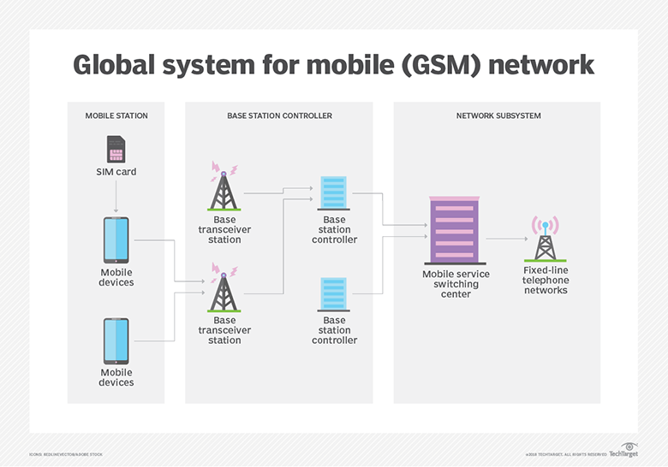

Slide 9
The BSS handles traffic between the cell phone and the NSS. It consists of two main components: the base transceiver station (BTS) and the base station controller (BSC). The BTS contains the equipment that communicates with the mobile phones, largely the radio transmitter receivers and antennas. The BSC, on the other hand, is the intelligence behind the BTSes. It communicates with and controls a group of BTSes.

Slide 10
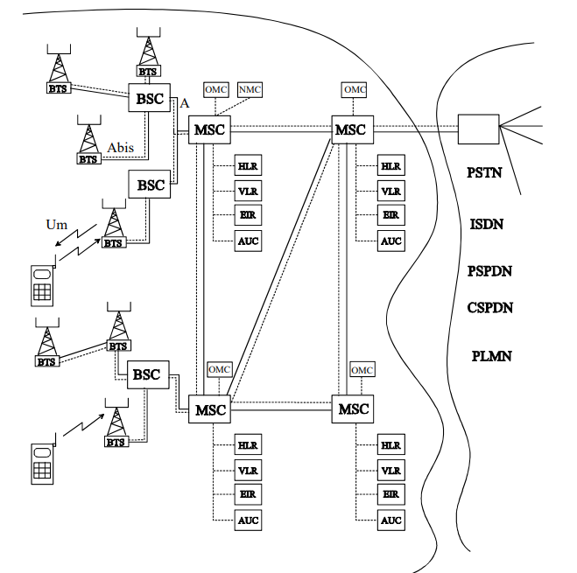
Figure: GSM-network structure

Slide 11
The NSS portion of the GSM network architecture, often called the core network, tracks the location of callers to enable the delivery of cellular services. Mobile carriers own the NSS. The NSS has a variety of parts, including mobile switching center (MSC) and home location register (HLN). These components perform different functions, such as routing calls and Short Message Service (SMS) and authenticating and storing caller account information via SIM cards.

Slide 12
Since many GSM network operators have roaming agreements with foreign operators, users can often continue to use their phones when they travel to other countries. SIM cards that hold home network access configurations may be switched to those with metered local access, significantly reducing roaming costs, while experiencing no reductions in service

Slide 13
Geographical structures in a mobile communication network
GSM is a world-wide standard for mobile communication with an extensive coverage. Due to the mobility of the subscribers, the organizational structure must be subdivided into different processing elements. The defined areas are necessary to establish point-to-point connections.

Slide 14
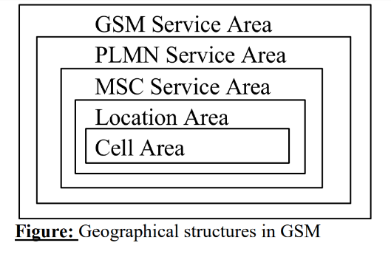
GSM Service Area: This highest area describes the whole world of GSM; all realized network elements are part of this area. PLMN Service Area: The defined area of the Public Land Mobile Network is the service area of one network operator. The borders are not necessarily the political borders of one country, furthermore it is possible to define on-duty areas of different operators.

Slide 15
MSC Service Area: Depending on the offered network capacity, one operator is subdividing his network into smaller service area, built up by one MSC. The MS is part of the switching network, responsible for connecting telephone calls. Location Area: Inside the GSM Area, the location area is the lowest existing level of the location information of one subscriber. The mobility management layer only knows in which location area one subscriber is located. Cell Area: The lowest area in the geographical layers is formed by one radio cell. The radio cell is stretched out by the radio coverage of one Base Transceiver Station, BTS and has a range between a few hundred metres up to a maximum of 35km.

Slide 16
Radio cells
In chapter 1 about the geographical structures within a GSM network it is already mentioned that one radio cell forms the smallest defined area in the structure and the access point into the network for the users. If the network operator performs a skilful planning of radio cells he can provide the needed coverage with field strength and capacity. The main job of the radio planning engineers is the distribution, configuration and optimisation of radio cells. The next chapter is describing the configuration of every single radio cell, in comparison to the already described relating of multiple radio cells.

Slide 17
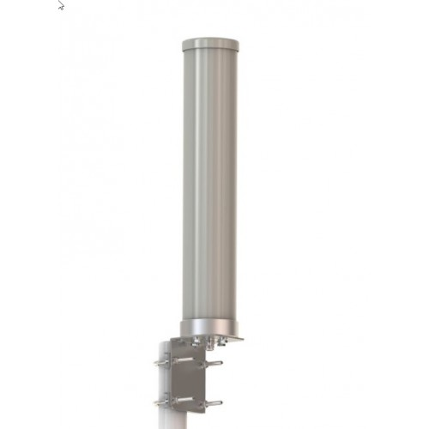
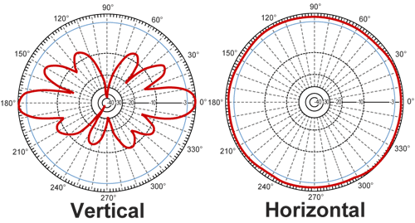
Antennas for mobile communication networks: One possibility to classify one radio cell is the size and kind of the installed antenna. In rural areas a common type is the omnidirectional antenna.
Figure : Omnidirectional antenna

Slide 18
Classes of radio cells:
Macrocells: It is the job of the macrocell to build up a wide area of coverage. Its radios range between 10km and 35km. Typically they are installed in low populated areas with a large coverage area but small traffic.
Microcells: Microcells are forming in the mean time the standard configuration in populated areas. With their configuration, a high base station density can be obtained and therefore the requested capacity can be provided. The radius of such a microcell is given in the range of 1 to 3km.
Picocells: picocells are used to ease the traffic of microcells. Most of the time they are not used to create some coverage in former uncovered areas, rather they are extending the existing coverage. Picocells can be found in Hot spot areas, or High-Traffic-Areas, e.g. market squares, fairs or street crossings.

Slide 19
Conclusion
In this thesis paper, I have tried to give an overview of the GSM technology。 As with any overview, this small paper cannot cover every aspect. There are many details missing. I believe, however, that I gave the general scenario of GSM and the philosophy behind its design and applications.

Slide 20
References
[1] Jan a. Audestad. Network aspects of the GSM system. In EUROCON 88, June 1988.
[2] David M Balston. The pan-European cellular technology. In R.C.V. Macario, editor, Personal and Mobile Radio Systems. Peter Peregrinus, London, 1991.
[3] M. Bezler et al. GSM station system. Electrical Communication, 2nd Quarter 1993.
[4] C. Dechaux and R. Scheller. What are GSM and DCS. Electrical Communication, 2nd Quarter 1993.
[5] John Scourias, Overview of the Global System for Mobile Communications.

