Slide 1
ClassMate – Timetable Generator
Presented By: Name: Aswin Chacko Jeemon Roll No: 19 Class: MCA S3
Guide: Miss Divya S B HOD Department of Computer Applications
Review: Zeroth Review Date:
13 Oct 2025

Slide 2
Abstract

Slide 3
Abstract
Timetable creation in colleges is often tedious and error-prone, especially with multiple classes and limited faculty. ClassMate is a web-based system designed for departmental use that allows faculty to generate weekly timetables for various classes like MCA and BCA without clashes. It supports lab hours (spanning 3 periods), tutorial sessions, and fixed breaks. Faculty can edit, update, and download timetables with ease. The system ensures proper allocation and avoids scheduling conflicts, making the entire process faster and more accurate.

Slide 4
Existing System

Slide 5
Existing System (Pros & Cons)
Existing System: Manual Timetable Generation
Pros:
Familiar process for academic staff
No infrastructure dependency
Flexible for immediate changes
Cons:
Time-consuming
High chance of human errors
Scheduling conflicts (teacher/classroom overlaps)
Difficult to scale with multiple departments
Inefficient lab session handling

Slide 6
Proposed System

Slide 7
Proposed System
Proposed System: ClassMate – A Web-Based Timetable Generator
Pros:
Automated scheduling
Conflict-free class and faculty assignment
Easy visualization with calendar view
Manages labs, tutorials, and theory classes
Scalable for multiple departments
Reduced manual work and errors

Slide 8
Modules of Proposed System

Slide 9
Modules of Proposed System
Faculty Module – Generate, edit, and view timetables for assigned classes.
Class & Subject Management – Add subjects, classes (e.g., MCA/BCA), and tutorial/lab hour details.
Timetable Generation Module – Automatically allocate periods while avoiding faculty and lab conflicts.
Lab Handling Module – Incorporate predefined breaks and 3-hour lab sessions into the schedule.
Download & Reporting Module – Export and download timetables in printable formats.

Slide 10

System Specifications

Slide 11
System Specifications
Frontend:
React.js
Bootstrap
FullCalendar.js
Backend:
Django
Django REST Framework

Slide 12
System Specifications
Database:
MySQL
Timetable Logic:
Basic rule-based slot filling
Handles theory, lab, and tutorial sessions

Slide 13

LITERATURE REVIEW

Slide 14
Automated Timetable Generator - 2024
Techniques / Algorithms Used:
Web tech (Node.js, MySQL), Optimization Algorithms.
Highlights / Features:
Real-time visualization, user role modules, conflict resolution, scalable deployment with AWS EC2.
Disadvantages:
Lacks AI, manual input, scalability unclear.
Tuijin Jishu / Journal of Propulsion Technology

Slide 15
A Survey Paper on Timetable Generator Using AI Methods - 2025
Techniques / Algorithms Used:
Decision Tree, K-Means, Random Forest.
Highlights / Features:
AI-based scheduling, workload balancing, clustering, role-based access, multi-year engineering division support.
Disadvantages:
Theoretical focus, no UI, not implemented.
IRJAEH (International Research Journal on Advanced Engineering Hub)

Slide 16
TIMELY TRIGGER: A Smart Timetable Generator - 2024
Techniques / Algorithms Used:
Genetic Algorithm, Push Notifications, Live Tracking.
Highlights / Features:
Cloud-based, customizable UI/UX, Excel integration, automated conflict detection, real-time updates.
Disadvantages:
Heavy on system resources, soft constraint handling weak.
IJNRD (International Journal of Novel Research and Development)

Slide 17
AUTOMATIC TIMETABLE GENERATOR - 2021
Techniques / Algorithms Used:
Custom Algorithm, Django, MySQL, Python.
Highlights / Features:
Generates timetable per semester, Excel export, faculty & subject conflict management, manual data input interface.
Disadvantages:
One class only, partial GA, lacks notifications.
IRJET (International Research Journal of Engineering and Technology)

Slide 18
A STUDY ON AUTOMATIC TIMETABLE GENERATOR - 2018
Techniques / Algorithms Used:
Genetic Algorithm, Tabu Search, Simulated Annealing.
Highlights / Features:
Constraint satisfaction problem approach, hard vs soft constraints, algorithm comparison (GA, CP), realistic solution development.
Disadvantages:
Outdated algorithms, manual tuning, no UI focus.
International Journal of Science and Innovative Engineering & Tech

Slide 19
Feasibility Study

Slide 20
1. Technical Feasibility
The tools and frameworks used in ClassMate are modern, well-documented, and open-source, making them highly suitable for academic software projects.
Frontend:
React.js enables fast and dynamic component-based UI development.
Bootstrap helps build a responsive and clean layout with minimal design effort.
FullCalendar.js integrates easily with React and provides an intuitive visual timetable.
Backend:
Django is a powerful Python framework with built-in admin support and security.
Django REST Framework allows seamless creation of APIs for frontend-backend communication.
Database:
MySQL is widely supported, reliable, and easy to integrate with Django ORM.

Slide 21
2. Economic Feasibility
This project can be developed without any cost for licenses or infrastructure:
All tools used are open-source.
Development can be done on local machines or deployed using free-tier platforms like Render or Railway.
No hardware or additional software purchases are required.

Slide 22
3. Operational Feasibility
The system is designed to be simple and functional for its primary users:
Admin can manage faculty, classes, and sessions through a user-friendly UI.
Faculty schedules are handled by automated logic, reducing errors.
Timetable visualization is clean and readable through FullCalendar.js.
User interaction is minimal, and once the inputs are set, the timetable generation is automatic.

Slide 23
4. Legal and Ethical Feasibility
The system stores no sensitive personal information beyond academic data.
Data is handled securely within Django’s framework.
The technology stack adheres to open-source licenses and ethical development practices.

Slide 24
Entity-Relationship Diagram(ER)

Slide 25
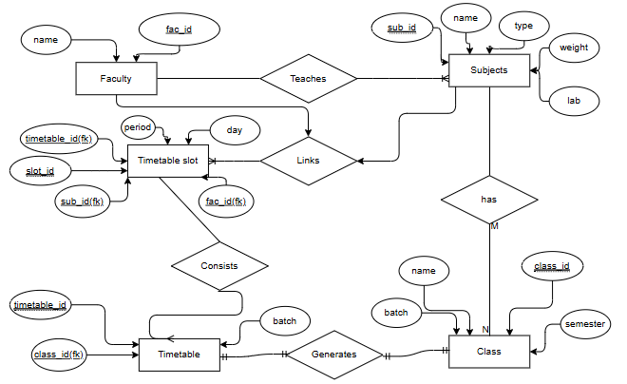
E-R Diagram

Slide 26
Data-Flow Diagram(DFD)

Slide 27
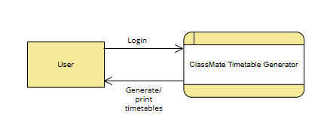
Level 0

Slide 28
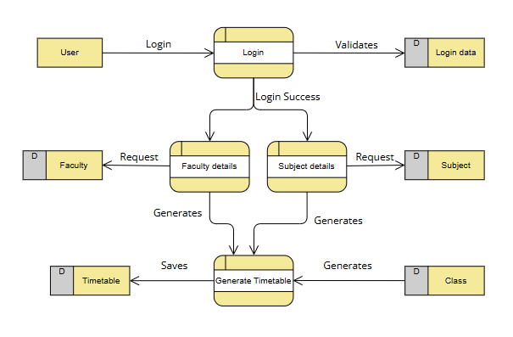
Level 1

Slide 29
Use-Case Diagram

Slide 30
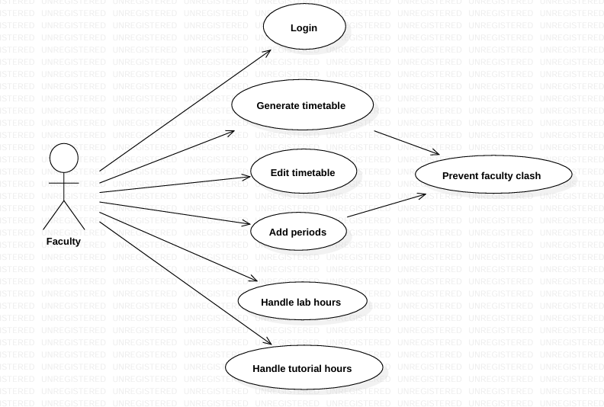
Faculty

Slide 31
Class Diagram

Slide 32
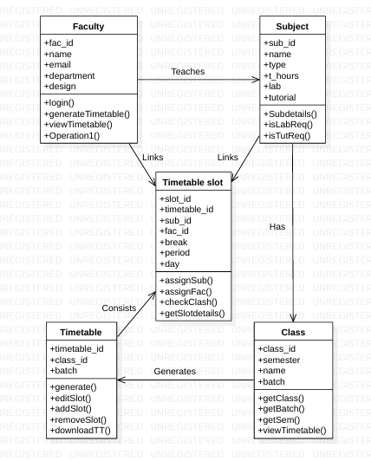
Class Diagram

Slide 33
State Diagram

Slide 34
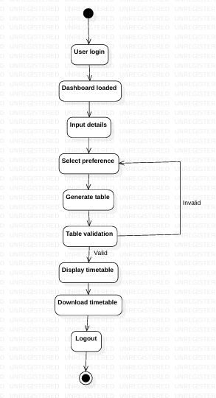
State diagram

Slide 35
Sequence Diagram

Slide 36
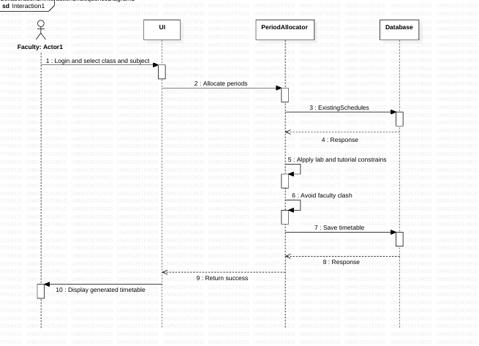

Slide 37
Screenshots

Slide 38
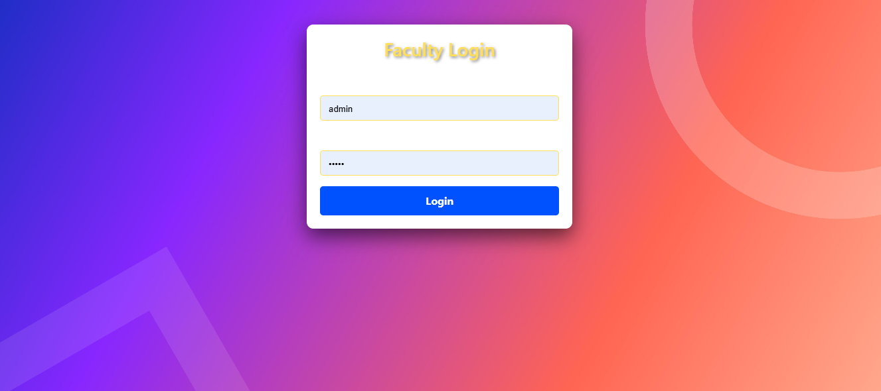

Slide 39
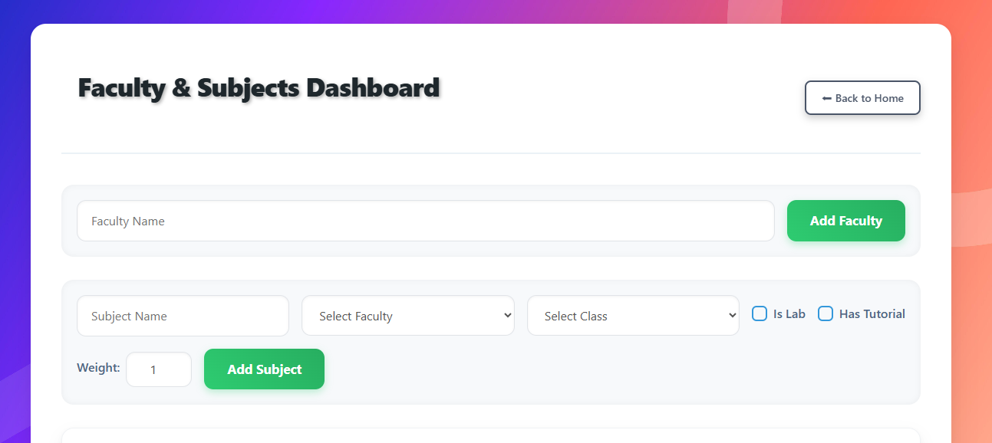

Slide 40
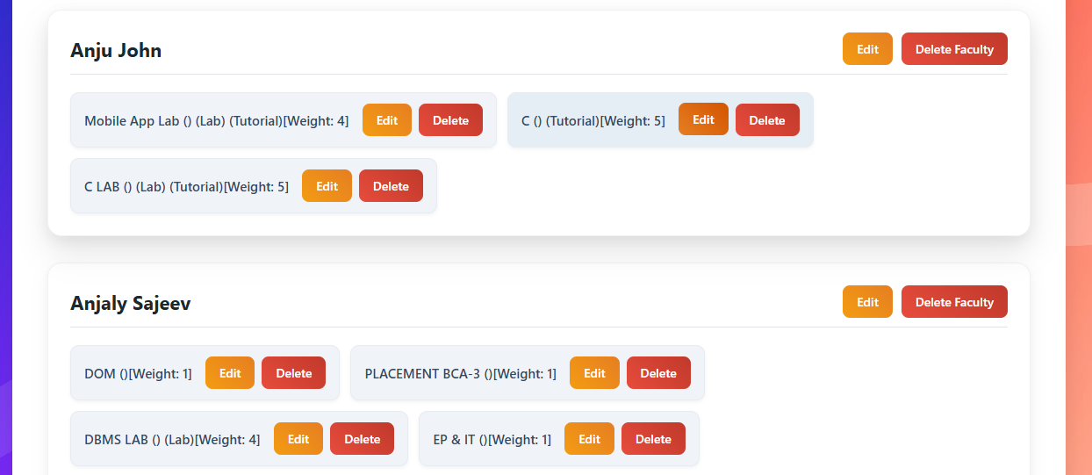

Slide 41
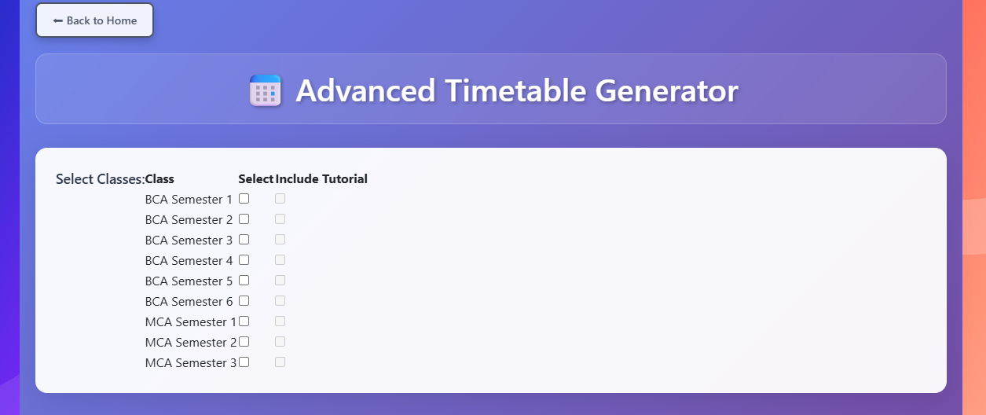

Slide 42
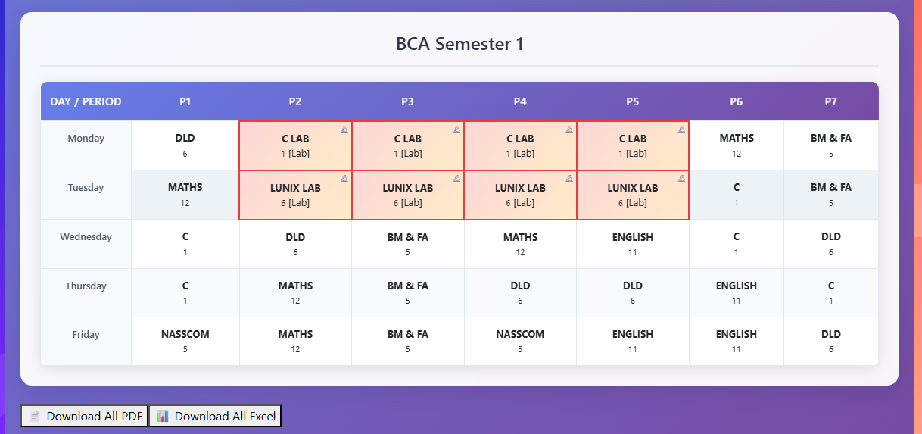

Slide 43
Results

Slide 44
Results
System Implementation and Testing: The ClassMate Timetable Generator system was successfully designed and tested as an intelligent timetable management platform for academic institutions.
Key Achievements:
Automated Timetable Generation:
Generated conflict-free timetables for multiple classes and semesters automatically.
Ensured no faculty or lab scheduling overlaps.
Faculty and Subject Management:
Allowed addition, editing, and deletion of faculty and subject details.
Supported lab hours (3 periods) and tutorial hours efficiently.

Slide 45
Results
User Interface & Experience:
Developed a responsive React frontend for easy use.
Integrated with Django REST API and MySQL for seamless backend operations.
Performance:
Generated optimized timetables in seconds.
Improved scheduling accuracy and reduced manual planning time by 70–80%.

Slide 46
Future Scope

Slide 47
Future Scope
1. AI-Powered Optimization:
Implement advanced genetic algorithms and machine learning models for better timetable accuracy.
Predict best slot allocations based on faculty availability and student preferences.
2. Mobile Application Integration:
Develop an Android/iOS app for faculty and students to view and download timetables easily.
3. Real-Time Notifications:
Enable real-time alerts for timetable changes or substitutions via email/SMS.

Slide 48
Future Scope
4. Cloud Deployment:
Host the system on AWS or Google Cloud for scalability and multi-department access.
5. Advanced Reporting:
Provide visual analytics on faculty workload, subject distribution, and classroom utilization.
6. Integration with Attendance & Exam Systems:
Extend functionality to automatically sync with attendance tracking and exam scheduling.
7. Multi-Institution Support:
Enable multi-campus and cross-department scheduling under one unified platform.

Slide 49
Conclusion

Slide 50
Conclusion
The ClassMate Timetable Generator successfully automates and simplifies the process of academic scheduling.
By combining React.js, Django, and MySQL, the system ensures smooth communication between the frontend and backend.
This project demonstrates how modern web technologies and optimization algorithms can revolutionize institutional scheduling, improving productivity, accuracy, and academic organization.
Key contributions include:
Automatic generation of conflict-free timetables.
Efficient faculty and subject management.
Real-time, user-friendly web interface.
Accurate and time-saving scheduling process.

Slide 51
References

Slide 52
References
1. Automated Timetable Generation Systems
Research in academic scheduling emphasizes the importance of automation to reduce human effort and scheduling conflicts.
A study (2024) introduced an AI-based timetable generator using genetic algorithms, improving timetable accuracy and reducing manual workload.
2. Genetic Algorithm and Optimization Techniques in Scheduling
A study (2025) demonstrated that applying optimization algorithms like Genetic Algorithm (GA) significantly enhances timetable generation by minimizing teacher and room conflicts.
3. Web-Based Academic Management Platforms
Recent work (2025) highlighted how combining React.js, Django, and MySQL can create scalable, user-friendly academic systems with real-time updates and easy data management.

Slide 53

Thank you

