Slide 1

Link Prediction in Social Network
By:
Ali Hussain Alaswad
Majd Mustafa
Supervisor:
Dr.Eng.Kadan Jumma
Eng.Anas Abdululaziz
2023/2024

Slide 2
Outlines
01
02
03
MODEL ARCHITECTURE
ACTIVATION FUNCTION
05
LOSS FUNCTION
Unfinished Works
06
07
CURVES
08
COMPLETED WORK
CONFUSION MATRIX
09
ABOUT DATA
USED LIBRARIES
10
Evaluating Standards
04
11
PREDICTION EXAMPLE
12
13
SPLITTING THE DATA
FUTURE WORKS

Slide 3
COMPLETED WORK
Find a social media dataset
Study the dataset
Building a model for deep learning
Improve the model
Improve accuracy by splitting the dataset
Training the model

Slide 4



ABOUT DATA
THE TARGET
Each node represents a page on Facebook, each node represents an official page on the site, while the links represent likes exchanged between the pages.
Node features are extracted from page descriptions created by the page owner to illustrate the idea and purpose of the page.
The existing pages are of several categories: pages for politicians, pages for television programs, and pages for companies.
THE EDGES
THE FEATURES

Slide 5
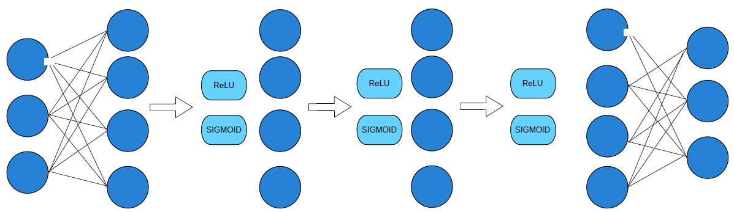
MODEL ARCHITECTURE
hidden_channel
hidden_channel
hidden_channel
hidden_channel
In_channel
out_channel
f(x) = max(0, x)
f(x) = max(0, x)
f(x) = max(0, x)
f(x) = 1 / (1 + e^(-x))
f(x) = 1 / (1 + e^(-x))
f(x) = 1 / (1 + e^(-x))
The input
The input
The input
Hidden layer 1 :
GCN
Hidden layer 2 :
GATConv
Hidden layer 3 :
SAGConv
Hidden layer 4 :
GCN
Test accuracy = 0.91
train accuracy = 0.96

Slide 6
ACTIVATION FUNCTION
ReLU
We used (ReLU) activation function
It helps to introduce non-linearity into the model and can help to prevent overfitting
The equation for (ReLU) is f(x) = max(0, x)
Where (x) is the input to the function, and f(x) is the output.
The ReLU function simply outputs the input if it is greater than or equal to zero, and outputs zero otherwise.

Slide 7
ACTIVATION FUNCTION
SIGMOID
The sigmoid function is used in logistic regression to squash your model's hypothesis (prediction) between 0 and 1
Sigmoid transformation function converts the real-valued output to a value between 0 and 1. It's interpreted as the probability of a particular sample belonging to the positive class. A value close to 0 indicates low probability of belonging to the positive class, while a value close to 1 represents high probability. It's used in binary classification problems.
f(x) = 1 / (1 + e^(-x))
where:
-f(x) is the output of the sigmoid function for the input x
-e is the base of the natural logarithm (approximately equal to 2.71828)
-x is the input to the sigmoid function

Slide 8
LOSS FUNCTION
The loss function used in this code is the binary cross-entropy loss function, which is commonly used in binary classification problems, including the binary link prediction task in graph neural networks.
The mathematical equation of the loss function in this code is as follows:
loss = -1/N * Σ[log(pos_scores) + log(1 - neg_scores)]
where:
- N is the total number of positive and negative samples,
- pos_scores are the prediction scores for positive edges,
- neg_scores are the prediction scores for negative edges, which are sampled randomly,
- log() is the natural logarithm function,
- Σ represents the summation over all positive and negative samples.

Slide 9
SPLITTING THE DATA
data can be split into training, and testing sets to train and evaluate the model effectively.
So we split the data as follows:
1. Training Set: This subset of data is used to train the GNN model and it takes 85% of the data.
2. Testing Set: This subset is used to evaluate the final performance of the trained GNN model it takes 15% of the data.

Slide 10
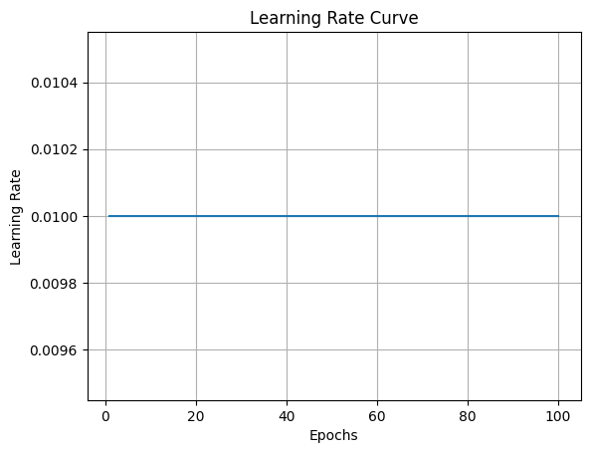
CURVES
learning rate curve

Slide 11
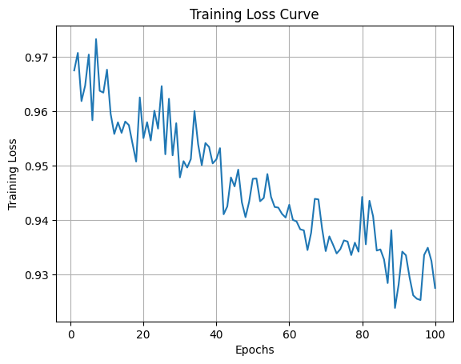
CURVES
Training loss curve

Slide 12
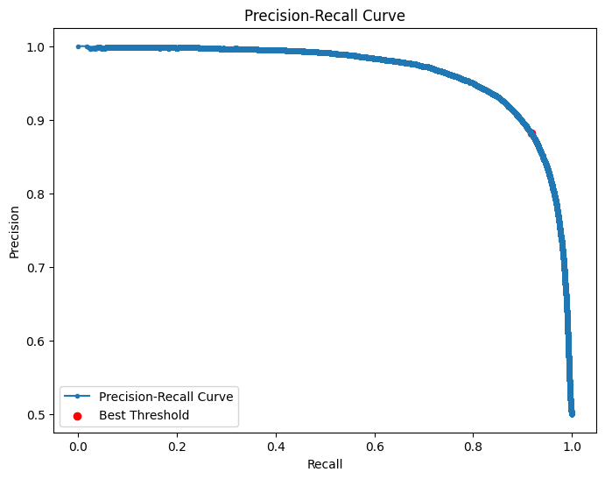
CURVES
precision recall curve

Slide 13
CONFUSION MATRIX
True Positives (TP): 23584 - The model correctly predicted this many edges.
True Negatives (TN): 23133 - The model correctly predicted this many non-edges.
False Positives (FP): 2518 - The model incorrectly predicted these as edges when they were not.
False Negatives (FN): 2067 - The model incorrectly predicted these as non-edges when they were actually edges.

Slide 14
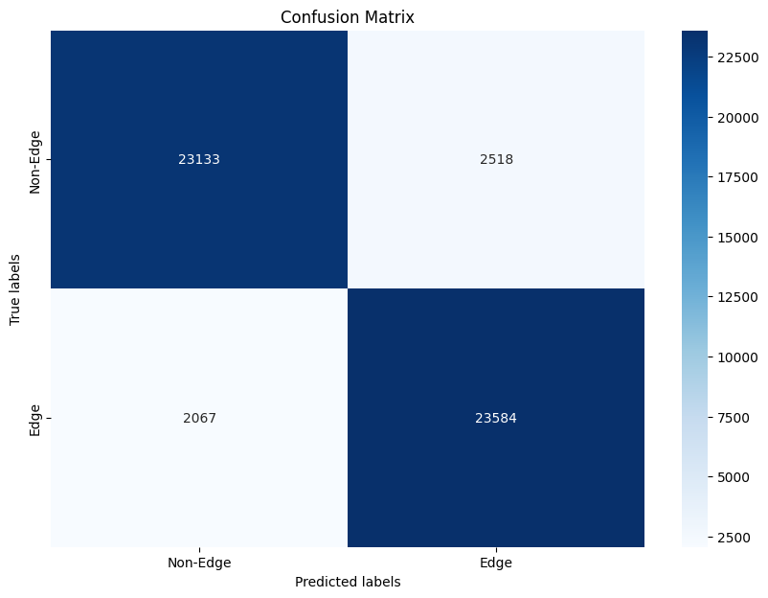
CONFUSION MATRIX
1. True Positive (TP): 23584
2. True Negative (TN): 23133
3. False Positive (FP): 2518
4. False Negative (FN): 2067

Slide 15







USED LIBRARIES
matplotlib
Pandas
Scikit-learn
OS
TensorFlow
numpy
torch
optimizer

Slide 16
Evaluating Standards
Accuracy: Accuracy measures the proportion of correctly classified instances out of all instances in the dataset.
Precision: Precision measures the proportion of true positive predictions among all positive predictions made by the model.
Recall (Sensitivity): Recall measures the proportion of true positive predictions among all actual positive instances in the dataset.

Slide 17
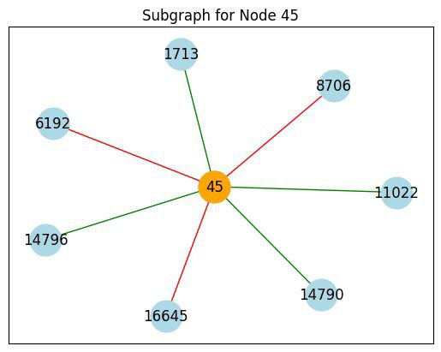
PREDICTION EXAMPLE
This is node(45) the out put from the file that has the ID and the name of the Facebook pages .
So we want to display the name of the page instead of its ID

Slide 18
Unfinished Works
Work on documentation
Deployment phase
PREPARING for code committee

Slide 19
FUTURE WORK
Develop models and using multi modeling
Dealing with bigger dataset
Enjoin the bioinformatics
Searching about Link Prediction in general and finding what the gaps that it has

Slide 20
THANK YOU
Do you have any questions?

