Slide 1
Whither research integrity? Plagiarism, self-plagiarism and coercive citation in an age of research assessment
Ben R. Martin
SPRU – Science and
Technology Policy Research
B.Martin@sussex.ac.uk
Presentation at the Jubilee Seminar on ‘Supporting Solid Science’, Helsinki, 11-12 September 2012

Slide 2
Structure
  Introduction
  Aims
  Background
  Plagiarism
  Salami-publishing, redundant publication and self-plagiarism
  Analysis
  Journal impact factor and ‘coercive citation’
  Conclusions

Slide 3
Introduction
Academic community – long cherished belief in effectiveness of ‘self-policing’
Other professional communities (GPs, accountants, journalists, politicians) operated on same basis
But succession of scandals challenged assumptions about efficacy of self-policing
Where do matters currently stand in academia?
Is peer-review and self-policing still keeping research misconduct at bay?
Academic profession has strong, clear norms about research integrity and ethical behaviour

Slide 4
Introduction
Widespread assumption that research misconduct
  rare and generally small scale
  easily detected, investigated and judged
  kept firmly in check by vigilance of peer-review and severity of sanctions imposed
  confined to junior researchers and/or ‘other’ countries
But pressures of academic competition rising
  Performance indicators based on publications etc. ➔ temptation to stray from previous conventions re appropriate research behaviour
Worrying signs
  No. of retractions of journal articles increased >10-fold in last 10 years (Van Noorden, 2011)

Slide 5
Aims
Report experiences of one journal (Research Policy)
  Case-study of whether self-policing keeping misconduct in check
Set out the boundary between appropriate and inappropriate research behaviour
Examine whether growing tendency to quantify research performance having a deleterious impact on research behaviour and integrity
Draw attention to tendency of some editors to engage in ‘coercive citation’ to bolster impact factor

Slide 6
Background
Editor of Research Policy since 2004
Prior to 2007, only occasional problem of research misconduct
2007 – the Gottinger saga
  1993 RP paper – ‘the tip of the iceberg’
  Serial plagiarist over >30 years
  Made up institutional affiliations (e.g. Maastricht Uni)
  Exposed in RP (Martin et al., 2007) and Nature (Abbott, 2007)
  Case widely publicised
  Numerous other instances of plagiarised papers found
  But still going strong!
  ‘Self-policing’ cannot prevent offender from continuing to offend

Slide 7
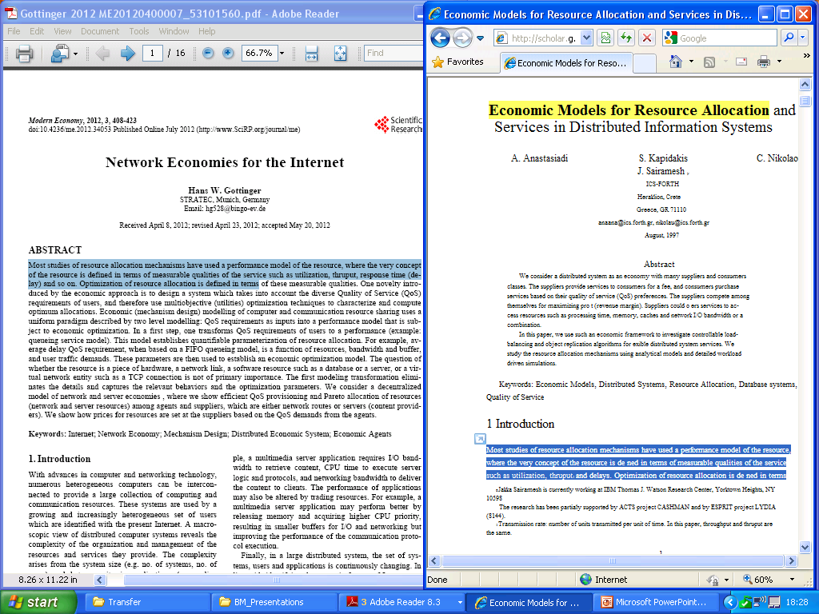

Slide 8
Background
Other, lesser cases ➔ 2009 editorial
  identified different types or levels of misconduct
  set out clear guidelines and rules
  reminded referees and readers of responsibility to report suspicions
What has happened since?

Slide 9
Plagiarism
Plagiarism – “the copying of ideas, data or text (or various combinations of the three) without permission or acknowledgment”
Plagiarism of ~ entire paper rare (more common in lower status journals?)
Plagiarism of substantial sections more common
  e.g. by PhD students – reject and report to supervisor
  Exchange of info with editor of another journal about an author ➔ discovered paper with 1000 words lifted
  Reviewer noted author had reproduced methodological description (and also used database without permission)
Check with iThenticate (but time-consuming)
More serious cases ➔ authors banned for x years

Slide 10
Salami-publishing, redundant publication and self-plagiarism
Salami-publishing – the deliberate attempt to artificially inflate the total of publications yielded by a particular research study by inappropriately dividing the overall contribution to knowledge into a number of thin ‘slices’
Redundant publication – one where the existence of other paper(s) by same author(s) means the new paper offers insufficient of an original contribution to knowledge to merit publication in its own right
Self-plagiarism – reproducing text, ideas, data, findings etc. from other paper(s) by the author(s) without explicitly citing or otherwise acknowledging those other papers, thus misleading the reader regarding the level of originality

Slide 11
Self-plagiarism
Examples
  Paper already published in another journal
  Same/similar paper submitted in parallel to another journal
  Sometimes spotted by alert referee, but how many more missed?
Other cases more complicated – author written several papers on similar theme/database
  Can’t ask ref’s to read several papers ➔ Ed must sort out
  One researcher produced ~30 papers in 3 years
    Content overlapped substantially but not cross-referenced
  Another author published over 60 journal articles since 2004 (~15 in ‘top’ journals)
    Long, complex investigation – also found methodological problems
    ➔ Retraction of 2 RP papers (& others)

Slide 12
Self-plagiarism
Various excuses offered by authors
“Trying to reach a different audience” (e.g. Frey)
  Requires prior and explicit permission of Editor
  Still need to cite earlier version
“References omitted to ensure double-blind review”
  RP requires 2 versions - full and ‘blinded’
“My supervisor said I should avoid self-citations”
  Not if misleads referees/editors re originality of paper

Slide 13
Analysis
Scale of misconduct is significant and growing
Occupying large amount of time of referees and editors – need to go through “due process”
  Establish whether prima facie case
  Put allegation(s) to author to respond
  Assess author’s response in light of evidence
  Decide whether to give author chance to retrieve situation
  If misconduct serious, decide on sanction – reject? ban?
Misconduct not confined to PhD students/young researchers (although often the most blatant cases)
  More complex cases involve senior researchers ‘pushing the boundary’
  Also more adept at covering their tracks

Slide 14
Analysis
Misconduct not confined to ‘other’ countries – majority of cases from W Europe and N America
Appears to reflect specific incentives under which academics now operate
  articles in leading journals with high impact factors
  linked to tenure, RAE/REF, funding, prestige
While some referees and editors willing to act, others continue to ‘pass by on the other side’
  Leave it to ‘someone else’ to sort out
  ‘Second-order defectors’

Slide 15
Journal impact factor and ‘coercive citation’
Journal editors increasingly judged on impact factor
➔ Game-playing to maximise JIF
  Publishing ‘non-articles’ that get cited but don’t count in denominator of JIF calculation
  Writing editorials citing recent articles in journal
More insidious = ‘coercive citations’
  Ed accepts article subject to adding a few recent refs
Wilhite and Fong (2012) – survey of thousands of social scientists
  175 journals guilty of ‘coercive citation’
  include several top journals in business, management and economics

Slide 16
Conclusions
Misconduct is significant in scale and apparently growing rapidly
Time-consuming to investigate
  cost to the ‘whistle-blower’, journal and investigator
Failure of some editors to follow up when misbehaviour brought to their attention
  a form of ‘second-order free-riding’
  If too many assume that can leave it to ‘someone else’ to sort out, likely to result in a ‘tragedy of the commons’

Slide 17
Conclusions
Declining standards linked to growth of research assessment, perf indicators and ‘audit culture’
  More and more ‘playing the game’ to maximise ‘score’
  Some succumb to temptation to cut corners
  Others assume they can unilaterally shift the boundary between acceptable and unacceptable behaviour
If the academic community does nothing, problem will only get worse
  Need greater vigilance by referees, editors and readers
  Individuals must be willing to pursue well-found suspicions
  “All that is necessary for the triumph of evil is that good men do nothing.” (Burke)

Slide 18
Conclusions
Editors and others in authority must be willing to impose sanctions
  Retracting papers
  Banning authors for set period
  Notifying superiors/institutions
  Notifying editors of other journals
Authors asked by Editors to add gratuitous references should refuse as a matter of principle
  If Editor persists, notify publisher and advisory board
  Weakens moral authority of Editor to intervene in cases where faced by acts of research misconduct by authors

Slide 19
References
A. Abbott (2007), ‘Academic accused of living on borrowed lines’, Nature, 448, 632–633
B.R. Martin et al. (2007), ‘Keeping plagiarism at bay – A salutary tale’, Research Policy, 36, 905–911
B.R. Martin (2012a), ‘Does peer review work as a self-policing mechanism in preventing misconduct: a case study of a serial plagiarist, in: T. Mayer & N. Steneck (Eds), Promoting Research Integrity in a Global Environment, World Scientific Publishing/Imperial College Press, London and Singapore, pp.97-114
B.R. Martin (2012b), ‘Whither research integrity? Plagiarism, self-plagiarism and coercive citation in an age of research assessment’, Research Policy (forthcoming)
R. Van Noorden (2011), ‘Science publishing: the trouble with retractions’, Nature, 478, 26-28
A.W. Wilhite, E.A. Fong, (2012), ‘Coercive citation in academic publishing’, Science, 335, 542-543

