Slide 1
SAMAJIK
Online Fundraiser Website
Asifujjaman Opi - 01181295
Mosiour Rahman - 011181293

Slide 2
What is Online Fundraising?
Online fundraising is a way for nonprofit organizations to raise money via the internet.
Why is Online Fundraising important?
Online fundraising allows donors to give quickly, easily, and securely. Nonprofits are able to collect donations from across the country and around the world.

Slide 3
Some benefits:
Online fundraising save your time and money
You get better data and reporting
Online fundraising improves donor relationships
Online fundraising expands your reach

Slide 4


Slide 5
What do you suggest?
Fund at your closest.
Categorized Post.
Sort as you want.
Post as Individual/Organization.
Leaderboard.
Blog
Search
Yes, you can post comment.

Slide 6
Technologies, that will be used
HTML
CSS
Apache
MySQL
PHP

Slide 7
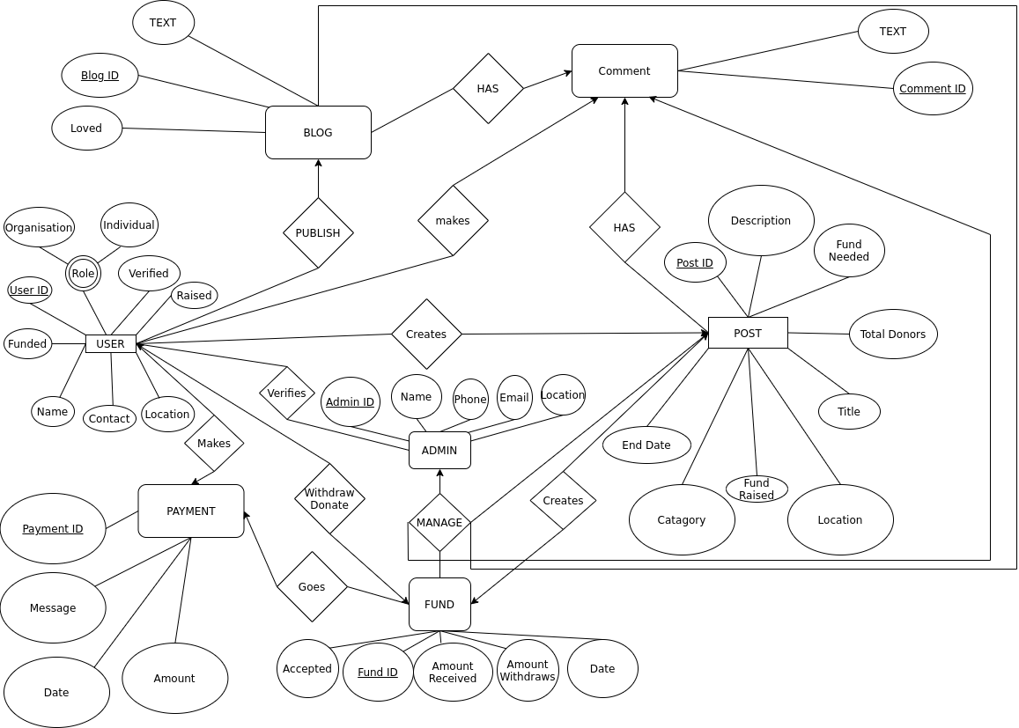

Slide 8
Future improvement of this project
Personalised feed.
Ensure security.
A good frontend.
It will be open source.
Obviously you will find it on google.

