Slide 1
Xamarin.QuickUI
Cross-Platform UI Abstraction

Slide 2
What is QuickUI?
Cross platform way to create UI
Android 4.0.0+ (2.3 support coming soon)
iOS 6+
Windows Phone 7.1+
Near 100% code sharing
Interop with existing code-bases

Slide 3
QuickUI Application Architecture
Your Application
Business Logic
Android
iOS
Windows Phone
QuickUI Interface

Slide 4
Usage Scenarios
100% QuickUI
Embed QuickUI
QuickUI + Native
Allows for maximum code sharing
No need to write platform specific code
Build new QuickUI elements and embed them into your existing app
May embed entire pages of content at a time
Ideal for beginning the process of moving to QuickUI
Build QuickUI application and embed pre-built or custom native UI elements
Write a renderer for each target platform
Allows direct access to the full power of the Xamarin platform

Slide 5
Embed QuickUI
Shared Code
Android UI
iOS UI
Windows Phone UI
QuickUI Elements
Your Application
QuickUI Platform Renderer

Slide 6
QuickUI + Native Elements
Your Application
QuickUI Interface
Android
Shared Code
iOS
Windows Phone
Custom View
Models
Custom View
Renderers

Slide 7
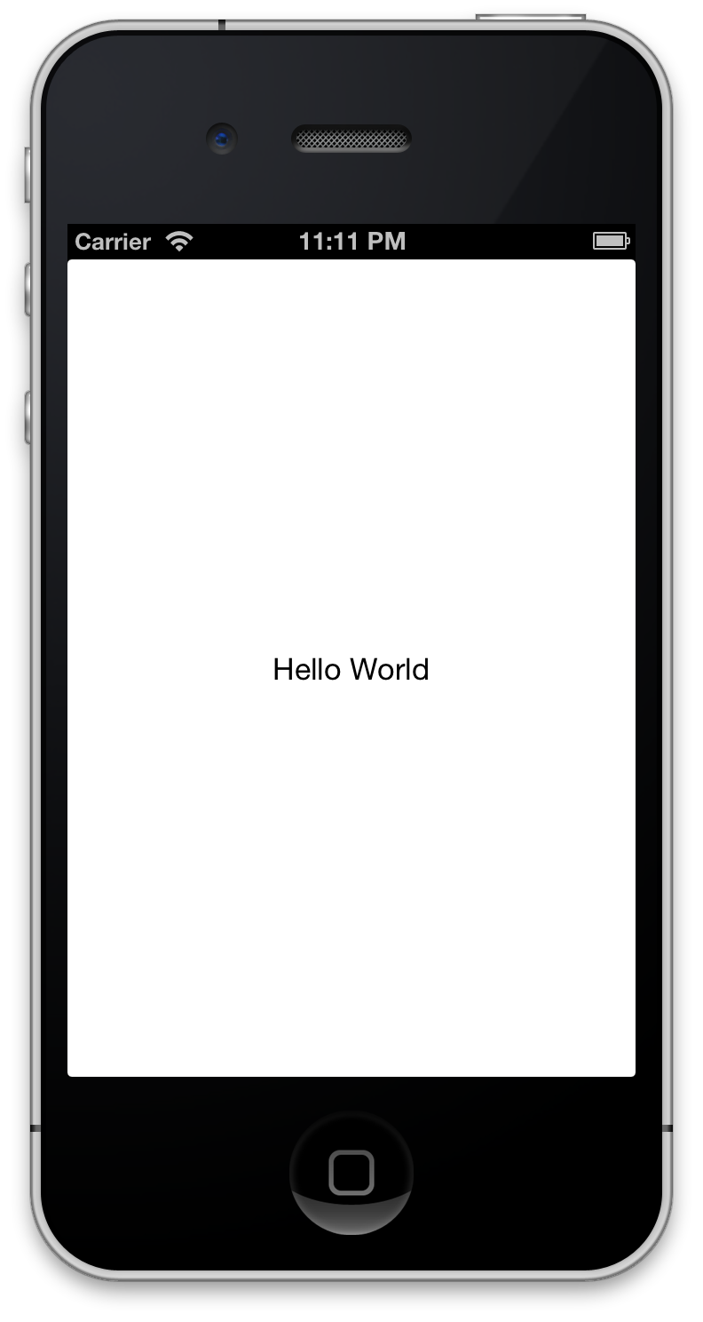
Hello World
Page myApp = new ContentPage {
Content = new Label {
Text = “Hello World”,
XAlign = TextAlignment.Center
}
};

Slide 8
Primary Objects
View
Layout
Page
Base class for all QuickUI Controls
Contains basic size and positioning data
Can not contain children by default
QuickUI Control which can contain children
Contains public Add and Remove methods for Views
Element used for containing logical groupings of Views and Layouts
Contains application lifecycle events
Used for creating navigation, tabbed, and split interfaces

Slide 9
Bindings
QuickUI provides bindings to common API elements
Enable MVVM pattern when developing apps
Simply and quickly bind your data into lists and tables
Bind data into custom Pages

Slide 10
Views
ActivityIndicator
Button
BoxView
DatePicker
Entry
Editor
Frame
Label
ListView
Map
NavigationMenu
OpenGLView
ProgressBar
ScrollView
SearchBar
Slider
Stepper
Switch
TableView
TimePicker
Toolbar

Slide 11
Layouts
StackLayout
GridLayout
AbsoluteLayout
Simplest and most commonly used Layout
Lays out children either vertically or horizontally in single stack
Can be nested into multiple levels
Most complicated but powerful Layout
Lays out children into a configurable grid
Nesting of grids works but is not advised and should not be needed
Manual positioning layout
User must position each elements X, Y, Width, and Height by hand
Users are responsible for relayouts when View size changes

Slide 12
Pages
NavigationPage
TabbedPage
MasterDetailPage
Can push or pop other pages to and from the visual stack
Provides a back button to return to previous Pages
UINavigationController like interface
Embeds multiple pages into a single page
Display text and an icon for each embedded Page
UITabbarController like interface
Embeds a Master and a Detail Page
Similar to a UISplitViewController
Behaves differently depending on the target idiom (phone or tablet)

