Slide 1


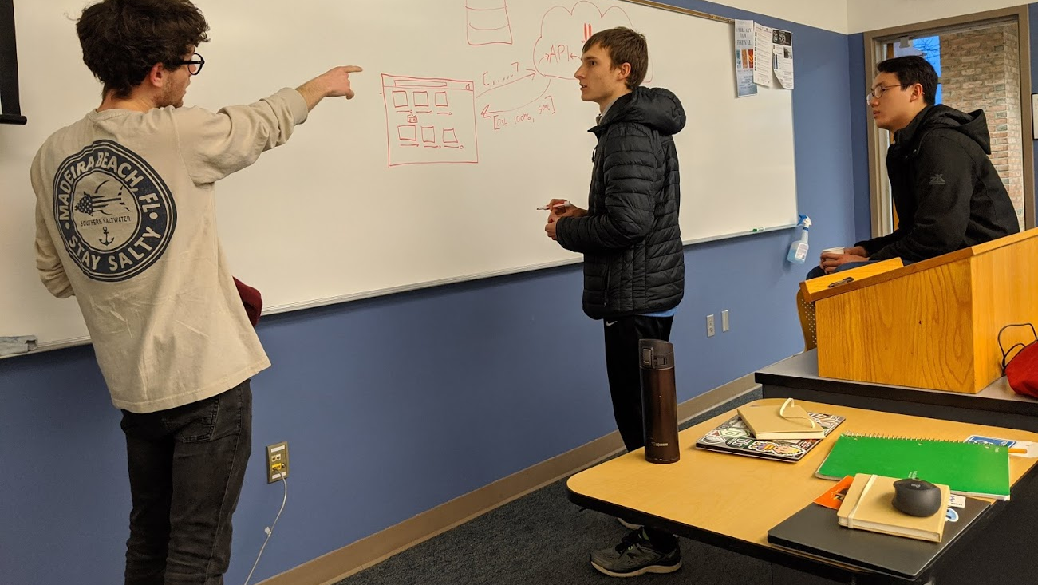
BaitHate: Clickbait Identifier Extension
Justin Keller, Dylan Strohschein, Matthew Shan, Max Toor

Slide 2
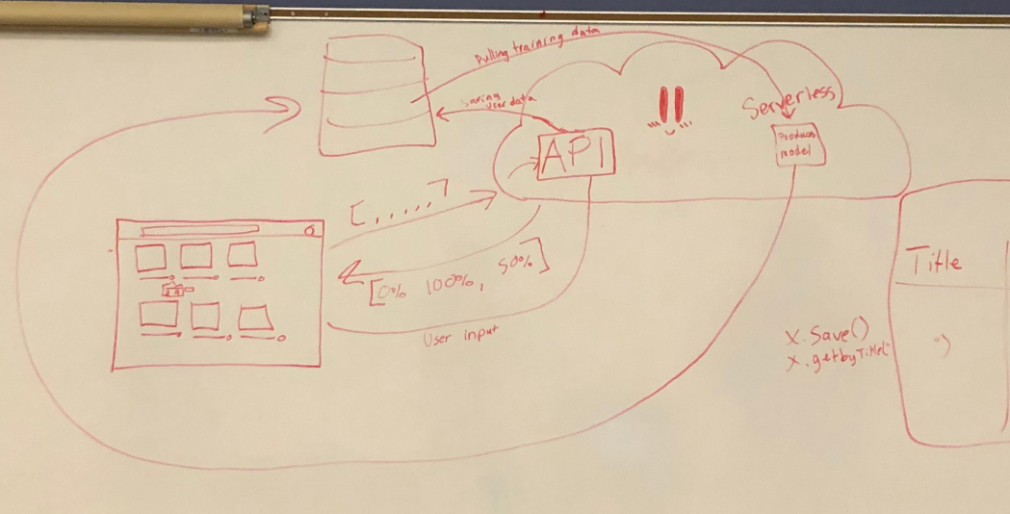

Slide 3











GearHost
Database Engine
Machine Learning & Serverless Function
Microsoft Azure
Google Cloud
ML Web API
Admin Portal
Chrome Extension
Summarize API

