Slide 1

Album Artwork Classification
Metis Deep Learning Project
By: Max Wood

Slide 2

Problem Statement
Objective
Usefulness
Build a neural network that can classify an albums musical genre from its album artwork
Record companies and artists will be able to better understand what listeners the cover of their album is targeting

Slide 3


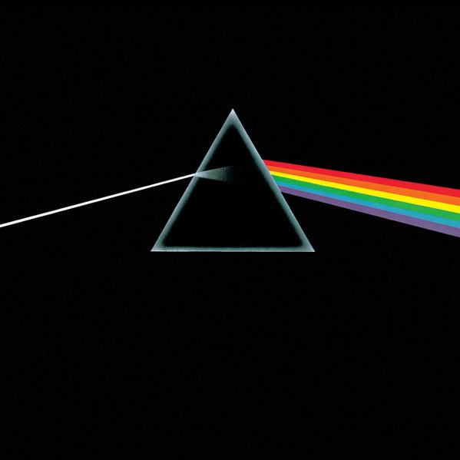
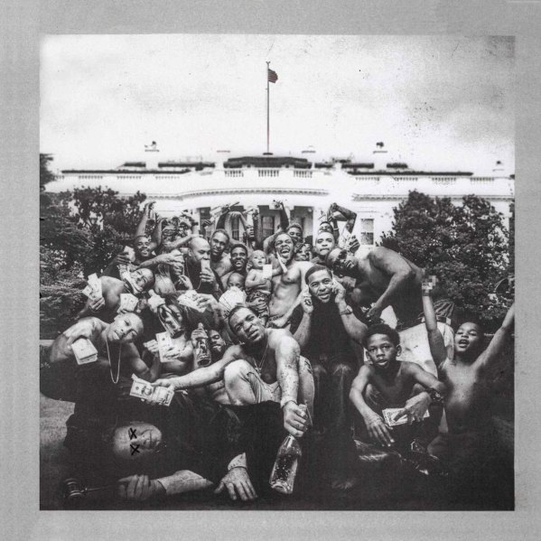

Data Collection
Album Genres
Album Artwork
Collected using billboard.py
Used billboard’s album genre charts to define album genres
Albums collected – 8.2K :
Rock – 2.3 K
Rap - 1.2 K
Country – 1.2 K
Jazz – 1.5 K
Latin – 1.5 K
Holiday – 0.5 K
Collected Using Spotify’s API and spotipy
*Albums on multiple lists were removed from all lists

Slide 4
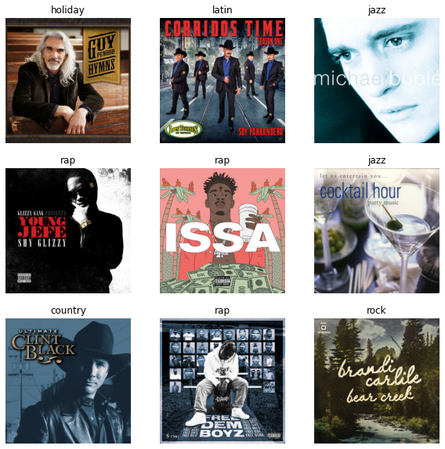
Example Data (try yourself)
Genres:
Rock
Rap
Country
Jazz
Holiday
Latin

Slide 5
Example Data (answers)
Holiday
Latin
Jazz
Genres:
Rock
Rap
Country
Jazz
Holiday
Latin
Rap
Rap
Jazz
Country
Rap
Rock
Rock

Slide 6
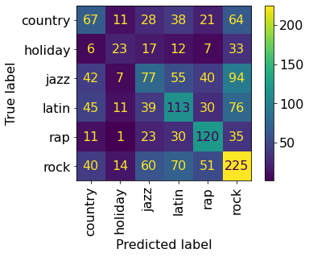
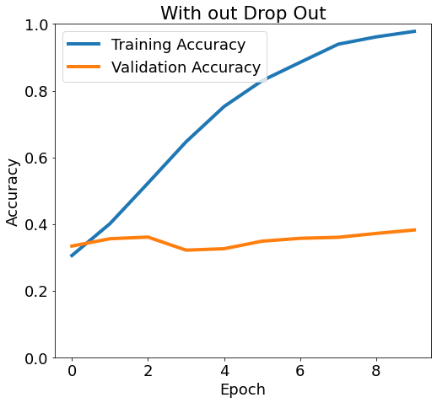
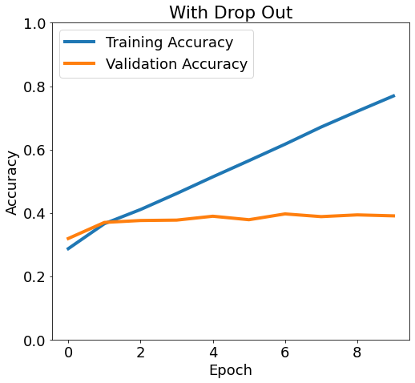
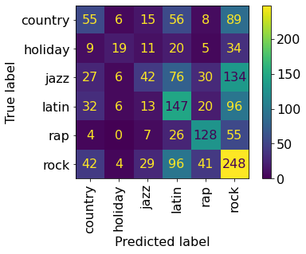
Model From Scratch
CNN no Drop Out
80/15/5 Training/ Validation/ Test Split
80/20 Training/ Validation Split
CNN with Drop Out
Val_acc = 0.38
Val_acc = 0.39

Slide 7
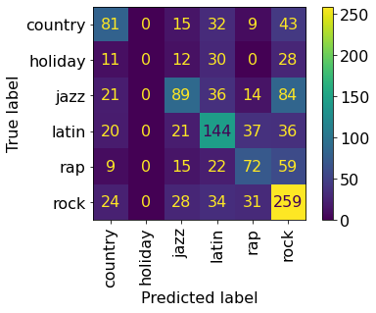
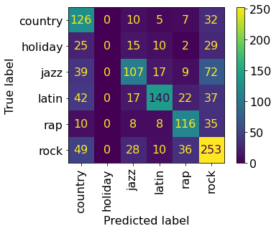
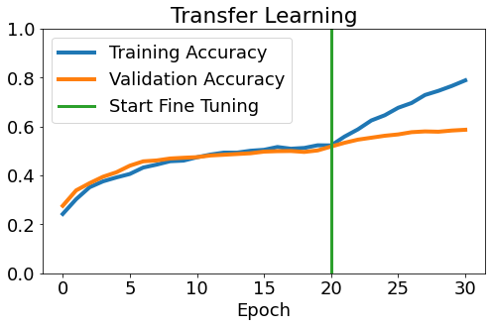
Transfer Learning
Pre Fine Tuning
Mobile Net V2
Initially froze the base model
Then allowed for some Training on Full Model
Post Fine Tuning
Val_acc = 0.59
Val_acc = 0.50

Slide 8
Results on Test

Slide 9
Thanks!

Slide 10


