Slide 1
What neighborhood in Toronto should I center my dog walking business around?

Slide 2
The data…
Toronto Open Data: Licensed Dogs and Cats Reports for 2013 through 2017 by FSA (*FSA = Forward Sortation Area (first 3 characters of a Canadian Postal Code)
Population by FSA from Census 2016
FourSquare Api: to get number of pet stores/services per FSA
geopy: to get latitude/longitude coordinates for each FSA
Wikipedia: to get the neighborhood names for each FSA

Slide 3
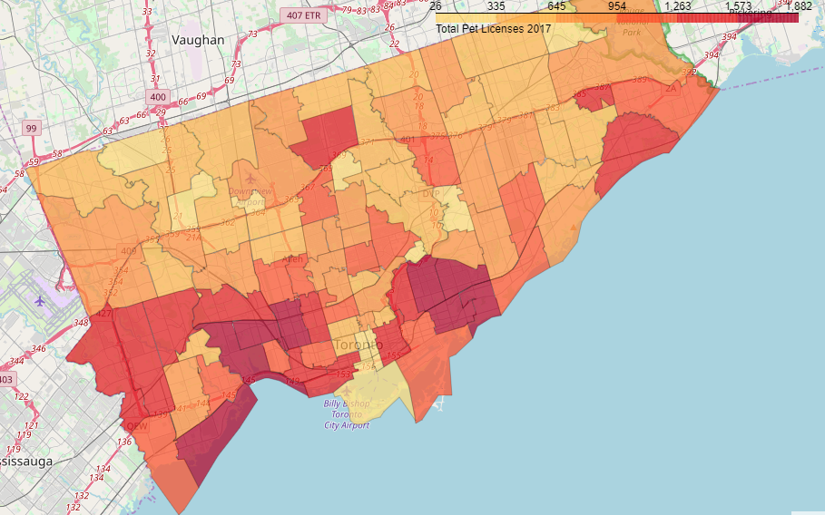
Pet Ownership in Toronto 2017
Total new Pet Licenses Issued (2017)
Highest pet ownership rates are in: East Toronto (M4L) and Etobicoke (M8V)
Lowest pet ownership rates are in: Downtown toronto (M5H) and East York (M4H)

Slide 4
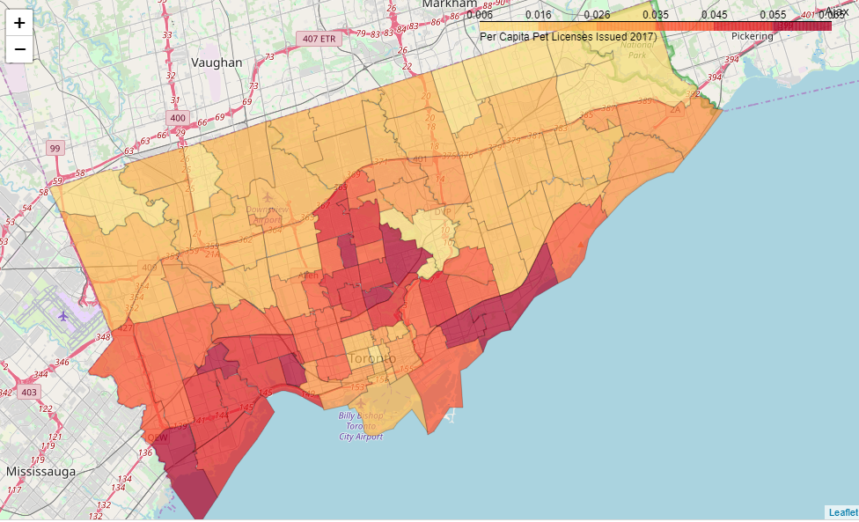
Per Capita Pet Licensing
The highest per capita ownership of pets is in
The Beaches (M4E):
Parkdale/ Roncesvalles (M6R)
Alderwood/Long Branch(M8W)

Slide 5
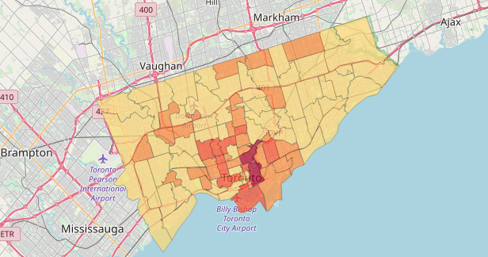
Venues to walk a dog (parks/trails/dog runs)
The following neighborhoods have the most venues for walking a dog:
Rosedale (M4W):
Harbourfront, Regent Park (M5A)
Cabbagetown, St. James Town (M4X)
*Data provided by Foursquare

Slide 6
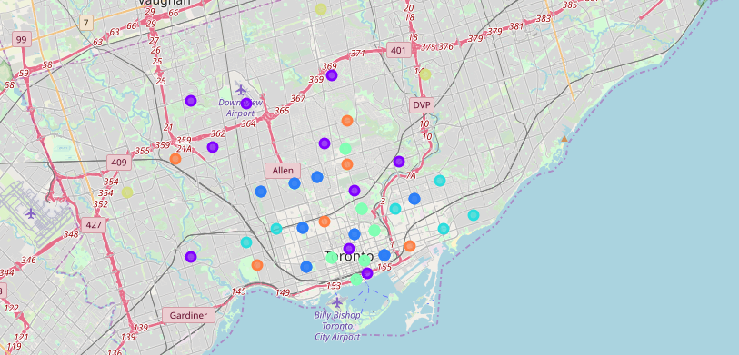
Cluster Analysis
Using Kmeans algorithm, found 7 clusters of FSAs in Toronto based on:
Population,
Number of Pet Licenses issued in 2017
Number of Dog Walking Venues

Slide 7
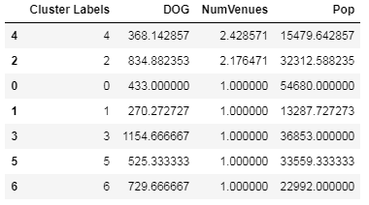
Clusters good for dog walking…
Clusters 2 and 4 look to be good candidates
Large Pet Population
High number of walking venues

Slide 8
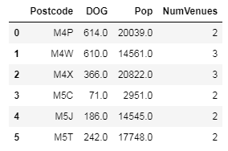
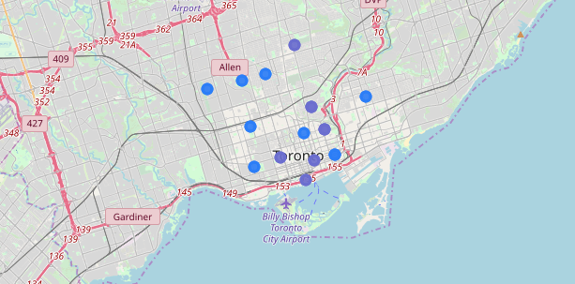
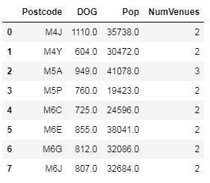
Where are these clusters?
Best Candidates:
Cluster 4: Purple
Cluster 2: Blue

Slide 9
So where should I start my business?
M5A (Harbourfront,Regent Park) with 949 dogs and 3 walking venues
M4J (East Toronto) with 1110 dogs and 2 walking venues
M4J
M5A
Looking at the map, East Toronto (M4J) is relatively isolated whereas Harbourfront,Regent Park (M5A) has other neighborhoods in clusters 2 and 4 nearby. I would recommend M5A for starting a dog walking business.

