Slide 1

Composing Suspending Functions
새차원
새로운 차원의 앱을 지향합니다.
https://www.youtube.com/c/새차원
https://blog.naver.com/cenodim
hohoins@nate.com

Slide 2
Sequential by default
fun main() = runBlocking<Unit> { val time = measureTimeMillis { val one = doSomethingUsefulOne() val two = doSomethingUsefulTwo() println("The answer is ${one + two}") } println("Completed in $time ms") } suspend fun doSomethingUsefulOne(): Int { delay(1000L) // pretend we are doing something useful here return 13 } suspend fun doSomethingUsefulTwo(): Int { delay(1000L) // pretend we are doing something useful here, too return 29 }
coroutine, just like in the regular code, is sequential by default
https://github.com/kotlin/kotlinx.coroutines/blob/master/kotlinx-coroutines-core/jvm/test/guide/example-compose-01.kt

Slide 3
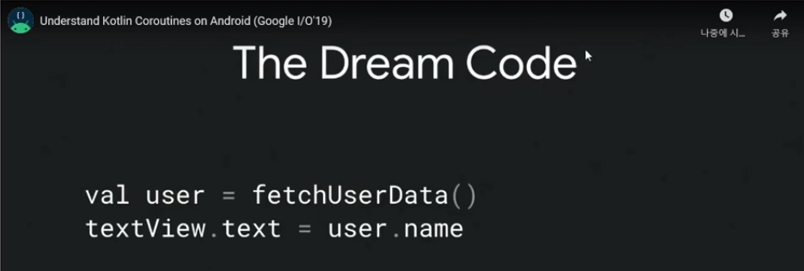
The Dream Code
to simplify code that executes asynchronously.
converts async callbacks to sequential code.
Use suspend functions to make async code sequential
https://youtu.be/Vs34wiuJMYk?t=615

Slide 4
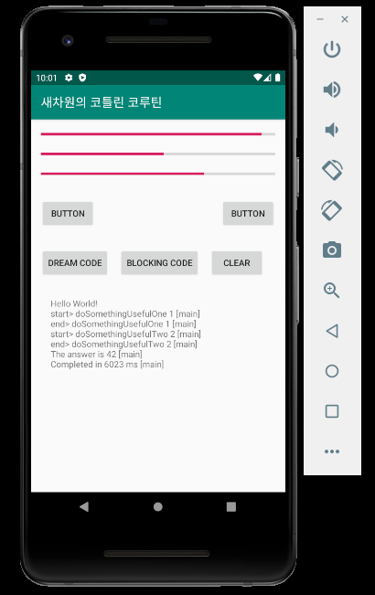
The Dream Code on Android
suspend fun runDreamCode() { val time = measureTimeMillis { val one = doSomethingUsefulOne() val two = doSomethingUsefulTwo() println("The answer is ${one + two}") } println("Completed in $time ms") } suspend fun doSomethingUsefulOne(): Int { println("start> doSomethingUsefulOne 1") delay(2000L) println("end> doSomethingUsefulOne 1") return 13 } suspend fun doSomethingUsefulTwo(): Int { println("start> doSomethingUsefulTwo 2") delay(2000L) println("end> doSomethingUsefulTwo 2") return 29 }
https://github.com/kotlin/kotlinx.coroutines/blob/master/kotlinx-coroutines-core/jvm/test/guide/example-compose-01.kt

Slide 5
Concurrent using async
fun main() = runBlocking<Unit> { val time = measureTimeMillis { val one = async { doSomethingUsefulOne() } val two = async { doSomethingUsefulTwo() } println("The answer is ${one.await() + two.await()}") } println("Completed in $time ms") } suspend fun doSomethingUsefulOne(): Int { delay(1000L) // pretend we are doing something useful here return 13 } suspend fun doSomethingUsefulTwo(): Int { delay(1000L) // pretend we are doing something useful here, too return 29 }
What if there are no dependencies between invocations
we want to get the answer faster, by doing both concurrently?
This is twice as fast, because the two coroutines execute concurrently.
Note that concurrency with coroutines is always explicit.
https://github.com/kotlin/kotlinx.coroutines/blob/master/kotlinx-coroutines-core/jvm/test/guide/example-compose-02.kt

Slide 6
Lazily started async
fun main() = runBlocking<Unit> { val time = measureTimeMillis { val one = async(start = CoroutineStart.LAZY) { doSomethingUsefulOne() } val two = async(start = CoroutineStart.LAZY) { doSomethingUsefulTwo() } // some computation one.start() // start the first one two.start() // start the second one println("The answer is ${one.await() + two.await()}") } println("Completed in $time ms") } suspend fun doSomethingUsefulOne(): Int { delay(1000L) // pretend we are doing something useful here return 13 } suspend fun doSomethingUsefulTwo(): Int { delay(1000L) // pretend we are doing something useful here, too return 29 }
Optionally, async can be made lazy by setting its start parameter
its result is required by await, or if its Job's start function is invoked
if we just call await in println without first calling start
https://github.com/kotlin/kotlinx.coroutines/blob/master/kotlinx-coroutines-core/jvm/test/guide/example-compose-03.kt

Slide 7
Async-style functions
fun main() { val time = measureTimeMillis { val one = somethingUsefulOneAsync() val two = somethingUsefulTwoAsync() runBlocking { println("The answer is ${one.await() + two.await()}") } } println("Completed in $time ms") } fun somethingUsefulOneAsync() = GlobalScope.async { doSomethingUsefulOne() } fun somethingUsefulTwoAsync() = GlobalScope.async { doSomethingUsefulTwo() } suspend fun doSomethingUsefulOne(): Int { delay(1000L) // pretend we are doing something useful here return 13 } suspend fun doSomethingUsefulTwo(): Int { delay(1000L) // pretend we are doing something useful here, too return 29 }
We can define async-style functions
xxxAsync functions are not suspending functions
They can be used from anywhere
Using this style with Kotlin coroutines is strongly discouraged
This problem does not happen with structured concurrency
https://github.com/kotlin/kotlinx.coroutines/blob/master/kotlinx-coroutines-core/jvm/test/guide/example-compose-04.kt

Slide 8
Structured concurrency with async
fun main() = runBlocking<Unit> { val time = measureTimeMillis { println("The answer is ${concurrentSum()}") } println("Completed in $time ms") } suspend fun concurrentSum(): Int = coroutineScope { val one = async { doSomethingUsefulOne() } val two = async { doSomethingUsefulTwo() } one.await() + two.await() } suspend fun doSomethingUsefulOne(): Int { delay(1000L) // pretend we are doing something useful here return 13 } suspend fun doSomethingUsefulTwo(): Int { delay(1000L) // pretend we are doing something useful here, too return 29 }
This way, if throws an exception, all the coroutines will be cancelled.
https://github.com/kotlin/kotlinx.coroutines/blob/master/kotlinx-coroutines-core/jvm/test/guide/example-compose-05.kt

Slide 9
Cancellation propagated coroutines hierarchy
fun main() = runBlocking<Unit> { try { failedConcurrentSum() } catch(e: ArithmeticException) { println("Computation failed with ArithmeticException") } } suspend fun failedConcurrentSum(): Int = coroutineScope { val one = async<Int> { try { delay(Long.MAX_VALUE) // Emulates very long computation 42 } finally { println("First child was cancelled") } } val two = async<Int> { println("Second child throws an exception") throw ArithmeticException() } one.await() + two.await() }
Note how both the first async and the awaiting parent are cancelled on failure of one of the children (namely, two):
https://github.com/kotlin/kotlinx.coroutines/blob/master/kotlinx-coroutines-core/jvm/test/guide/example-compose-06.kt

Slide 10
Composing Suspending Functions
Async to sequential
Sequential by default
The Dream Code on Android
async
Concurrent using async
Lazily started async
Structured concurrency
Async-style functions (strongly discouraged)
Structured concurrency with async

Slide 11
THE END
새차원
새로운 차원의 앱을 지향합니다.
https://www.youtube.com/c/새차원
https://blog.naver.com/cenodim
hohoins@nate.com

Slide 12
부록 안드로이드 예제코드

Slide 13
package com.example.coco import android.os.Bundle import android.util.Log import androidx.appcompat.app.AppCompatActivity import kotlinx.android.synthetic.main.activity_main.* import kotlinx.coroutines.* import kotlin.system.measureTimeMillis class MainActivity : AppCompatActivity() { override fun onCreate(savedInstanceState: Bundle?) { super.onCreate(savedInstanceState) setContentView(R.layout.activity_main) button_coroutines.setOnClickListener { CoroutineScope(Dispatchers.Main).launch { runDreamCode() } } button_blocking.setOnClickListener { runBlocking { runDreamCode() } } button_clear.setOnClickListener { text_view.text = "" } initProgress() } suspend fun runDreamCode() { val time = measureTimeMillis { val one = doSomethingUsefulOne() // val user = fetchUserData() (Network I/O) val two = doSomethingUsefulTwo() // cacheUserData(user) (Database I/O) println("The answer is ${one + two}") // textView.text = user.name (update ui) } println("Completed in $time ms") } suspend fun doSomethingUsefulOne(): Int { println("start> doSomethingUsefulOne 1") delay(2000L) println("end> doSomethingUsefulOne 1") return 13 } suspend fun doSomethingUsefulTwo(): Int { println("start> doSomethingUsefulTwo 2") delay(2000L) println("end> doSomethingUsefulTwo 2") return 29 } fun <T>println(msg: T) { val log = "$msg [${Thread.currentThread().name}]" runOnUiThread { text_view.append("\n$log") } Log.d("TEST", log) } fun initProgress() { progressBar1.max = 100 progressBar2.max = 200 progressBar3.max = 300 GlobalScope.launch { while (isActive) { delay(10) var progress = progressBar1.progress + 1 if (progress > progressBar1.max) { progress = 0 } progressBar1.progress = progress progress = progressBar2.progress + 1 if (progress > progressBar2.max) { progress = 0 } progressBar2.progress = progress progress = progressBar3.progress + 1 if (progress > progressBar3.max) { progress = 0 } progressBar3.progress = progress } } } }

Slide 14
<?xml version="1.0" encoding="utf-8"?> <androidx.constraintlayout.widget.ConstraintLayout xmlns:android="http://schemas.android.com/apk/res/android" xmlns:app="http://schemas.android.com/apk/res-auto" xmlns:tools="http://schemas.android.com/tools" android:layout_width="match_parent" android:layout_height="match_parent" tools:context=".MainActivity"> <Button android:id="@+id/button_blocking" android:layout_width="wrap_content" android:layout_height="wrap_content" android:layout_marginStart="16dp" android:text="blocking code" app:layout_constraintStart_toEndOf="@+id/button_coroutines" app:layout_constraintTop_toTopOf="@+id/button_coroutines" /> <TextView android:id="@+id/text_view" android:layout_width="0dp" android:layout_height="0dp" android:layout_marginLeft="32dp" android:layout_marginTop="32dp" android:layout_marginRight="32dp" android:layout_marginBottom="32dp" android:text="Hello World!" app:layout_constraintBottom_toBottomOf="parent" app:layout_constraintLeft_toLeftOf="parent" app:layout_constraintRight_toRightOf="parent" app:layout_constraintTop_toBottomOf="@+id/button_blocking" /> <Button android:id="@+id/button_coroutines" android:layout_width="wrap_content" android:layout_height="wrap_content" android:layout_marginStart="16dp" android:layout_marginTop="32dp" android:text="dream code" app:layout_constraintStart_toStartOf="parent" app:layout_constraintTop_toBottomOf="@+id/button3" /> <Button android:id="@+id/button3" android:layout_width="wrap_content" android:layout_height="wrap_content" android:layout_marginStart="16dp" android:layout_marginTop="32dp" android:text="Button" app:layout_constraintStart_toStartOf="parent" app:layout_constraintTop_toBottomOf="@+id/progressBar3" /> <Button android:id="@+id/button4" android:layout_width="wrap_content" android:layout_height="wrap_content" android:layout_marginTop="32dp" android:layout_marginEnd="16dp" android:text="Button" app:layout_constraintEnd_toEndOf="parent" app:layout_constraintTop_toBottomOf="@+id/progressBar3" /> <ProgressBar android:id="@+id/progressBar3" style="?android:attr/progressBarStyleHorizontal" android:layout_width="0dp" android:layout_height="wrap_content" android:layout_marginStart="16dp" android:layout_marginTop="16dp" android:layout_marginEnd="16dp" app:layout_constraintEnd_toEndOf="parent" app:layout_constraintStart_toStartOf="parent" app:layout_constraintTop_toBottomOf="@+id/progressBar2" /> <ProgressBar android:id="@+id/progressBar2" style="?android:attr/progressBarStyleHorizontal" android:layout_width="0dp" android:layout_height="wrap_content" android:layout_marginStart="16dp" android:layout_marginTop="16dp" android:layout_marginEnd="16dp" app:layout_constraintEnd_toEndOf="parent" app:layout_constraintHorizontal_bias="0.0" app:layout_constraintStart_toStartOf="parent" app:layout_constraintTop_toBottomOf="@+id/progressBar1" /> <ProgressBar android:id="@+id/progressBar1" style="?android:attr/progressBarStyleHorizontal" android:layout_width="0dp" android:layout_height="wrap_content" android:layout_marginStart="16dp" android:layout_marginTop="16dp" android:layout_marginEnd="16dp" app:layout_constraintEnd_toEndOf="parent" app:layout_constraintHorizontal_bias="0.0" app:layout_constraintStart_toStartOf="parent" app:layout_constraintTop_toTopOf="parent" /> <Button android:id="@+id/button_clear" android:layout_width="wrap_content" android:layout_height="wrap_content" android:layout_marginStart="16dp" android:text="clear" app:layout_constraintStart_toEndOf="@+id/button_blocking" app:layout_constraintTop_toTopOf="@+id/button_blocking" /> </androidx.constraintlayout.widget.ConstraintLayout>

