Slide 1

Coroutines under the hood
새차원
새로운 차원의 앱을 지향합니다.
https://www.youtube.com/c/새차원
https://blog.naver.com/cenodim
hohoins@nate.com

Slide 2

There is no magic
01:50, There is no magic
03:20, CPS == Callbacks
04:20, CPS Transformation
06:25, Direct code
07:40, Labels
10:40, Callback
https://youtu.be/YrrUCSi72E8

Slide 3
Like the dream code
fun main(): Unit { GlobalScope.launch { val userData = fetchUserData() val userCache = cacheUserData(userData) updateTextView(userCache) } } suspend fun fetchUserData() = "user_name" suspend fun cacheUserData(user: String) = user fun updateTextView(user: String) = user

Slide 4
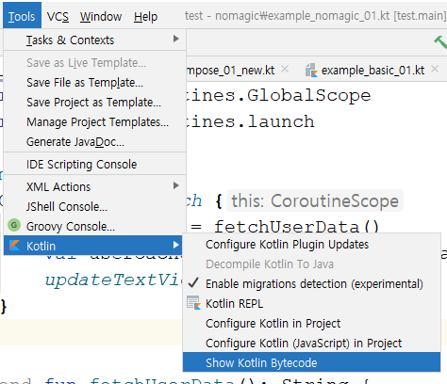
Show Kotlin Bytecode

Slide 5
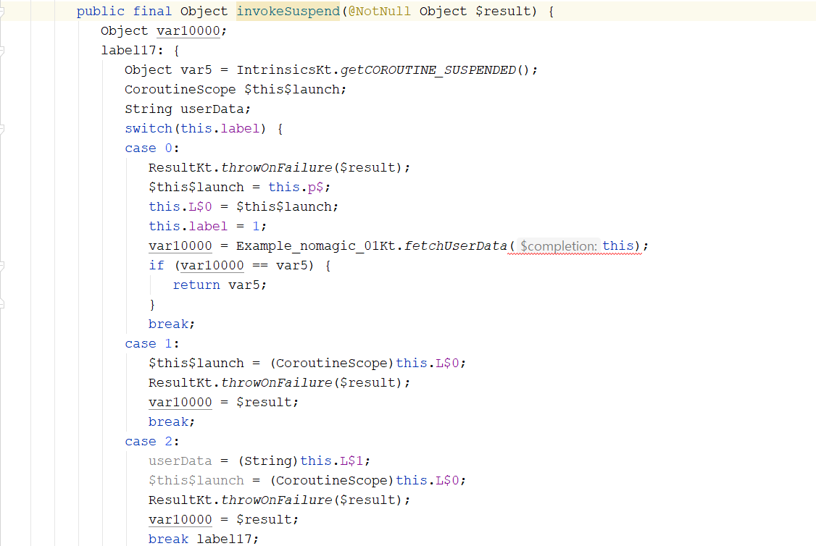
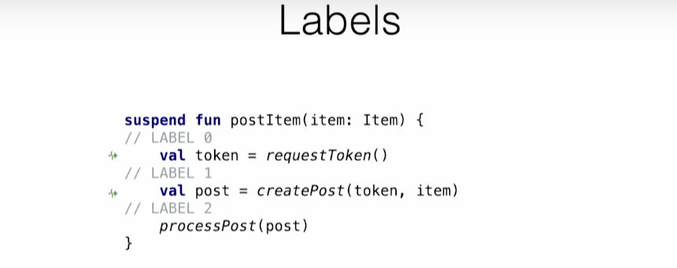
Labels
https://youtu.be/YrrUCSi72E8?t=447

Slide 6
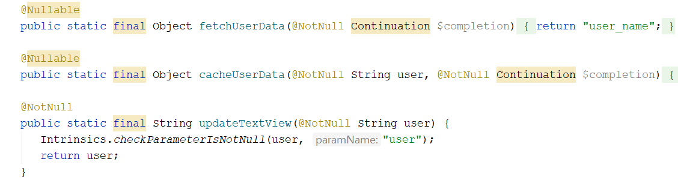
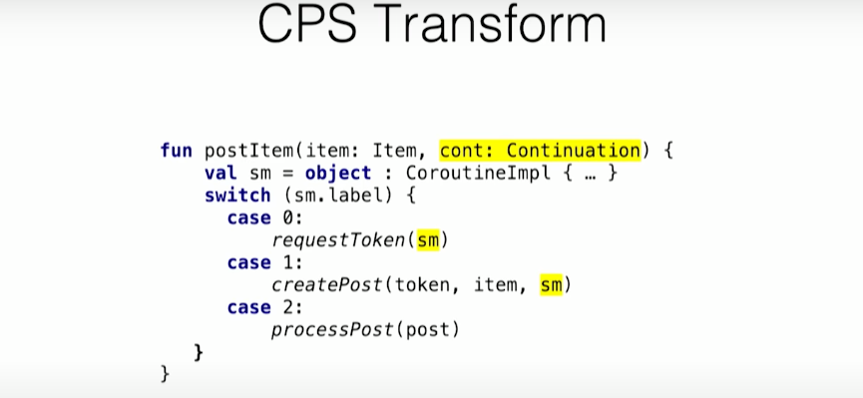
CPS Transform
https://youtu.be/YrrUCSi72E8?t=541

Slide 7
CPS simulation
GlobalScope.launch { val userData = fetchUserData() val userCache = cacheUserData(userData) updateTextView(userCache) }
fun main() { println("[in] main") myCoroutine(MyContinuation()) println("\n[out] main") } fun myCoroutine(cont: MyContinuation) { when(cont.label) { 0 -> { println("\nmyCoroutine(), label: ${cont.label}") cont.label = 1 fetchUserData(cont) } 1 -> { println("\nmyCoroutine(), label: ${cont.label}") val userData = cont.result cont.label = 2 cacheUserData(userData, cont) } 2 -> { println("\nmyCoroutine(), label: ${cont.label}") val userCache = cont.result updateTextView(userCache) } } } fun fetchUserData(cont: MyContinuation) { println("fetchUserData(), called") val result = "[서버에서 받은 사용자 정보]" println("fetchUserData(), 작업완료: $result") cont.resumeWith(Result.success(result)) } fun cacheUserData(user: String, cont: MyContinuation) { println("cacheUserData(), called") val result = "[캐쉬함 $user]" println("cacheUserData(), 작업완료: $result") cont.resumeWith(Result.success(result)) } fun updateTextView(user: String) { println("updateTextView(), called") println("updateTextView(), 작업완료: [텍스트 뷰에 출력 $user]") } class MyContinuation(override val context: CoroutineContext = EmptyCoroutineContext) : Continuation<String> { var label = 0 var result = "" override fun resumeWith(result: Result<String>) { this.result = result.getOrThrow() println("Continuation.resumeWith()") myCoroutine(this) } }

Slide 8
Coroutines under the hood 정리
There is no magic
CPS == Callbacks
CPS Transformation
Decompile
Labels
Callback
CPS simulation
debugging

Slide 9
THE END
새차원
새로운 차원의 앱을 지향합니다.
https://www.youtube.com/c/새차원
https://blog.naver.com/cenodim
hohoins@nate.com

