Slide 1
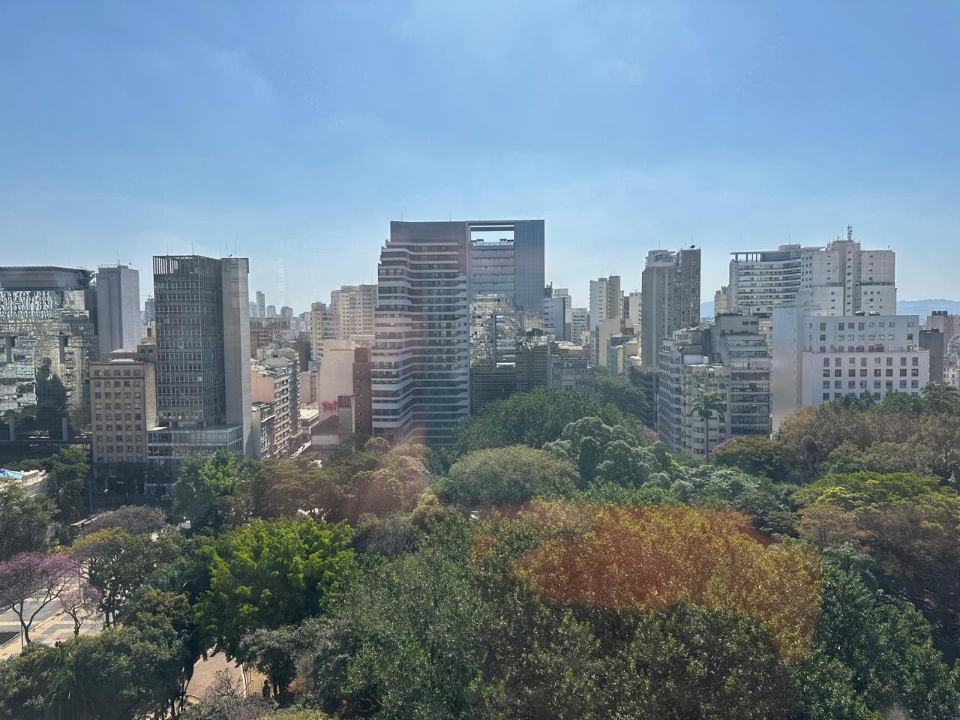
INVESTMENT DOSSIER
Real Estate
Opportunity
in São Paulo
Praça da República · 162/166
Historic Center · São Paulo, Brazil
HERITAGE-LISTED · 4,000 sqm · ZEU ZONING · REQUALIFICA CENTRO PROGRAM

Slide 2
EXECUTIVE SUMMARY
A singular asset in the heart of São Paulo
A 4,000 sqm commercial building located on Praça da República, directly facing the subway station (Lines 3-Red and 4-Yellow). The former headquarters of the State of São Paulo's Department of Education is a heritage-listed asset with consolidated documentation and full eligibility for the Requalifica Centro Program — the most aggressive tax incentive package ever offered for downtown São Paulo.
BUILT AREA
APPRAISAL
4,000 sqm
USD 5.6–10M*
13 floors + mezzanine + loft
direct sale
TITLES
ZONING
38 deeds
ZEU
* Local appraisal: BRL 31–56 million. USD figures at illustrative FX rate of 5.55.
individually registered
mixed-use, high density
INVESTMENT PILLARS
LOCATION
HERITAGE
STRUCTURE
INCENTIVES
Facing Praça da República
subway 100m away
Officially listed building
historic value
38 individual deeds
full flexibility
Requalifica Centro
IPTU + ISS + ITBI + 25%
PRAÇA DA REPÚBLICA · 162/166 · HISTORIC CENTER · SÃO PAULO, BRAZIL
02 / 13

Slide 3
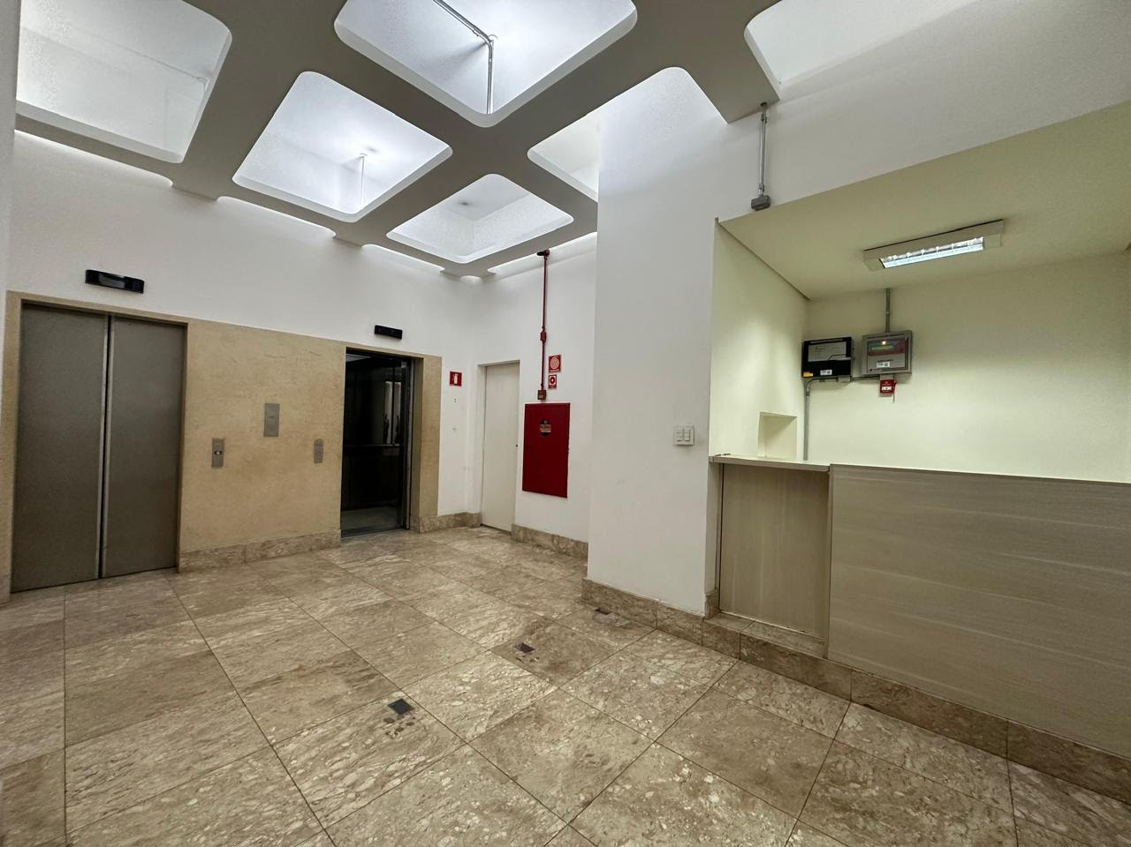
THE ASSET
Technical Profile
ADDRESS
Praça da República, 162/166 — Downtown, São Paulo, Brazil
BUILT AREA
4,000 sqm (≈ 43,055 sqft)
STRUCTURE
13 floors + mezzanine + loft
ROOMS
30 wide units, flexible layout
ELEVATORS
2 operating units
CAPACITY
Up to 600 simultaneous occupants
ZONING
ZEU — Centrality Zone
TITLES
38 individually registered deeds
FIRE CERT.
AVCB — fully compliant, up to date
HISTORY
Former HQ — São Paulo State Dept. of Education
HERITAGE
Officially listed building
PROPERTY TAX
≈ BRL 13,000 / month (whole building)
03 / 13

Slide 4
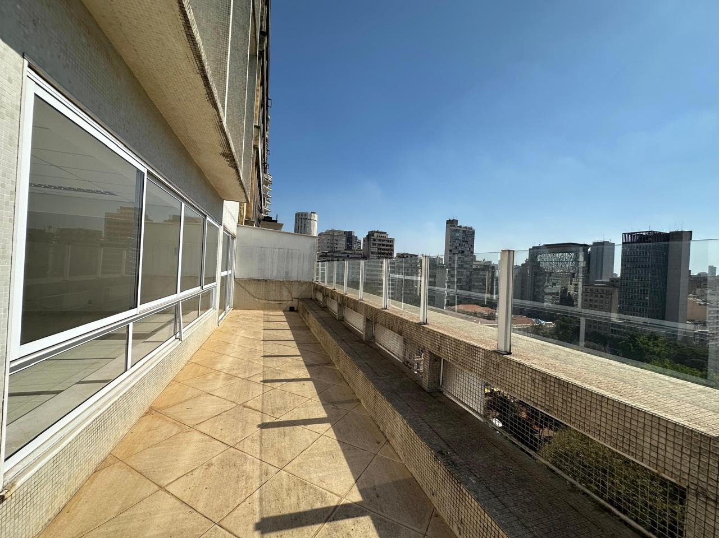
STRATEGIC LOCATION
Heart of
downtown SP
100 m
from República subway station — Lines 3-Red and 4-Yellow
Direct
access to Ipiranga, São João, São Luís and Consolação avenues
Nearby
Copan Building, Mário de Andrade Library, Municipal Theater
Inside
the accelerated urban redevelopment perimeter
Hub
for commercial, legal, educational, cultural and tourism activity
PRAÇA DA REPÚBLICA · 162/166 · HISTORIC CENTER · SÃO PAULO, BRAZIL
04 / 13

Slide 5
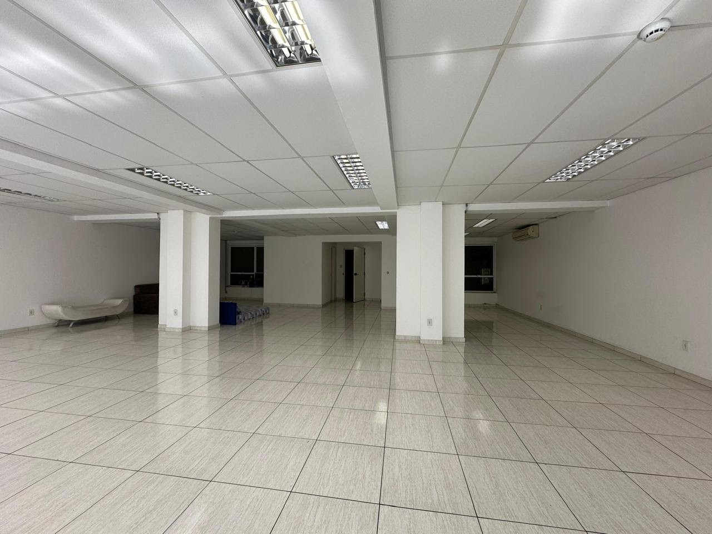
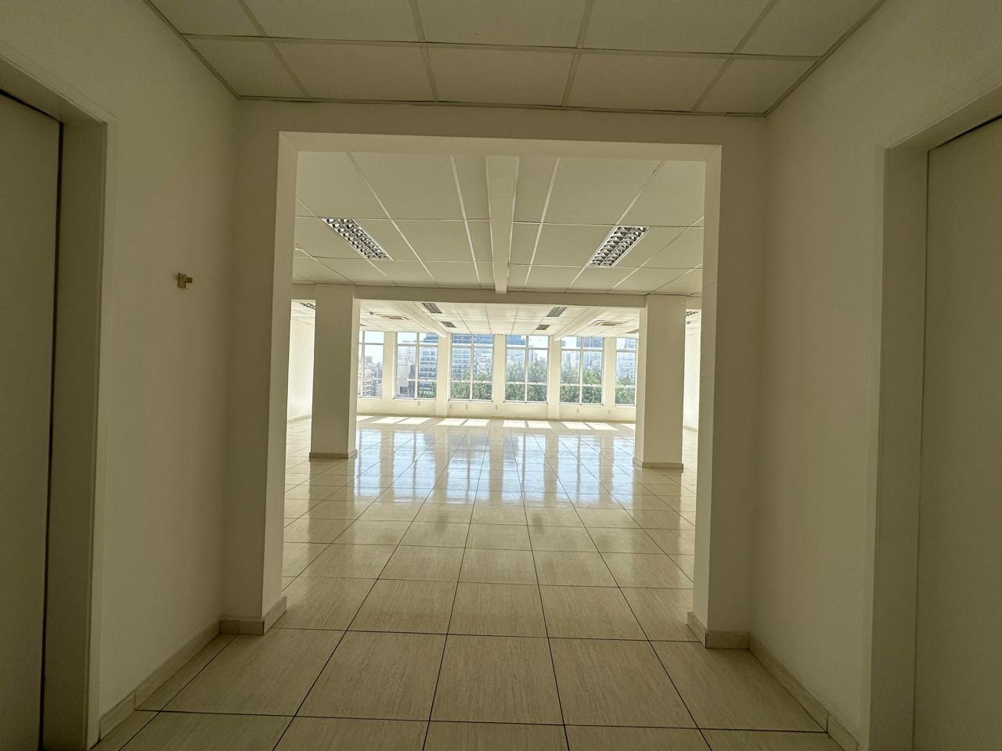
LAYOUT & FLEXIBILITY
30 wide rooms · 38 individually registered deeds
Each floor was designed to host large-scale corporate operations. The 38 independent property titles allow for partial sales, segregated collateral and flexible financial structuring — from full single-tenant sale to the assembly of a real estate fund (REIT) with multiple investors.
▎
Open floor plans with widely-spaced columns
▎
Generous ceiling height
▎
Full-height windows with natural light
▎
Power distribution segmented by floor
▎
Adaptable to open space, private offices or auditorium
05 / 13

Slide 6
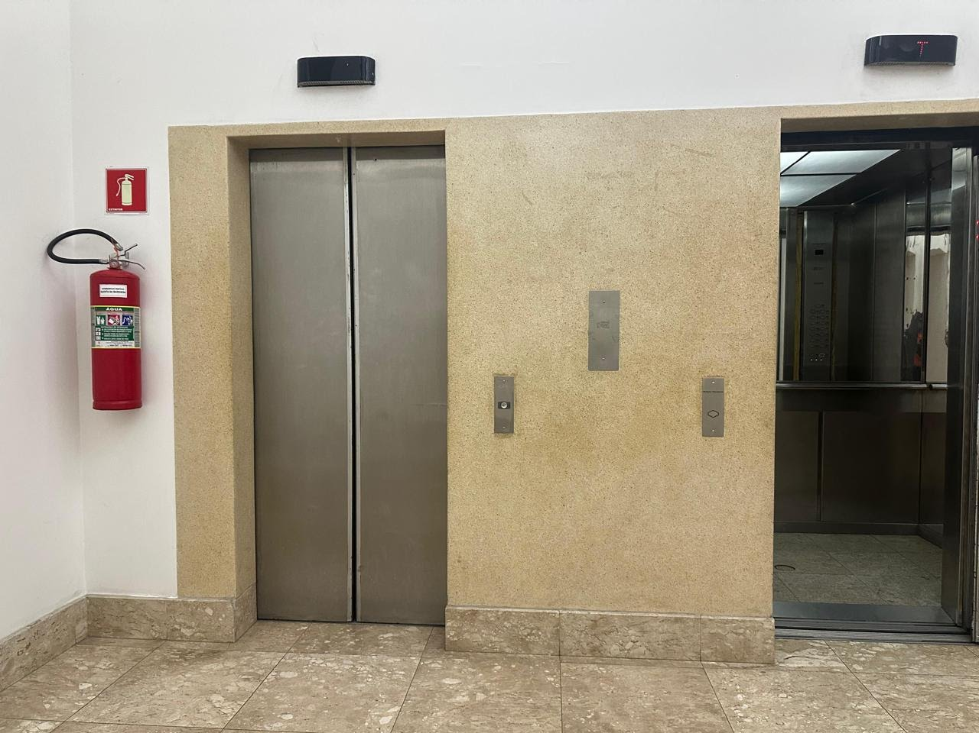
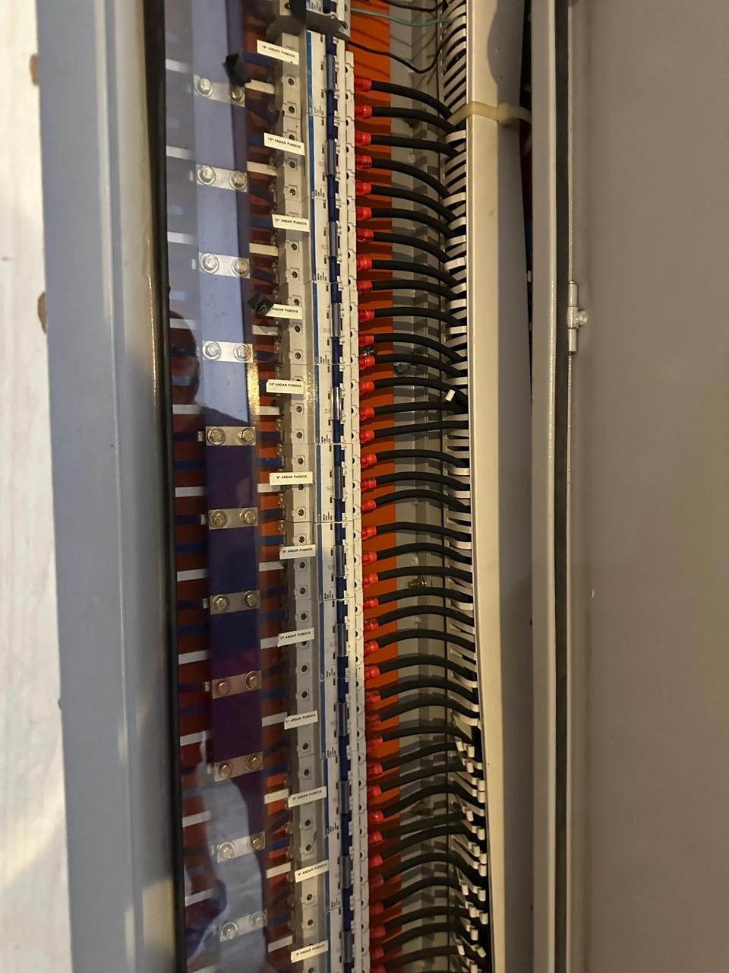
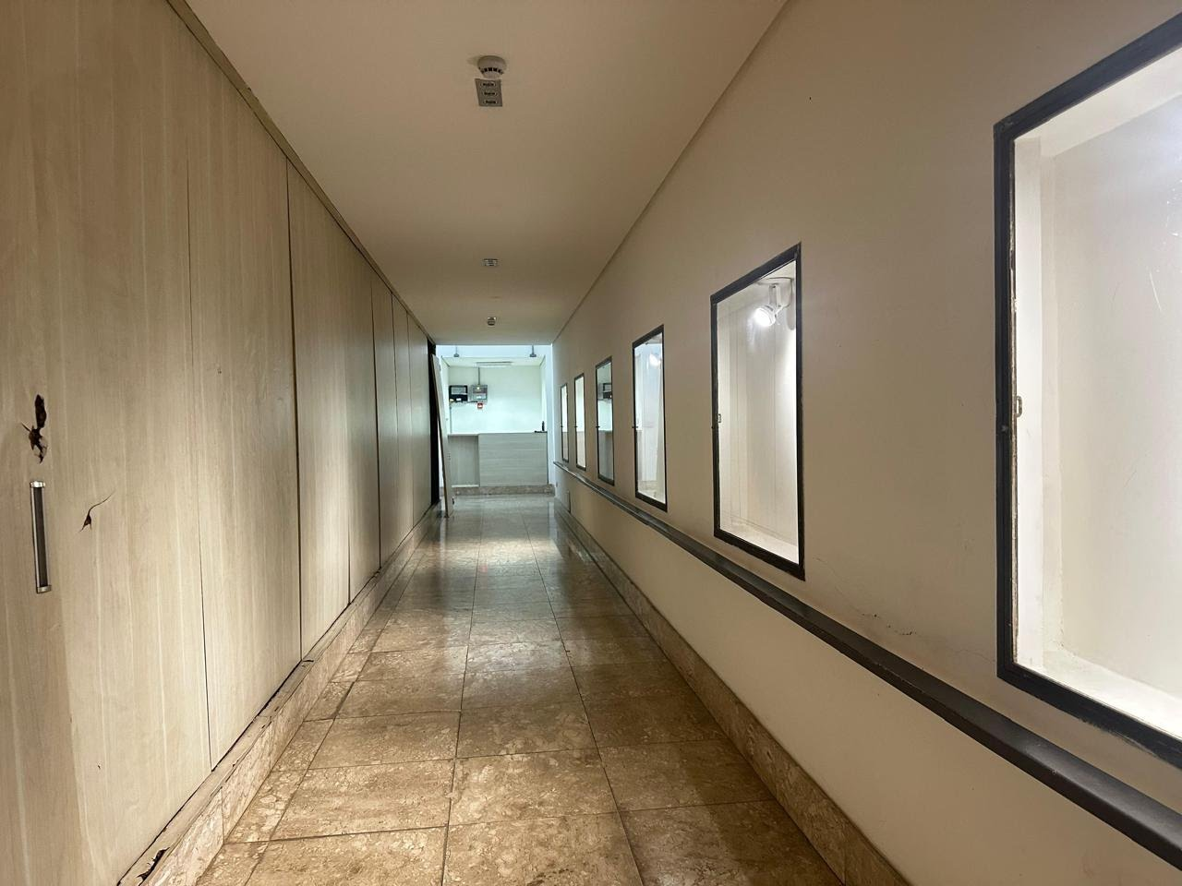
INFRASTRUCTURE
Ready to operate
ELEVATORS
ELECTRICAL
CIRCULATION
2 operating units
Power panel segmented by floor
Wide corridors and double staircase
FIRE CERT.
HVAC
TECH ARCHIVE
AVCB compliant and up to date
Split + cassette systems in approved use
Architectural plans and drawings available
06 / 13

Slide 7
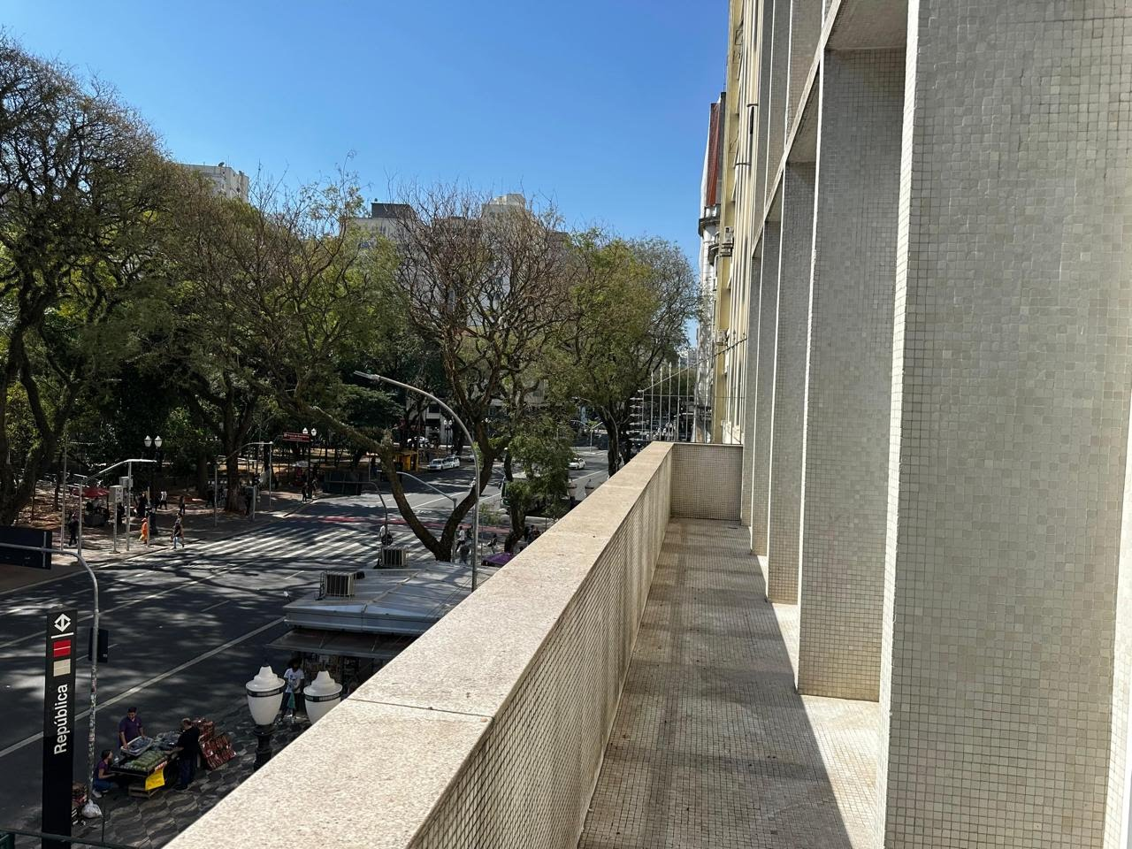
THE INVESTMENT THESIS
Requalifica
Centro
Program
The asset is fully eligible under the most aggressive municipal incentive program ever launched for downtown São Paulo. The combination of tax exemptions, direct subsidy and fast-track permitting structurally transforms the investment equation.
Legal basis: Municipal Law 17,577/2021 · Law 17,844/2022 (AIU-SCE) · Decrees 61,311/2022 and 62,465/2023 · IN SF/SUREM nº 01/2023
07 / 13

Slide 8
REQUALIFICA CENTRO · 1/2
Tax incentive stack
IPTU
ISS
ITBI
Property Tax
Service Tax
Transfer Tax
•
Forgiveness of all prior tax debt
•
Rate reduced from 5% to 2%
•
Full exemption on transfers
•
100% exemption for 3 years after CCR
•
Applies to construction, engineering,
•
destined for requalification
•
Progressive rates from year 4 to 8
•
architecture and refurbishment
•
Drastically reduces acquisition
•
Full rate only restored in year 9
•
linked to the retrofit
•
and structuring costs
DIRECT IMPACT
DIRECT IMPACT
DIRECT IMPACT
Savings exceeding BRL 2,000,000
over an 8-year cycle
Savings of BRL 300,000
on a BRL 10M retrofit
100% exemption
on acquisition
Current property tax ≈ BRL 13,000/month · 3-year exemption = BRL 468,000 saved on IPTU alone
08 / 13

Slide 9
REQUALIFICA CENTRO · 2/2
Direct subsidy + fast track
DIRECT GOVERNMENT SUBSIDY
FAST-TRACK PERMITTING
Up to 25%
non-refundable
Summary rite · 60 business days
▎
Project approval in up to 60 business days
▎
Municipal licensing fees waived for 5 years
Direct municipal grant over construction costs, awarded through public calls issued by the Municipal Department of Urbanism and Licensing (SMUL).
▎
Inspection fees waived during the same period
▎
Priority status in public-sector contracts
On a BRL 10M retrofit → up to BRL 2,500,000 non-refundable
✓ ELIGIBILITY CONFIRMED
Pre-1992 building + ZEU Zone
Article 37 of Law 17,844/2022
09 / 13

Slide 10
USE CASES
Multiple operating models
Corporate Headquarters
REIT / Real Estate Fund
For companies seeking representativeness, centrality and a prestige address in São Paulo.
Ideal asset for income portfolio composition — 38 deeds enable phased acquisitions.
Education Operation
Mixed-Use Retrofit
Structure compatible with universities, training centers, technical schools and open courses.
Conversion to residential, hospitality or mixed use with enhanced municipal incentives.
Family Office
Institutional HQ
Patrimonial positioning in a historic asset with cultural status and high fractional liquidity.
Natural vocation for government bodies, cultural institutions, foundations or NGOs.
10 / 13

Slide 11
PROJECTED RETURNS
Investment return scenarios
Simulation after acquisition and retrofit · based on local m² appreciation
CONSERVATIVE
MODERATE
REALISTIC
OPTIMISTIC
ACQUISITION
ACQUISITION
ACQUISITION
ACQUISITION
BRL 31 M
BRL 43.5 M
BRL 43.5 M
BRL 56 M
CAP RATE
CAP RATE
CAP RATE
CAP RATE
5.8%
6.1%
7.4%
6.9%
10-YEAR ROI
10-YEAR ROI
10-YEAR ROI
10-YEAR ROI
58%
61%
74%
69%
Scenarios do not include additional Requalifica Centro savings — which may add 8 to 15 percentage points to ROI.
11 / 13

Slide 12
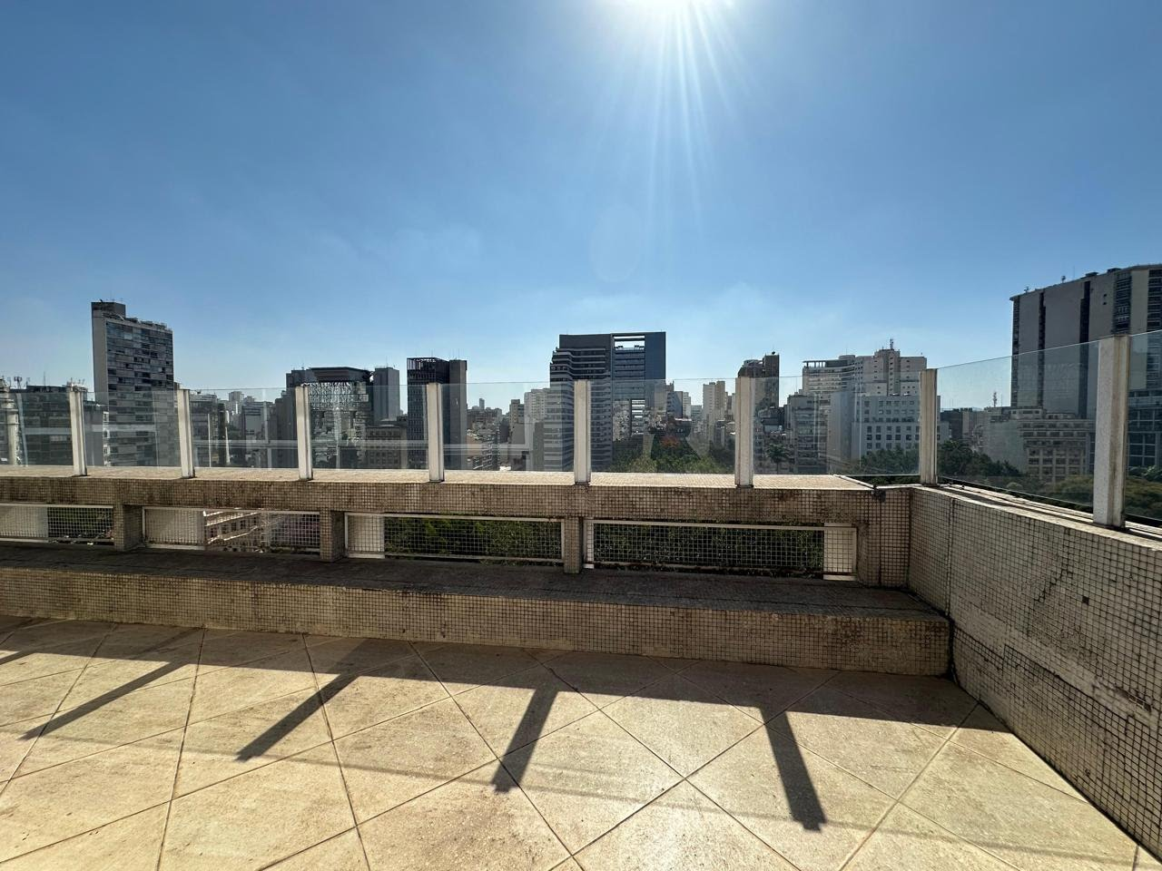
LEGAL SECURITY
Documentation ready to operate
▎
38 individual deeds
Enables partial sales and segregated collateral structures
▎
AVCB compliant
Fire department certification active and up to date
▎
Complete tech archive
Original architectural plans and drawings available
▎
Heritage as upside
Eligible for the "Requalified Heritage" seal and cultural funding lines
▎
Collateral-ready
Compatible with fiduciary assignment and structured financing
▎
Open due diligence
Full documentation made available under NDA
NEXT STEPS · site visit · NDA · formal offer
12 / 13

Slide 13

CONTACT
Nicollas J. Haimerl
nicollas.joseph@mcap.com.br
REAL ESTATE INVESTMENT OPPORTUNITY
Praça da República, 162/166 · Historic Center · São Paulo, Brazil

