Slide 1
OOM Project
Software for
Drawing 2D and 3D Shapes

Slide 2
Objectives :
To Draw 2D Shapes like Square ,Rectangle ,Circle ,Ellipse ,Star and
Triangle.
And to Draw 3D Shapes like Sphere ,Cube , Cylinder and Cone.
And to do operations on them like Rotating ,Resizing.., etc.

Slide 3
FEATURES :
Draw a Frame, in which you have to enter your choice.
According to choice you have to draw a 2D or 3D shape.
There should be a component by which you can control the rotation or the orientation of shape.

Slide 4
Analysis :
Use Case Diagram
Class Diagram
CRC Diagram

Slide 5
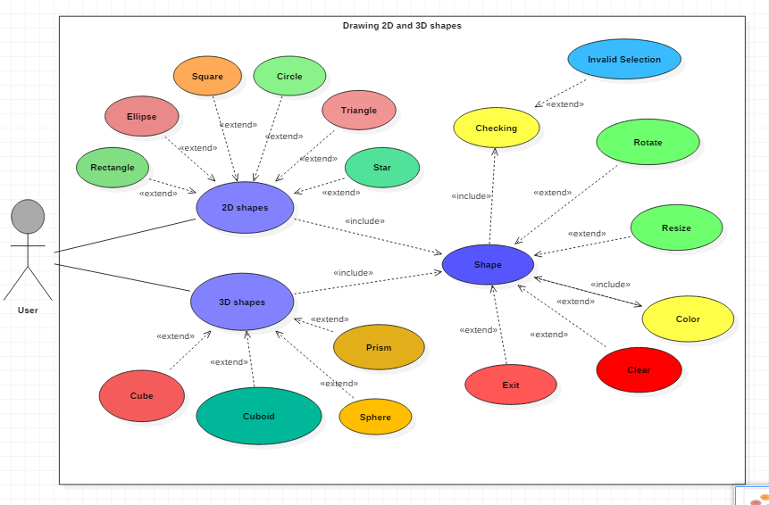
User Case Diagram

Slide 6
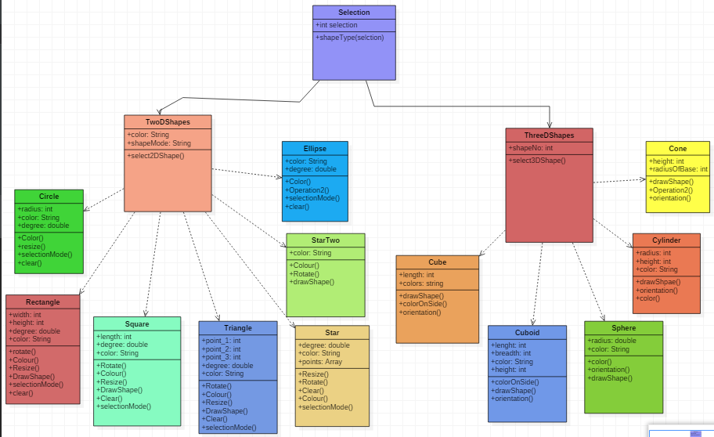
Class Diagram

Slide 7
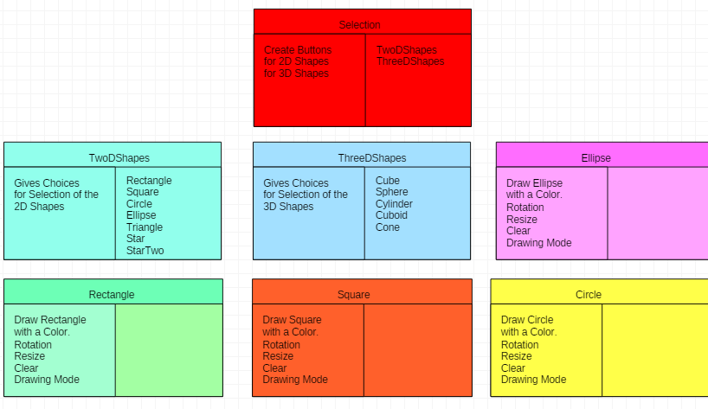
CRC Diagram

Slide 8
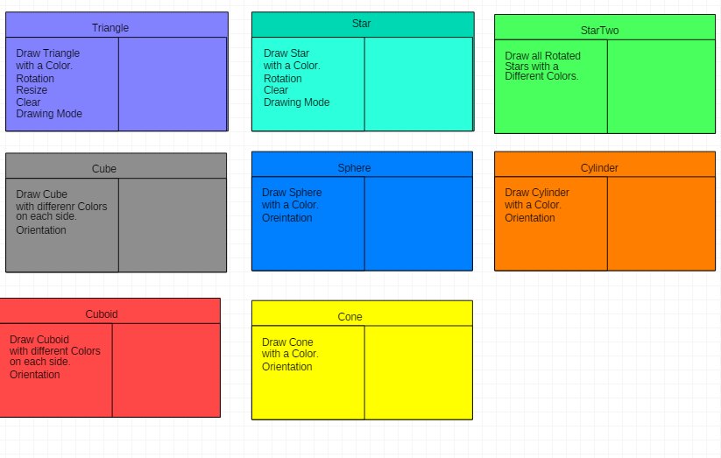

Slide 9
Directions to Use :
First ,Selection of 2D Shapes or 3D Shapes.
Next ,Choose a Shape from this respective shapes.
A Color can be selected for the shape.
Choose either fill the Shape or draw the shape.

Slide 10
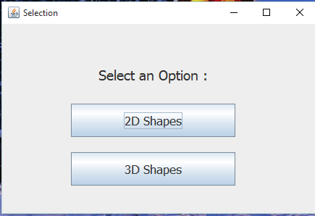
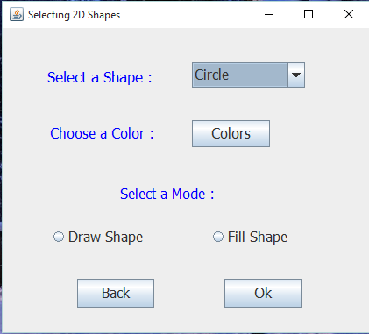
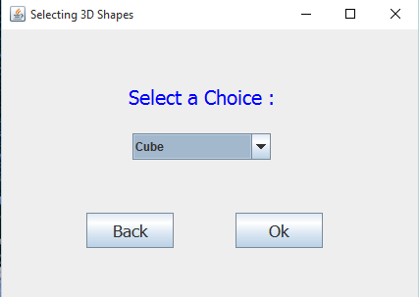

Slide 11
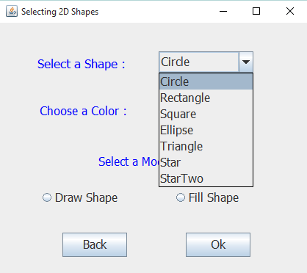
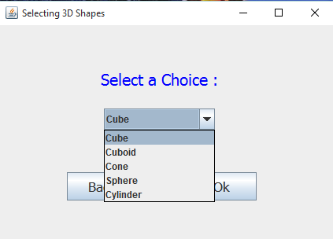

Slide 12
For the selected 2D shape :
Can change color of the shape
Can Increment the size of the shape
Can Decrement the size of the shape.
Can Rotate the Shape

Slide 13
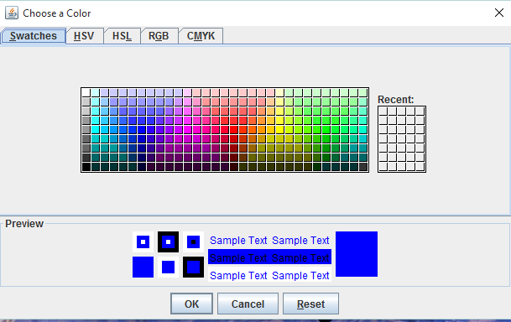
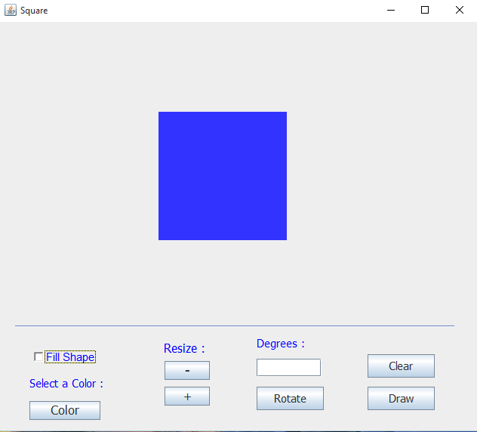

Slide 14
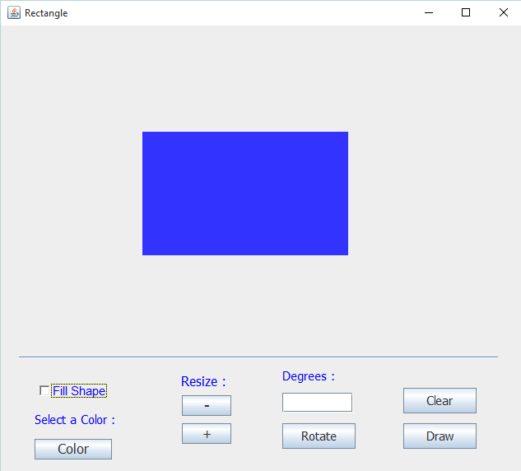
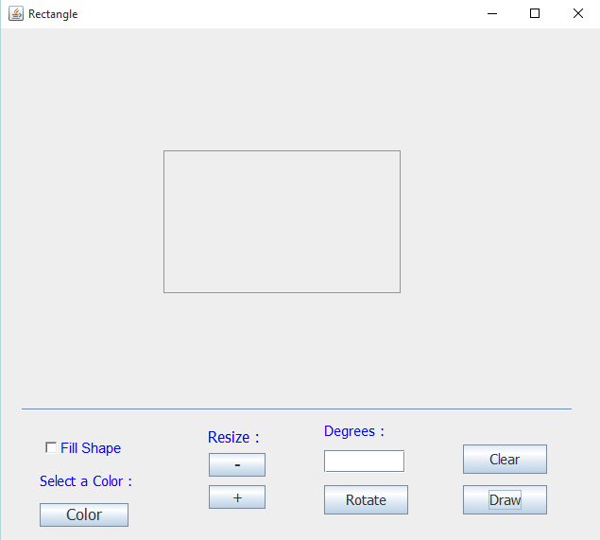

Slide 15
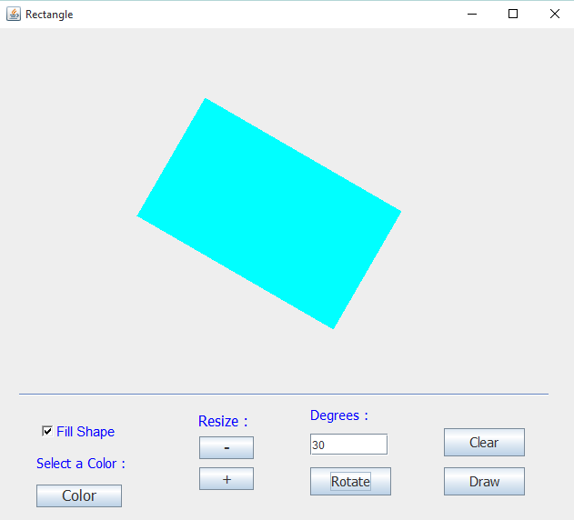

Slide 16
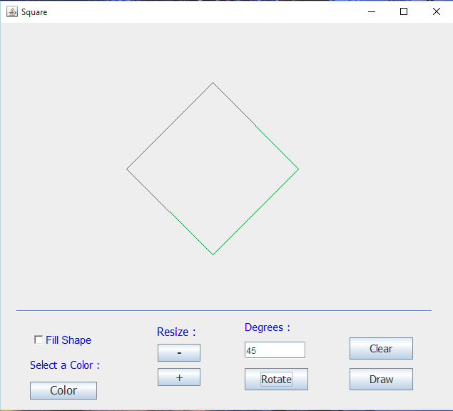
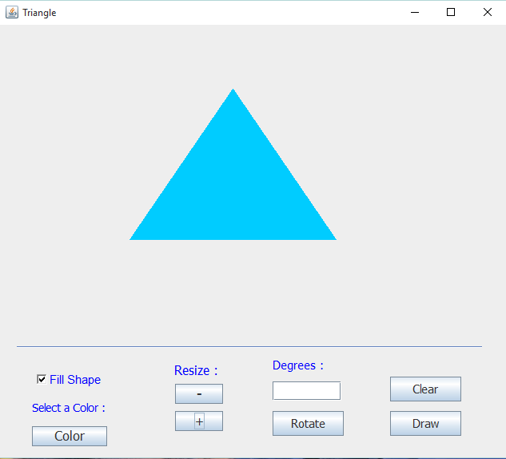

Slide 17
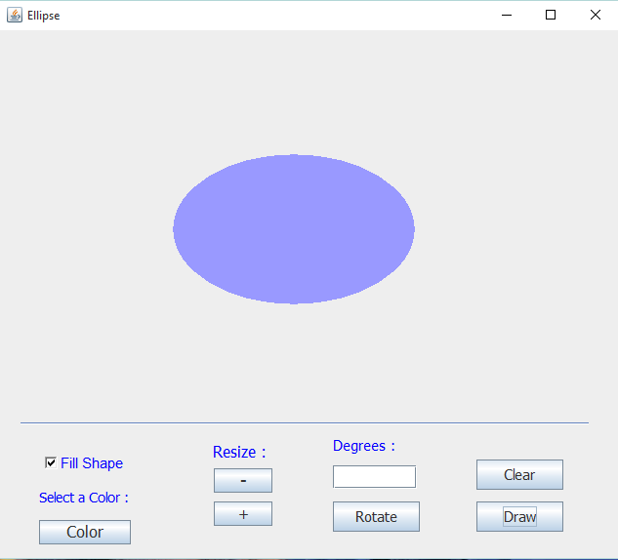
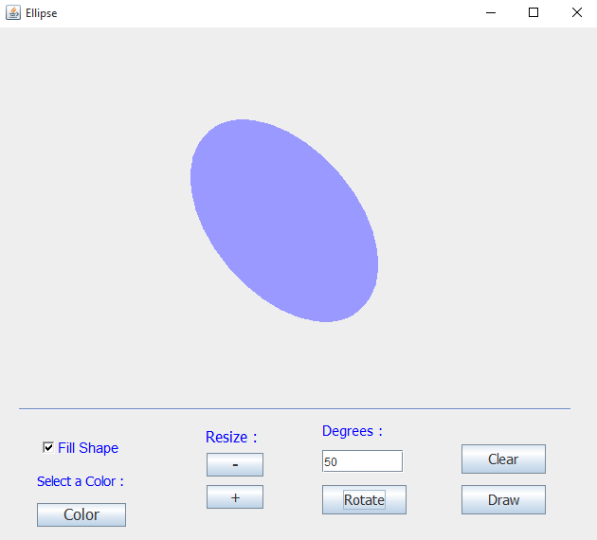

Slide 18
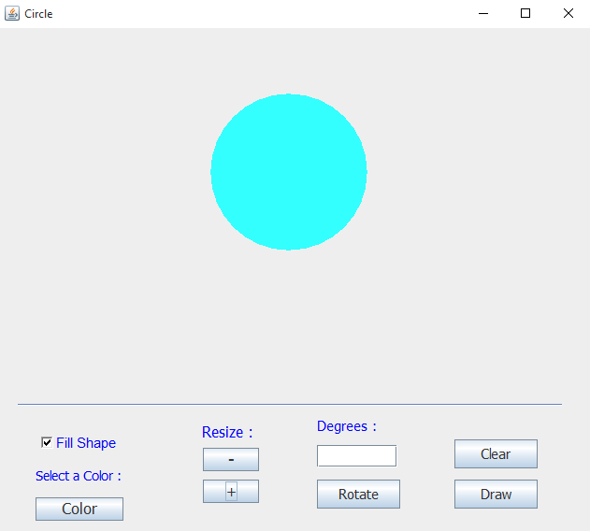
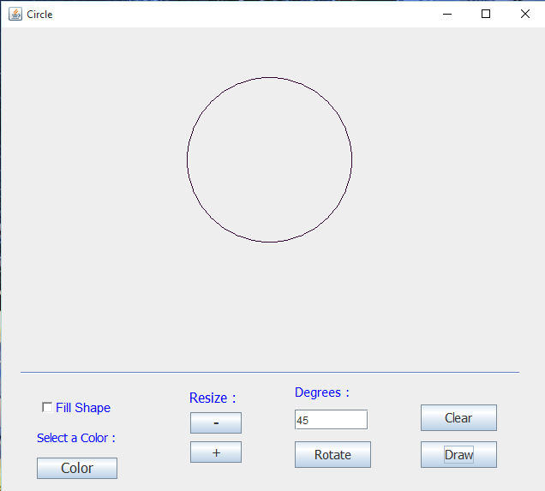

Slide 19
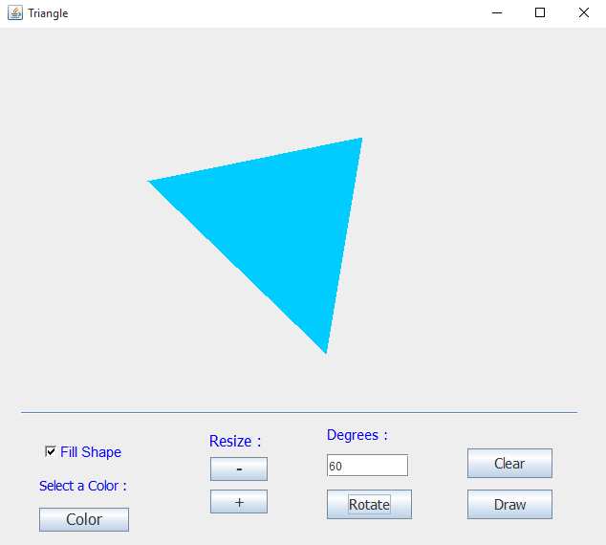
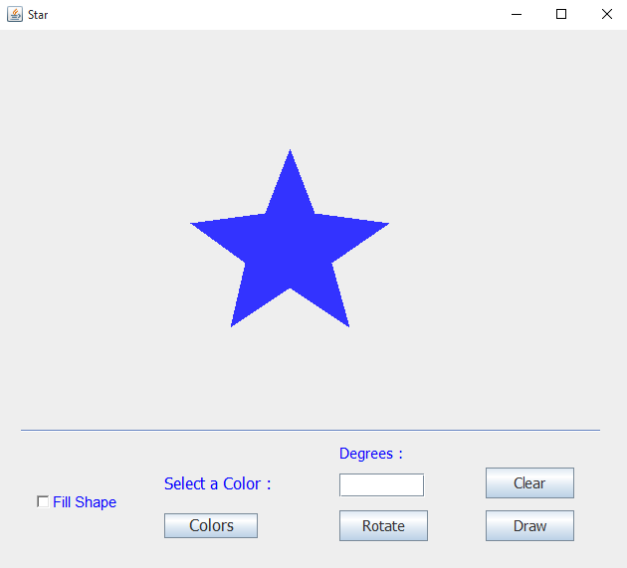

Slide 20
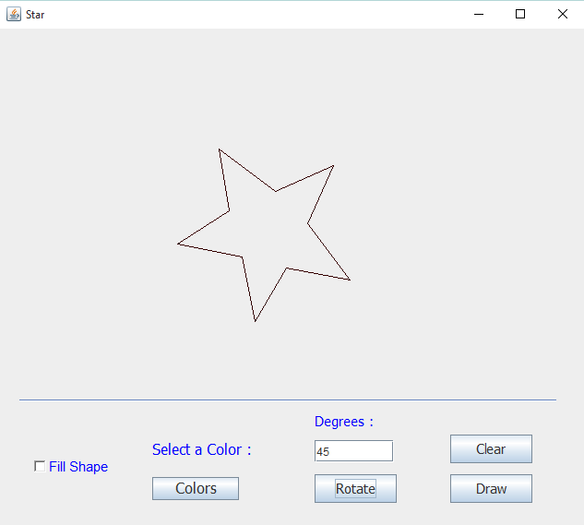
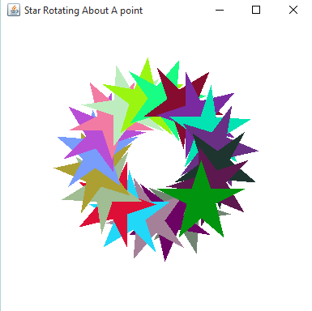

Slide 21
For the selected 3D shape :
Can view the shape through different directions(orientation).

Slide 22
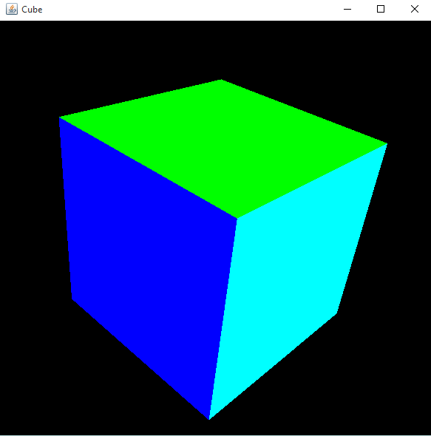

Slide 23
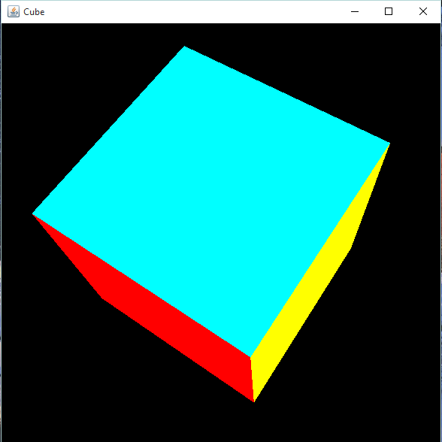
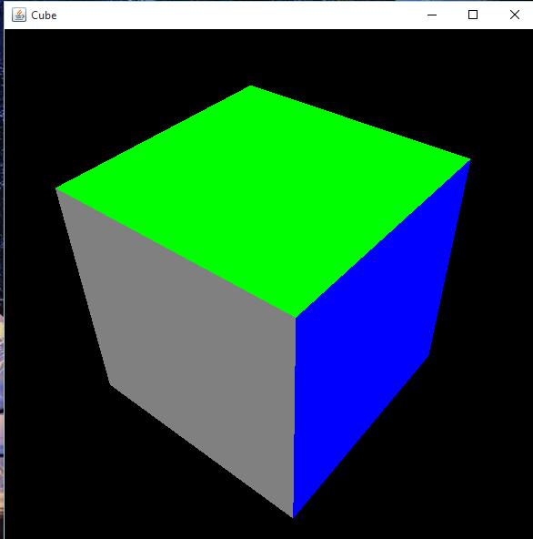

Slide 24
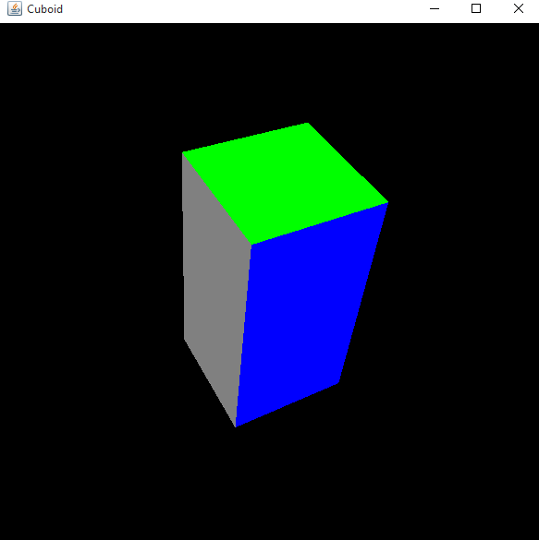
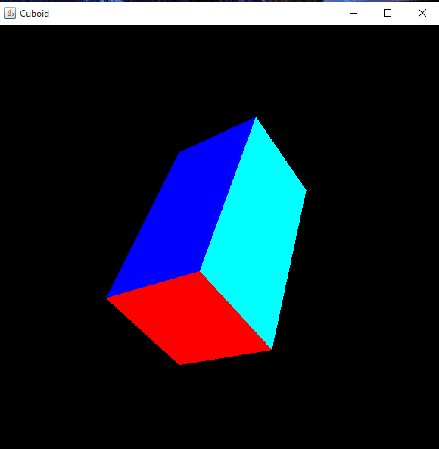

Slide 25
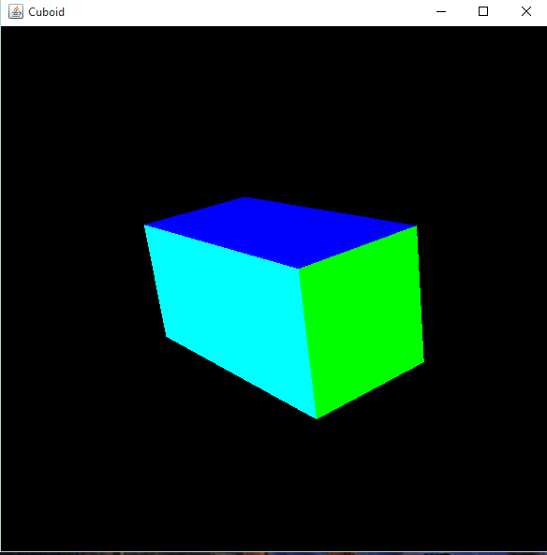
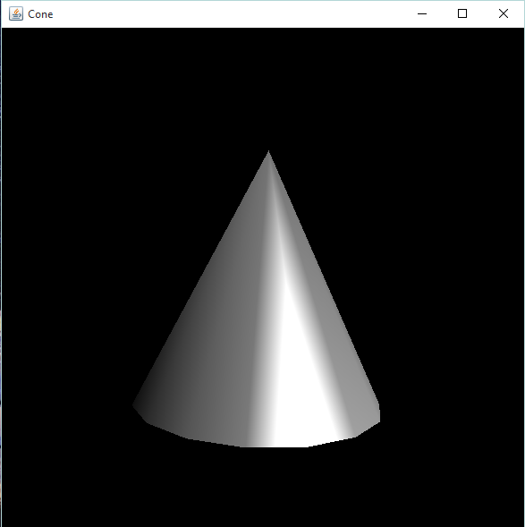

Slide 26
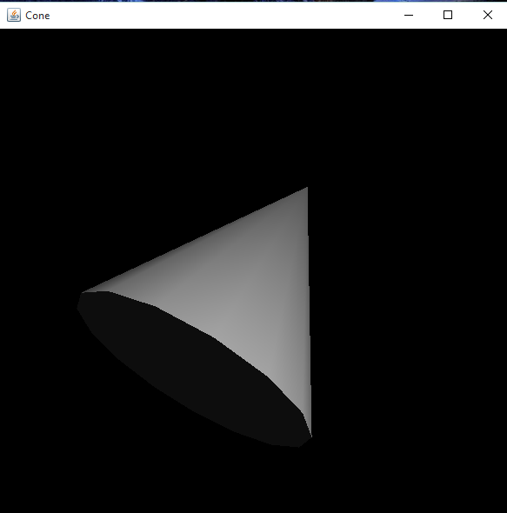
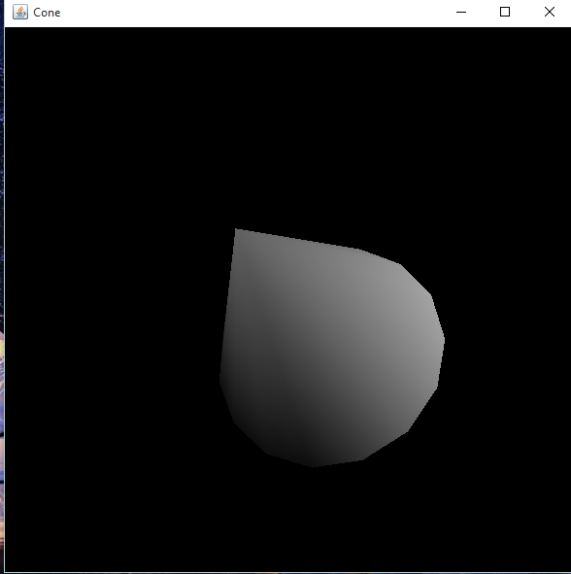

Slide 27
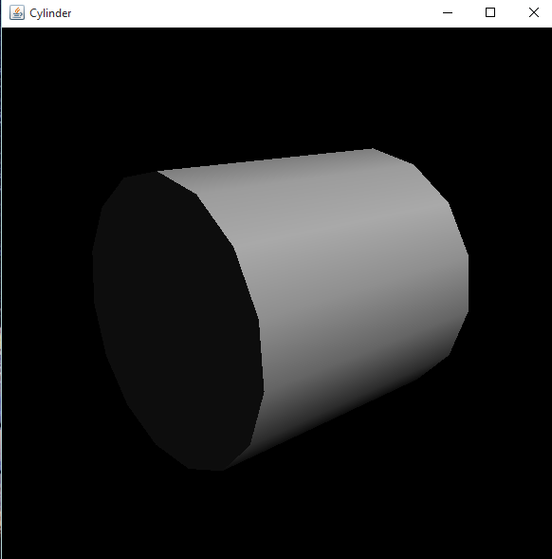

Slide 28
OOM Project:
Drawing 2D And 3D Shapes.
-IIT2014101
IIT2014113
IIT2014114

