Slide 1
ECE 6276 – CDR Image Processing: 2D Discrete Cosine Transform
Team 11
Andrew Paredes
Haines Todd
Hanyu Liu
Xingyang Liu

Slide 2
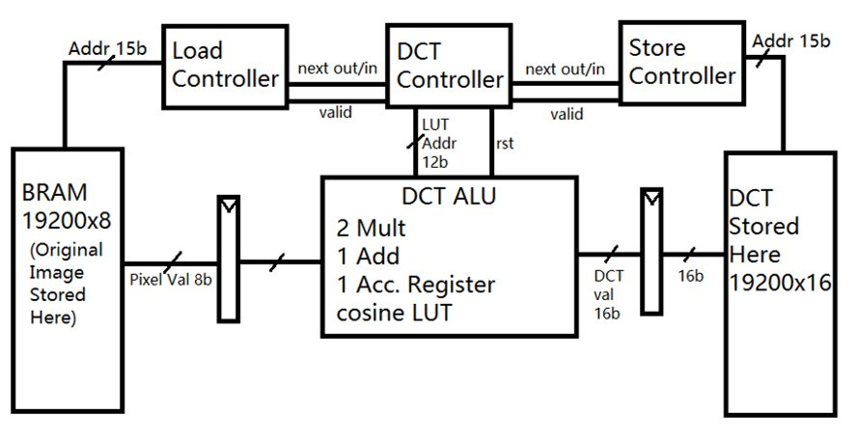
Main DCT architecture
4 Main Clusters
BRAM
Original Image here
Image Load Controller/Datapath
Read/Write Address Calculation
DCT Controller/Datapath
Computes DCT Values
Writes to DCT_RAM
DCT RAM
Store computed DCT values

Slide 3
Current milestones
DCT_8x8_MAC: The testbench simulation output matches the reference.
Load controller: The test bench simulation shows correct pixel values reading out out BRAM.
VGA Component : Has been created and is writing out the stored image to the display.

Slide 4
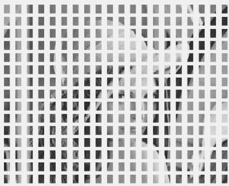
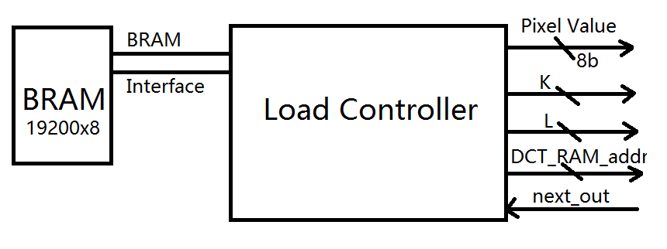
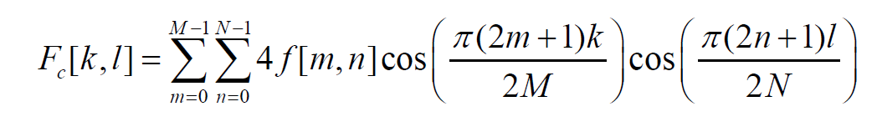
Cluster uArch: LoadController.vhd
DCT Blocks are 8x8
M=N=8
64 reads per DCT value
(64)(64) = 4096 reads per DCT block
1228800 reads for the entire Image
Minimum of 1228800 clock cycles to perform the entire DCT
Assuming one clock cycle per read and single port memory

Slide 5
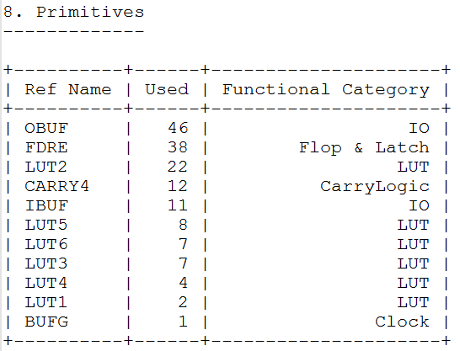
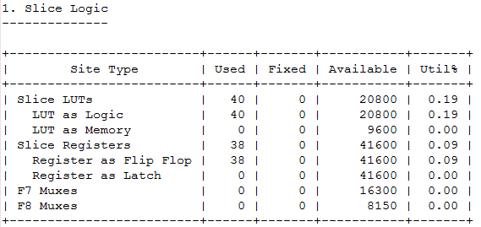
Cluster uArch: LoadController.vhdd
Area: 40 LUTs, 38 Registers
Notes:
Synthesis results (Area, timing, throughput)
LUTs < 1%
Regs 0.11%
Timing issue: 100MHz timing violation. Slowed down to 50MHz to meet timing constraint

Slide 6




Cluster uArch: DCT_8x8_MAC.vhd
Handshake with Load controller
Handshake with Store controller
in_valid
control
out_valid
next_in
next_out
clk
m_out
m_in
n_out
n_in
clear_sum
rst
$$f[m,n]$$
pixel_
reg
pixel
clear_sum
m_in
m_reg
m_out
cos_
LUT
$$Fc[k,l]$$
>> 14
DCT_out
cos_LUT stores cosine values. 8x8=64 entries
of 9-bit fixed-point binary with 8-bit fractional part.
k
k_reg
sum_reg
Round off the 14 fractional part
n_in
n_reg
n_out
l
l_reg
$$∑ ∑$$
$f[m,n]cos⁡(\frac{π\left(2m+1\right)k}{2M})$ $cos⁡(\frac{π\left(2n+1\right)l}{2M})$
Notes:
Handshake
Input 8x8 8-bit pixel in series
M,n: index of the 8x8 img block
K,l: index to the 8x8 DCT block
Output DCT at index[k,l]
Starting from 1st pixel, m,n increment
Dual output port cosLUT, 9-bit fix-point decimal
right shift 14 bit to round to integer. Why 14

Slide 7
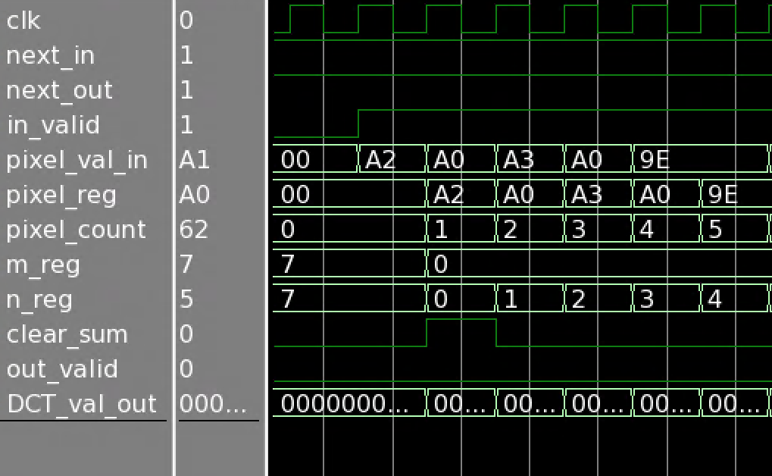
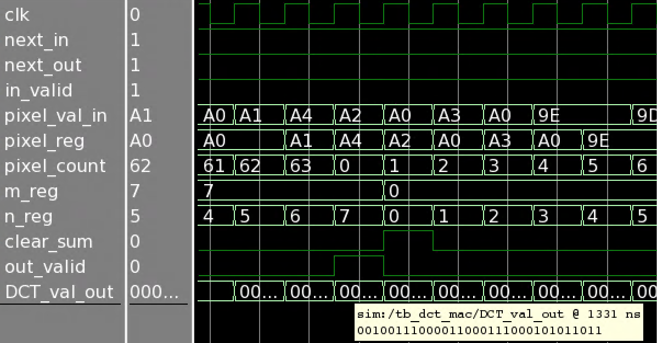
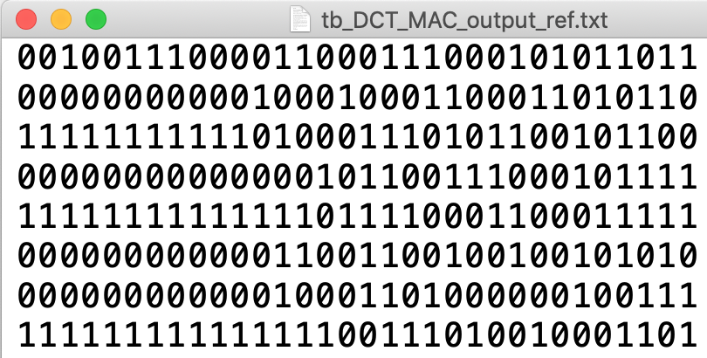
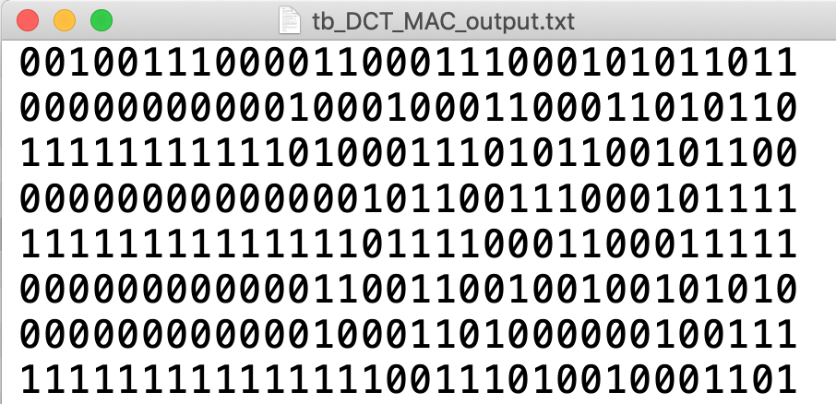
Cluster uArch: DCT_8x8_MAC.vhd
First DCT value is evaluated after 64 pixels fed in to the module
Matlab generated reference for 1st 8x8 DCT Block
ModelSim simulated result for 1st 8x8 DCT Block
match
Notes:
Simulation results
Launching: in_valid, m,n increment
Output_valid
If pixel comes in without gap, DCT out every 64 cycles
Output matches

Slide 8
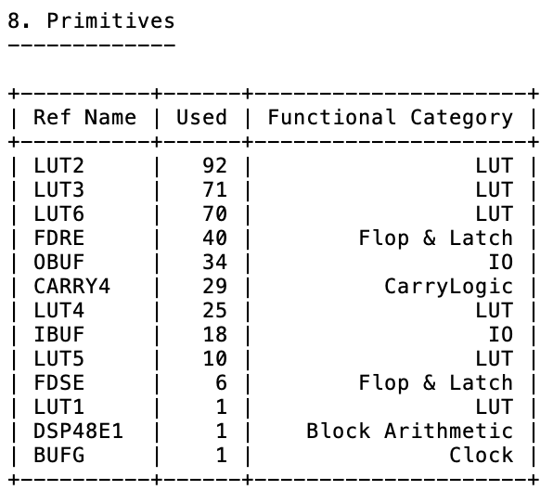
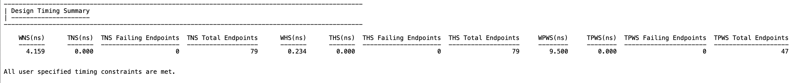
Cluster uArch: DCT_8x8_MAC.vhd
Area: 199 LUTs, 46 Registers, 1 DSPs
Throughput: Every 64 valid pixels value gives 1 DCT value.
1 cycle per pixel => 64 cycles per DCT value
If run at 100 MHz (10 ns), 640 ns per DCT value.
If run at 50 MHz (20 ns), 1.28 us per DCT value.
Timing:
Notes:
Synthesis results (Area, timing, throughput)
LUTs < 1%
Regs 0.11%
Timing issue: 100MHz timing violation. Slowed down to 50MHz to meet timing constraint

Slide 9
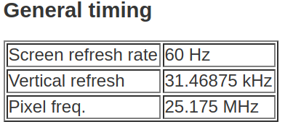
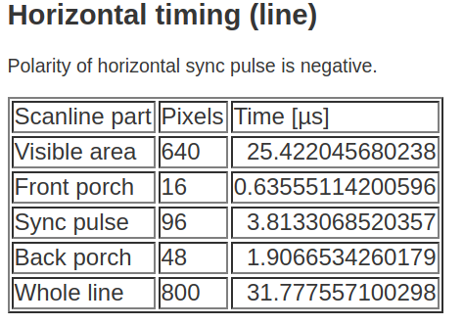
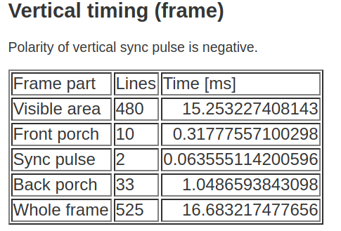
Cluster uArch: VGA_out.vhd
VGA follows a raster scanning method like old CRT televisions
Basys VGA port supports 4 bit precision.
Timing is very important to construct the image.
http://tinyvga.com/vga-timing/640x480@60Hz

Slide 10
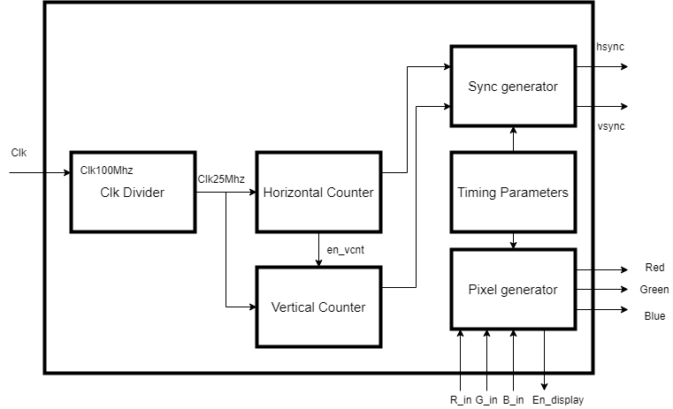
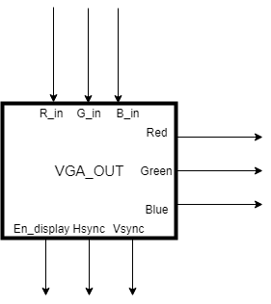
Cluster uArch: VGA_out.vhd
Clk

Slide 11
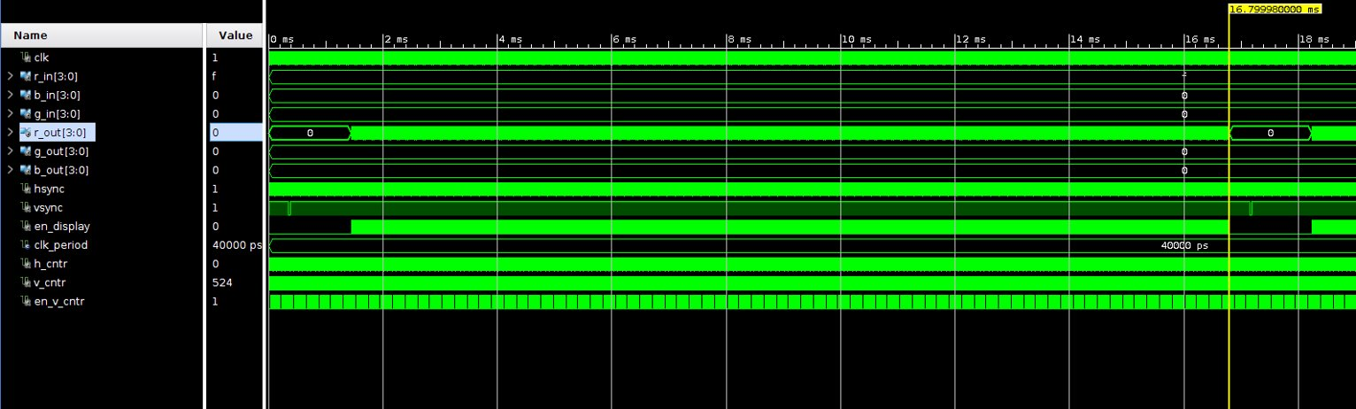
Cluster uArch: VGA_out.vhd
One frame is completed at 16.7 ms which is the required time to get 60FPS

Slide 12
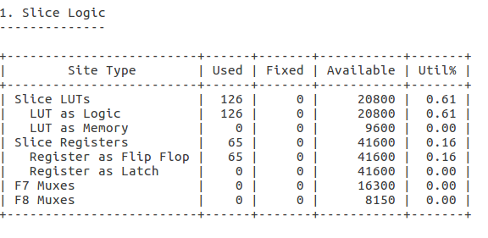
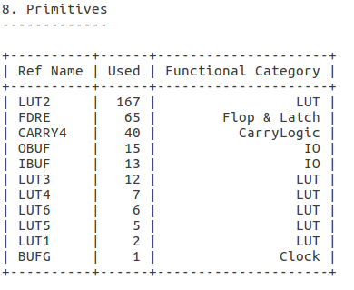
Cluster uArch: VGA_out.vhd
Synthesis and Implementation Results

Slide 13
Risks Met
DCT_8x8_MAC module violated time constraints when synthesizing with 100 MHz clock.
Slowing down clock to 50 MHz meet the timing constraints.
Or insert buffer (pipeline stage) in between cosLUT and multiplication to meet 100MHz clock timing constraints.
Even with reduced image size a large amount of BRAM is utilized.
VGA port has 4 bit precision so may need to reduce the precision of the DCT output for display.
DCT RAM must be dual port so the write port can happen at 100Mhz and read can occur at the VGA pixel clock frequency
Notes:
Describe what risk you met for a specific block or algorithm implementation, as well as your current workaround (if applicable)

Slide 14
Plan for Final Design Review
Load everything onto the Basys 3 Board and output the DCT coefficients as an image on the VGA output.
(If time allows) Modify the DCT MAC to IDCT MAC and quantize coefficients to compress the image.

Slide 15
Timeline
 | Work done so far | Remaining Work
Andrew Paredes | Coded Matlab Model Worked on testbench Created VGA_out.vhd Tested VGA_Out with an Image | Connect the VGA module and DCT_RAM Help with top level integration of all components
Hanyu Liu | Coded Matlab model | Modify DCT_8x8_MAC.vhd to IDCT_8x8_MAC
Haines Todd | Designed LoadController.vhd Worked on testbench | Connect the VGA module and DCT_RAM
Xingyang Liu | Coded Matlab model Generated golden reference for DCT_8x8_MAC.vhd Simulated DCT_8x8_MAC.vhd | Add one more pipeline stage to meet timing requirement Integrate DCT_8x8_MAC module into the top level

Slide 16
Reference
“ECE 6258: Transforms of Images”, Prof. Ghassan AlRegib, Georgia Institute of Technology, 2017
“dct2: 2-D discrete cosine transform”, MathWorks, https://www.mathworks.com/help/images/ref/dct2.html
“idct2: 2-D inverse discrete cosine transform”, MathWorks, https://www.mathworks.com/help/images/ref/idct2.html
“fi: Construct fixed-point numeric object”, MathWorks, https://www.mathworks.com/help/fixedpoint/ref/fi.html

