Slide 1

Discussion on QCC Project for JLR Sweden
July 2026
Notes:
This set of guidelines is designed to describe how to use the templates as per required communication. Refer through the slides from 1 to 7 and remember to remove these slides when you share the final presentation with someone.

Slide 2
Quality Checker for LUCID Motors
Project : CAD Data Quality Checks
Customer : LUCID Motors
Service : PLM Rule Set using Quality Rules Designer App in 3D Experience.
Service Scope :-
Profile Creation using Profile Manager to run the Quality Checker tool in their assemble.
Checks added for different object types.
Report of the checks generated.
Result saved for future reference.

Slide 3


Quality Checker for LUCID Motors
Tools & Technologies Used
PLM Ruleset creation
EKL
VBA
Quality rule capture
OOTB report
PLM Ruleset extraction
EKL
VBA
Knowledge ware
A visualization of the end result:-
Data setup
EKL
CAD model configuration
Knowledge resources

Slide 4
Renault Nissan Quality Checks- RCC
Project : RCC – Rule Checks & Compliance
Customer : Renault Nissan (Vehicle Architecture Team)
Service : PLM Rule Creation - Automated Assembly Validation in 3DEXPERIENCE
Service Scope :-
Collect and assemble CAD data received from multiple suppliers.
Validate vehicle assemblies against architecture-defined rules before plant release.
Automate key compliance checks including:
Interference Analysis
Kinematics Validation
Ergonomic Checks using Digital Mannequins accessibility & orientation validation
Assembly Compliance Verification
Provide OK/NOK status for each validation rule.
Support architecture teams in identifying and correcting design issues before manufacturing.

Slide 5

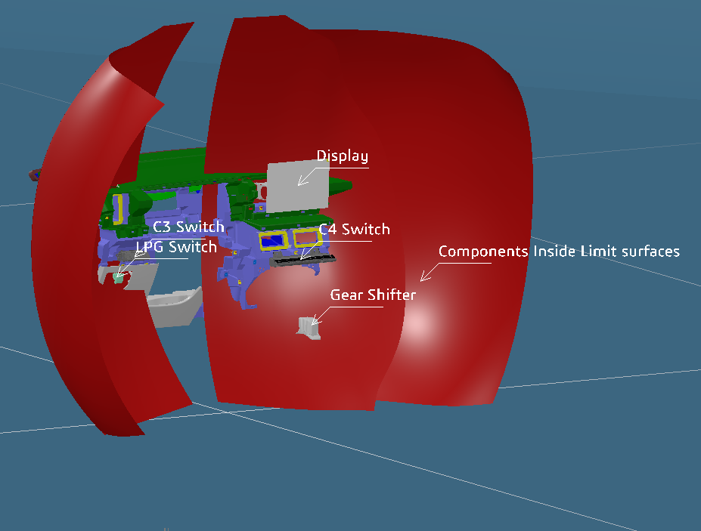
Renault Nissan Quality Checks - RCC
Technologies Used
PLM Ruleset creation
EKL
VBA
Quality rule capture
Part Testing
EKL
Visual Scripting
Assembly handling
Data setup
EKL
CAD model configuration
Knowledge resources

Slide 6
