Slide 1

CM2307 Group 21
Final Presentation

Slide 2

NyteSafe – A night-time economy security application

Slide 3

Accelerometer - Fall/Impact Detection
Began with Matlab graph analysis based on data collected in a padded gym room
Algorithm to detect a fall/impact based on harsh acceleration change then thought up and implemented into Python
Then transferred into Android Studio using built in using Sensors in Android phones
Harsh fall or impact is detected and reported through both calculating a mean and a threshold (explain here)
This then alerts emergency services and contacts if not cancelled by the user

Slide 4

User Accounts & Authentication
Talk about basics of user accounts:
User signup (show what a user needs to sign up)
User login (done via email and password)
Forgot password (done through sending a password-reset link via email)
User can change details via settings
Firebase used as well

Slide 5
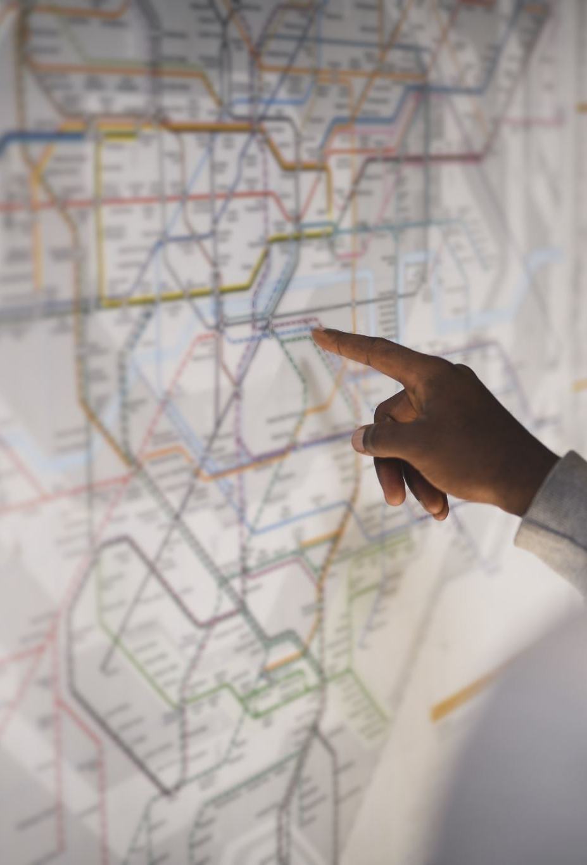
Location Tracking and querying
Use of google maps API along with android studio location tracking to show users location on a map
Use of python script to clean crime data along with using android studio to compile locations of crimes in Cardiff and then plot on heatmap
Use of Google's geoCoder to query user inputs and plot query location on map

Slide 6

GPS and Google Maps API Integration
Seamless integration of Google Maps API into the application
Coding in Java for a reliable and versatile foundation
Display of the user’s current location on the map
Text input for the destination addresses
Route planning from the user’s location to the destination specified

Slide 7
Address Input and Geolocation
Flexible address input for improved user experience
Intelligent geolocation algorithms to interpret user input
Accurate location data retrieval for the desired destination
Convenient route planning with a single click

Slide 8

Dynamic UI and Adaptability
Intuitive user interface designed for ease of use
Dynamic adaptation to various screen sizes and device orientations
Ensures optimal display and functionality across different Android devices
A seamless user experience, regardless of the Android device used

Slide 9

Map View Heatmap
Utilises data obtained from South Wales Police website to display a heatmap of local crime in Cardiff area
Accurate latitude and longitude of each crime reported is used to create the heatmap
Higher traffic areas are shown in red/orange and lower traffic areas are clear/green
Toggle allows users to see/hide the heatmap as per their discretion

Slide 10

SOS and Emergency Contact
Homepage has a big SOS button that is held down to activate SOS
When an SOS is triggered, a text is sent to the emergency contact, similar to when an accelerometer anomaly gets detected
(Emergency contact feature not fully implemented and we couldn’t get the text to send location yet)
(App also asks for permission to send SMS when an emergency happens but in practice when the app is installed this permission should be resolved then instead)

Slide 11
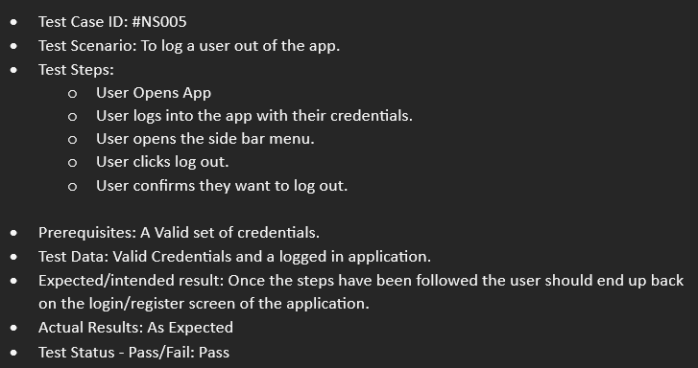
Testing
In-house Debugging
Test cases
Course-mates Testing
Proposed Beta Testing
Notes:
Our main source of testing throughout the project has been in-house debugging, which we conducted as and when we created new features. This was to keep in line with our agile approach to the project. For example, when a new feature was implemented and integrated with the main app prototype, we would then conduct extensive in house testing on that feature before beginning to implement the next feature.
We conducted this testing uses test cases, you can see an example on the screen, these cases allowed us to track and recreate any bugs we discovered and subsequently fix them.
We also used friends and colleagues on our course to test the app to see if they could find any issues with the design to features
Finally, we had proposed to do open beta testing where the app would be released to a control group, however this didn’t happen to do delays with ethics clearance.

Slide 12

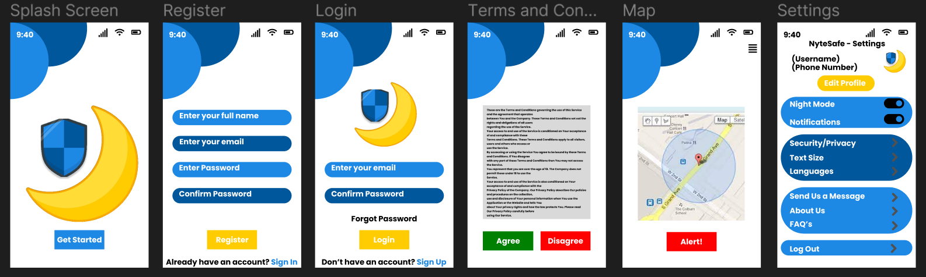
App Logo and Design
Moon=night, shield=safety, red=danger, green=safe
Blue=trust, yellow=positivity
Main pages=start up, registration, log in, T&C’s, home screen, settings.
Maintain theme throughout app
Easy to navigate (drunk users)

Slide 13
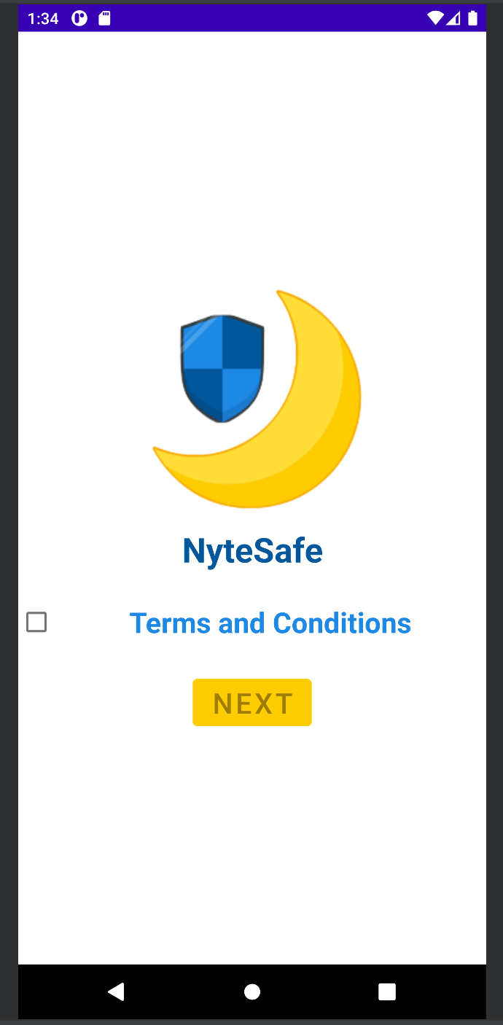
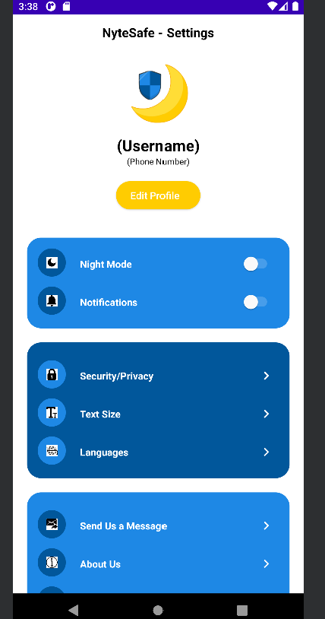
Further Design Ideas
Some extra design ideas that we had in mind for the application

