Slide 1
An EPSRC Perspective on ‘Big Data / Data Analytics / Data Science / …..’
17 November 2015
Miriam Dowle, Portfolio Manager, EPSRC ICT Theme

Slide 2
Summary
Introduction and some context
Doctoral training in this area
ICT Theme specific activities
Cross-SAT workshop outputs
Some questions for you …

Slide 3
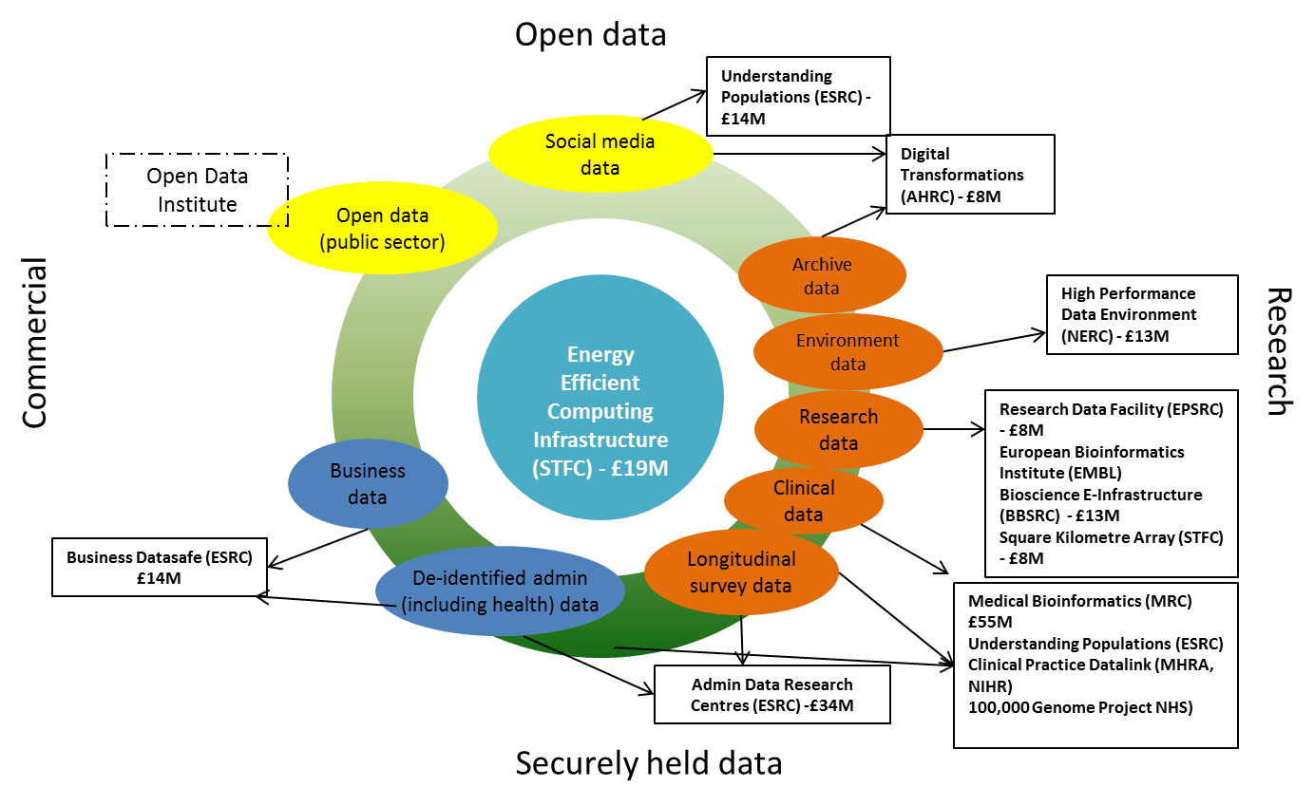
RCUK ‘Big Data’ Landscape
Notes:
received £189M for Big Data Capital in Autumn Statement 2012

Slide 4
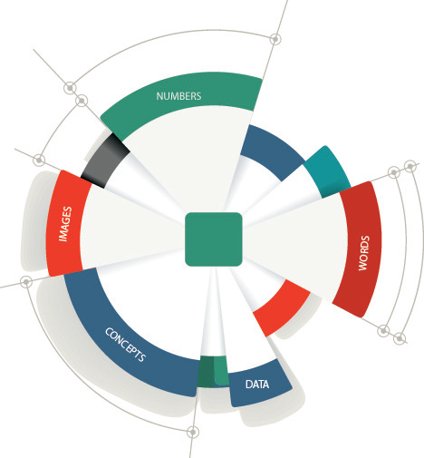
Big Data: Big Opportunity
We cannot make sense of Big Data without new tools and methods to harvest, structure and analyse it. The full value of
Big Data will only be realised through fundamental research in engineering, mathematics and computer science
Sir Nigel Shadbolt, Professor of Artificial Intelligence, University of Southampton, and Chairman of the Open Data Institute¹
The Big Data era has only just emerged
but the practice of advanced analytics
is grounded in years of mathematical
research and scientific application
McKinsey, How Big Data Can Improve Manufacturing, July 2014
Big Data provides a unique opportunity
to deliver better healthcare at
lower cost
Sir John Bell, Regius Professor of Medicine,
University of Oxford
Analysing, simulating and visualising complex data plays an important role in our business, and will continue to expand in the future
Dr Wolfgang Epple, Director for Research and Development, Jaguar Land Rover
The Big Data marketplace could
benefit the UK economy by £216 billion and
create 58,000 new jobs in the UK before 2017
Centre for Economics and Business Research
¹EPSRC High Level Position Statement: Big Data – Big Potential 2015
Notes:
EPSRC published a high level position statement on big data earlier this year. This is a rapidly growing area of immense importance to the UK, where the role of mathematical sciences, ICT, etc is crucial to ensure the UK harnesses the benefits

Slide 5
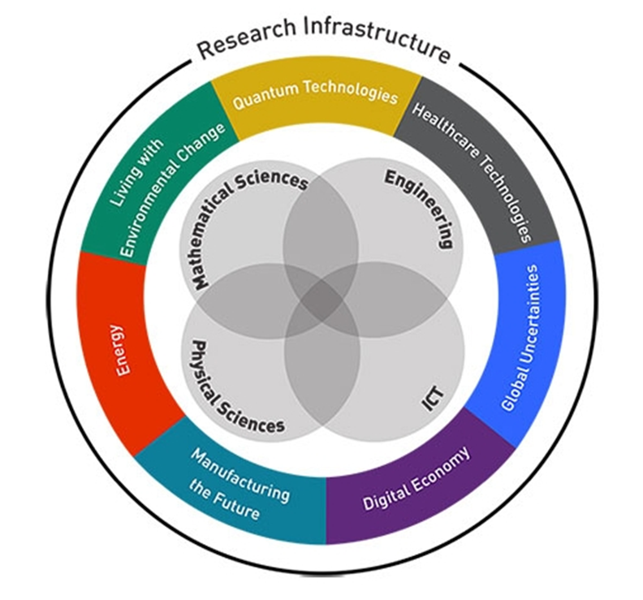
Where does ‘Big Data’ fit within the EPSRC Themes?
Notes:
Some Themes can support the development of new techniques in data science, some can support the application of these – all are relevant in some way

Slide 6

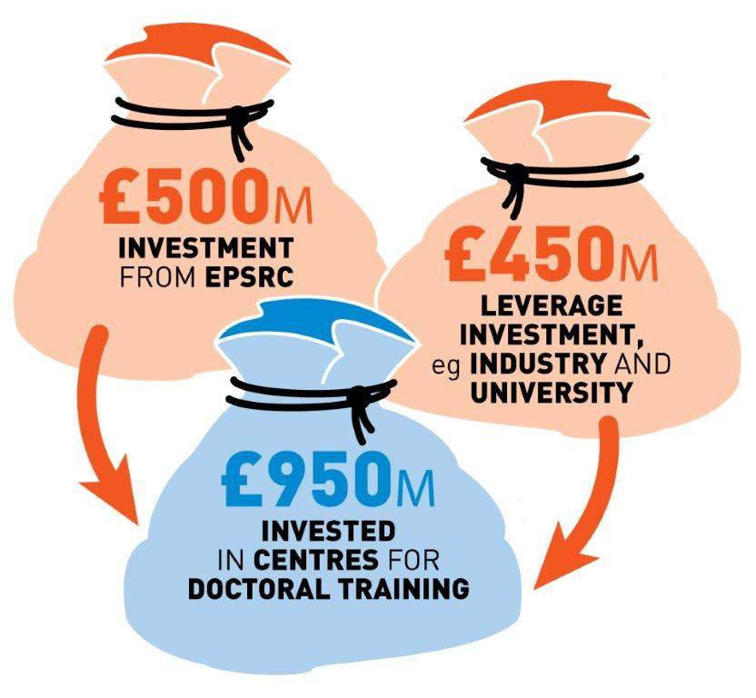
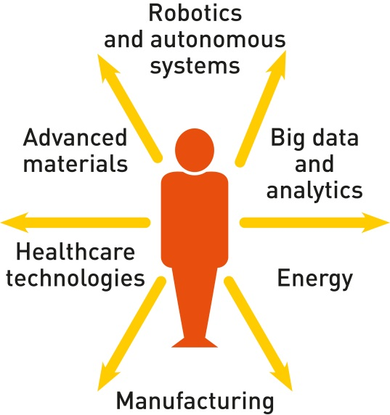



EPSRC Centres for Doctoral Training
Notes:
General slide on CDTs –producing potential ‘data scientists’

Slide 7
EPSRC Centres for Doctoral Training
Data to Knowledge priority area:
The rapidly increasing scale, complexity and diversity of data generated by modern technologies, combined with the increased accessibility to data provided by open-data initiatives, has the potential to provide wide-ranging societal and economic benefits. Creating value from raw data to create new knowledge requires the development of new scalable approaches to capturing, storing, managing, analysing and visualising large-scale, complex and diverse data from multiple sources. In addition, societal concerns around data provenance, security, trust and accountability will need to be addressed.
8 CDTs of direct relevance to this were funded
Notes:
Several CDTs that have direct relevance to Big Data and the Data to Knowledge priority area

Slide 8
EPSRC Centres for Doctoral Training relevant to ‘Data Science’
My Life in Data, Professor Steve Benford, University of Nottingham
Financial Computing & Analytics (covering Computational finance, Financial ICT, Regulation, Retail), Professor Philip Treleaven, University College London
Data Science, Professor Chris Williams, University of Edinburgh
Urban Science and Progress, Professor Stephen Jarvis, University of Warwick
Cloud Computing for Big Data, Professor Paul Watson, Newcastle University
Statistical Applied Mathematics at Bath (SAMBa), Professor Andreas Kyprianou, University of Bath
Next Generation Statistical Science: the Oxford-Warwick Statistics Programme, Professor Christopher Holmes, University of Oxford
Statistics and Operational Research, Professor Jonathan Tawn, Lancaster University
Notes:
Here is a list

Slide 9
ICT Theme actions in this area
‘Towards an Intelligent Information Infrastructure’ (TI3) Cross-ICT Priority from April 2011 – April 2016
‘A future information infrastructure needs to intelligently manage massive amounts of data, ensure efficient communications and exploit the content and information that will be available’
Three targeted calls have been launched – one being ‘Making Sense from Data’
Several programme grants and fellowships contributing to this priority

Slide 10

ICT Perspectives on Big Data Analytics Workshop
ICT Perspectives on Big Data Analytics Workshop held in March 2015 where the main research challenges identified were:
dealing with heterogeneous data
algorithms to interrogate data
storage and communication of data
human interaction with data
data security
Workshop report has now been published online.

Slide 11
EPSRC Cross-SAT Big Data Workshop
A meeting was held with strategic advisors from the Mathematical Sciences, ICT, Digital Economy, PaCCS, Research Infrastructure and Manufacturing Themes in August 2015.
Four main research priorities were identified:
Trust, Identity, Privacy and security for Big Data
Contextual Data Capture and Exploitation
Connecting up the data threads
Maths, Algorithms and Machine Learning across Scales
The outputs of this workshop will be considered during our planning for the next EPSRC Delivery Plan and have been published online.

Slide 12

Some questions …
What is ‘Data Science’? Would you call yourself a Data Scientist?
What should the balance of research and support be between ‘data analytics’ and ‘data management’?
A key point that keeps coming up is around the need for skilled people – but at what level do these skills need to be?
Any questions for me?
Miriam Dowle
miriam.dowle@epsrc.ac.uk
01793 444321

Slide 13
The ICT Team
Liam Blackwell | Theme Lead
Nigel Birch | DSP; Music & Acoustics
Zoe Brown | Graphics, Image, Vision & Speech; Biological Informatics
Lisa Coles | HCI, Pervasive and Ubiquitous Computing
Anke Davis | Fundamentals of Computing
Miriam Dowle | Information Systems, Databases and Software Engineering
Ellie Gilvin | Electronics
Diane Howard | AI, NLP
Alex Hulkes | Cybersecurity
Matthew Scott | Communications
Susan Peacock | Photonics
firstname.lastname@epsrc.ac.uk
Notes:
Star next to name or some such

