Slide 1
A little about me

Slide 2
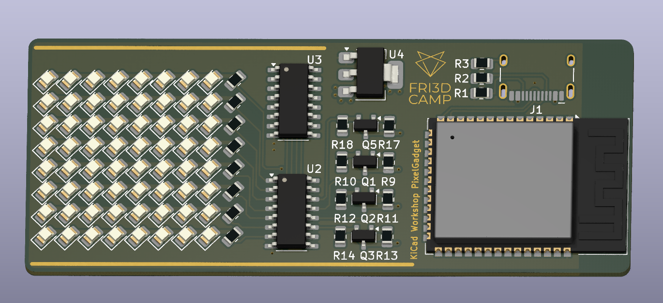
What will we do today?
This! (hopefully)

Slide 3
Why KiCad?
KiCad
  Free and open source
  Not too many features
  Plugins
  Mature software
  Good backing and support

Slide 4
Workshop
Start with schematic
We will make an LED gadget
  ESP32
  WS2812B
  USB-C
  Sensors
Schematic
PCB manufacturer rules
PCB layout
Design rule checks
Manufacturing

Slide 5
Workshop
Download template project
  Add a schema page
  Add LED
  Add to main schematic
  Add sensor to main schema
Schematic
PCB manufacturer rules
PCB layout
Design rule checks
Manufacturing

Slide 6
Schematic tips
Reads like test, from left to right
  Inputs on the left
  Outputs on the right
Reuse blocks for repetitive items
  Brings structure
Text annotations and rectangles help
  Makes it easier to understand
  Makes it more organized
Schematic
PCB manufacturer rules
PCB layout
Design rule checks
Manufacturing

Slide 7
Manufacturing rules
Few options
  Aisler
  JLCPCB
  PCBWay
  Eurocircuits
  ...
Schematic
PCB manufacturer rules
PCB layout
Design rule checks
Manufacturing

Slide 8
Manufacturing rules
Look up rules
  Aisler for example
    Via size most important
    Track spacing
    KiCad default rules are good for most 2L boards
Schematic
PCB manufacturer rules
PCB layout
Design rule checks
Manufacturing

Slide 9
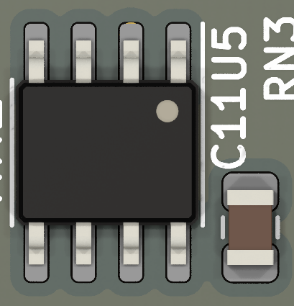
Layout tips (power)
Capacitors go close to device
  Good decoupling
Use via stitching on large PCB
  Ensure good ground connection over entire PCB
Use power & ground planes
  Make a very strong connection to power pins
Schematic
PCB manufacturer rules
PCB layout
Design rule checks
Manufacturing

Slide 10
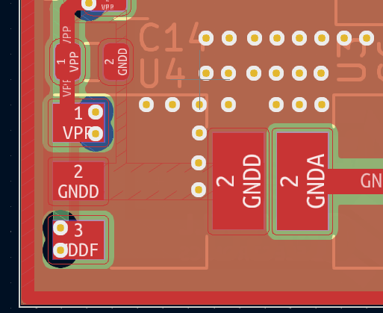
Layout tips (thermal)
Use lots of vias to sink heat away
  If component expected to be hot
Always use ground plane for PCB
  Helps with heat
Schematic
PCB manufacturer rules
PCB layout
Design rule checks
Manufacturing

Slide 11
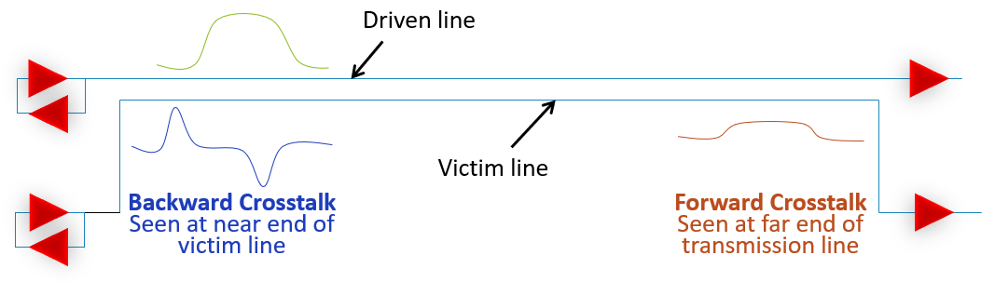
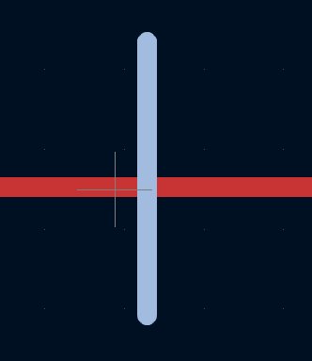
Layout tips (sensitive signals)
Use ground plane for shielding
Minimize wire crossings, cross at 90° if possible
  Minimize crosstalk
Schematic
PCB manufacturer rules
PCB layout
Design rule checks
Manufacturing

Slide 12
Layout tips (manufacturing)
Rounded PCB corners decrease risk of delamination
Set good design rules
Use ground planes to fill copper
  Improves copper uniformity
Schematic
PCB manufacturer rules
PCB layout
Design rule checks
Manufacturing

Slide 13
DRC checks
Check that PCB adheres to design rules
  Checks that manufacturing is possible
  Does some additional checks, like accidental shorts
Schematic
PCB manufacturer rules
PCB layout
Design rule checks
Manufacturing

Slide 14
Manufacturing
Export gerber files
  Submit .zip to manufacturer
Choose manufacturing options
Schematic
PCB manufacturer rules
PCB layout
Design rule checks
Manufacturing

