Slide 1

AI reinvention made real
Accenture Innovation Challenge 2026

Slide 2
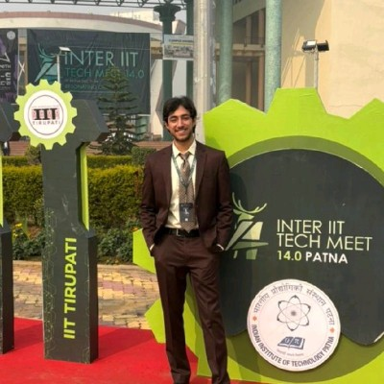
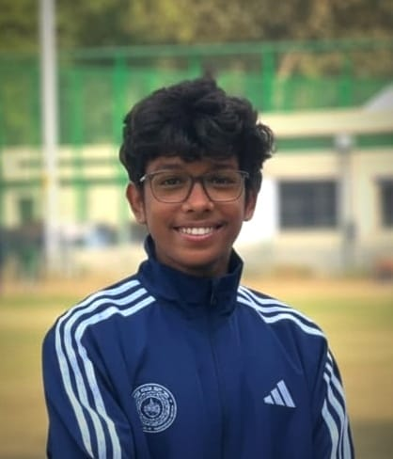
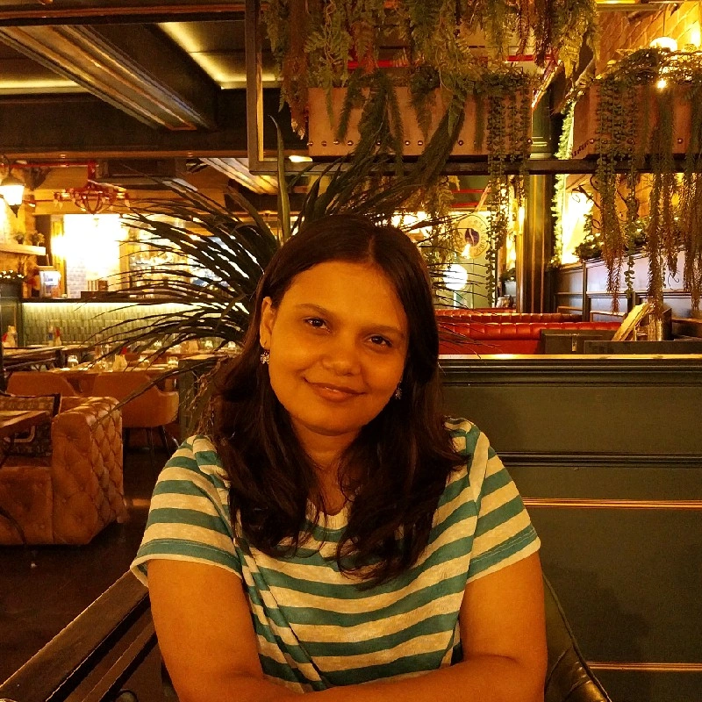
Team details
TEAM NAME: | Sentinel
Ishan Kamboj (Team Leader)
Ayush Gaud
College: IIT Kanpur
Stream: Aerospace Engineering
Year of graduation: 2027
College: IIT Kanpur
Stream: Aerospace Engineering
Year of graduation: 2027
Aditi Arya
College: IIT Kanpur
Stream: Civil Engineering
Year of graduation: 2027

Slide 3
1. Problem framing
Emergency triage is a two-minute call, made on thin data, while more patients keep arriving. It is not a clean ranking problem.
Age changes every number
A heart rate of 150 is an emergency in a calm adult and almost normal in a distressed toddler.
One adult-calibrated scale silently misreads children and the elderly.
Intake data is uneven
About half of arrivals have useful history on file; the other half are effectively strangers.
Tools that assume rich records fail worst on the people they know least.
Under-triage can kill
Over-triage only wastes some capacity, but missing a critical patient can be fatal.
Stroke, STEMI, and sepsis have treatment windows measured in minutes.
It does not end at the desk
Patients keep deteriorating in the waiting room, exactly when the department is busiest.
A score-once tool forgets them, so someone has to keep watching.
The real job is not average accuracy. It is to stay safe under sparse data and time pressure, keep watching the people who are waiting, and leave the final call to a clinician.
Team Sentinel | PatientTriage.ai | Accenture Innovation Challenge 2026
3

Slide 4
2. Solution overview
Sentinel recommends urgency and placement. A Gemini agent reasons with tools. A clinician makes the final call. No diagnosis, treatment, or discharge.
PRIMARY PATH
1
2
3
4
5
Intake
Note and vitals
Agent state
Case memory
Gemini agent
Reasons + tools
Recommend
ESI 1 to 5
Clinician
Final authority
HOW IT STAYS SAFE
Agent reasons
• Observes, picks tools, then recommends
• Can ask for more info or escalate
• Never invents missing data
Watcher keeps watch
• Monitors patients still waiting
• Wakes reassess on unsafe wait or worse vitals
• Never owns the final clinical call
Uncertainty stays visible
• Escalate when unsure; under-triage is worse
• Low confidence routes to nurse review
• Sparse notes can refuse a firm score
Fallback only
If the agent fails or times out, age-banded rules cover baseline and offline continuity. They never overwrite a valid agent recommendation.
Team Sentinel | PatientTriage.ai | Accenture Innovation Challenge 2026
4

Slide 5
3. Data strategy and decision model
Built for incomplete intake, not the average chart. The Gemini agent decides; rules support, never silently override.
Data strategy
• Design for sparse arrivals. Missing fields lower confidence; they are never invented.
• When present: age, sex, arrival, complaint, pain, AVPU, vitals, onset, history, meds, allergies, prior-record flag.
• Weigh life-threat and age-banded danger-zone vitals first. Stroke, STEMI, and sepsis open clocks.
• About half the cohort has prior history, half does not. Zero-history walk-ins go to nurse review.
• Notes parse to structure. If the model is off or wrong, a rule parser keeps the desk moving.
Decision model
• Gemini agent is primary: tools, priority 1 to 5, confidence, and evidence.
• May request more information or escalate instead of guessing mid acuity.
• Rules are fallback only: baseline, offline continuity, auto-use on failure or timeout.
• A valid agent recommendation is never overwritten by the rules layer.
• Uncertainty stays visible. Thin mild notes can refuse a firm score. Eval compares agent, baseline, and clinician.
Invariants
Danger-zone vitals only push urgency up · Watcher never softens priority · Override / modify needs a reason · Original agent recommendation stays intact
Team Sentinel | PatientTriage.ai | Accenture Innovation Challenge 2026
5

Slide 6
4. Workflow and safety-first design
WORKFLOW
At the desk
The live board lists everyone waiting, most urgent first, with confidence and flags.
Open a patient to see evidence, gaps, and the baseline comparison.
Act in seconds: accept, modify, override, request more, or escalate.
Intake
A nurse pastes a short note with age, vitals, and a description.
One click parses it into structured fields and scores it.
Review the recommendation, or the needs-more gate, then add to the board.
Waiting room
The Watcher keeps scanning everyone who is still waiting.
It wakes a reassessment on unsafe wait time or worsening vitals.
It only escalates, and never softens priority because the floor got busy.
SAFETY RULES
Escalate when unsure
Upward-only ratchet
Clinician always final
Immutable audit trail
Team Sentinel | PatientTriage.ai | Accenture Innovation Challenge 2026
6

Slide 7
5. Prototype proof points
Phase 0, working in this repo on simulated data
WHAT'S ALREADY BUILT
25-patient synthetic board, most urgent first, live at the root URL.
Hard cases covered: ambiguous elder, febrile toddler, atypical geriatric MI, zero-history walk-in.
✓
✓
3x surge toggle plus a Watcher that catches a deteriorating waiter (P-011).
Confidence on every score. Low confidence routes to a nurse; thin notes can abstain.
✓
✓
Clinician override and modify with a required reason, on an append-only audit trail.
Age-banded vital thresholds, shown against the patient's own age band.
✓
✓
HIPAA (US) assumed. Non-Device Clinical Decision Support: it recommends, it does not command.
Posture
Team Sentinel | PatientTriage.ai | Accenture Innovation Challenge 2026
7

Slide 8
6. Target users
WHO USES IT
Triage nurse
The everyday user, working under real time pressure.
Gets a fast, explained starting point and clear confidence.
Accepts or adjusts in seconds without fighting the UI.
Charge nurse
Owns patient flow when the department is under load.
Sees who is waiting, who is overdue, and where surge is building.
The board and surge view are built for this role.
Emergency physician
Needs a defensible rationale behind each call.
Watches running clocks for time-critical syndromes.
Gets a clean record of every change and the reason for it.
CMO and CNO for safety and liability. Operations for throughput and LWBS. CIO and CISO for integration and security.
Buyers
Team Sentinel | PatientTriage.ai | Accenture Innovation Challenge 2026
8

Slide 9
7. Business case and impact
Assumed setting: US emergency departments, about 100 to 500+ visits a day, ESI-style acuity, HIPAA. Figures are illustrative, not a quote.
Safety
PRIMARY
Cut under-triage of high-acuity patients. Age-aware vitals, escalate-when-unsure, and waiting-room monitoring attack the failure that matters most to a CMO. Even a small reduction in missed critical cases dominates the cost of the system.
Throughput
HUNDREDS/YR
Faster, consistent first pass plus active re-check of the queue. At a mid-size site of about 40,000 visits a year, a one-point cut in leave-without-being-seen keeps hundreds of patients in care instead of walking out.
Time-critical
MINUTES
Running clocks for stroke, STEMI, and sepsis surface treatable windows earlier. We do not invent site-specific minute savings; the product is built so those windows are hard to miss.
Cost to run
Gemini is optional, cached, and iteration-capped. Quiet Watcher ticks skip model calls. With the model on, AI cost is a fraction of a cent per patient; with it off, the desk still runs on deterministic fallback.
Commercial model
Per-department annual SaaS, tiered by visit volume. Pilots priced low or free in exchange for validation data and a reference site. The first credible outcomes study is worth more than year-one revenue.
Team Sentinel | PatientTriage.ai | Accenture Innovation Challenge 2026
9

Slide 10
8. Adoption, compliance, and scale
Adoption, privacy, and scale are treated as product work, not afterthoughts.
Adoption
• Shadow mode first: score beside triage, change nothing.
• Clinician in charge, always, with a reason on overrides.
• Fight alert fatigue: risk-weighted alerts, abstain on thin notes.
• Fit the existing two minutes, do not add clicks.
Compliance
• HIPAA (US) assumed; audit and retention follow it.
• Minimize PHI to the model; BAA or on-prem option.
• Model-off mode loses none of the age-banded logic.
• Non-Device CDS: recommend, never command.
Scale
• Same core, different config, not forks.
• Age bands, safe-wait tables, and surge multipliers.
• Deterministic path is light enough for a hospital VM.
• Read-only shadow first, deeper write-back later.
Team Sentinel | PatientTriage.ai | Accenture Innovation Challenge 2026
10

Slide 11
9. Roadmap and risks
ROADMAP
Phase 0
Prototype, done
Phase 1
Shadow pilot
Phase 2
Supervised live
Phase 3
Multi-site
Phase 4
Evidence moat
RISKS AND MITIGATIONS
A wrong recommendation contributes to harm
Escalate under uncertainty, keep the clinician final, and run shadow mode before any live use.
The agent sounds sure on thin data
A needs-more gate, confidence bands, and deterministic fallback when the model fails or times out.
Alerts get ignored (alert fatigue)
A risk-weighted Watcher budget with a required reason on every escalation.
Privacy or medical-device exposure
HIPAA controls, a transparent decision-support posture, and counsel before clinical use.
Team Sentinel | PatientTriage.ai | Accenture Innovation Challenge 2026
11

Slide 12
10. The ask
THE ASK
To turn a working prototype into a validated tool, we need three things.
1. Partner ED
One emergency department willing to run Sentinel in shadow mode,
scoring beside real triage while changing no decisions at first.
2. Read-only access
Records and flow data over standard health-data interfaces,
enough to score patients and measure agreement, nothing more.
3. Clinical champion
A clinician to help tune thresholds to the site,
and to interpret where the assistant and the desk disagree.
The site gets an early, safe view of its own mistriage and crowding, and a real say in how the assistant behaves.
In return
Safe when it is unsure. Always watching the people who wait. The clinician always decides. That is the product Round 2 asked us to prove.
Team Sentinel | PatientTriage.ai | Accenture Innovation Challenge 2026
12

Slide 13
Thank you

