Slide 1


Session types: Asynchronous in-place
These session type cards were produced by Jisc for the Beyond Blended project to support curriculum and course design. There are four sets of cards, one each for the four ‘modes of participation’ in learning.
For more about the modes, visit the Beyond Blended web guide
This document is made available under CC BY NC SA

Slide 2
About these cards
The cards can be used in a curriculum design workshop or course meeting, to:
Plan sessions and activities
Consider a wider range of session types
Ensure a balance of session types to meet different needs
Describe new session types and activities (beyond those described here)
The activity icons included on each card are from the ABC Learning Design resources, licensed CC BY-NC-SA 4.0, Clive Young and Nataša Perović, UCL (2015), Learning types, Laurillard, D. (2012). Original resources at abc-ld.org. We are grateful for permission to use the icons in this way.
ABC Learning Design is a collaborative programme and module design method created at University College London (UCL) and used widely across the sector. It enables programme and module teams to develop a storyboard visualising the learner journey based on their activities through the course of study. The ’session type’ cards can be used to consider how activities may be undertaken in different sessions and modes, linking these cards to the ABC design process.

Slide 3
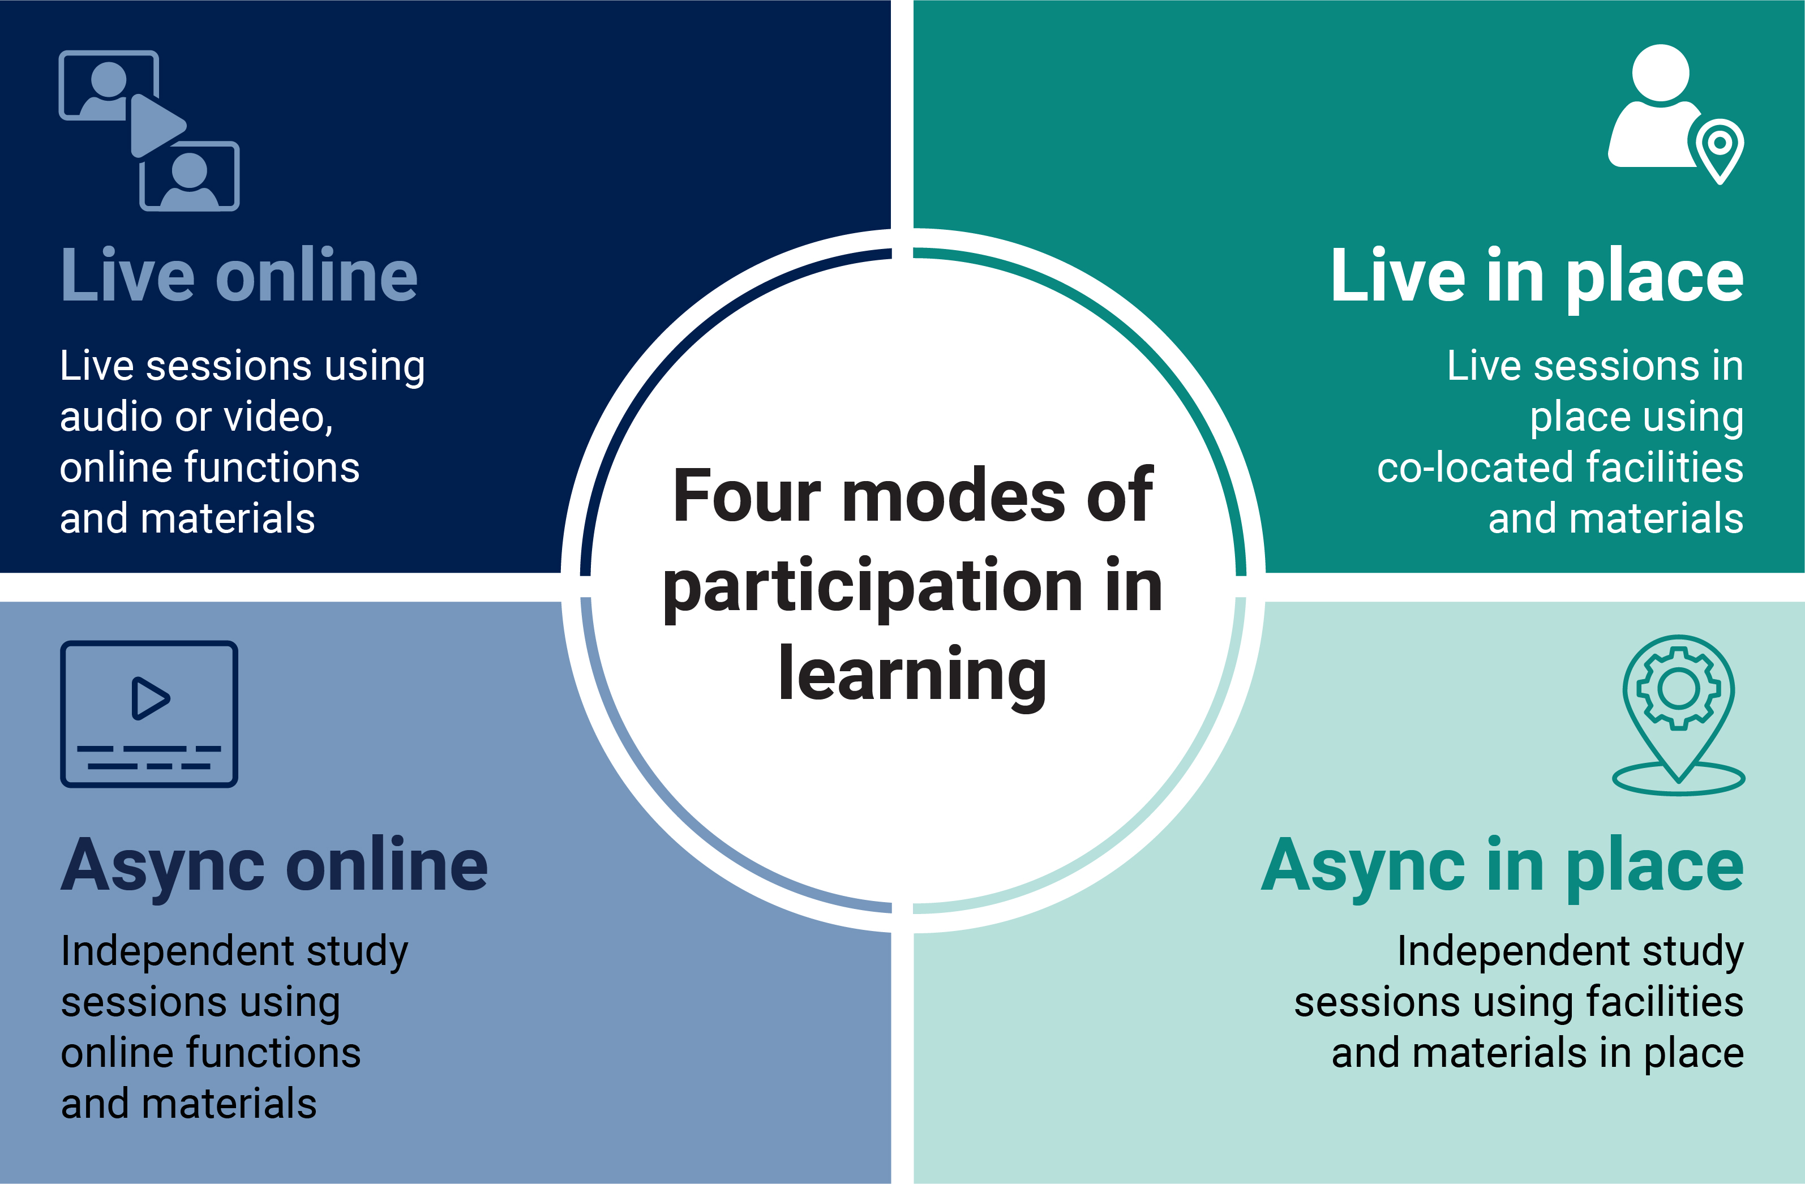
Four modes of participation in learning

Slide 4

Asynchronous
Asynchronous learning
Students usually choose time and place, pace and path
Can be experienced by students as more: self-directed, independent and demanding
Can be experienced by students as less: supportive and structured
Supports extended knowledge building and iterative learning processes, including collaborative
Supports preview and preparation, review and reflection
Tasks may be more or less structured as learners gain independent/collaborative study skills
Learning materials may help structure the session, but students need task and time management
Collaborative learning is still valuable but requires students to self-organize and/or have access to learning spaces at times to suit them

Slide 5
Asynchronous in place
In-place learning
Can be experienced by students as more: authentic, responsive and interpersonal
Can be experienced by students as less: reflective, private and convenient
Some students may find accessing in-place learning more difficult than others
Material environment may support learning directly, or may provide facilities that support learning
Room design and configuration shapes learning interactions and group dynamics
Both informal spaces and bookable rooms should be available for students to use outside of class times
Devices and networks should be available to students free or at minimal cost
Facilities should allow students to record, make notes, share screens, access software and library resources

Slide 6

Recorded lecture
Features
Students watch or review a lecture in their own time and place
Review may be solo or in a group (i.e. a ‘watch party’)
Pedagogic benefits
Students can focus on areas of the content that they need to review
Students can review content as often as they like, solo or with peers
Students can use preferred interface eg transcription, audio description
Places and facilities
Recording facilities in lecture
Room with screen(s) for watching back
Optionally:
Annotation
Transcription
Description
Discussion with peers
Typical activities and interactions
Students watch (acquire); they may make notes (organise, review)
Students may discuss with peers (discuss)
Recordings may include questions, micro-tasks (respond, solve, produce)
Acquisition

Slide 7
Practice session
Features
Students practice a method or procedure
Activities set by tutor; time and pace set by students
Practice may be informal, iterative, or accredited
Pedagogic benefits
Learning in specialist environment such as a lab, practice room, studio or field site
Students control time, pace and frequency
Develops self-direction and relevant skills
Places and facilities
Specialist environment (lab, studio etc)
Facilities may include:
Recording facility
Guidance (eg how-to videos)
Specialist devices, instruments, interfaces and software
Typical activities and interactions
Practice specialist skills (practice)
May be used to review performance (reflect, review)
Peers may be present to provide support and feedback (review)
Practice

Slide 8
Study session (research focus)
Features
Students undertake research in their own time and chosen location
Research may be primary (data/evidence collected) or secondary (existing literature or data used)
Pedagogic benefits
Independence, self-direction, time and task management
Relevant study skills including research and data skills
Convenience for students and any research subjects
Places
Library or study area
Data model or simulation
Data collection site
Facilities may include:
(Connection to) archive, catalogue, index, collection
Data and data sets
Instrument(s), data recording device(s)
Surveys
Data analysis
Reference management
Typical activities and interactions
Formulate questions, search terms
Explore materials (acquire, enquire)
Collect and organize data (inquire)
Analyse data (solve, analyse)
Manage data, references, notes
Investigation

Slide 9
Self-organised groupwork session
Features
Small group session organised by student(s)
May focus on specific project or assignment, general study or revision
Pedagogic benefits
Informal collaboration has many learning benefits
Students determine time and pace
Students may also determine group composition, tasks and roles
Places
Bookable or informal study space
Functions may include:
Recording
Note-making
Collaborative design space or shared document
Typical activities and interactions
Students share work and receive feedback (review)
Students plan their learning (plan)
Students generate notes, record processes, review outcomes (organise, reflect)
Student ask for and receive support
Discussion

Slide 10
Mixed-mode: augmented reality session
Features
Students participate in real time in an augmented reality setting
Pedagogic benefits
Interactive and engaging
Can involve teamwork
Can involve settings not otherwise available to students
Place and platform
Real-world location
Subject-specialist scenario, simulation
Features may include:
Wearables, headsets
Screens, input-output devices
In-world materials, resources, guides
Typical activities and interactions
Students explore setting
Students may solve problems, investigate situations, devise solutions (practice)
Investigation
Practice

Slide 11
Describe your own asynchronous in-place session
Features
List of features
Pedagogic benefits
List of benefits
Platform
Platform detail
Functions may include:
Function detail
Typical activities and interactions
Activity detail
Production
Practice
Investigation
Discussion
Collaboration
Acquisition

