Slide 1


Session types: Asynchronous online
These session type cards were produced by Jisc for the Beyond Blended project to support curriculum and course design. There are four sets of cards, one each for the four ‘modes of participation’ in learning.
For more about the modes, visit the Beyond Blended web guide
This document is made available under CC BY NC SA

Slide 2
About these cards
The cards can be used in a curriculum design workshop or course meeting, to:
Plan sessions and activities
Consider a wider range of session types
Ensure a balance of session types to meet different needs
Describe new session types and activities (beyond those described here)
The activity icons included on each card are from the ABC Learning Design resources, licensed CC BY-NC-SA 4.0, Clive Young and Nataša Perović, UCL (2015), Learning types, Laurillard, D. (2012). Original resources at abc-ld.org. We are grateful for permission to use the icons in this way.
ABC Learning Design is a collaborative programme and module design method created at University College London (UCL) and used widely across the sector. It enables programme and module teams to develop a storyboard visualising the learner journey based on their activities through the course of study. The ’session type’ cards can be used to consider how activities may be undertaken in different sessions and modes, linking these cards to the ABC design process.

Slide 3
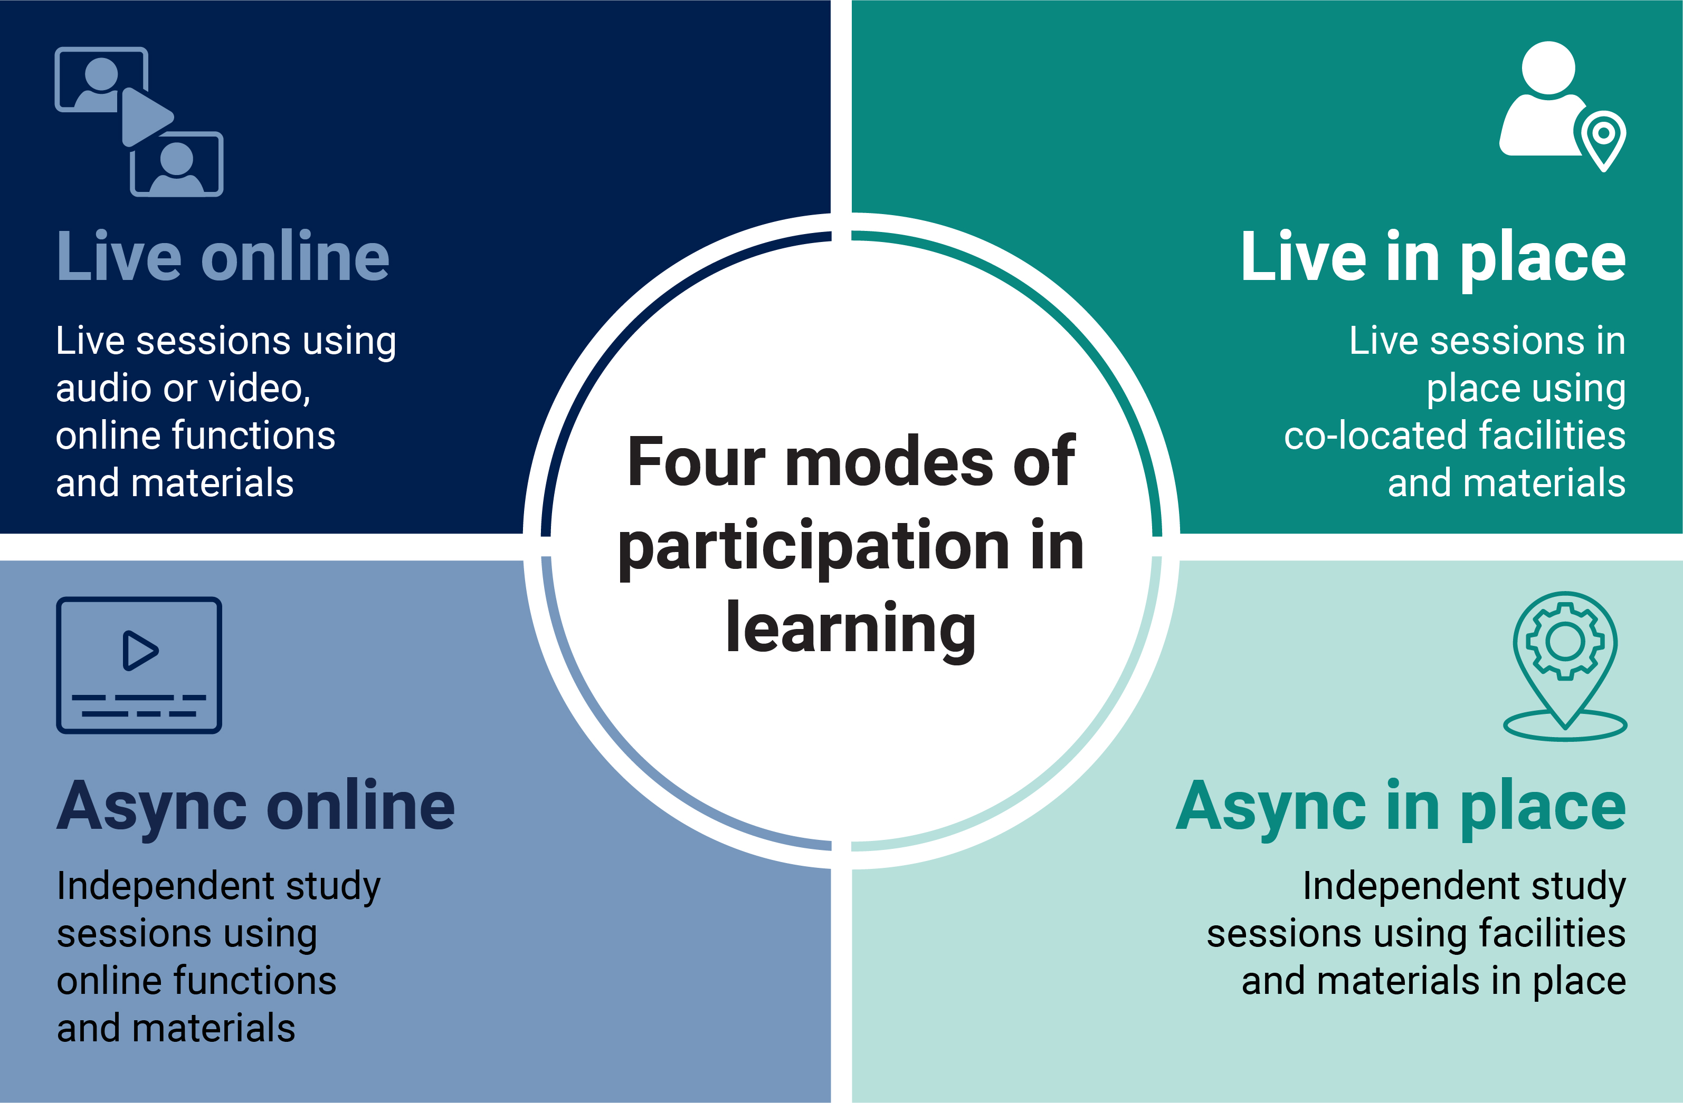
Four modes of participation in learning

Slide 4

Asynchronous
Asynchronous learning
Students usually choose time and place, pace and path
Can be experienced by students as more: self-directed, independent and convenient
Can be experienced by students as less, dynamic, supportive and engaging
Supports extended knowledge building and iterative learning processes
Supports preview and preparation, review and reflection
Tasks may be more or less structured as learners gain independent study skills
Learning materials are used to provide structure, pace and interactivity
Requires task and time management
Collaborative learning is still valuable but requires iterative engagement and can be time consuming

Slide 5
Asynchronous online
Online learning
Can be experienced by students as more: explicit, reflective and convenient
Can be experienced by students as less: responsive, (inter)personal and engaging
Online environment may be specialist or generic
Platform shapes roles and interactions; rules and norms may need to be negotiated explicitly
Some students benefit from a slower pace, more explicit rules and diverse ways to engage
Learning naturally produces a trace or record (some students may be concerned about this)
Easy to share materials, ideas and work in progress; contributions are easy to track
Allows learning beyond the classroom eg external exchanges, virtual site visits, public pedagogies

Slide 6

Asynchronous discussion
Features
Students participate in discussion using a text-based environment
Teacher as facilitator: establishes theme, poses questions, amplifies points
Students share information, arguments, clarifications, further questions, responses
Learners may be asked to research content or prepare arguments in advance
Pedagogic benefits
Shared knowledge building
Clear record of contributions and exchanges
Time to reflect
Iterative engagement
Possibility of extending to public spaces
Places
Online discussion environment OR
text-based social media (usually closed group)
Facilities may include:
Messaging media
Targeted (person to person) chat
Shared document(s)
Annotation tool
Public space (wiki, social media)
Media attachments
Sub-groups
Typical activities and interactions
Discussion (discuss)
Pre-discussion research (acquire, enquire)
Students may facilitate and support discussion (collaborate)
Open/public discussion allows students to explore ideas further (explore)
Discussion

Slide 7
Virtual practical or lab session
Features
Students practice a method or procedure
Activities set by tutor; time and pace may be set by students
May be preparation for live practical, or may support practice in safe/consistent environment
Pedagogic benefits
Learning from specially designed environments
Safe, consistent and repeatable
Highly relevant subject-specialist skills
Platforms and functions
Specialist virtual environment (lab, ward, studio etc)
Facilities may include:
Virtual instruments
Models and simulations
Guidance (embedded or free-standing, how-to videos)
Recording practice for assessment/review
Typical activities and interactions
Activities similar to real-world practice OR gain skills in specialist virtual environment (practice)
Explore inputs and outcomes (inquire)
May be used to prepare (plan)
May generate notes, recordings (organise, review)
Practice

Slide 8
Virtual fieldwork or site visit
Features
Educator as guide and facilitator
Students gain experience of context or environment via virtual platform(s)
May be used to prepare for visit to real world site, or as an alternative
Pedagogic benefits
Convenient, equitable access in students’ own time
Intrinsic learning and feedback from environment
Safe, consistent experience; can be repeated as needed
Access to wider range of sites
Platforms and functions
Specialist virtual environment, ideally interactive/immersive
Functions may include:
Video, multi-media resources
Virtual tools or instruments for acting in-world
Preparation and guidance media
Typical activities and interactions
Students study environment (investigate)
Students practice methods in situ (practice, produce)
Students record processes and data (reflect, review)
May solve problems or undertake research tasks
Investigation

Slide 9
Study session (content focus)
Features
Students access course materials online to learn new concepts, plan, prepare, review, revise, make and organise notes, do tasks and assignments
Materials may be more or less structured; tasks may be more or less open-ended
Pedagogic benefits
Independence, self-direction, time and task management
Student preferences and needs to the fore eg study with peers, solo, in preferred locations and sensory environments
Multiple media can support different learning needs and approaches
Platforms and functions
Virtual/personal learning environment with eg
e-books and journals
digital images
videos, animations, podcasts, web pages, wikis, blogs
data sets
interactive maps, timelines
subject specialist courseware
quizzes and tests
study apps
tasks, success criteria
Typical activities and interactions
Explore content (acquire, enquire)
Review notes, references, recordings (review, organise)
Prepare assignments (produce)
Optionally, collaborate around study tasks (collaborate)
Production

Slide 10
Learning support (asynchronous)
Features
Educator as tutor or mentor
One-to-one or small group session focused on student progress
Typically accessed or initiated by student
Confidentiality and trust are critical
Pedagogic benefits
Just in time, as needed support
Student paced
Time to reflect on progress, practice skills
Low pressure, students may experience less anxiety than f2f or live online sessions
Platforms and functions
Confidential (closed) text-based environment OR private communication medium eg email, chat
Functions may include:
Messaging and threaded messaging
Sharing and annotating work in progress
Audio and video notes, feedback
Typical activities and interactions
Students share work and receive feedback (review)
Students plan their learning (plan)
Students generate notes, record processes, review outcomes (organise, reflect)
Students ask for and receive support
Discussion

Slide 11
Online practice test/exam
Features
Students practice test questions, usually with automated feedback
Students choose time and timing
Same system may be used for summative assessments, allowing for familiarisation
Pedagogic benefits
Rapid feedback helps with precision and recall
Multiple opportunities to re-take and improve performance
May be less stressful than in-place practice tests/exams
Platforms and functions
Online testing or assessment platform, or specialist app (eg for maths, languages)
Questions, Multiple choice questions (MCQ) items, examples, prompts
Functions may include:
Automated feedback
Dashboard of attempts, scores etc
Typical activities and interactions
Students respond to questions (practice, solve)
Students review results and progress (review, reflect)
Practice

Slide 12
Online time-limited assignment
Features
Students produce assignments within a time window
Examples are open-book tests, essays, (data) reports, case studies, presentations, videos, demonstrations, infographics, web and wiki pages, podcasts, lit reviews, posters, e-portfolios…
Pedagogic benefits
Students determine time, pace and effort
Multiple media and modes for students to showcase achievements
Student work can be shared with wider stakeholders for authentic feedback
Platform
Online testing or assessment platform, or specialist app (eg for maths, languages)
Questions, MCQ items, examples, prompts
Functions may include:
Automated feedback (eg plagiarism score)
Automated submission
Dashboard of attempts, scores etc
Typical activities and interactions
Students respond to questions (practice, solve)
Students review results and progress (review, reflect)
Production
Practice

Slide 13
Project work (extended)
Features
Students collaborate on a shared project over time
Examples: research projects, reports, case studies, presentations, videos, designs and made artefacts, performances, web and wiki pages, podcasts, posters, exhibitions…
Pedagogic benefits
Students determine time, pace and effort
Multiple media and modes for students to showcase achievements
Iterative contributions, shared process
Student work can be shared with wider stakeholders for authentic feedback
Platforms
Design board
Any shared document(s)
Wiki/web site
Editing/production suite
Functions may include:
Design, drawing, writing, editing
Video/audio recording, production
Data analysis and visualisation
Other specialist software
Typical activities and interactions
Students collaborate to design, produce and edit shared materials
Teamwork eg role allocation, facilitation, feedback, support
Production
Collaboration

Slide 14
Describe your own asynchronous online session
Features
List of features
Pedagogic benefits
List of benefits
Platform
Platform detail
Functions may include:
Function detail
Typical activities and interactions
Activity detail
Production
Practice
Investigation
Discussion
Collaboration
Acquisition

