Slide 1


Session types: Live in-place
These session type cards were produced by Jisc for the Beyond Blended project to support curriculum and course design. There are four sets of cards, one each for the four ‘modes of participation’ in learning.
For more about the modes, visit the Beyond Blended web guide
This document is made available under CC BY NC SA

Slide 2
About these cards
The cards can be used in a curriculum design workshop or course meeting, to:
Plan sessions and activities
Consider a wider range of session types
Ensure a balance of session types to meet different needs
Describe new session types and activities (beyond those described here)
The activity icons included on each card are from the ABC Learning Design resources, licensed CC BY-NC-SA 4.0, Clive Young and Nataša Perović, UCL (2015), Learning types, Laurillard, D. (2012). Original resources at abc-ld.org. We are grateful for permission to use the icons in this way.
ABC Learning Design is a collaborative programme and module design method created at University College London (UCL) and used widely across the sector. It enables programme and module teams to develop a storyboard visualising the learner journey based on their activities through the course of study. The ’session type’ cards can be used to consider how activities may be undertaken in different sessions and modes, linking these cards to the ABC design process.

Slide 3
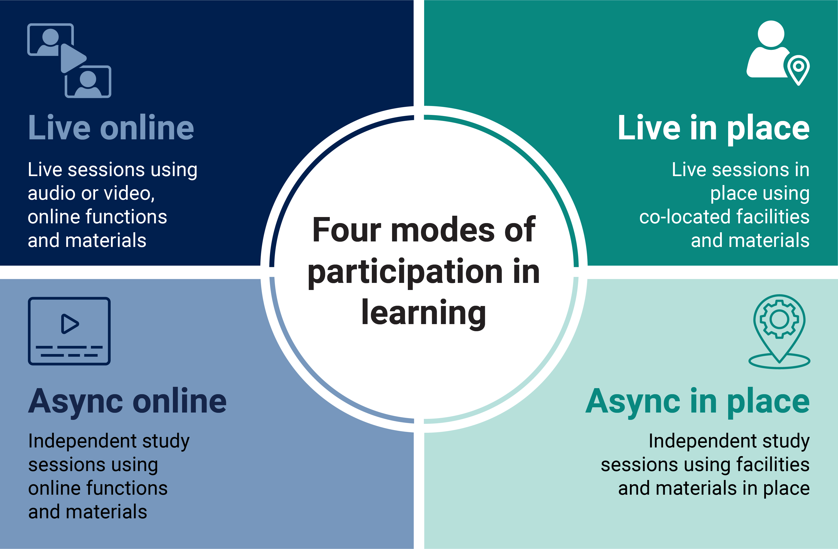
Four modes of participation in learning

Slide 4

Live
Live learning
Educator usually coordinates activities in time, but students may present, respond, initiate or lead
Learning can be sequenced and paced
Can be experienced by students as more dynamic, supported and engaging
Can be experienced by students as less reflective, self-directed and convenient
Supports rapid knowledge building, mind mapping, problem solving and design sprints
Supports responsive exchanges in discussion and debate, giving and receiving feedback
Small groups and one-to-ones good for: making connections, grasping complex topics, consensus
Large groups good for: building belonging and community, establishing foundations, polling diverse opinions

Slide 5
Live in-place
In-place learning
Presence can be established naturally and rapidly
Can be experienced by students as more responsive, (inter)personal, authentic and engaging
Can be experienced by students as less explicit, reflective and convenient
Material environment may support learning
Some students may find the social demands difficult; others benefit from social context and non-verbal cues
Room design and configuration shapes classroom expectations, group dynamics and teacher presence
Body language and eye contact help with engagement: student contributions can be elicited naturally
Easy to organise students into small groups on the fly; larger break-out groups only if suitable space available
Sessions may be recorded; otherwise dependent on learners making their own records and notes

Slide 6

Live lecture or presentation
Features
Educator as presenter, determining pace, content and structure
Can include interactive elements eg quizzes, research tasks, buzz questions
Can be recorded for students to review or catch up later
Students may prepare (own time) eg watch videos, read, preview
Pedagogic benefits
Sense of belonging and shared experience
Culturally significant learning event
Interactive elements (questions, tasks) can be improvised by the teacher
Responsive teaching using feedback
Places
Lecture room
Facilities may include:
Screens
Presentation media
Mics and mobile mics
Polling or quizzing tools
Live recording and captioning
Typical activities and interactions
Students attend to presentation (acquire)
Students may: make notes (organise) respond to questions individually or collectively (respond), work in pairs/small groups on small tasks (collaborate, produce)
Acquisition

Slide 7
Live practical or lab session
Features
Educator as demonstrator and coach
Students practice a method or procedure
Pace may be set by teacher (follow-along) or by students
Students may prepare ahead (own time) eg video demonstration
Students may record their practice, or make notes for review
Pedagogic benefits
Learning from materials and environments
Opportunity for live, embodied practice: learning through doing
Subject-specialist skills
Places
Laboratory, computer lab or live environment (eg ward, studio)
Facilities may include:
Live or virtual instruments
Material environment as a resource
Recording devices (camera, video camera, smartphone)
Guidance media (prompts, methods, how-to videos)
Typical activities and interactions
Students watch (acquire) and practice methods and procedures (practice, produce)
Students investigate and record findings (investigate)
Students review notes, data, outcomes (reflect, review)
Investigation

Slide 8
Fieldwork or site visit
Features
Educator as guide and facilitator
Students gain experience of authentic context or environment
Access to and time on site usually limited (external resources)
Students prepare ahead (own time) to maximise value of time on site
Pedagogic benefits
Authentic learning
Intrinsic learning and feedback from environment
Opportunity for situated, embodied practice
Sense of shared experience with others
Places
Live environment (field, research site, workplace)
Facilities may include:
Live environment as a resource
Instruments and data collection tools
Recording devices (video, camera, smartphone)
Preparation and guidance media
Typical activities and interactions
Students study environment (explore)
Students practice methods in situ (practice, produce)
Students record processes and data (reflect, review)
Students ask questions and analyse data (inquire, analyse)
Students may collaborate
Investigation

Slide 9
Live seminar or discussion
Features
Educator as facilitator
Students explore a topic through discussion
Open-ended or more structured format eg debate, role-play, group scenario
Students may lead all or part: students and educators negotiate pace
Pedagogic benefits
Learning from dialogue, argumentation and debate
Responsive exchanges
Building consensus OR negotiating solutions OR exploring different perspectives
Places
Seminar room
Possible break-out rooms
Facilities may include:
Presentation media, screens (shared)
Reconfigurable furniture
Recording devices
Typical activities and interactions
Students review or research topics in advance (acquire, enquire)
Students share, propose, clarify, question, respond etc (present, discuss, respond)
Outcomes recorded for review (review)
Discussion

Slide 10
Tutorial or support session
Features
Educator as tutor or mentor
One-to-one or small group session focused on student progress
Educator may be assigned to student(s) for whole course of study
Pedagogic benefits
Close attention
Focus on development and progression
Considered feedback
Can foster feelings of being supported, mattering
Places
Tutorial or meeting room
Facilities may include:
Shared screen
Student dashboard or progress record
Recording and/or note making facilities
Typical activities and interactions
Students share work and receive feedback (review)
Students discuss their work (discuss)
Students plan their learning (plan)
Students generate notes, review outcomes (organise, reflect)
Discussion

Slide 11
Live groupwork
Features
Educator as facilitator (if present)
Student-led session in small groups
Tasks may be set by educator or agreed by students
One-off session or ongoing project
Pedagogic benefits
Learning from peers (Zone of proximal development - ZPD)
Authentic practice for professional teams
Task and time management skills
Building community and commitment
Places
Any class space or informal meeting space
Facilities may include:
Specialist facilities and materials depending on groupwork tasks
Recording, note-making, screen sharing
Time, task or project management software
Typical activities and interactions
Students work together (collaborate) to produce an outcome (produce), or on a task of application (solve)
Both collaboration and task outcomes may be assessed
Production
Collaboration

Slide 12
Surgery, drop-in, live Q&A
Features
Educator as resource, mentor or tutor
Students dictate content and pace
May provide feedback on work in progress or general revision
Pedagogic benefits
Allows for adaptive feedback eg to check understanding
Opportunities for students to lead
Educator gains insight into student issues, perspectives and challenges
If voluntary and/or informal, can deepen relationships
Places
Any classroom or meeting room for small/ medium groups
Facilities may include:
Presentation and screen sharing
Access to course materials
Note-making or recording
Quiz, poll or test to support responsive teaching
Typical activities and interactions
Students watch (acquire) and practice methods and procedures (practice, produce)
Students generate their own notes, record processes, review outcomes (reflect, review)
Practice
Acquisition

Slide 13
Live assessment
Features
Educator as moderator or assessor
Students are assessed on their performance at a specific time, for example at a moderated exam, practical or performance
Peers may be involved as critical friends, reviewers, commentators
Pedagogic benefits
More authentic in some cases
Motivating for some students (but stressful for many)
Peer review has many learning benefits
Places
Exam room, practice room, performance space
Facilities may include:
Practical resources
Guidance media (questions, prompts, protocols)
Assessors may need to record student performance, make notes, give feedback and share assessments
Typical activities and interactions
Students answer questions (solve, apply), produce work live (produce), practice or perform
Students may receive feedback eg from peers, assessors (review)
Production

Slide 14
Describe your own live in-place session
Features
List of features
Pedagogic benefits
List of benefits
Platform
Platform detail
Functions may include:
Function detail
Typical activities and interactions
Activity detail
Production
Practice
Investigation
Discussion
Collaboration
Acquisition

