Slide 1


Session types: Live online
These session type cards were produced by Jisc for the Beyond Blended project to support curriculum and course design. There are four sets of cards, one each for the four ‘modes of participation’ in learning.
For more about the modes, visit the Beyond Blended web guide
This document is made available under CC BY NC SA

Slide 2
About these cards
The cards can be used in a curriculum design workshop or course meeting, to:
Plan sessions and activities
Consider a wider range of session types
Ensure a balance of session types to meet different needs
Describe new session types and activities (beyond those described here)
The activity icons included on each card are from the ABC Learning Design resources, licensed CC BY-NC-SA 4.0, Clive Young and Nataša Perović, UCL (2015), Learning types, Laurillard, D. (2012). Original resources at abc-ld.org. We are grateful for permission to use the icons in this way.
ABC Learning Design is a collaborative programme and module design method created at University College London (UCL) and used widely across the sector. It enables programme and module teams to develop a storyboard visualising the learner journey based on their activities through the course of study. The ’session type’ cards can be used to consider how activities may be undertaken in different sessions and modes, linking these cards to the ABC design process.

Slide 3
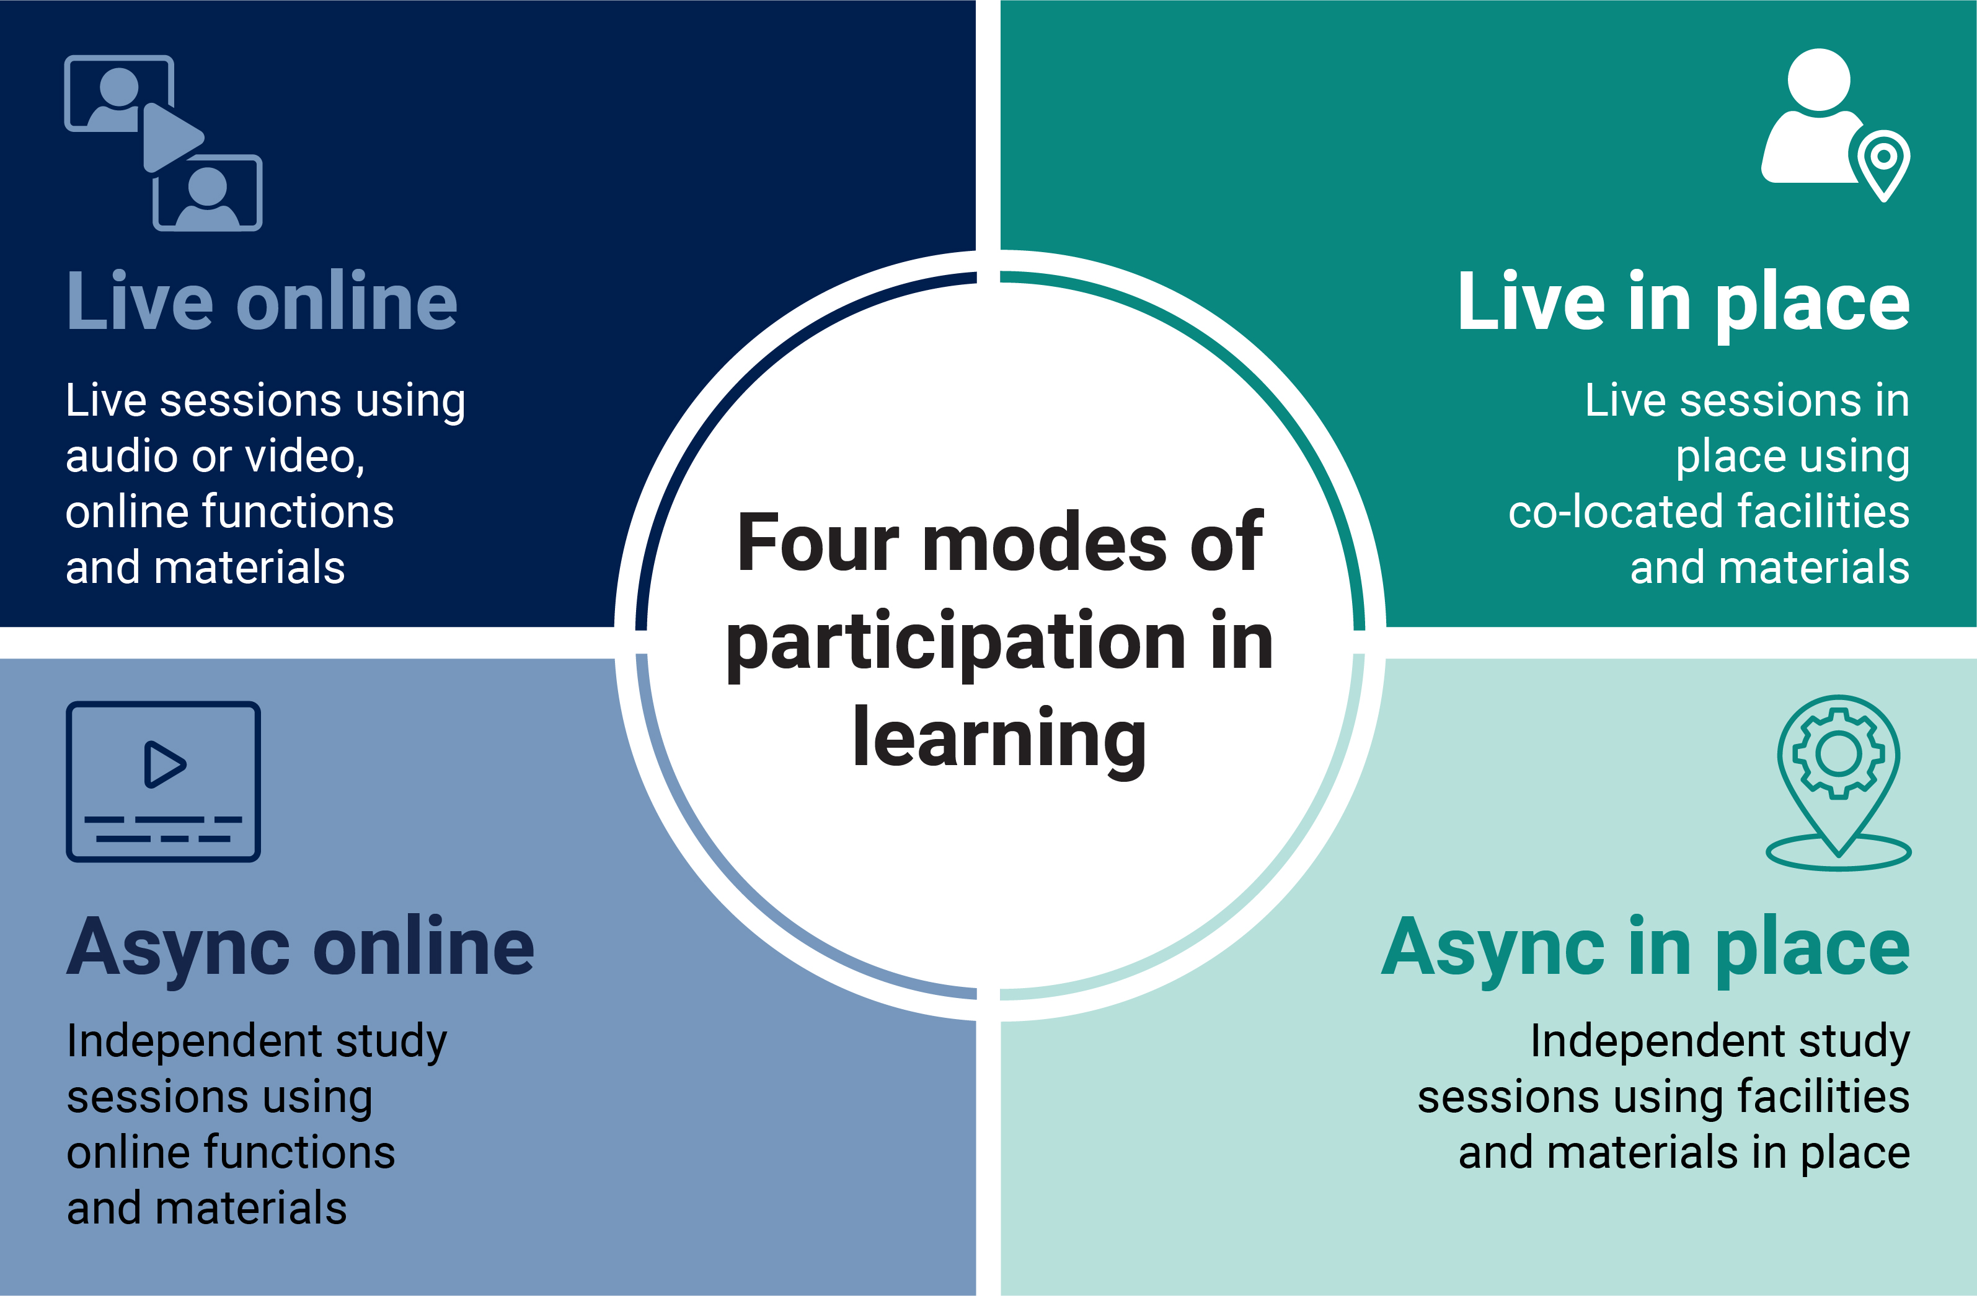
Four modes of participation in learning

Slide 4

Live
Live learning
Educator usually coordinates activities in time, but students may present, respond, initiate or lead
Learning can be sequenced and paced
Can be experienced by students as more dynamic, supported and engaging
Can be experienced by students as less reflective, self-directed and convenient
Supports rapid knowledge building, mind mapping, problem solving and design sprints
Supports responsive exchanges in discussion and debate, giving and receiving feedback
Small groups and one-to-ones good for: making connections, grasping complex topics, consensus
Large groups good for: building belonging and community, establishing foundations, polling diverse opinions

Slide 5
Live online
Online learning
Can be experienced by students as more: explicit, structured and convenient
Can be experienced by students as less: responsive, (inter)personal and motivating
Platform shapes roles and interactions; rules and norms may need to be negotiated explicitly
Some students benefit from more explicit rules and diverse ways to engage
Learning naturally produces a trace or record (some students may be concerned about this)
Easy to share materials, ideas and work in progress; contributions are easy to track
Allows learning beyond the classroom eg external speakers, virtual site visits, public pedagogies

Slide 6

Online lecture or presentation
Features
Educator as presenter, determining pace, content and structure
Typically recorded for students to review or catch up later
Easy to give students presenter rights
Pedagogic benefits
Shared experience
Group work can easily be integrated
Interactive elements (responses, quizzes, tasks) can be included
Responsive teaching using feedback via polls, chat etc
Multiple ways for students to participate
Platform
Live webinar platform (video + audio)
Live streaming platform
Facilities may include:
Presentation
Chat, reactions
Live quizzes, polls
Student participation via mic, screen sharing
Live captioning or transcription
External apps
Typical activities and interactions
Students attend to presentation (acquire) and respond
Students may: make notes (organise) respond to questions individually or collectively (respond), work in pairs/small groups on small tasks (collaborate, produce) show or present work
Acquisition

Slide 7
Online seminar or discussion
Features
Educator as facilitator
Students explore a topic eg through discussion
Open-ended or more structured format eg debate, role-play, group scenario
Students may lead all or part of session: students and educators negotiate pace
Pedagogic benefits
Learning from dialogue, argumentation, presentation and debate
Learning in smaller groups
Responsive exchange: good for building consensus, negotiating solutions, exploring perspectives
Places
Live webinar platform (video+audio)
Facilities may include:
Presentation media, screen sharing
Break-out rooms for smaller groups
Responsive media – polls, emoticons
External apps
Typical activities and interactions
Students review or research topics in advance (acquire, enquire)
Students share, propose, clarify, question, respond etc (present, discuss, respond)
Outcomes recorded for review (review)
Discussion

Slide 8
Online tutorial or support session
Features
Educator as tutor or mentor
One-to-one or small group session focused on student progress
Educator may be assigned to student(s) for whole course of study
Pedagogic benefits
Close attention with responsive feedback
Focus on development and progression
Variety of feedback eg audio, video, screencasting, text
Can foster feelings of being supported, encouraged, mattering individually
Platform
Live webinar platform (video+audio)
Functions may include:
Annotation space or shared document(s)
Student dashboard or progress record
Recording and/or note making facilities
Screen sharing, recording, casting
External software and apps as relevant
Typical activities and interactions
Students share work and receive feedback (review)
Students discuss their work (discuss)
Students plan their learning (plan)
Students generate notes, review outcomes (organise, reflect)
Practice
Discussion

Slide 9
Simultaneous virtual experience
Features
Students participate in real time in a shared virtual environment eg simulation or multi-player game
Pedagogic benefits
Highly interactive and engaging
Builds community and commitment
Experience of team work in a variety of settings, including those not available in real life
Platform
Shared virtual or gaming environment
Subject-specialist multi-role simulation
Facilities may include:
Wearables, input devices, sensors
In-world tools, avatars, resources
Live messaging/audio for communication
Guidance (prompts, video segments, embedded text)
Typical activities and interactions
Interact (explore, enquire), work with others to achieve goals (collaborate)
Practice skills and procedures (practice)
Practice
Collaboration

Slide 10
Online surgery, drop-in
Features
Educator as resource, mentor or tutor
Students dictate content and pace
May provide feedback on work in progress or general revision
Pedagogic benefits
Allows for adaptive feedback eg to check understanding
Opportunities for students to lead
Educator gains insight into student issues, perspectives and challenges
Can promote feelings of being supported, mattering individually
Platform
Live webinar environment (audio/video)
Functions may include:
Screen sharing, (student/educator)
Annotation and feedback eg shared doc(s)
Note-making, recording facilities
Quiz, poll or test to check understanding
Typical activities and interactions
Students watch (acquire) and practice methods and procedures (practice)
Students generate notes, recordings
Students test themselves and review progress (reflect, review)
Practice
Acquisition

Slide 11
Live online assessment
Features
Educator as moderator or assessor
Students are assessed on their performance at a specific time, for example a moderated test, online practical or virtual performance
Peers may be involved as critical friends, reviewers, commentators
Pedagogic benefits
More convenient, less stressful for many students
Enables multiple reviewers (eg external stakeholders, peer reviewers)
Platform
Online assessment platform
Streaming platform
Live virtual platform with recording facility
Functions may include:
Live or automated feedback
Recording and annotation
(In summative assessments) integrity measures such as timed release
Typical activities and interactions
Students answer questions (solve, apply), produce live work (produce), practice or perform
Students may receive immediate feedback eg from peers, assessors (review)
Production

Slide 12
Describe your own live online session
Features
List of features
Pedagogic benefits
List of benefits
Platform
Platform detail
Functions may include:
Function detail
Typical activities and interactions
Activity detail
Production
Practice
Investigation
Discussion
Collaboration
Acquisition

