Slide 1

Hacettepe University
VBM688 TERM PROJECT
PATHFINDING with Q-LEARNING
MERT KARAGÖZ
N20134084

Slide 2


Q-Learning
Have you ever trained a pet and rewarded it for every correct command you asked for?
Have you ever receive stars from your primary school teacher?

Slide 3
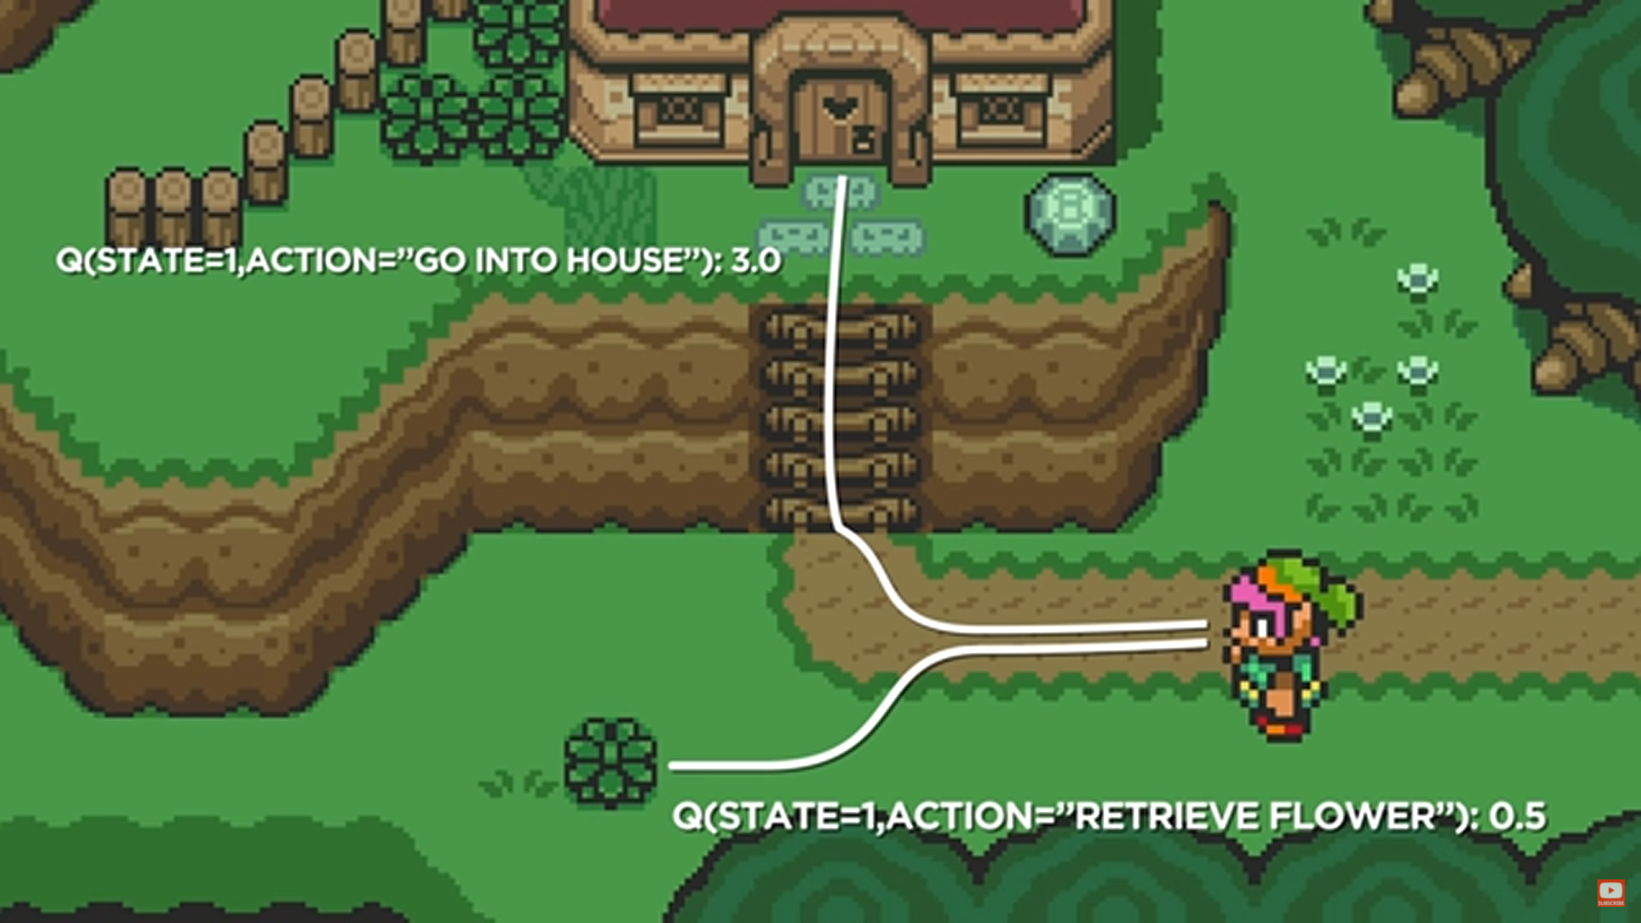

Slide 4
Q Learning
Q learning is a model-free learning technique that can be used to find the optimal action-selection policy using a Q function.

Slide 5
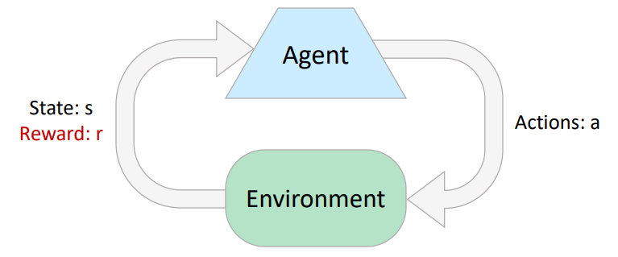
Q Learning
We want to obtain a function Q(s,a) that predicts best action a in state s in order to a maximize cumulative reward.

Slide 6

Q Learning
Q(state, action) = R(state, action) + γ . MAX[Q(next state, all actions)]
Immediate Reward Future Reward

Slide 7
Q Learning
Before Acting, Agent must learn.
Agent receive feedback from rewards.
Agent’s utility is defined by the reward function.(Quality function)

Slide 8
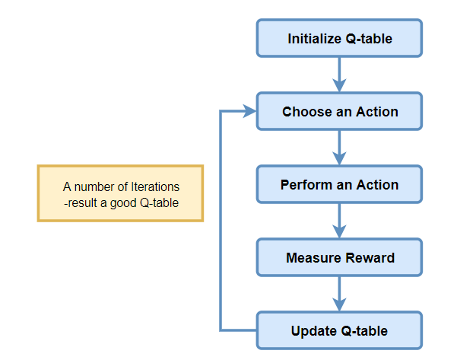
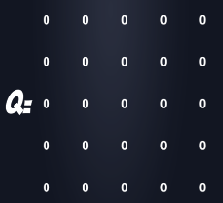
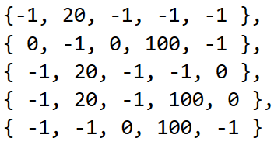
Q-Learning Algorithm
Q MATRIX
In my demonstration 100 iterations applied.
R MATRIX

Slide 9
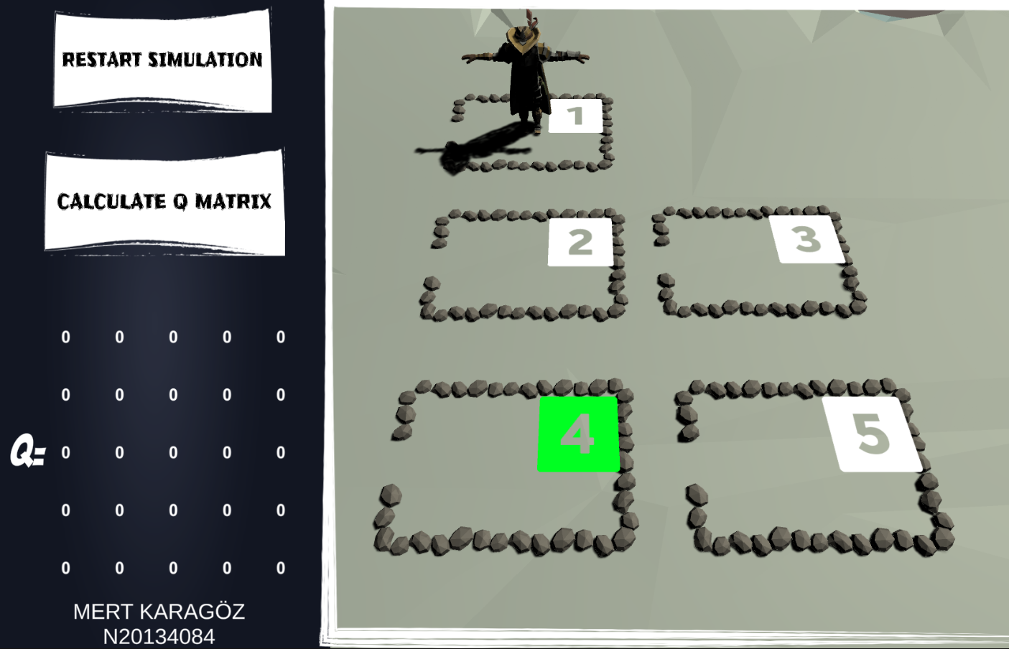

Slide 10
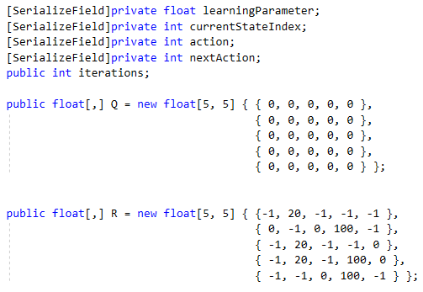
Coding Q Learning Agent

Slide 11
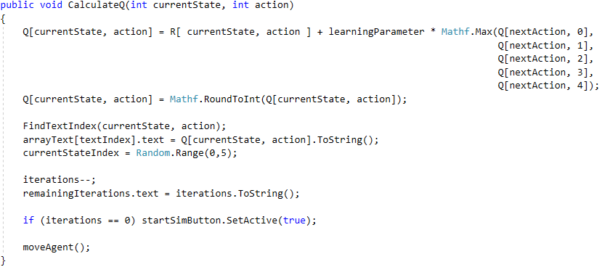
Coding Q Learning Agent II

Slide 12
Q Learning Application Demonstration
Video Link

Slide 13

Thanks for Watching!

Slide 14
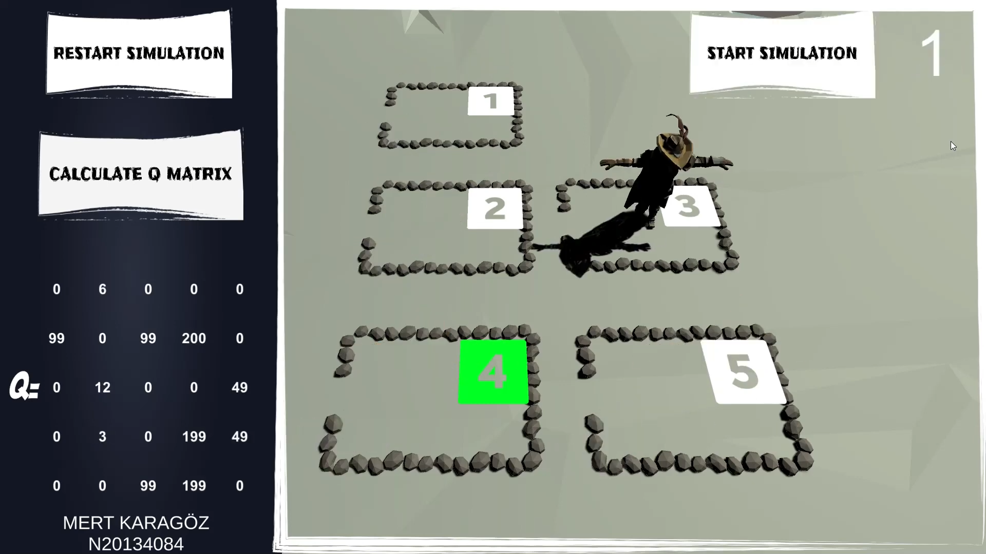
1
4
5
2
6
3

