Slide 1

Introduction to XProc 3.0
Markup UK 2020
Online Tutorial

Slide 2

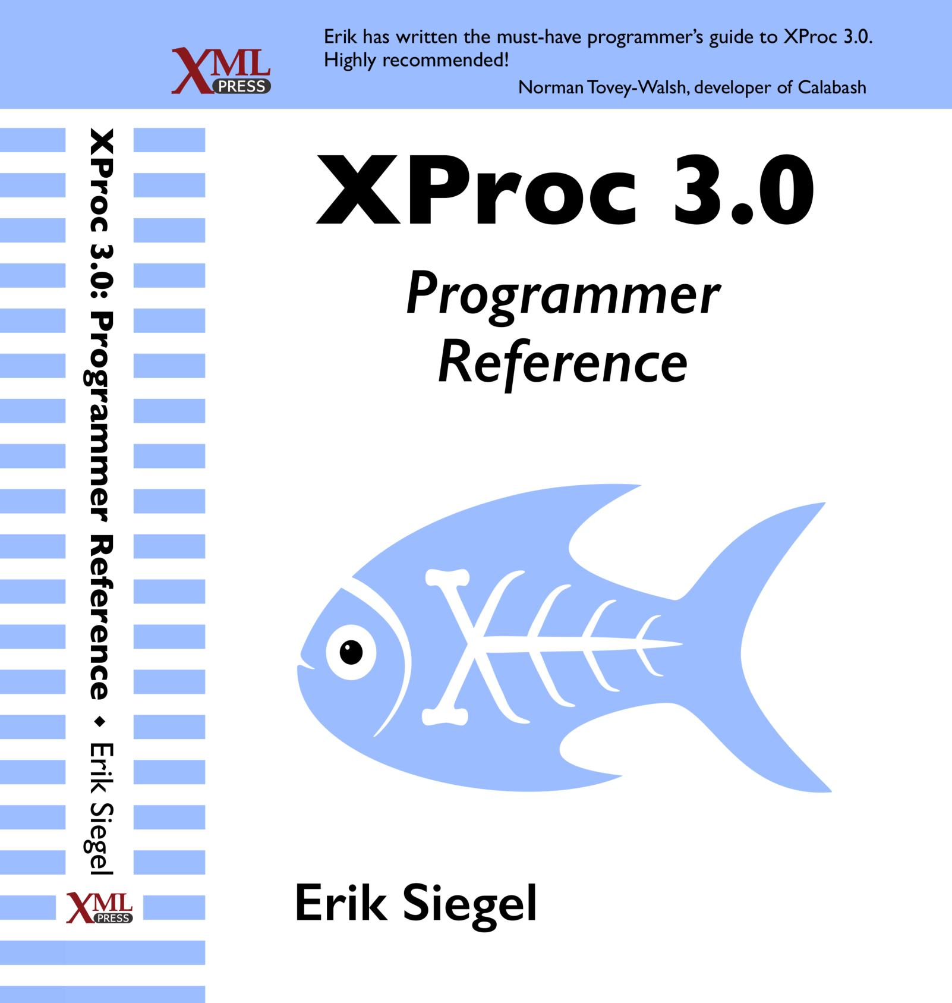
Who Am I?
Erik Siegel
Content Engineer, XML Specialist, Technical Writer
One-man company: Xatapult
Groningen, The Netherlands
Customers mostly in publishing and standardization
Part of the XProc 3.0 editing committee
Writer of the XProc 3.0 Programmer Reference
Contact:
erik@xatapult.nl www.xatapult.com www.linkedin.com/in/esiegel/ +31 6 53260792

Slide 3
XProc?
XProc is an XML based programming language for complex data processing - pipelining
Extensible set of small, sharp tools for creating and transforming XML and other documents
V1.0 available (two processor implementations to run your pipelines)
Specification and implementation V3.0 under development
And my name is Kanava (which is Finnish for… pipeline)
I’m proud to be the XProc logo!

Slide 4

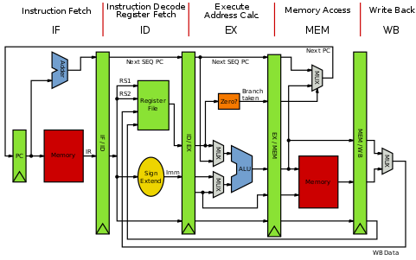

Why should I bother?
Pipelines are ubiquitous all around us
Solve problems with a set of small, sharp tools that combine in many ways
Like the UNIX command line
Very natural choice for document processing
Compose small tools into something bigger, pipelines…
XProc beats the alternatives
A successful example of large-scale application of XProc (1.0) pipelines doing document engineering:
https://www.le-tex.de/en/transpect.html

Slide 5
Links
XProc 3.0:
Specification: http://spec.xproc.org
Github: https://github.com/xproc/
W3C: https://www.w3.org/community/xproc-next/
XProc 1.0:
Specification: https://www.w3.org/TR/xproc/
XML Calabash processor: https://xmlcalabash.com/
Morgana XProc processor: https://www.xml-project.com/

Slide 6

Hands-on: Installation and pre-flight check
Go to https://github.com/eriksiegel/DocEng-2019-XProc/releases and download the latest release zip
Unzip this somewhere on your machine
JRE (V1.8.x works, maybe others too…) must be installed! https://www.java.com/en/download/
Open a command window in exercises/01-hello-xproc/
Try run.bat or run.sh
=================================
MorganaXProc-III 0.8.21-alpha
Copyright 2011-2019 by <xml-project /> Achim Berndzen
=================================
<hello-xproc timestamp="2019-08-22T11:37:55+01:00"/>
If it works you’ve just run your first XProc pipeline!

Slide 7

XProc fundamentals
You need to understand this!

Slide 8
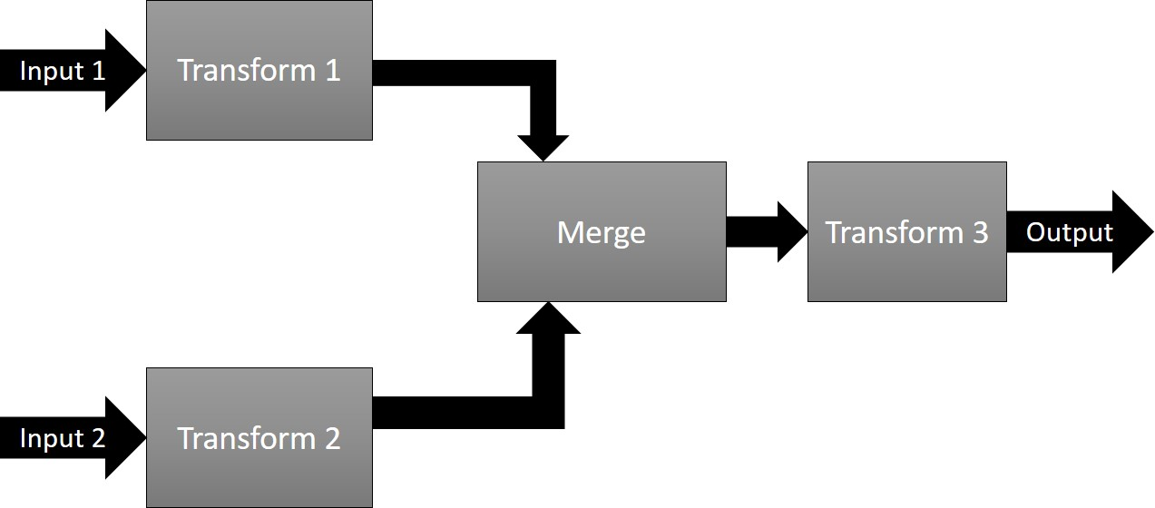
Pipelines, steps
Document(s) as input
Process the data flowing through using steps
Produce output(s)
Documents can be of any type, not just XML!

Slide 9
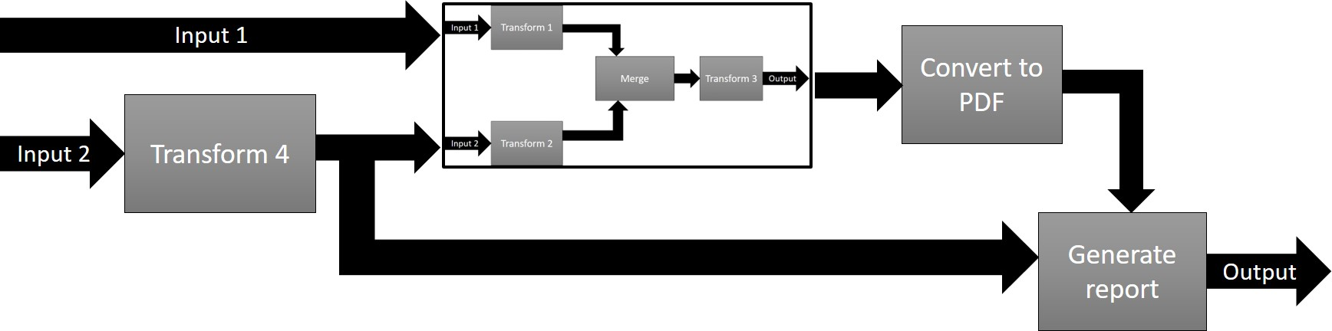
Pipelines, steps
In XProc, a pipeline and a step are essentially the same. The terms can be used interchangeably!

Slide 10
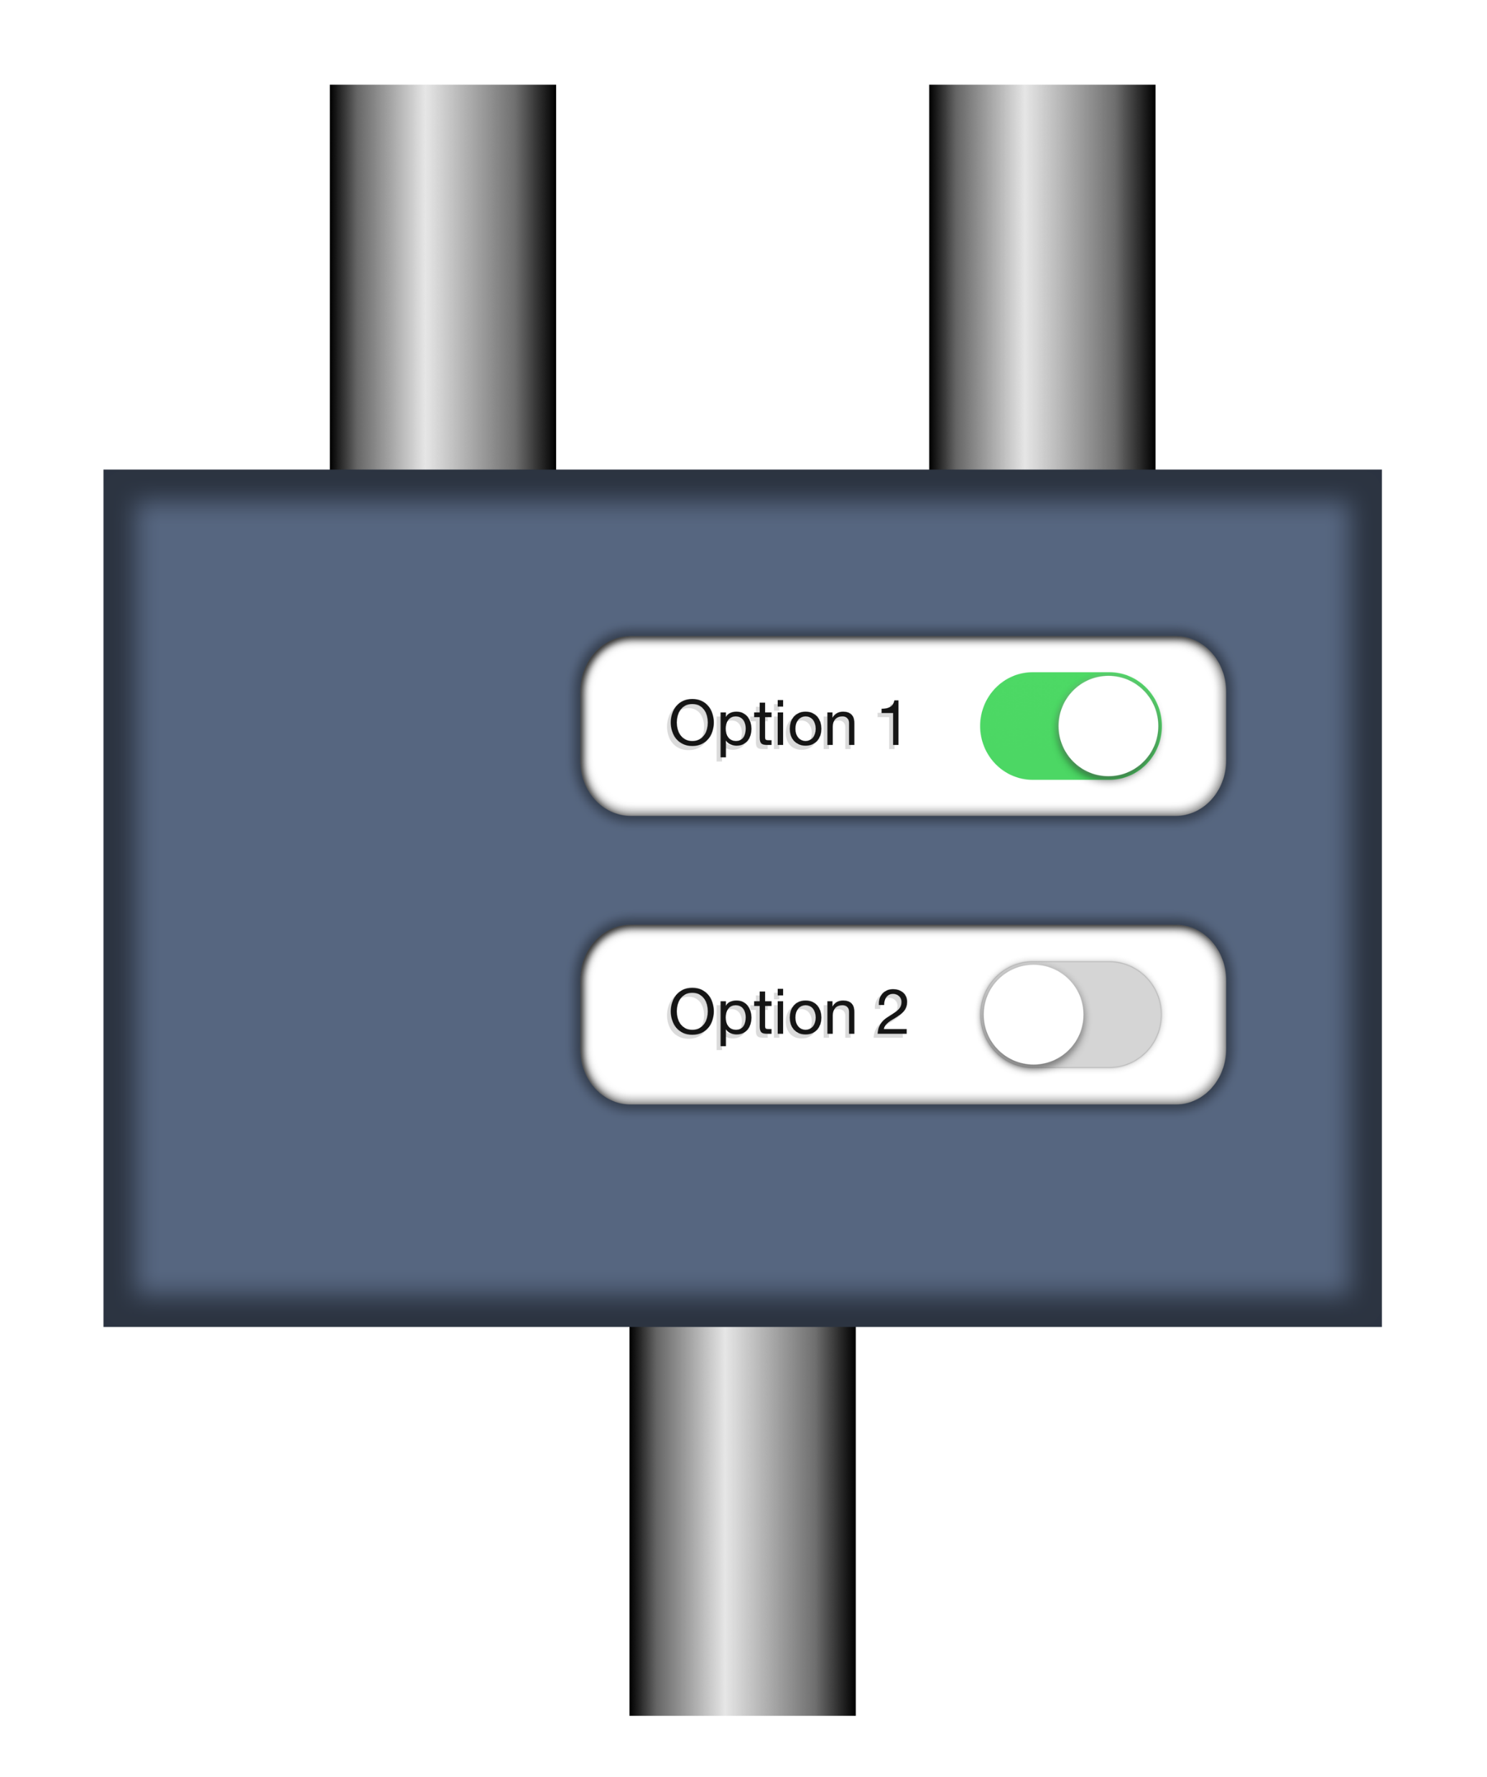
Steps/pipelines, ports, options
document
source
options
p:add-attribute
match
attribute-name
attribute-value
result
Have a look ate the step specification: http://spec.xproc.org/master/head/steps/#c.add-attribute
Transformed document

Slide 11
Step/pipeline that adds an attribute - root
Root p:declare-step element
Namespace and preferred prefix (p:)
XProc version
<p:declare-step xmlns:p="http://www.w3.org/ns/xproc" version="3.0“
name="add-attribute-pipeline">
<p:input port="source"/>
<p:output port="result">
<p:pipe step="add-attribute-1" port="result"/>
</p:output>
<p:add-attribute name="add-attribute-1">
<p:with-input port="source">
<p:pipe step="add-attribute-pipeline" port="source"/>
</p:with-input>
<p:with-option name="match" select="'/*'"/>
<p:with-option name="attribute-name" select="'timestamp'"/>
<p:with-option name="attribute-value" select="current-dateTime()"/>
</p:add-attribute>
</p:declare-step>

Slide 12
Step/pipeline that adds an attribute - in/output ports
<p:declare-step xmlns:p="http://www.w3.org/ns/xproc" version="3.0“
name="add-attribute-pipeline">
<p:input port="source"/>
<p:output port="result">
<p:pipe step="add-attribute-1" port="result"/>
</p:output>
<p:add-attribute name="add-attribute-1">
<p:with-input port="source">
<p:pipe step="add-attribute-pipeline" port="source"/>
</p:with-input>
<p:with-option name="match" select="'/*'"/>
<p:with-option name="attribute-name" select="'timestamp'"/>
<p:with-option name="attribute-value" select="current-dateTime()"/>
</p:add-attribute>
</p:declare-step>
Input port
Output port
Emit the result of an output port of a step in this pipeline

Slide 13
Step/pipeline that adds an attribute - connect a port
<p:declare-step xmlns:p="http://www.w3.org/ns/xproc" version="3.0“
name="add-attribute-pipeline">
<p:input port="source"/>
<p:output port="result">
<p:pipe step="add-attribute-1" port="result"/>
</p:output>
<p:add-attribute name="add-attribute-1">
<p:with-input port="source">
<p:pipe step="add-attribute-pipeline" port="source"/>
</p:with-input>
<p:with-option name="match" select="'/*'"/>
<p:with-option name="attribute-name" select="'timestamp'"/>
<p:with-option name="attribute-value" select="current-dateTime()"/>
</p:add-attribute>
</p:declare-step>
Connect the source port of p:add-attribute to what flows into the encompassing step
Port connections are always defined on the input ports

Slide 14
Step/pipeline that adds an attribute - set options
<p:declare-step xmlns:p="http://www.w3.org/ns/xproc" version="3.0“
name="add-attribute-pipeline">
<p:input port="source"/>
<p:output port="result">
<p:pipe step="add-attribute-1" port="result"/>
</p:output>
<p:add-attribute name="add-attribute-1">
<p:with-input port="source">
<p:pipe step="add-attribute-pipeline" port="source"/>
</p:with-input>
<p:with-option name="match" select="'/*'"/>
<p:with-option name="attribute-name" select="'timestamp'"/>
<p:with-option name="attribute-value" select="current-dateTime()"/>
</p:add-attribute>
</p:declare-step>
Set the 3 options of p:add-attribute
XProc uses XPath 3.1 for all expressions, just like XSLT 3.0 and XQuery 3.1

Slide 15
Hands-on: Add a second attribute
Open a command window in exercises/02-add-attribute-1/
Try run.bat or run.sh.
The input comes from input.xml in the same directory
Change the pipeline and add a second p:add-attribute step that also adds an enabled=“true” attribute to the root element.
Connect the source port of your new p:add-attribute explicitly to the result port of the existing p:add-attribute.
Try it!
Whow, that’s a boring thing to do! I encourage you to experiment a bit …

Slide 16
Add a second attribute - solution
<p:declare-step xmlns:p="http://www.w3.org/ns/xproc" version="3.0“
name="add-attribute-pipeline">
<p:input port="source"/>
<p:output port="result">
<p:pipe step="add-attribute-2" port="result"/>
</p:output>
<p:add-attribute name="add-attribute-1">
…
</p:add-attribute>
<p:add-attribute name="add-attribute-2">
<p:with-input port="source">
<p:pipe step="add-attribute-1" port="result"/>
</p:with-input>
<p:with-option name="match" select="'/*'"/>
<p:with-option name="attribute-name" select="'enabled'"/>
<p:with-option name="attribute-value" select="true()"/>
</p:add-attribute>
</p:declare-step>
Get the final result from the new p:add-attribute
Read from the result port of the first p:add-attribute
Awkward and verbose. I don’t like it!

Slide 17
Connect ports using the pipe attribute
<p:declare-step xmlns:p="http://www.w3.org/ns/xproc" version="3.0" name="add-attribute-pipeline">
<p:input port="source"/>
<p:output port="result" pipe="result@add-attribute-1"/>
<p:add-attribute name="add-attribute-1">
<p:with-input port="source" pipe="source@add-attribute-pipeline"/>
<p:with-option name="match" select="'/*'"/>
<p:with-option name="attribute-name" select="'timestamp'"/>
<p:with-option name="attribute-value" select="current-dateTime()"/>
</p:add-attribute>
</p:declare-step>
Use a shorthand pipe=“port@step” notation
Same here

Slide 18
Hands-on: Add a second attribute using the pipe attribute
Open a command window in exercises/03-add-attribute-2/
Try run.bat or run.sh.
Change the pipeline and add a second p:add-attribute step that also adds an enabled=“true” attribute to the root element.
Connect the source port of your new p:add-attribute explicitly to the result port of the existing p:add-attribute using a pipe attribute.
Try it!

Slide 19
Add a second attribute using the pipe attribute - solution
<p:declare-step xmlns:p="http://www.w3.org/ns/xproc" version="3.0" name="add-attribute-pipeline">
<p:input port="source"/>
<p:output port="result" pipe="result@add-attribute-2"/>
<p:add-attribute name="add-attribute-1">
<p:with-input port="source" pipe="source@add-attribute-pipeline"/>
<p:with-option name="match" select="'/*'"/>
<p:with-option name="attribute-name" select="'timestamp'"/>
<p:with-option name="attribute-value" select="current-dateTime()"/>
</p:add-attribute>
<p:add-attribute name="add-attribute-2">
<p:with-input port="source" pipe="result@add-attribute-1"/>
<p:with-option name="match" select="'/*'"/>
<p:with-option name="attribute-name" select="'enabled'"/>
<p:with-option name="attribute-value" select="true()"/>
</p:add-attribute>
</p:declare-step>
Better, shorter, but still…
Why would I need to explicitly connect ports at all if its clear that they should connect anyway?

Slide 20
Primary ports
source
Primary ports
p:something
result
The port names source and result for the primary ports are a convention
Not all ports are created equal…

Slide 21
Primary ports, implicit connections
source
p:something
Click!
result
source
Primary ports implicitly connect
p:something-else
Think of primary ports having little magnets that snap automagically together
result

Slide 22
Primary ports, implicit connections
If a step has only a single input or output port, they’re primary by default. But you can set the primary status explicitly using a primary=“true/false” attribute here.
<p:declare-step … >
<p:input port="source"/>
<p:output port="result"/>
<p:add-attribute>
…
</p:add-attribute>
<p:add-attribute >
…
</p:add-attribute >
</p:declare-step>
Implicit connection of
primary input port to first step
Implicit connection of last step to primary output port
Implicit connection of steps

Slide 23
Connect ports implicitly
<p:declare-step xmlns:p="http://www.w3.org/ns/xproc" version="3.0">
<p:input port="source"/>
<p:output port="result"/>
<p:add-attribute>
<p:with-option name="match" select="'/*'"/>
<p:with-option name="attribute-name" select="'timestamp'"/>
<p:with-option name="attribute-value" select="current-dateTime()"/>
</p:add-attribute>
</p:declare-step>
Huh? Where are the name attributes?

Slide 24
Hands-on: Add a second attribute using implicit connections
Open a command window in exercises/04-add-attribute-3/
Try run.bat or run.sh.
Change the pipeline and add a second p:attribute step that also adds an enabled=“true” attribute to the root element.
Use the primary ports implicit connections
Try it!

Slide 25
Connect ports implicitly - solution
<p:declare-step xmlns:p="http://www.w3.org/ns/xproc" version="3.0">
<p:input port="source"/>
<p:output port="result"/>
<p:add-attribute>
<p:with-option name="match" select="'/*'"/>
<p:with-option name="attribute-name" select="'timestamp'"/>
<p:with-option name="attribute-value" select="current-dateTime()"/>
</p:add-attribute>
<p:add-attribute>
<p:with-option name="match" select="'/*'"/>
<p:with-option name="attribute-name" select="'enabled'"/>
<p:with-option name="attribute-value" select="true()"/>
</p:add-attribute>
</p:declare-step>
It’s getting better. But can’t we make it a tad more concise still?

Slide 26
Setting options using attributes
<p:declare-step xmlns:p="http://www.w3.org/ns/xproc" version="3.0">
<p:input port="source"/>
<p:output port="result"/>
<p:add-attribute match="/*" attribute-name="timestamp"
attribute-value="{current-dateTime()}"/>
</p:declare-step>
You can specify option values as attributes on the step invocation
To compute stuff use Attribute-Value-Templates (AVTs), just like in XSLT.

Slide 27
Hands-on: Add a second attribute using option values set by attributes
Open a command window in exercises/05-add-attribute-4/
Try run.bat or run.sh.
Change the pipeline and add a second p:add-attribute step that also adds an enabled=“true” attribute to the root element.
Set all the options by attributes
Try it!
Zzzzzzzz……
All that attribute adding is so boring, time to move on!

Slide 28
Set options using attributes - solution
<p:declare-step xmlns:p="http://www.w3.org/ns/xproc" version="3.0">
<p:input port="source"/>
<p:output port="result"/>
<p:add-attribute match="/*" attribute-name="timestamp"
attribute-value="{current-dateTime()}"/>
<p:add-attribute match="/*" attribute-name="enabled"
attribute-value="true"/>
</p:declare-step>
Short, concise and intuitively clear. That’s how I like it!

Slide 29
Intermezzo 1: Your own options
We’ve seen that built-in steps can have options
match
attribute-name
attribute-value
What if you want to add an option to your own step?
<p:declare-step xmlns:p="http://www.w3.org/ns/xproc" version="3.0">
<p:input port="source"/>
<p:output port="result"/>
<p:option name=“username"/>
<p:add-attribute match="/*" attribute-name=“username"
attribute-value="{upper-case($username)}"/>
</p:declare-step>
Declare the option in the prolog of your step
You can make an option required, set a datatype, supply a default, etc.
Reference the option using the $... notation, just like XSLT and XQuery
See: exercises/06-own-option/

Slide 30
Intermezzo 2: Variables
<p:declare-step xmlns:p="http://www.w3.org/ns/xproc" version="3.0">
<p:input port="source"/>
<p:output port="result"/>
<p:option name="username"/>
<p:variable name="id" select="upper-case($username) || '-' ||
p:system-property('p:episode')" />
<p:add-attribute match="/*" attribute-name="id" attribute-value="{$id}"/>
</p:declare-step>
Declare the variable anywhere
Reference the variable using the $... notation, just like XSLT and XQuery
Variables can be of any datatype, just like in XSLT or XQuery
See: exercises/07-variables/

Slide 31
Intermezzo 2: Variables
<some-root status="final">
…
</p:some-root>
Read values from the document flowing through!
<p:variable name="status" select="/*/@status" />
You can even base its value on something flowing from another output port

Slide 32
The p:insert step
See: http://spec.xproc.org/master/head/steps/#c.insert
Base
document
Document to insert
source
insertion
options
p:insert
match
position
result
Possible values for position:
first-child
last-child
before
after
The source and result port are primary, the insertion port is not…
Combined document

Slide 33
Connect a port to an inline document
In most cases you can leave out the <p:inline> wrapper
<p:some-step ...>
<p:with-input port="port-name">
<p:inline>
... (inline document) ...
</p:inline>
</p:with-input>
...
</p:some-step>
You can use expressions between curly braces {…} in your inline document
Expressions between curly braces are called TVTs (Text-Value-Templates and AVTs (Attribute-Value-Templates)

Slide 34
Hands-on: Add an additional child element using an inline document
Open a command window in exercises/08-connect-inline/
Finish the pipeline so it adds a <location>Berlin 2019</location> element after the <presenter> element.
Use the p:insert step
Use a <p:inline> wrapper
Compute the current year using a {…} construction
XPath cheat: year-from-date(current-date())
Try it with run.bat or run.sh
Remove the <p:inline> wrapper and try again. Any differences?
Now you’re on your own writing XProc, scary…

Slide 35
Insert inline document - solution
<p:declare-step xmlns:p="http://www.w3.org/ns/xproc" version="3.0">
<p:input port="source"/>
<p:output port="result"/>
<p:insert match="/*" position="last-child">
<p:with-input port="insertion">
<p:inline>
<location>Berlin {year-from-date(current-date())}</location>
</p:inline>
</p:with-input>
</p:insert>
</p:declare-step>

Slide 36
Connect a port to an external document
In most cases you can put the href attribute directly on the <p:with-input>, no need for a <p:document> then!
<p:some-step ...>
<p:with-input port="port-name">
<p:document href="reference-to-document"/>
</p:with-input>
...
</p:some-step>
The href attribute is an AVT: You can use expressions between curly braces {…} inside
We have no means to add the current year now, like we did in the last exercise…

Slide 37
Hands-on: Add an additional child element using an external document
Open a command window in exercises/09-connect-external/
Finish the pipeline so it adds the contents of insert.xml after the <presenter> element.
Use the p:insert step
Use a <p:document> element
Try it with run.bat or run.sh
Put the href attribute directly on the <p:with-input> Any differences?
Can you add a variable with the name of the file and use that to reference it?

Slide 38
Insert external document - solution
<p:declare-step xmlns:p="http://www.w3.org/ns/xproc" version="3.0">
<p:input port="source"/>
<p:output port="result"/>
<p:insert match="/*" position="last-child">
<p:with-input port="insertion">
<p:document href="insert.xml"/>
</p:with-input>
</p:insert>
</p:declare-step>

Slide 39
Intermezzo: Documents flowing through
Native document types:
XML
HTML
JSON
Text
Other
All documents carry an adaptable properties map
Document
Representation
(contents)
Properties:
Name | Value
content-type | application/xml
base-uri | file:///C:/data/doc.xml
… | …
Flow
It is also possible to flow multiple documents or none at all.

Slide 40
Intermezzo: The step libraries
Standard steps, see http://spec.xproc.org/master/head/steps/
These steps must be there in a conformant XProc processor!
Additional steps, see http://spec.xproc.org/master/head/#steps/
Implementation is optional (but recommended)
If such a step is implemented it must conform to what is written there
There are over 45 standard steps!

Slide 41
Intermezzo: The core (or compound) steps
p:for-each: loop over multiple documents or parts of a document
p:choose / p:when / p:otherwise: Make choices
p:if: Make a single choice (there is no else)
p:viewport: Work on only a part of a document
p:try / p:catch: Error catching and handling
p:group: Grouping of instructions
Regrettably, there is no time to look at them all…

Slide 42
Use p:for-each to split a document - Input
Split this in multiple documents
<documents>
<doc filename="output1.xml">
<contents>This is document number 1</contents>
</doc>
<doc filename="output2.xml">
<contents>This is document number 2</contents>
<more>It has some more...</more>
</doc>
</documents>
The filenames are in filename attributes
Boring contents Erik

Slide 43
Use p:for-each to split a document – Basic pipeline
<p:declare-step xmlns:p="http://www.w3.org/ns/xproc" version="3.0">
<p:input port="source"/>
<p:output port="result"/>
<p:for-each>
<p:with-input select="//doc"/>
<p:store href="{/*/@filename}"/>
</p:for-each>
</p:declare-step>
p:for-each has an anonymous input port…
select is a standard attribute of p:with-input
p:store stores a document to disk. The href attribute tells it where
p:store emits on its result port the same document as it received on its source port

Slide 44
Hands-on: Use p:for-each to split a document 1
Open a command window in exercises/10-for-each-1/
Try it with run.bat or run.sh
It does not run… why? What does the error message tell you?
Make the output port of the pipeline accept a sequence by adding a sequence="true" attribute
So how many documents flow out of this step now?

Slide 45
Use p:for-each to split a document 1 – Solution
Make the output port accept a sequence
<p:declare-step xmlns:p="http://www.w3.org/ns/xproc" version="3.0">
<p:input port="source"/>
<p:output port="result" sequence=“true"/>
<p:for-each>
<p:with-input select="//doc"/>
<p:store href="{/*/@filename}"/>
</p:for-each>
</p:declare-step>
You can also define what document types a port will accept

Slide 46
The p:wrap-sequence step
See: http://spec.xproc.org/master/head/steps/#c.wrap-sequence
Multiple documents
source
options
p:wrap-sequence
wrapper
group-adjacent
With the group-adjacent option you can group incoming documents based on an XPath expression. We’re not going to try that now
result
wrapped document(s)

Slide 47
Hands-on: Use p:for-each to split a document 2
Open a command window in exercises/10-for-each-2/
Add a p:wrap-sequence step after the p:for-each and use this to wrap the results in a <result> element
Try it with run.bat or run.sh

Slide 48
Use p:for-each to split a document 2 – Solution
<p:declare-step xmlns:p="http://www.w3.org/ns/xproc" version="3.0">
<p:input port="source"/>
<p:output port="result"/>
<p:for-each>
<p:with-input select="//doc"/>
<p:store href="{/*/@filename}"/>
</p:for-each>
<p:wrap-sequence wrapper="results"/>
</p:declare-step>
Wrap the results in a <result> element

Slide 49
Goodbye and thank the fish!
Specification in the making: http://spec.xproc.org/
Norman Walsh, Achim Berndzen, Gerrit Imsieke, Erik Siegel
We hope to finish before end 2019
Next meeting of the XProc 3.0 working group: November 9-10, Cologne
On its way, beside the specification:
Two processor implementations
https://www.xml-project.com/ (MorganaXProc)
https://xmlcalabash.com/ (XML Calabash)
A Programmer’s Reference Guide
To be published by XML Press beginning 2020
Your guide today: Erik Siegel – erik@xatapult.nl
Goodbye!
And remember, Kanava says:
XProc rocks…

