Slide 1

Introduction to XProc 3.0 – Part 1
Markup UK 2020
Webinar

Slide 2

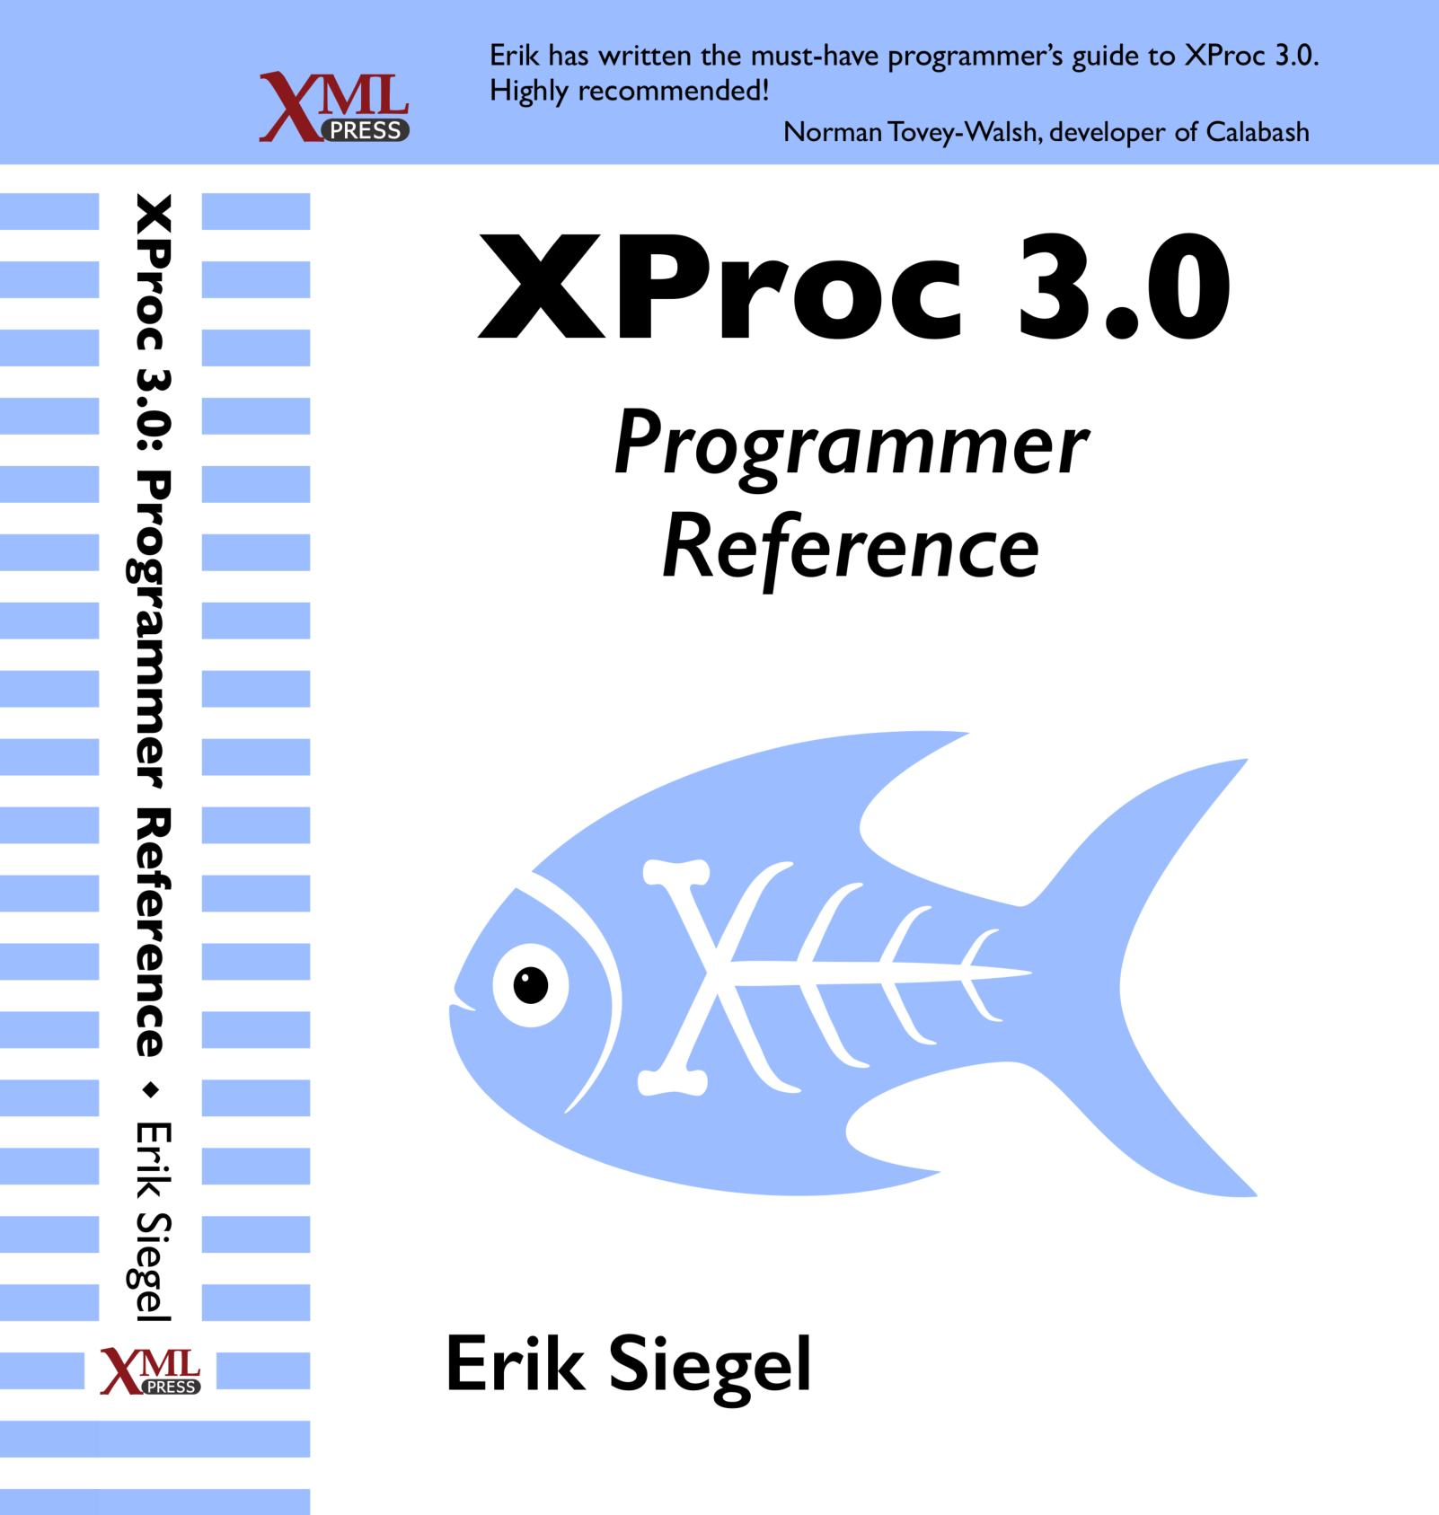
Who Am I?
Erik Siegel
Content Engineer, XML Specialist, Technical Writer
One-man company: Xatapult
Groningen, The Netherlands
Customers mostly in publishing and standardization
Part of the XProc 3.0 editing committee
Writer of the XProc 3.0 Programmer Reference
Contact:
erik@xatapult.nl www.xatapult.com www.linkedin.com/in/esiegel/ +31 6 53260792

Slide 3
XProc?
XProc is an XML based programming language for complex data processing - pipelining
Extensible set of small, sharp tools for creating and transforming XML and other documents
V1.0 available (two processor implementations to run your pipelines)
Specification and implementation V3.0 under development
And my name is Kanava (which is Finnish for… pipeline)
I’m proud to be the XProc logo!

Slide 4
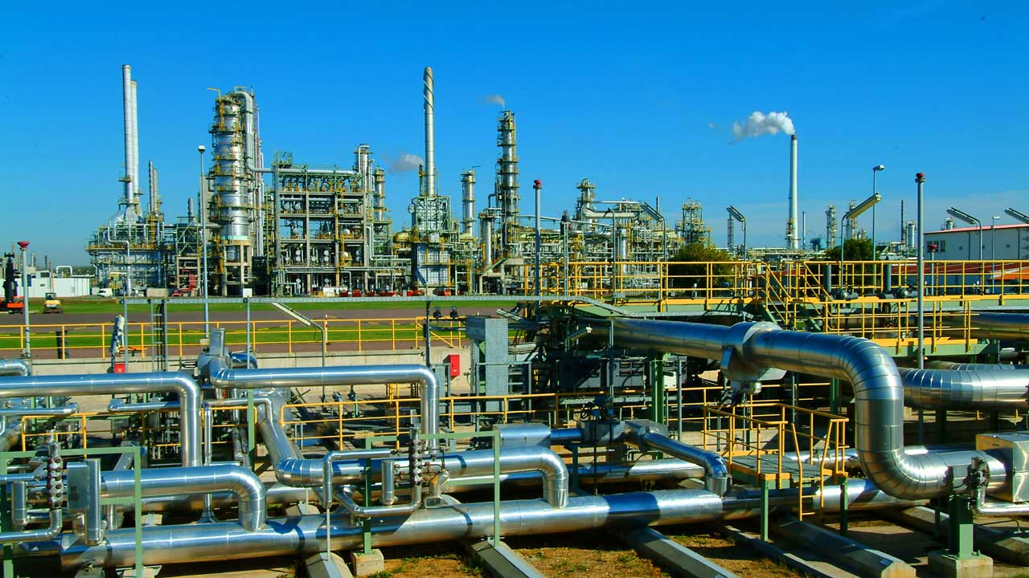
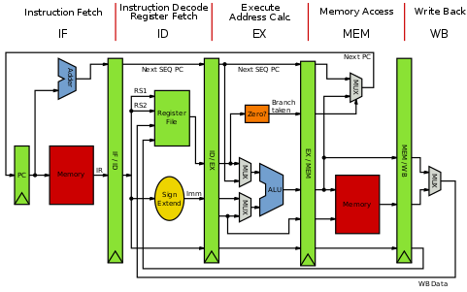

Why should I bother?
Pipelines are ubiquitous all around us
Solve problems with a set of small, sharp tools that combine in many ways
Like the UNIX command line
Very natural choice for document processing
Compose small tools into something bigger, pipelines…
XProc beats the alternatives
A successful example of large-scale application of XProc (1.0) pipelines doing document engineering:
https://www.le-tex.de/en/transpect.html

Slide 5
Important links
XProc 3.0:
Specification: http://spec.xproc.org
Github: https://github.com/xproc/
W3C: https://www.w3.org/community/xproc-next/
Morgana XProc processor: https://www.xml-project.com/
This webinar: https://github.com/xatapult/markupuk-2020
There are some introductory articles on https://www.xml.com/
XProc 1.0:
Specification: https://www.w3.org/TR/xproc/
XML Calabash processor: https://xmlcalabash.com/
Morgana XProc processor: https://www.xml-project.com/

Slide 6
Running XProc 3.0 examples yourself
Download Morgana by following the download link on https://www.xml-project.com/
Unzip the zip
Add the main Morgana directory to your system’s path
Switch (cd) to the directory with the pipeline you want to run (assume this is called pipeline.xpl)
View the command line options:
Morgana
Run with no specific input:
Morgana pipeline.xpl
… and with a specific input file for the source port:
Morgana pipeline.xpl –input source:input.xml
… and write the result port’s output to a file:
Morgana pipeline.xpl –input:source:input.xml –output:result=output.xml

Slide 7
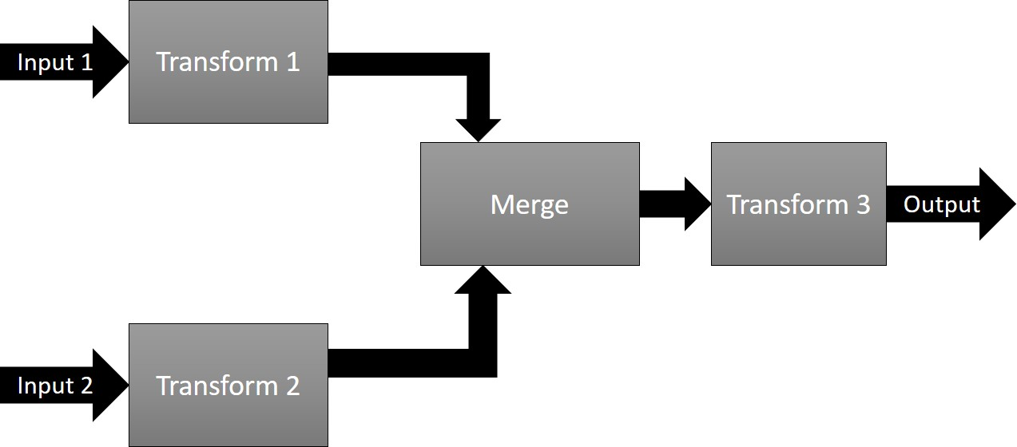
Pipelines, steps
Document(s) as input
Process the data flowing through using steps
Produce output(s)
Documents can be of any type, not just XML!

Slide 8
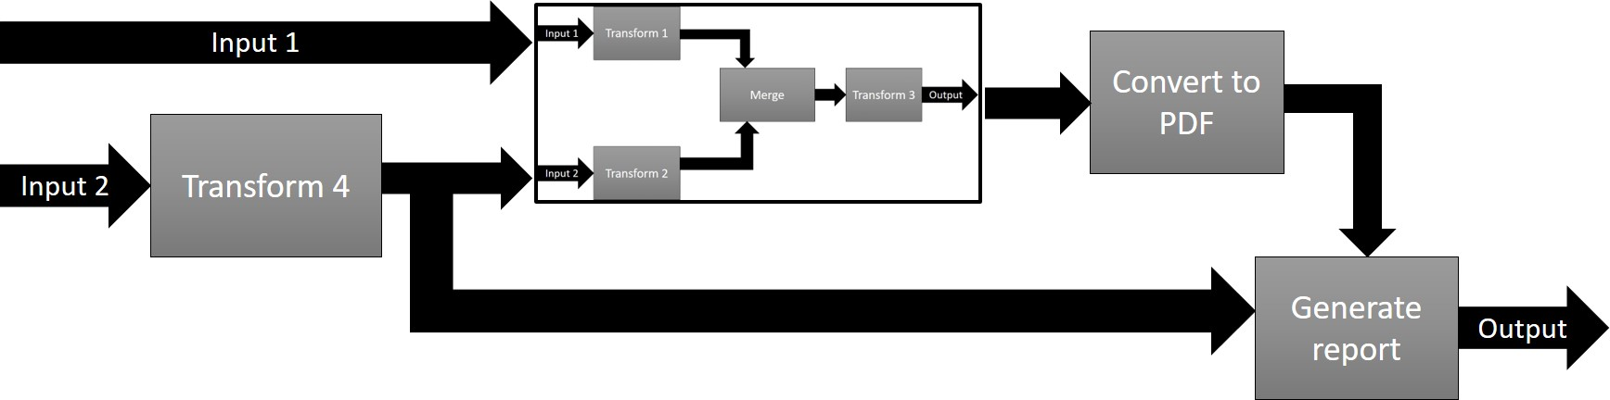
Pipelines, steps
In XProc, a pipeline and a step are essentially the same. The terms can be used interchangeably!

Slide 9
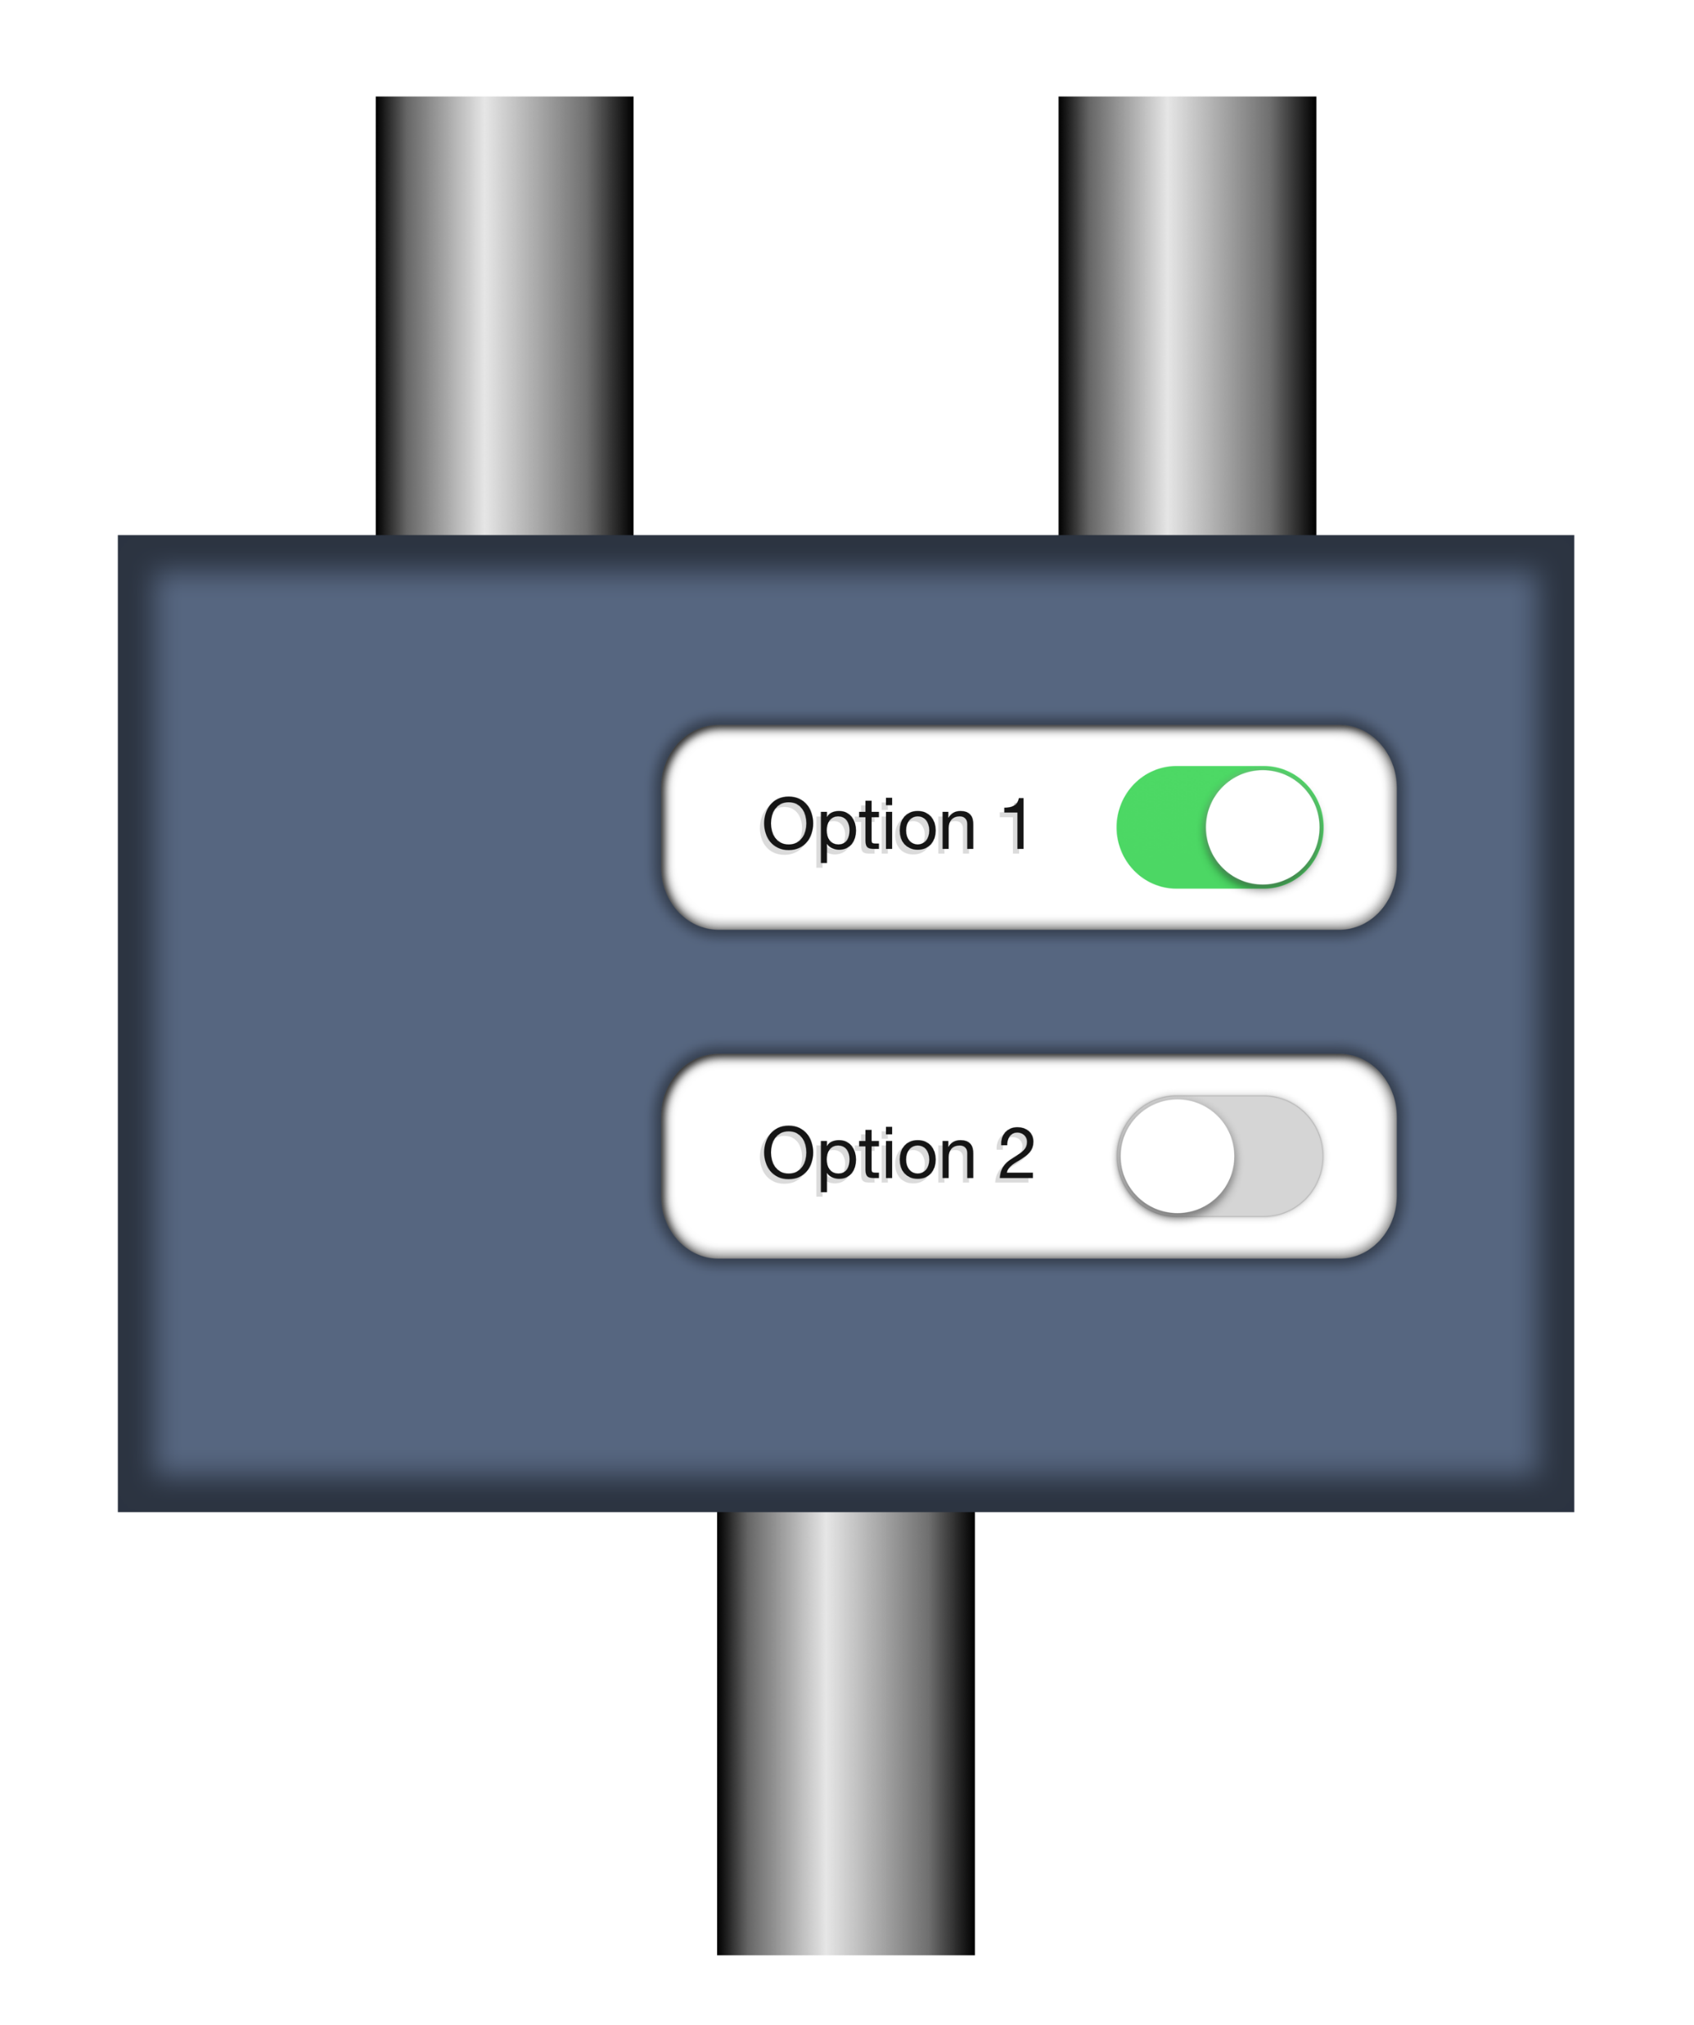
Steps/pipelines, ports, options
document
source
options
p:add-attribute
match
attribute-name
attribute-value
result
Have a look ate the step specification: http://spec.xproc.org/master/head/steps/#c.add-attribute
Transformed document

Slide 10
Example 1: markupuk-2020/101-A/example-1/example-1.xpl
Text document
source
wrap it in an element
Add a timestamp attribute
result
Result document

Slide 11
Primary ports
source
Primary ports
p:something
result
The port names source and result for the primary ports are a convention
Not all ports are created equal…

Slide 12
Primary ports, implicit connections
source
p:something
Click!
result
Think of primary ports having little magnets that snap automagically together
source
Primary ports implicitly connect
p:something-else
result

Slide 13
Primary ports, implicit connections
If a step has only a single input or output port, they’re primary by default. But you can set the primary status explicitly using a primary=“true/false” attribute here.
<p:declare-step … >
<p:input port="source"/>
<p:output port="result"/>
<p:wrap-sequence … />
<p:add-attribute … />
</p:declare-step>
Implicit connection of
primary input port to first step
Implicit connection of last step to primary output port
Implicit connection of steps

Slide 14
The p:insert step
See: http://spec.xproc.org/master/head/steps/#c.insert
Base
document
Document to insert
source
insertion
options
p:insert
match
position
result
Possible values for position:
first-child
last-child
before
after
The source and result ports are primary, the insertion port is not…
Combined document

Slide 15
Example 2: markupuk-2020/101-A/example-2/example-2a.xpl
Text document
<title>Hi there</title>
source
insertion
wrap it in a <text> element
wrap it in a <doc> element
insert a <title> element
Add a root timestamp attribute
result
<doc timestamp=“…”>
<title>Hi there!</title>
<text> … </text>
</doc>
Result document

Slide 16
Example 4: markupuk-2020/101-A/example-4/example-4a.xpl
wrap it in a <title> element
Text document
Title text: Hi there!
source
insertion
wrap it in a <text> element
wrap it in a <doc> element
insert the <title> element
Add a root timestamp attribute
result
<doc timestamp=“…”>
<title>Hi there!</title>
<text> … </text>
</doc>
Result document

Slide 17
Connect a port to an inline document
In most cases you can leave out the <p:inline> wrapper
<p:some-step ...>
<p:with-input port="port-name">
<p:inline>
... (inline document) ...
</p:inline>
</p:with-input>
...
</p:some-step>
You can use expressions between curly braces {…} in your inline document
Expressions between curly braces are called TVTs (Text-Value-Templates and AVTs (Attribute-Value-Templates)

Slide 18

Hands-on: Add an additional child element using an inline document
Open a command window in exercises/08-connect-inline/
Finish the pipeline so it adds a <location>Berlin 2019</location> element after the <presenter> element.
Use the p:insert step
Use a <p:inline> wrapper
Compute the current year using a {…} construction
XPath cheat: year-from-date(current-date())
Try it with run.bat or run.sh
Remove the <p:inline> wrapper and try again. Any differences?
Now you’re on your own writing XProc, scary…

Slide 19
Insert inline document - solution
<p:declare-step xmlns:p="http://www.w3.org/ns/xproc" version="3.0">
<p:input port="source"/>
<p:output port="result"/>
<p:insert match="/*" position="last-child">
<p:with-input port="insertion">
<p:inline>
<location>Berlin {year-from-date(current-date())}</location>
</p:inline>
</p:with-input>
</p:insert>
</p:declare-step>
<p:declare-step xmlns:p="http://www.w3.org/ns/xproc" version="3.0">
<p:input port="source"/>
<p:output port="result"/>
<p:insert match="/*" position="last-child">
<p:with-input port="insertion">
<p:inline>
<location>Berlin {year-from-date(current-date())}</location>
</p:inline>
</p:with-input>
</p:insert>
</p:declare-step>

Slide 20
Connect a port to an external document
In most cases you can put the href attribute directly on the <p:with-input>, no need for a <p:document> then!
<p:some-step ...>
<p:with-input port="port-name">
<p:document href="reference-to-document"/>
</p:with-input>
...
</p:some-step>
The href attribute is an AVT: You can use expressions between curly braces {…} inside
We have no means to add the current year now, like we did in the last exercise…

Slide 21
Hands-on: Add an additional child element using an external document
Open a command window in exercises/09-connect-external/
Finish the pipeline so it adds the contents of insert.xml after the <presenter> element.
Use the p:insert step
Use a <p:document> element
Try it with run.bat or run.sh
Put the href attribute directly on the <p:with-input> Any differences?
Can you add a variable with the name of the file and use that to reference it?

Slide 22
Insert external document - solution
<p:declare-step xmlns:p="http://www.w3.org/ns/xproc" version="3.0">
<p:input port="source"/>
<p:output port="result"/>
<p:insert match="/*" position="last-child">
<p:with-input port="insertion">
<p:document href="insert.xml"/>
</p:with-input>
</p:insert>
</p:declare-step>

Slide 23
Intermezzo: Documents flowing through
Native document types:
XML
HTML
JSON
Text
Other
All documents carry an adaptable properties map
Document
Representation
(contents)
Properties:
Name | Value
content-type | application/xml
base-uri | file:///C:/data/doc.xml
… | …
Flow
It is also possible to flow multiple documents or none at all.

Slide 24
Intermezzo: The step libraries
Standard steps, see http://spec.xproc.org/master/head/steps/
These steps must be there in a conformant XProc processor!
Additional steps, see http://spec.xproc.org/master/head/#steps/
Implementation is optional (but recommended)
If such a step is implemented it must conform to what is written there
There are over 45 standard steps!

Slide 25
Intermezzo: The core (or compound) steps
p:for-each: loop over multiple documents or parts of a document
p:choose / p:when / p:otherwise: Make choices
p:if: Make a single choice (there is no else)
p:viewport: Work on only a part of a document
p:try / p:catch: Error catching and handling
p:group: Grouping of instructions
Regrettably, there is no time to look at them all…

Slide 26
Use p:for-each to split a document - Input
Split this in multiple documents
<documents>
<doc filename="output1.xml">
<contents>This is document number 1</contents>
</doc>
<doc filename="output2.xml">
<contents>This is document number 2</contents>
<more>It has some more...</more>
</doc>
</documents>
The filenames are in filename attributes
Boring contents Erik

Slide 27
Use p:for-each to split a document – Basic pipeline
<p:declare-step xmlns:p="http://www.w3.org/ns/xproc" version="3.0">
<p:input port="source"/>
<p:output port="result"/>
<p:for-each>
<p:with-input select="//doc"/>
<p:store href="{/*/@filename}"/>
</p:for-each>
</p:declare-step>
p:for-each has an anonymous input port…
select is a standard attribute of p:with-input
p:store stores a document to disk. The href attribute tells it where
p:store emits on its result port the same document as it received on its source port

Slide 28
Hands-on: Use p:for-each to split a document 1
Open a command window in exercises/10-for-each-1/
Try it with run.bat or run.sh
It does not run… why? What does the error message tell you?
Make the output port of the pipeline accept a sequence by adding a sequence="true" attribute
So how many documents flow out of this step now?

Slide 29
Use p:for-each to split a document 1 – Solution
Make the output port accept a sequence
<p:declare-step xmlns:p="http://www.w3.org/ns/xproc" version="3.0">
<p:input port="source"/>
<p:output port="result" sequence=“true"/>
<p:for-each>
<p:with-input select="//doc"/>
<p:store href="{/*/@filename}"/>
</p:for-each>
</p:declare-step>
You can also define what document types a port will accept

Slide 30
The p:wrap-sequence step
See: http://spec.xproc.org/master/head/steps/#c.wrap-sequence
Multiple documents
source
options
p:wrap-sequence
wrapper
group-adjacent
With the group-adjacent option you can group incoming documents based on an XPath expression. We’re not going to try that now
result
wrapped document(s)

Slide 31
Hands-on: Use p:for-each to split a document 2
Open a command window in exercises/10-for-each-2/
Add a p:wrap-sequence step after the p:for-each and use this to wrap the results in a <result> element
Try it with run.bat or run.sh

Slide 32
Use p:for-each to split a document 2 – Solution
<p:declare-step xmlns:p="http://www.w3.org/ns/xproc" version="3.0">
<p:input port="source"/>
<p:output port="result"/>
<p:for-each>
<p:with-input select="//doc"/>
<p:store href="{/*/@filename}"/>
</p:for-each>
<p:wrap-sequence wrapper="results"/>
</p:declare-step>
Wrap the results in a <result> element

Slide 33
Goodbye and thank the fish!
Specification in the making: http://spec.xproc.org/
Norman Walsh, Achim Berndzen, Gerrit Imsieke, Erik Siegel
We hope to finish before end 2019
Next meeting of the XProc 3.0 working group: November 9-10, Cologne
On its way, beside the specification:
Two processor implementations
https://www.xml-project.com/ (MorganaXProc)
https://xmlcalabash.com/ (XML Calabash)
A Programmer’s Reference Guide
To be published by XML Press beginning 2020
Your guide today: Erik Siegel – erik@xatapult.nl
Goodbye!
And remember, Kanava says:
XProc rocks…

