Slide 1

Introduction to XProc 3.0 – Part 1
Markup UK 2020
Webinar
GIT for this webinar: https://github.com/xatapult/markupuk-2020

Slide 2

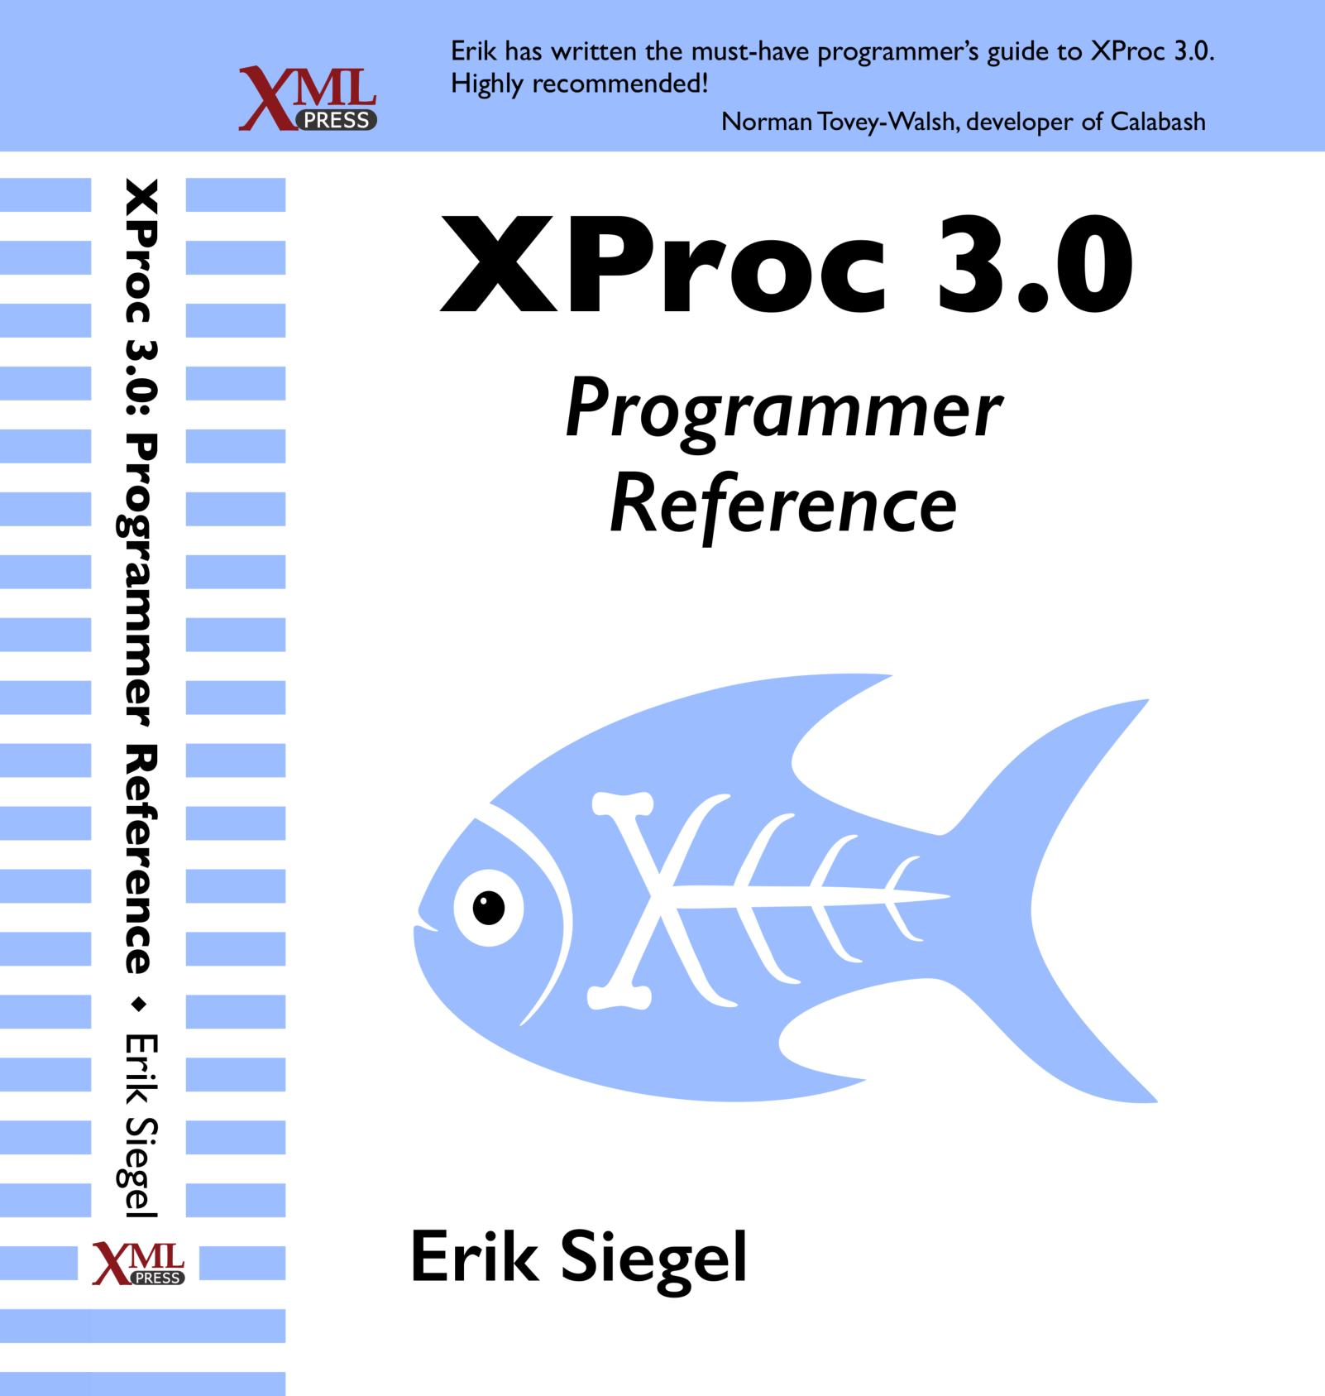
Who Am I?
Erik Siegel
Content Engineer, XML Specialist, Technical Writer
Company: Xatapult
Groningen, The Netherlands
Customers mostly in publishing and standardization
Member of the XProc 3.0 editing committee
Writer of the XProc 3.0 Programmer Reference
Contact:
erik@xatapult.nl www.xatapult.com www.linkedin.com/in/esiegel/ +31 6 53260792

Slide 3
XProc?
XProc is an XML based programming language for complex data processing - pipelining
Extensible set of small, sharp tools for creating and transforming XML and other documents
V1.0 available (two processor implementations to run your pipelines)
Specification and implementation V3.0 under development
And my name is Kanava (which is Finnish for… pipeline)
I’m proud to be the XProc logo!

Slide 4
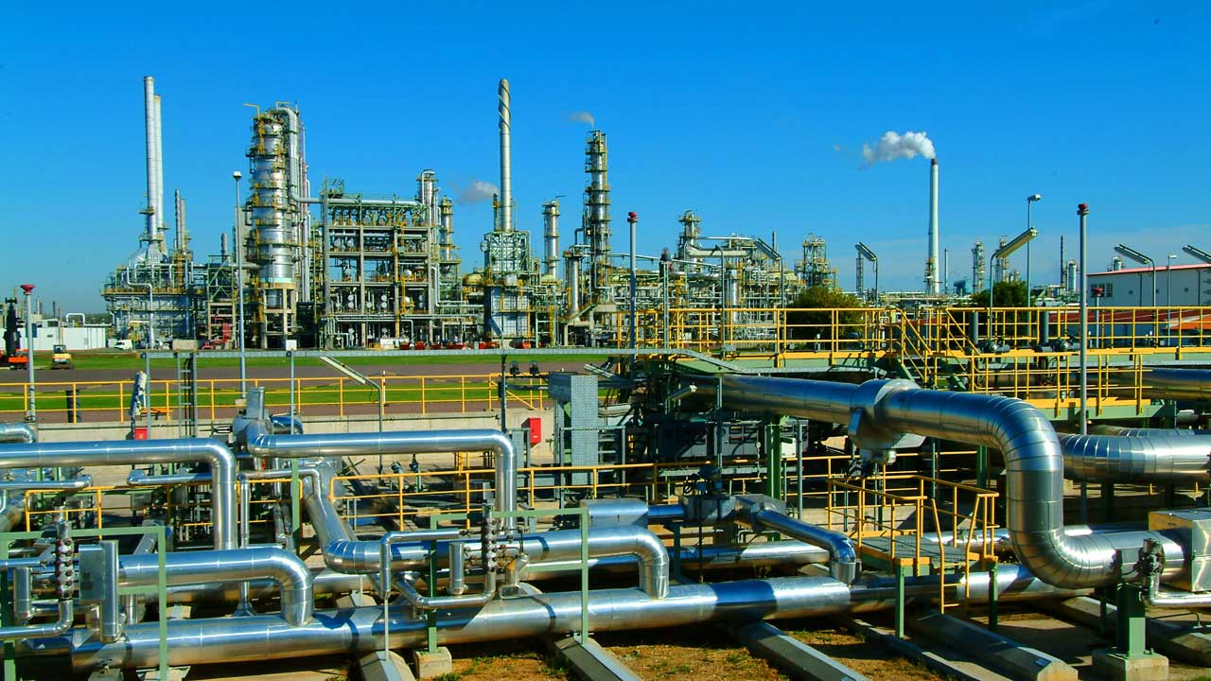
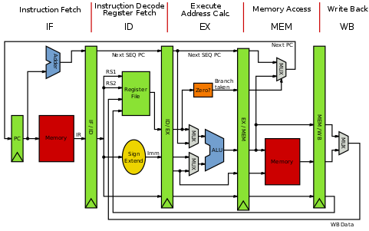

Why should I bother?
Pipelines are ubiquitous all around us
Solve problems with a set of small, sharp tools that combine in many ways
Like the UNIX command line
Very natural choice for document processing
Compose small tools into something bigger, pipelines…
XProc beats the alternatives
A successful example of large-scale application of XProc (1.0) pipelines doing document engineering:
https://www.le-tex.de/en/transpect.html

Slide 5
Important links
XProc 3.0:
Specification: http://spec.xproc.org
Github: https://github.com/xproc/
W3C: https://www.w3.org/community/xproc-next/
Morgana XProc processor: https://www.xml-project.com/
This webinar: https://github.com/xatapult/markupuk-2020
There are some introductory articles on https://www.xml.com/
XProc 1.0:
Specification: https://www.w3.org/TR/xproc/
XML Calabash processor: https://xmlcalabash.com/
Morgana XProc processor: https://www.xml-project.com/

Slide 6
Running XProc 3.0 examples yourself
Download Morgana by following the download link: https://www.xml-project.com/
Unzip the zip
Add one of the Saxon jars to the MorganaXProc-IIIse_lib sub-directory
Add the main Morgana directory to your system’s path
Switch (cd) to the directory with the pipeline you want to run (assume this is called pipeline.xpl)
View the command line options:
Morgana
Run with no specific input:
Morgana pipeline.xpl
… and with a specific input file for the source port:
Morgana pipeline.xpl –input source:input.xml
… and write the result port’s output to a file:
Morgana pipeline.xpl –input:source:input.xml –output:result=output.xml

Slide 7
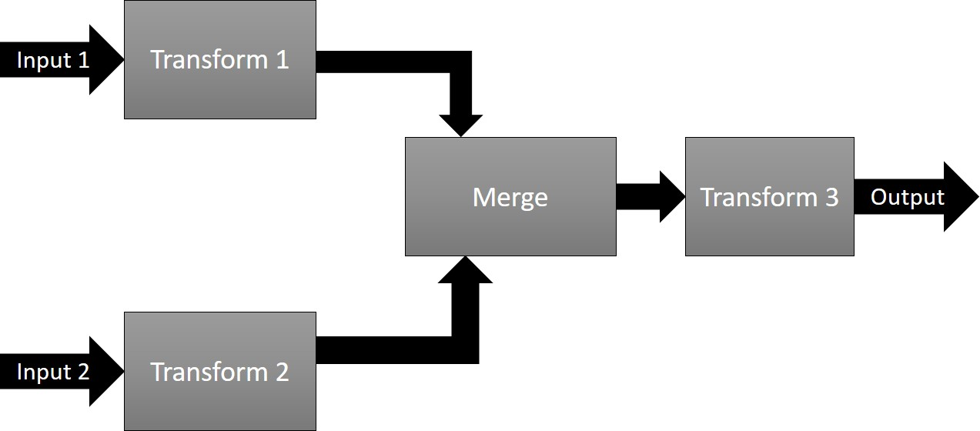
Pipelines, steps
Document(s) as input
Process the data flowing through using steps
Produce output(s)
Documents can be of any type, not just XML!

Slide 8
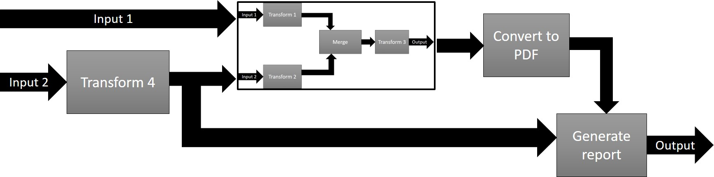
Pipelines, steps
In XProc, a pipeline and a step are essentially the same. The terms can be used interchangeably!

Slide 9
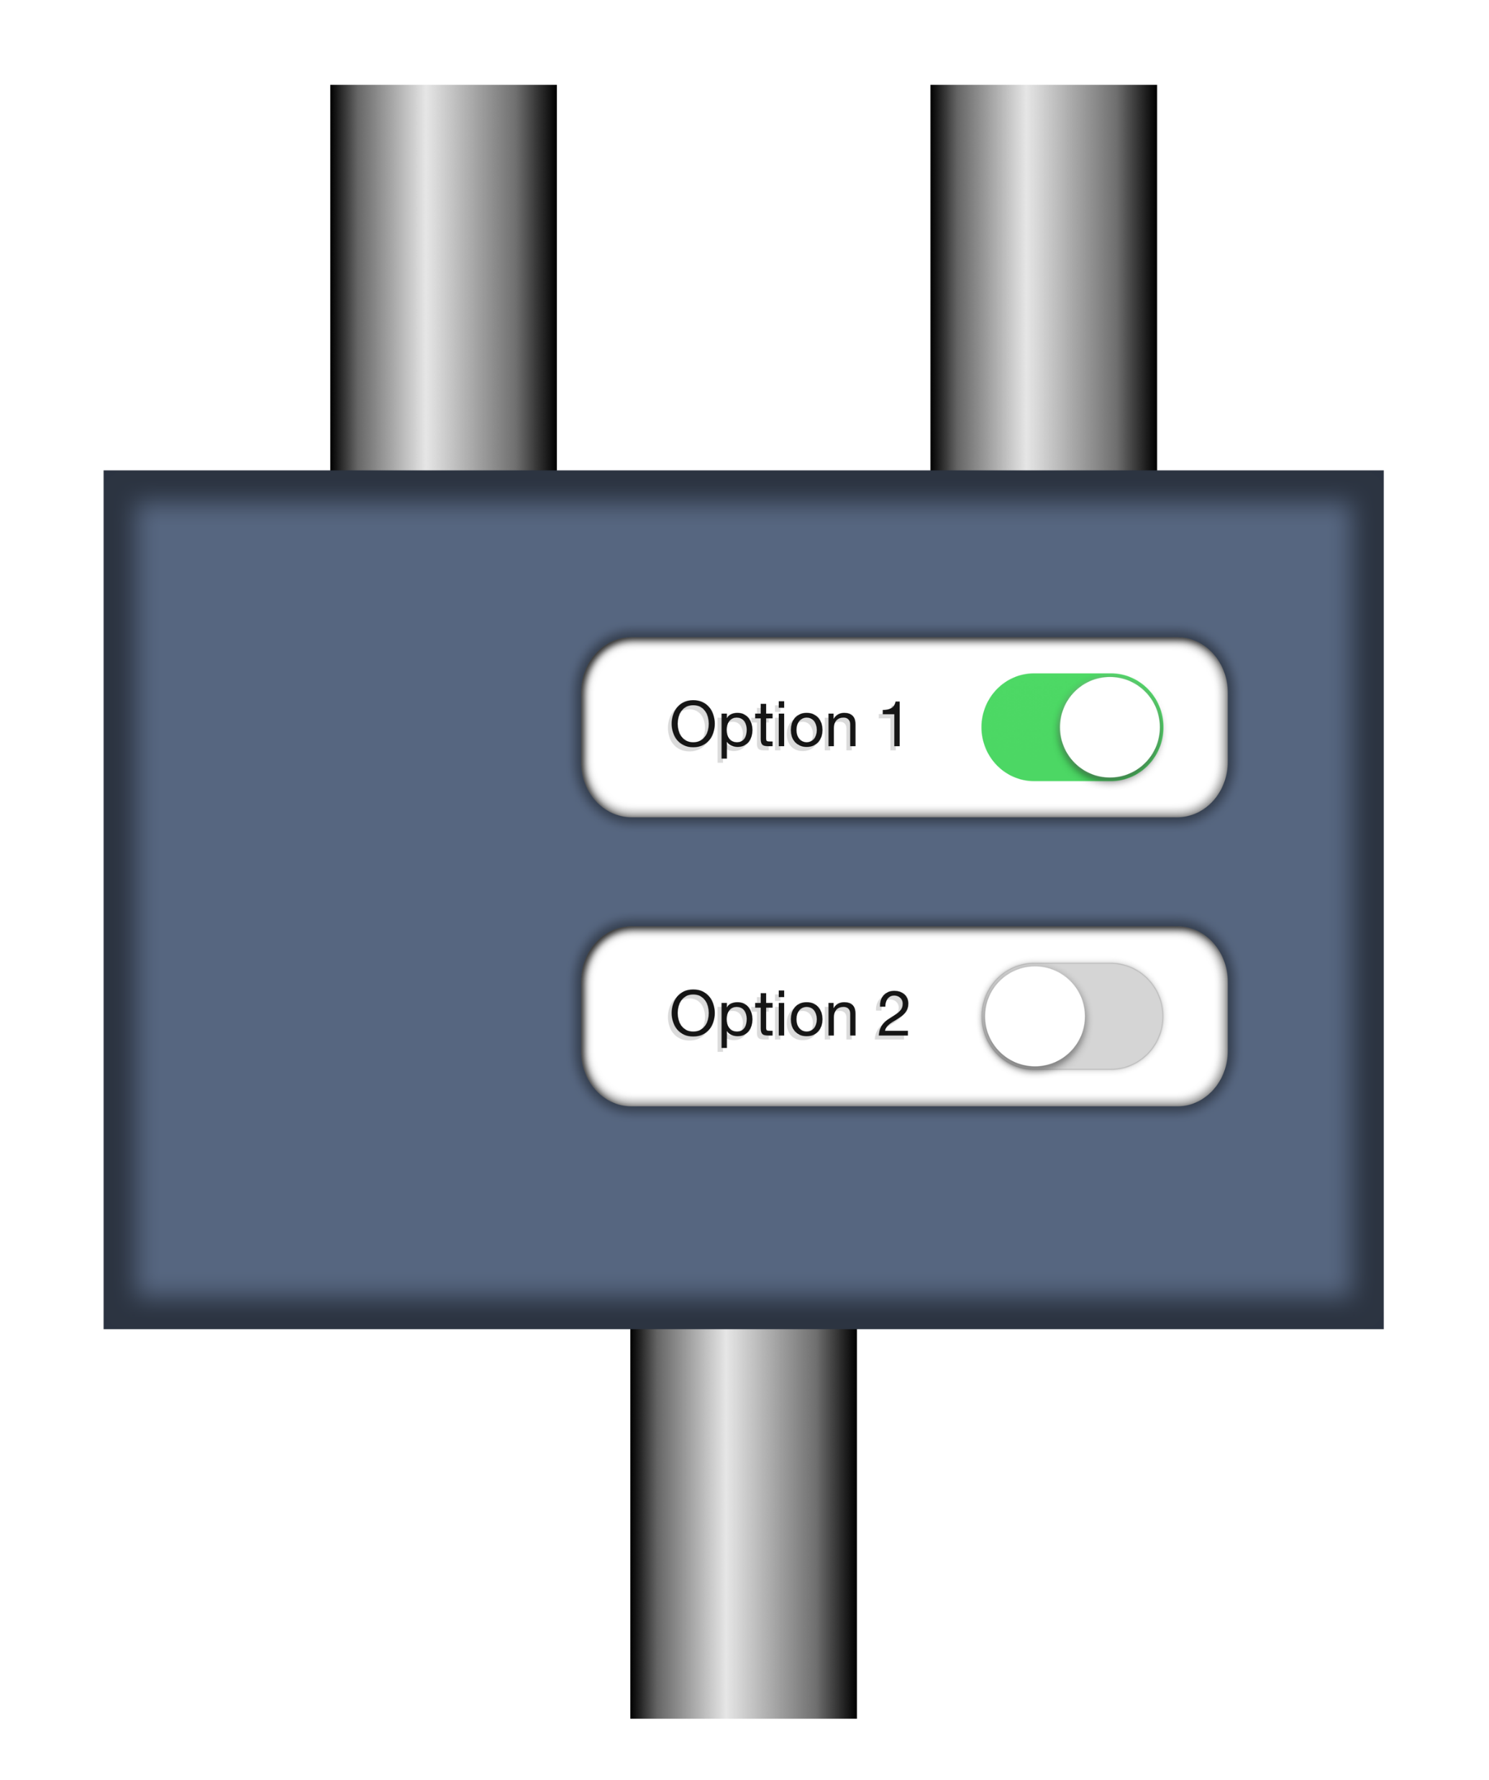
Steps/pipelines, ports, options
document
source
options
p:add-attribute
match
attribute-name
attribute-value
result
Have a look ate the step specification: http://spec.xproc.org/master/head/steps/#c.add-attribute
Transformed document

Slide 10
Example 1: markupuk-2020/101-A/example-1/example-1.xpl
Text document
source
wrap it in an element
Add a timestamp attribute
result
Result document

Slide 11
Primary ports
source
Primary ports
p:something
result
The port names source and result for the primary ports are a convention
Not all ports are created equal…

Slide 12
Primary ports, implicit connections
source
p:something
Click!
result
Think of primary ports as having little magnets that snap automagically together
source
Primary ports implicitly connect
p:something-else
result

Slide 13
Primary ports, implicit connections
If a step has only a single input or output port, they’re primary by default. But you can set the primary status explicitly using a primary=“true/false” attribute here.
<p:declare-step … >
<p:input port="source"/>
<p:output port="result"/>
<p:wrap-sequence … />
<p:add-attribute … />
</p:declare-step>
Implicit connection of
primary input port to first step
Implicit connection of last step to primary output port
Implicit connection of steps

Slide 14
The p:insert step
See: http://spec.xproc.org/master/head/steps/#c.insert
Base
document
Document to insert
source
insertion
options
p:insert
match
position
result
Possible values for position:
first-child
last-child
before
after
The source and result ports are primary, the insertion port is not…
Combined document

Slide 15
Example 2: markupuk-2020/101-A/example-2/example-2a.xpl
Text document
<title>Hi there</title>
source
insertion
wrap it in a <text> element
wrap it in a <doc> element
insert a <title> element
Add a root timestamp attribute
result
<doc timestamp=“…”>
<title>Hi there!</title>
<text> … </text>
</doc>
Result document

Slide 16
Example 3: markupuk-2020/101-A/example-4/example-3a.xpl
Title XML: Hi there!
Text document
source
insertion
wrap it in a <text> element
wrap it in a <doc> element
insert the <title> element
Add a root timestamp attribute
result
<doc timestamp=“…”>
<title>Hi there!</title>
<text> … </text>
</doc>
Result document

Slide 17
Example 4: markupuk-2020/101-A/example-4/example-4a.xpl
wrap it in a <title> element
Text document
Title text: Hi there!
source
insertion
wrap it in a <text> element
wrap it in a <doc> element
insert the <title> element
Add a root timestamp attribute
result
<doc timestamp=“…”>
<title>Hi there!</title>
<text> … </text>
</doc>
Result document

Slide 18
Example 5: markupuk-2020/101-A/example-5/example-5.xpl
wrap in an <author> element
Use the value of the author option
insertion
insert the <author> element
Add a root timestamp attribute
…
result
<doc timestamp=“…”>
<author> … </author>
<title>Hi there!</title>
<text> … </text>
</doc>
Result document

Slide 19
Wrap up:
XProc is a pipeline language for documents, it chains steps
Documents flow in and out of steps through ports
One input and one output port can be primary: These ports automatically connect
Primary ports are called source and result by convention
You can connect a port using <p:with-input port="…"> to:
Another port (either implicit for primary ports or explicit: <p:pipe> or @pipe)
To a document stated inline (<p:inline>)
To a document on disk (<p:document> or @href)
Options are additional switches for the steps and/or your pipelines

Slide 20
Goodbye and thank the fish!
Your guide today: Erik Siegel – erik@xatapult.nl
GIT for this webinar: https://github.com/xatapult/markupuk-2020
Specification: https://spec.xproc.org/
Processors:
Morgana: https://www.xml-project.com/
Calabash: https://xmlcalabash.com/
Articles on XProc: https://www.xml.com
Book: https://xmlpress.net/publications/xproc-3-0/
See you!
And remember, Kanava says:
XProc rocks…

